Slide 1
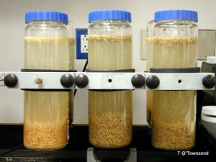
Human Health Risk Assessment Methods for PV
Part 2: Breakage Risks
Introduction and Purpose
Some stakeholders have expressed concerns regarding potential exposures to hazardous materials from broken PV modules left in the field.
This study applies the human health risk assessment paradigm to the case of residential rooftop, commercial rooftop, and utility-scale ground-mount PV systems.
Approach
Screening level risk assessment methods are based on:
  Experimental leachate concentrations from USEPA Method 1312 SPLP
  Fate and transport to soil, groundwater and air
  Comparisons to human health screening values
Risk assessment methods are demonstrated by evaluating potential Pb|Cd emissions from c-Si|CdTe broken PV modules, respectively.
Sinha, P, and A. Wade. 2015. Assessment of leaching tests for evaluating potential environmental impacts of PV module field breakage. IEEE J. of Photovoltaics, Vol. 5(6), 1710-1714.
Citation: P. Sinha, G. Heath, A. Wade, K. Komoto, 2019, Human health risk assessment methods for PV, Part 2: Breakage risks, International Energy Agency (IEA) PVPS Task 12, Report T12-15:2019.

Slide 2
Results and Discussion
Screening-level methods identify potential health risk scenarios that are greater than defined thresholds and may warrant further analysis.
Exposure point concentrations of Pb and Cd for c-Si and CdTe PV module field breakage, respectively, in residential, commercial, and utility-scale systems are orders of magnitude below USEPA health screening values in soil, air, and water.
Key uncertainty parameters are breakage rate, leachate concentration, soil/soil-water partitioning coefficient, and dilution-attenuation factor.
Screening-level methods in this report can be used to assess potential health risks from other chemicals of potential concern and other PV technologies.

