Slide 1
TRENDS 2022 Figures and Tables
Gaëtan Masson, Task 1 Manager, IEA PVPS
29th of September 2022

Slide 2
What is IEA PVPS?
The International Energy Agency (IEA), founded in 1974, is an autonomous body within the framework of the Organization for Economic Cooperation and Development (OECD). ​
The Technology Collaboration Programme was created with a belief that the future of energy security and sustainability starts with global collaboration. The programme is made up of thousands of experts across government, academia, and industry dedicated to advancing common research and the application of specific energy technologies.
The IEA Photovoltaic Power Systems Programme (PVPS) is one of ​the Technology Collaboration Programme established within the ​International Energy Agency in 1993​
32 members - 27 countries, European Commission, 4 associations​
“To enhance the international collaborative efforts which facilitate the role of photovoltaic solar energy as a cornerstone in the transition to sustainable energy systems”

Slide 3
Disclaimer
Data for non-IEA PVPS countries are provided by official contacts or experts in the relevant countries.
Data are valid at the date of publication and should be considered as estimates in several countries due to the publication date.
Please mention our references if you use these figures.

Slide 4
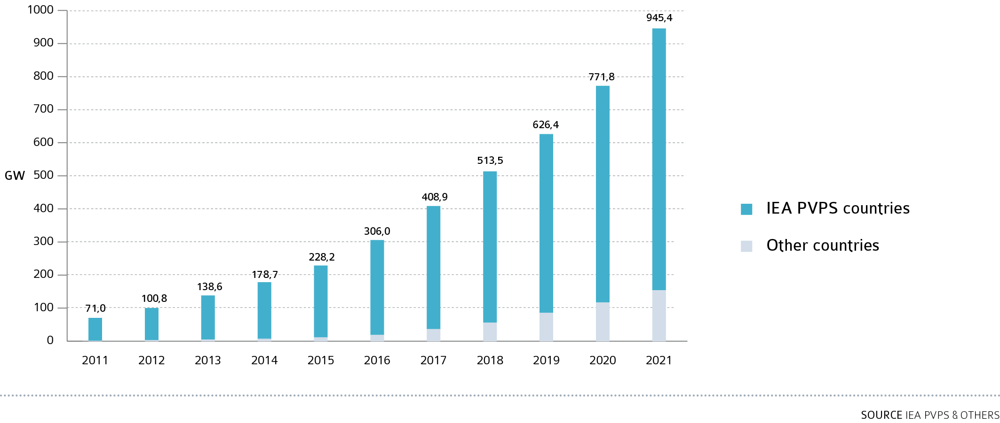
EVOLUTION OF CUMULATIVE PV INSTALLATIONS

Slide 5
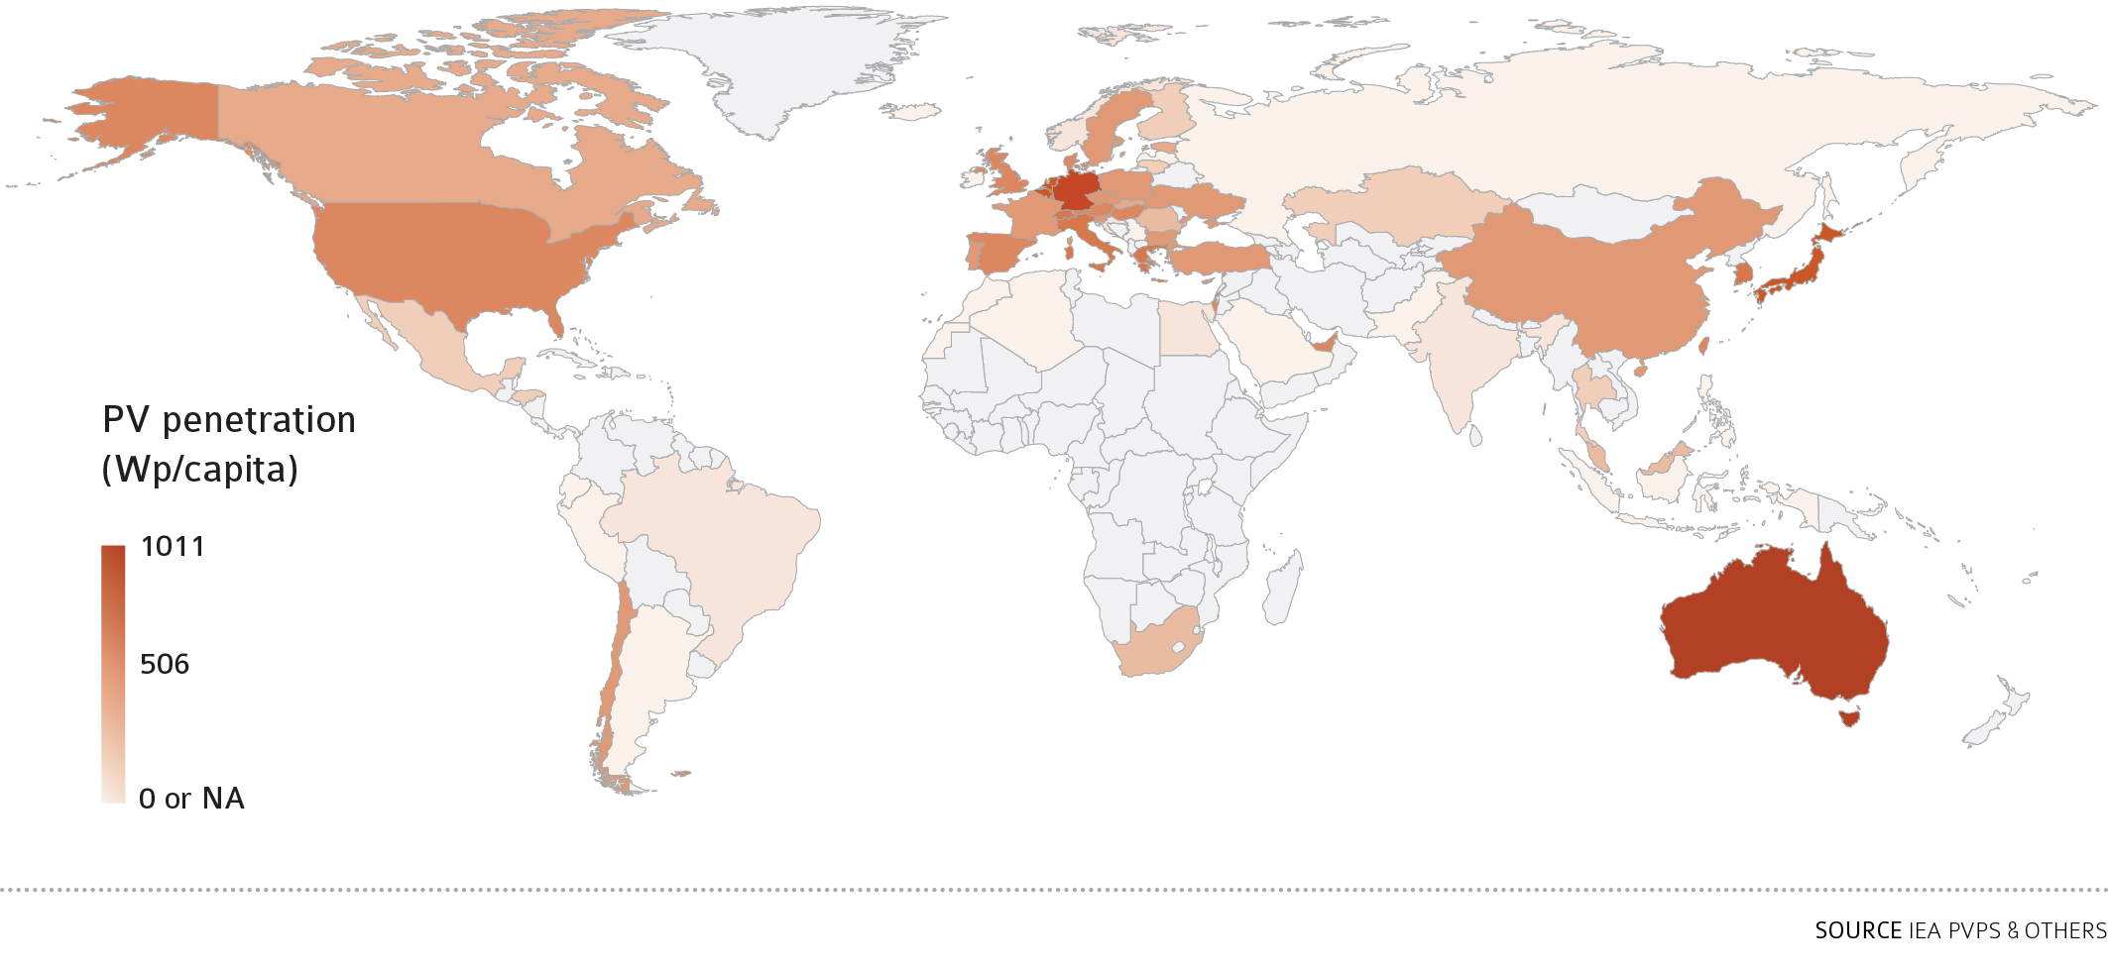
PV PENETRATION PER CAPITA IN 2021

Slide 6
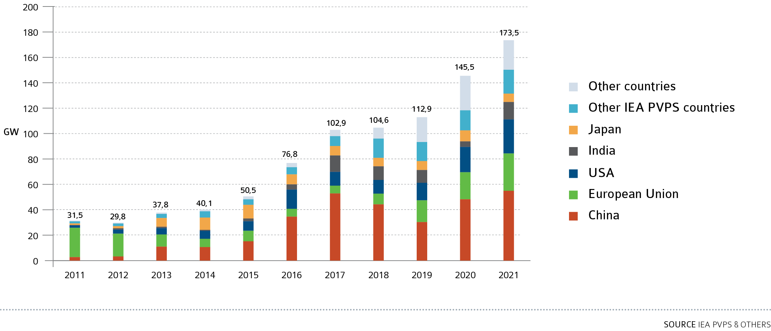
EVOLUTION OF ANNUAL PV INSTALLATIONS

Slide 7
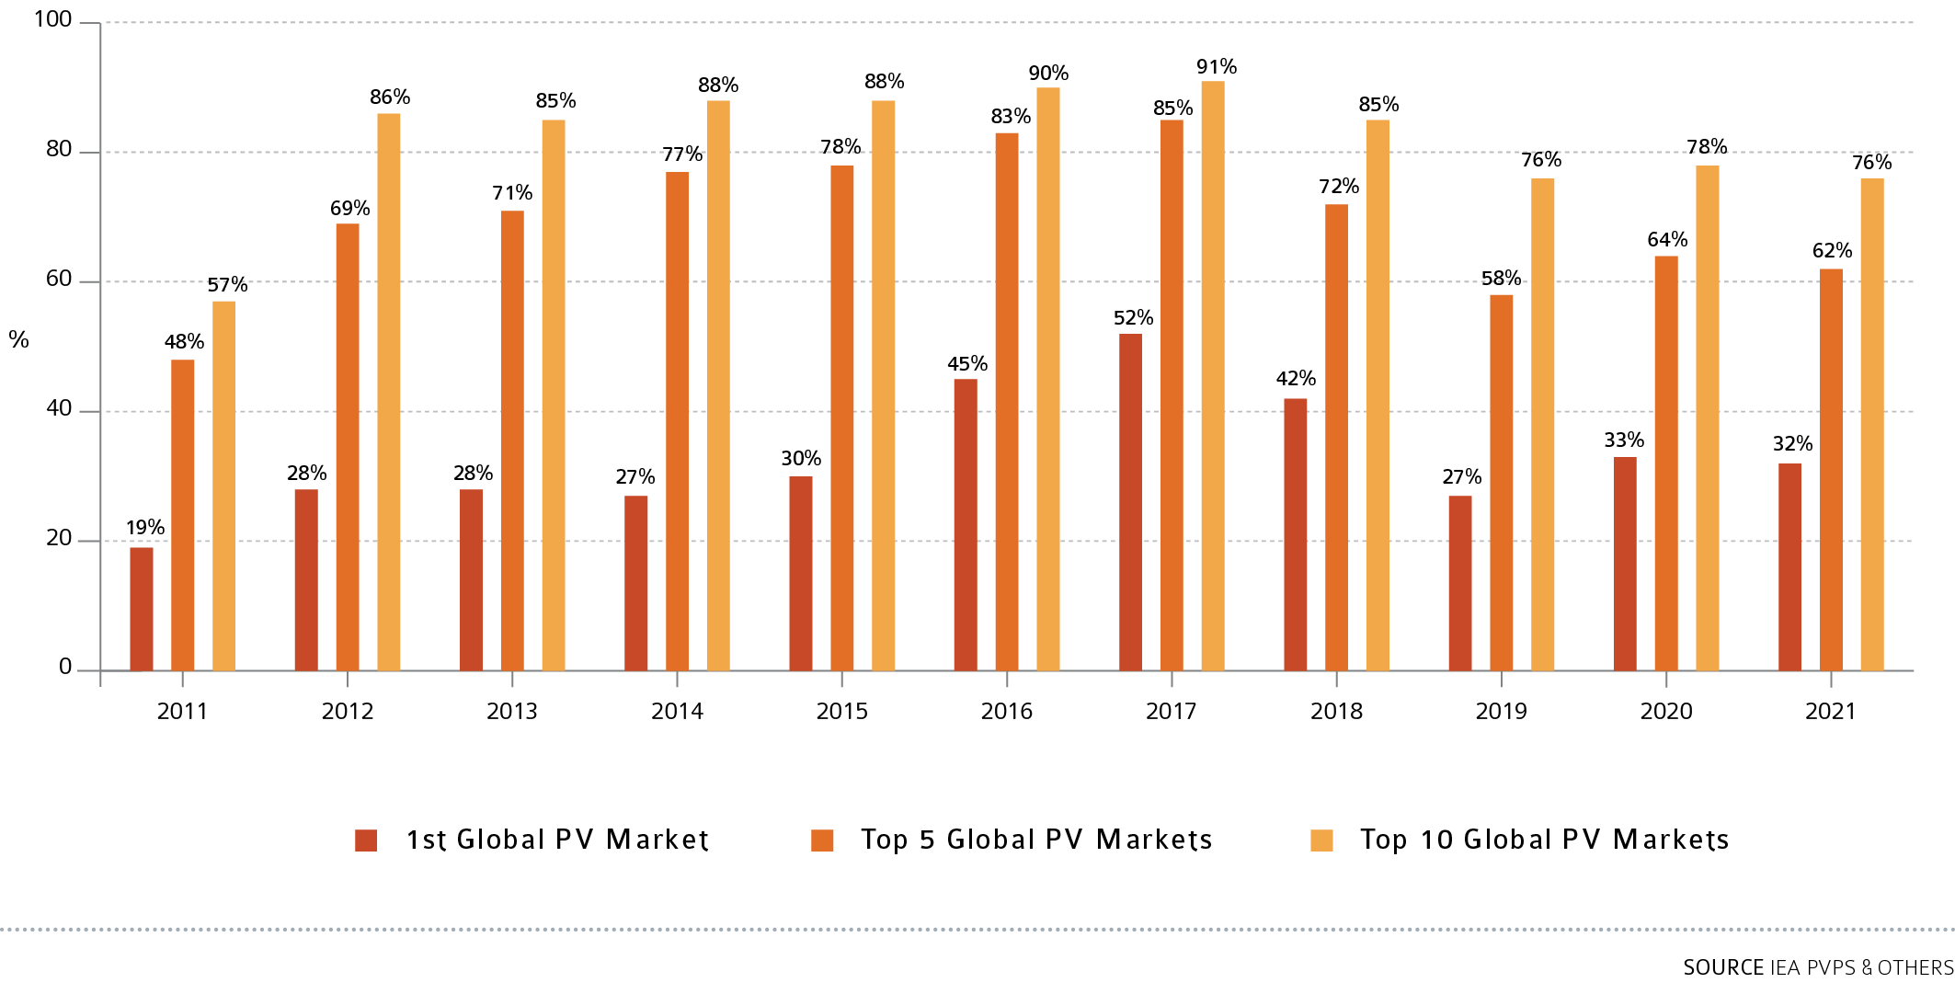
EVOLUTION OF MARKET SHARE OF TOP COUNTRIES

Slide 8
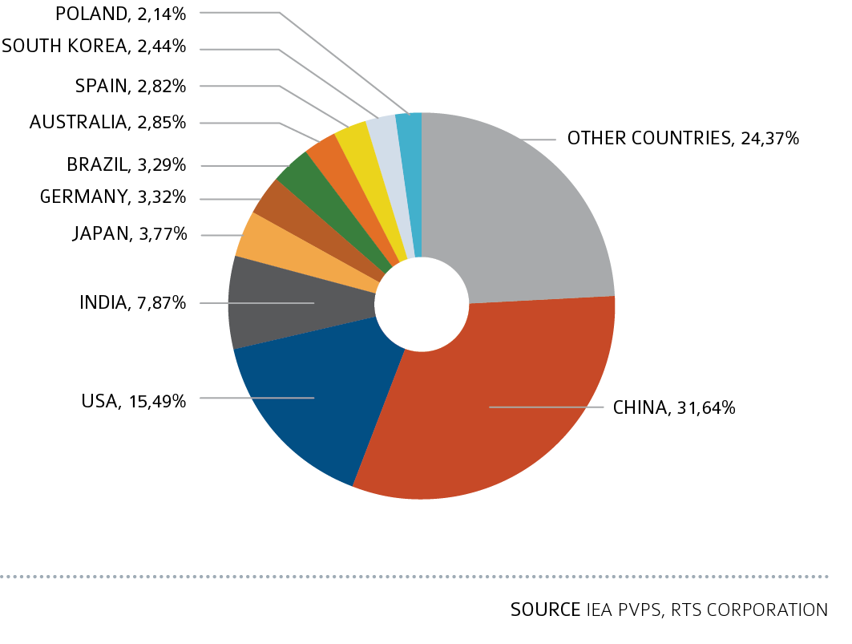
GLOBAL PV MARKET IN 2021

Slide 9
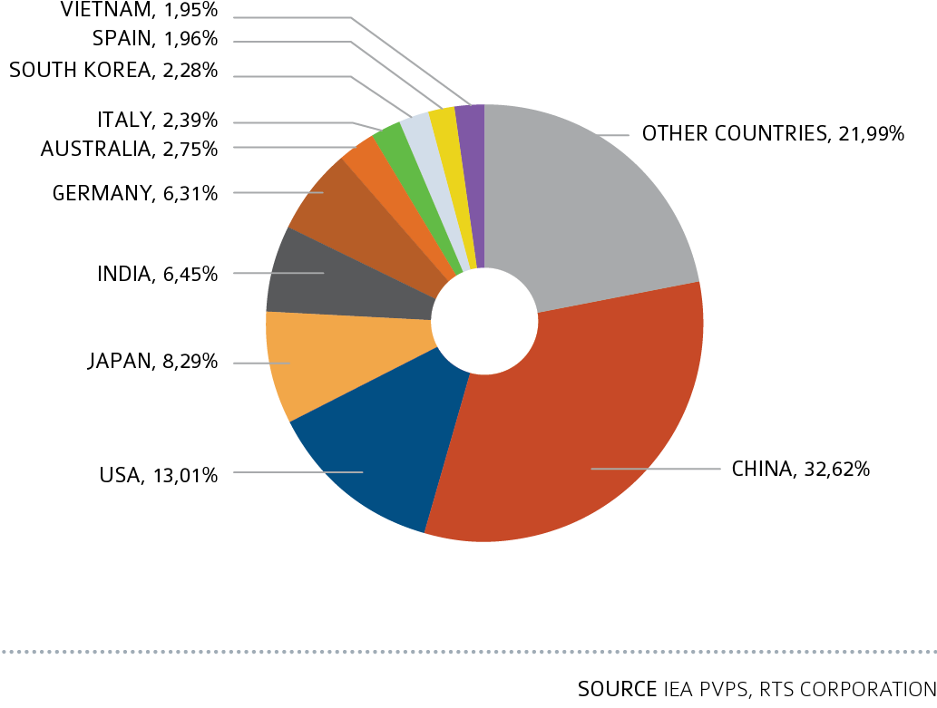
CUMULATIVE PV CAPACITY END 2021

Slide 10
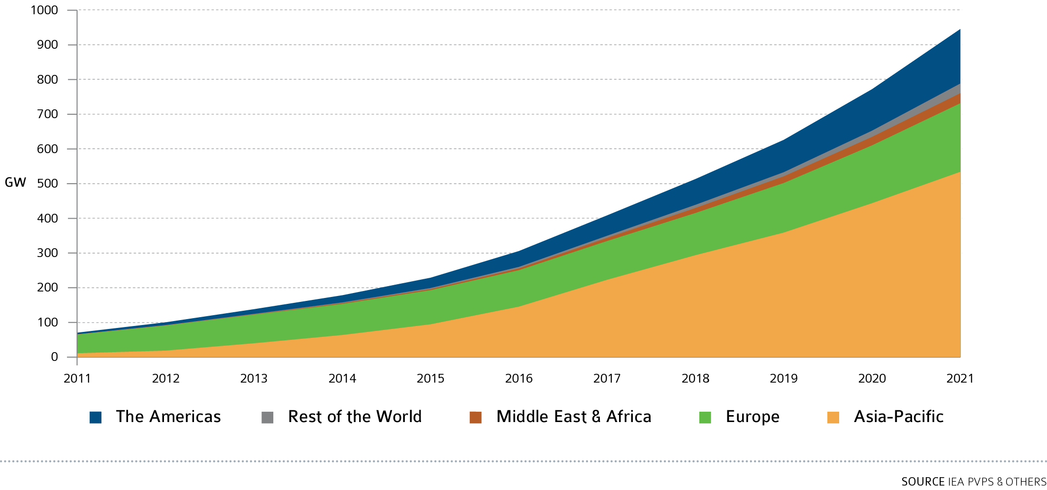
EVOLUTION OF REGIONAL PV INSTALLATIONS

Slide 11
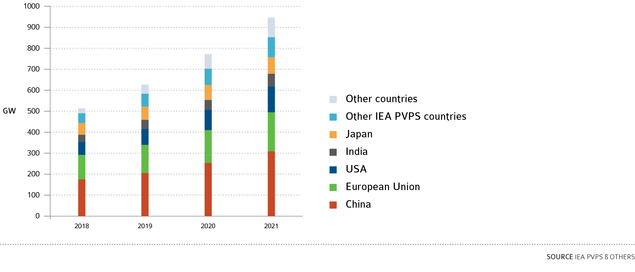
2018-2021 GROWTH PER REGION

Slide 12
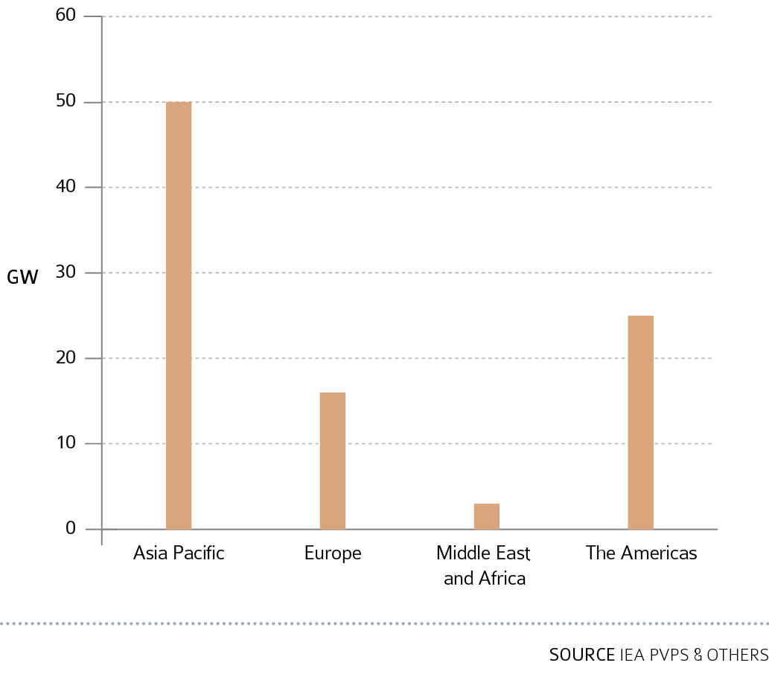
CENTRALIZED PV INSTALLED CAPACITY PER REGION 2021

Slide 13
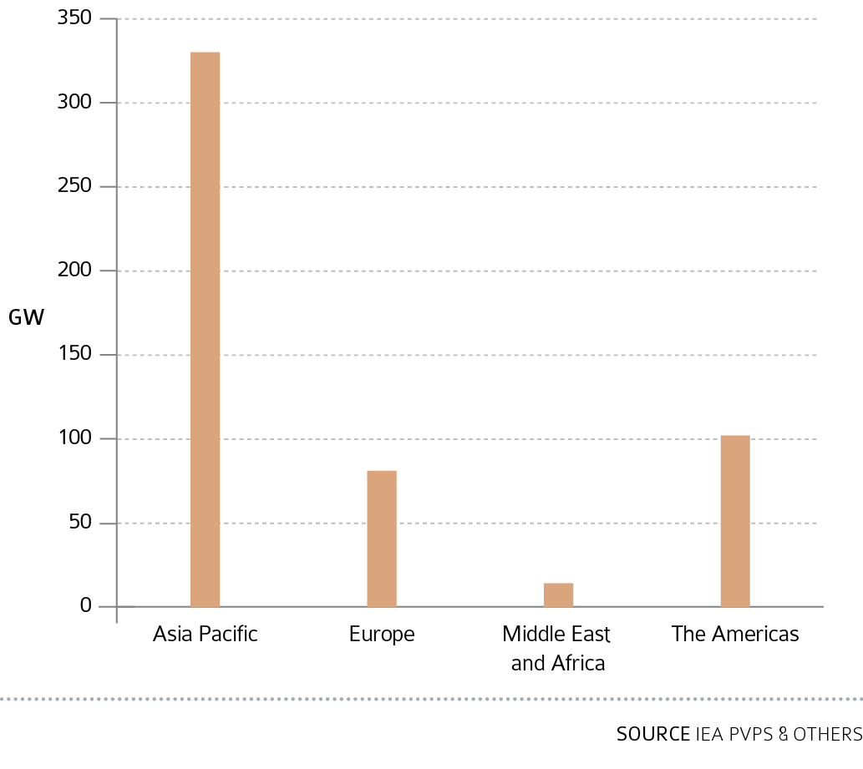
CENTRALIZED PV CUMULATIVE INSTALLED CAPACITY PER REGION 2021

Slide 14
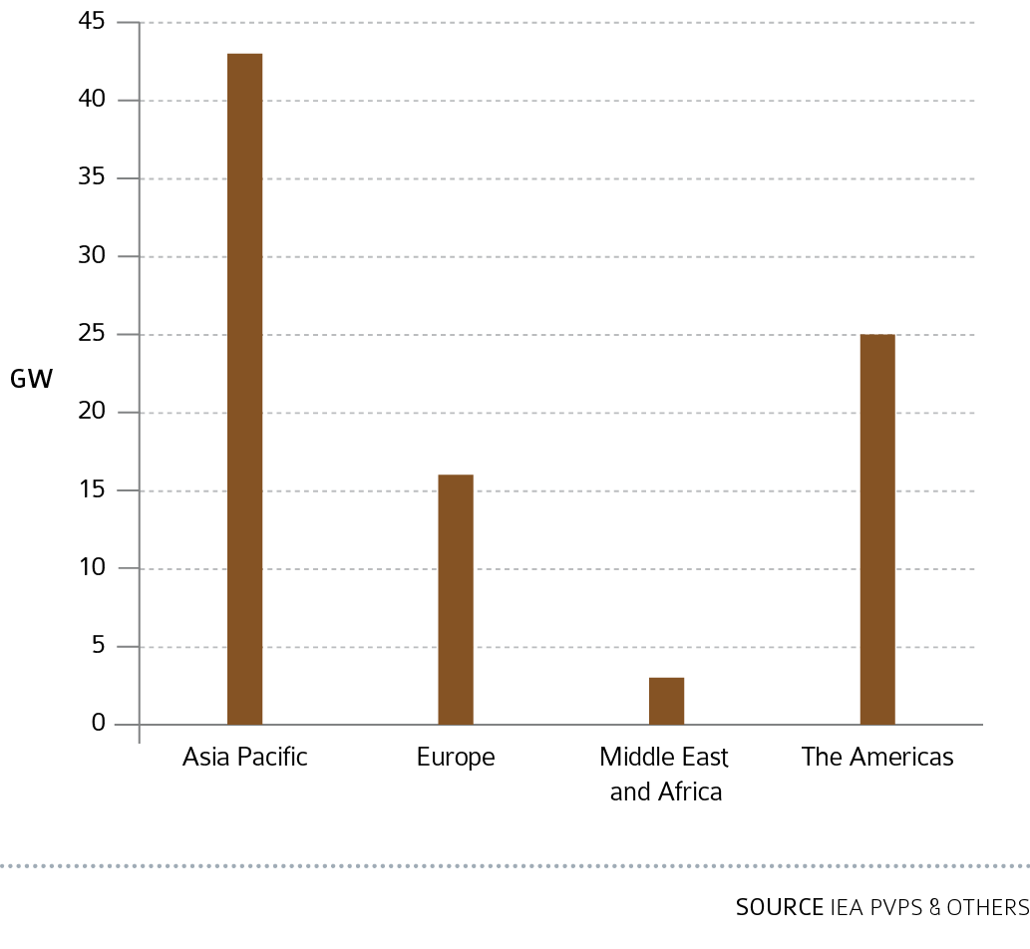
DISTRIBUTED PV INSTALLED CAPACITY PER REGION 2021

Slide 15
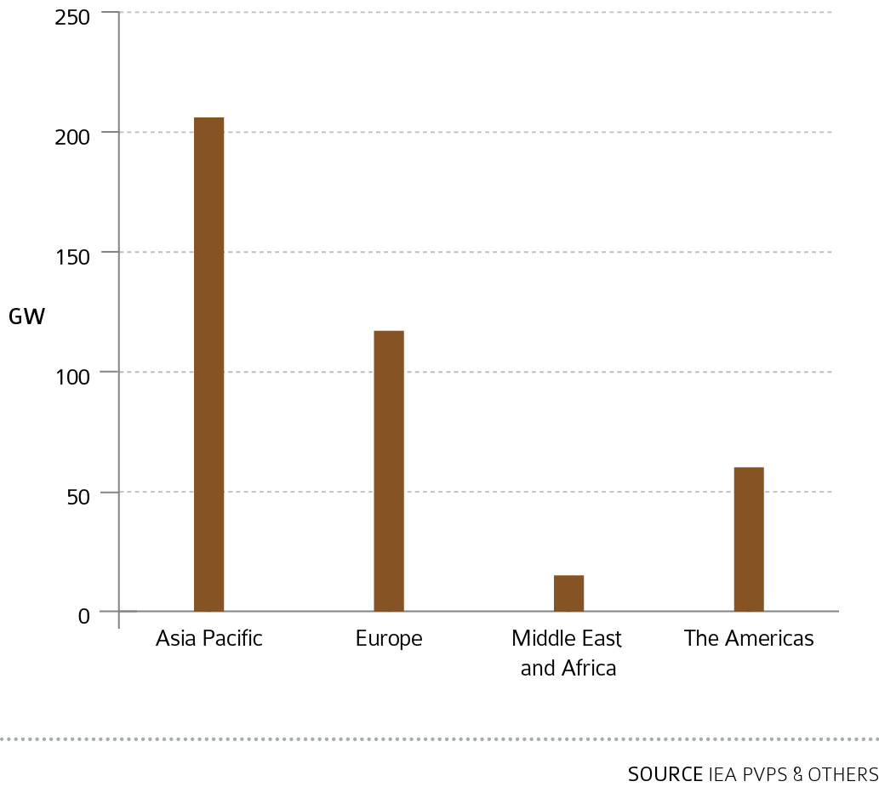
DISTRIBUTED PV CUMULATIVE INSTALLED CAPACITY PER REGION 2021

Slide 16
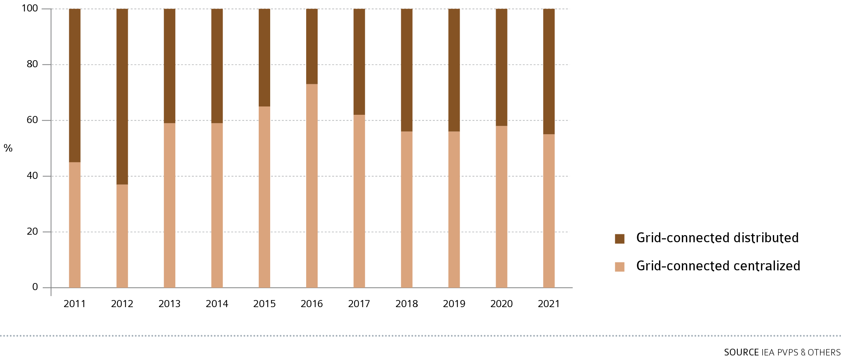
ANNUAL SHARE OF CENTRALIZED AND DISTRIBUTED GRID-Connected Installations 2011 – 2021

Slide 17
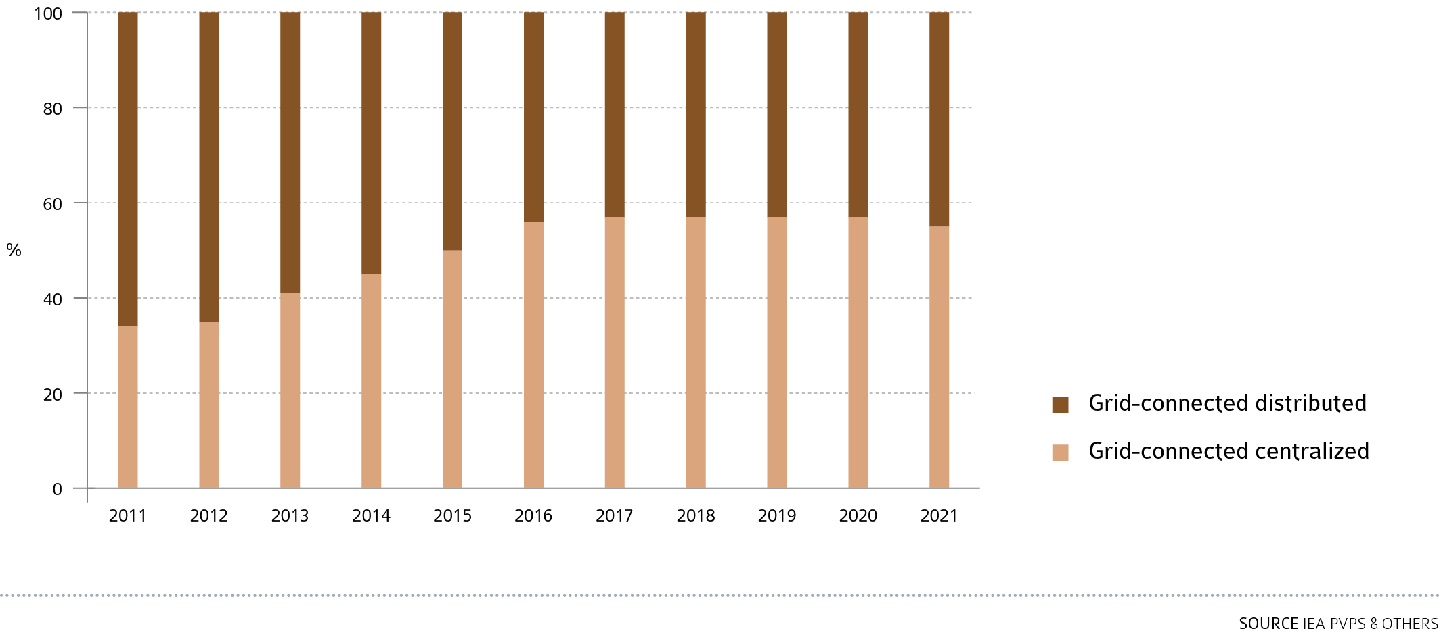
CUMULATIVE SHARE OF GRID CONNECTED PV INSTALLATIONS 2011 – 2021

Slide 18
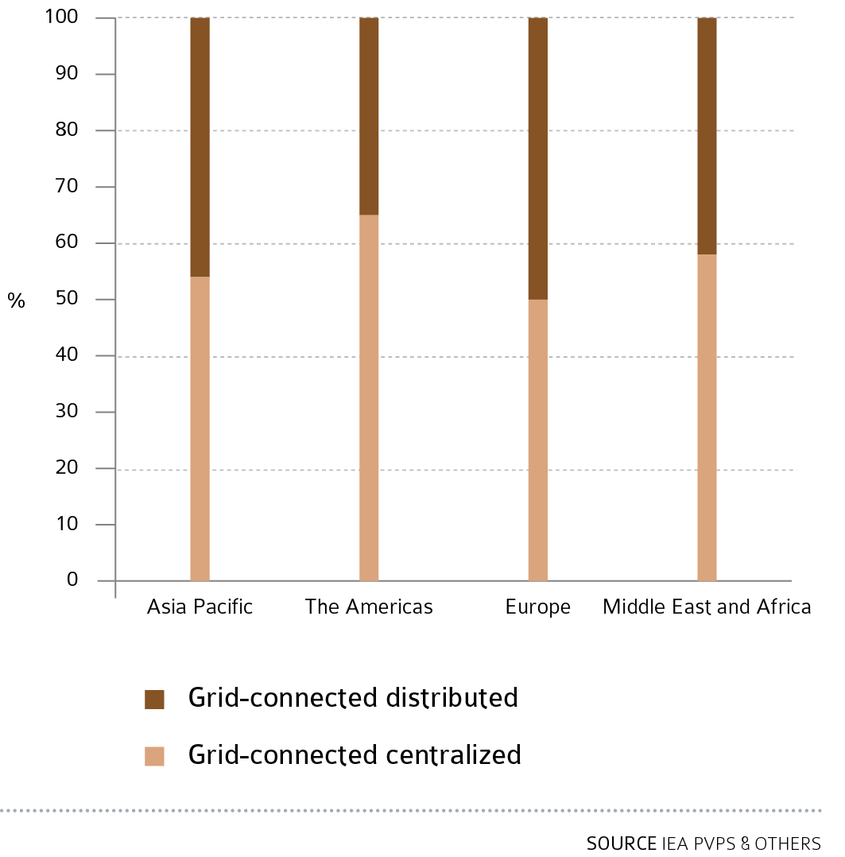
ANNUAL GRID-CONNECTED CENTRALIZED AND DISTRIBUTED PV Installations BY REGION IN 2021

Slide 19
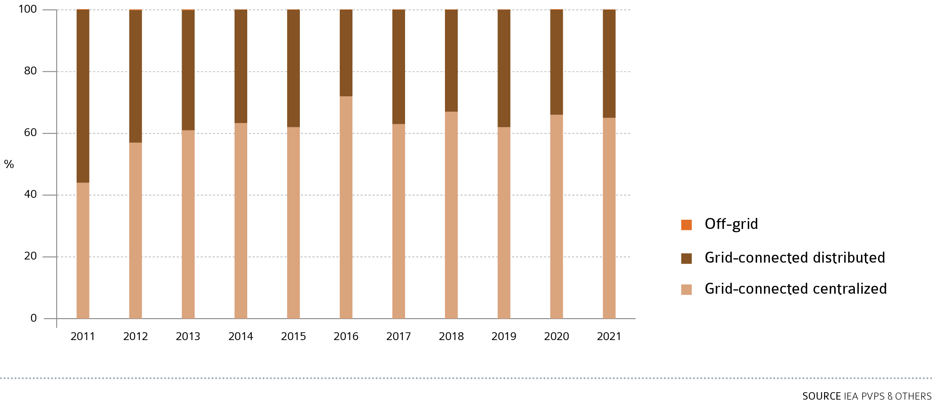
EVOLUTION OF PV INSTALLATIONS IN THE Americas per segment

Slide 20
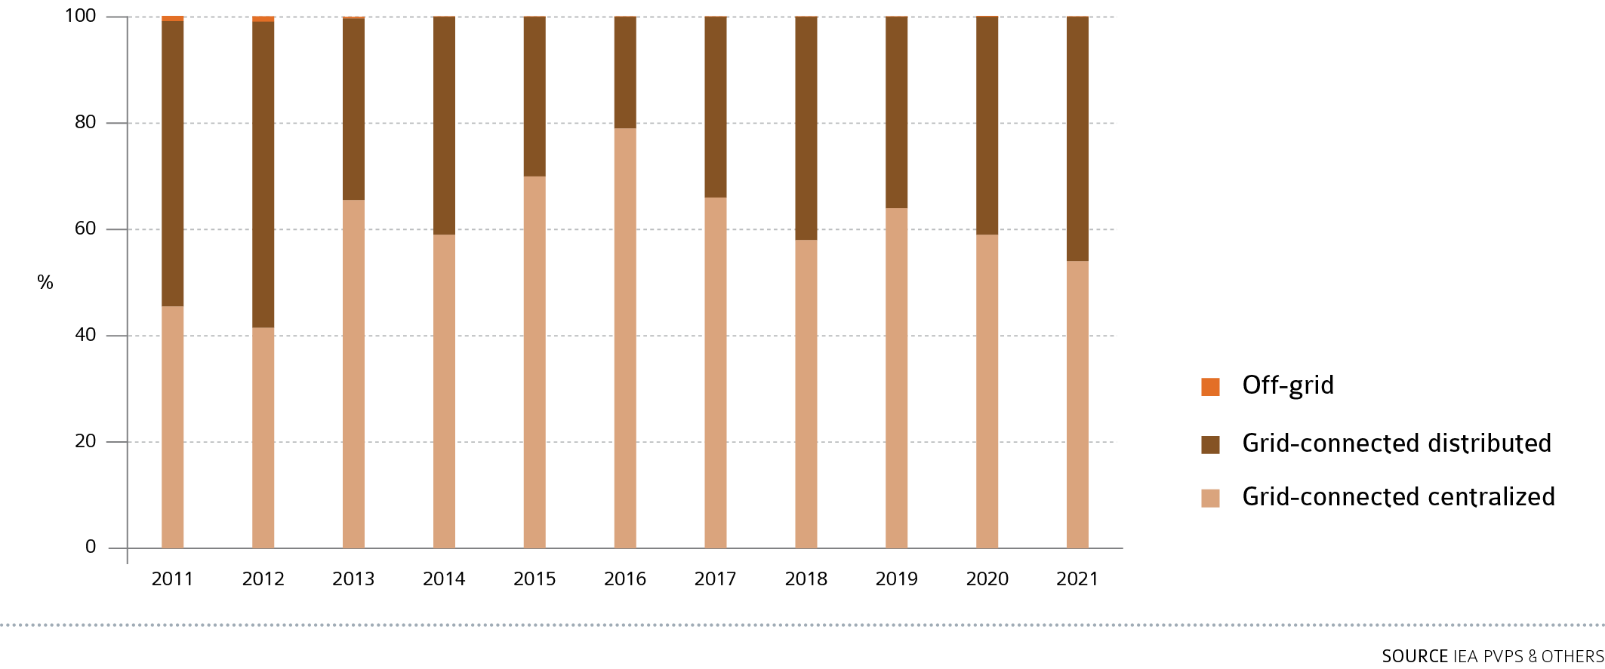
EVOLUTION OF PV INSTALLATIONS IN ASIA Pacific per segment

Slide 21
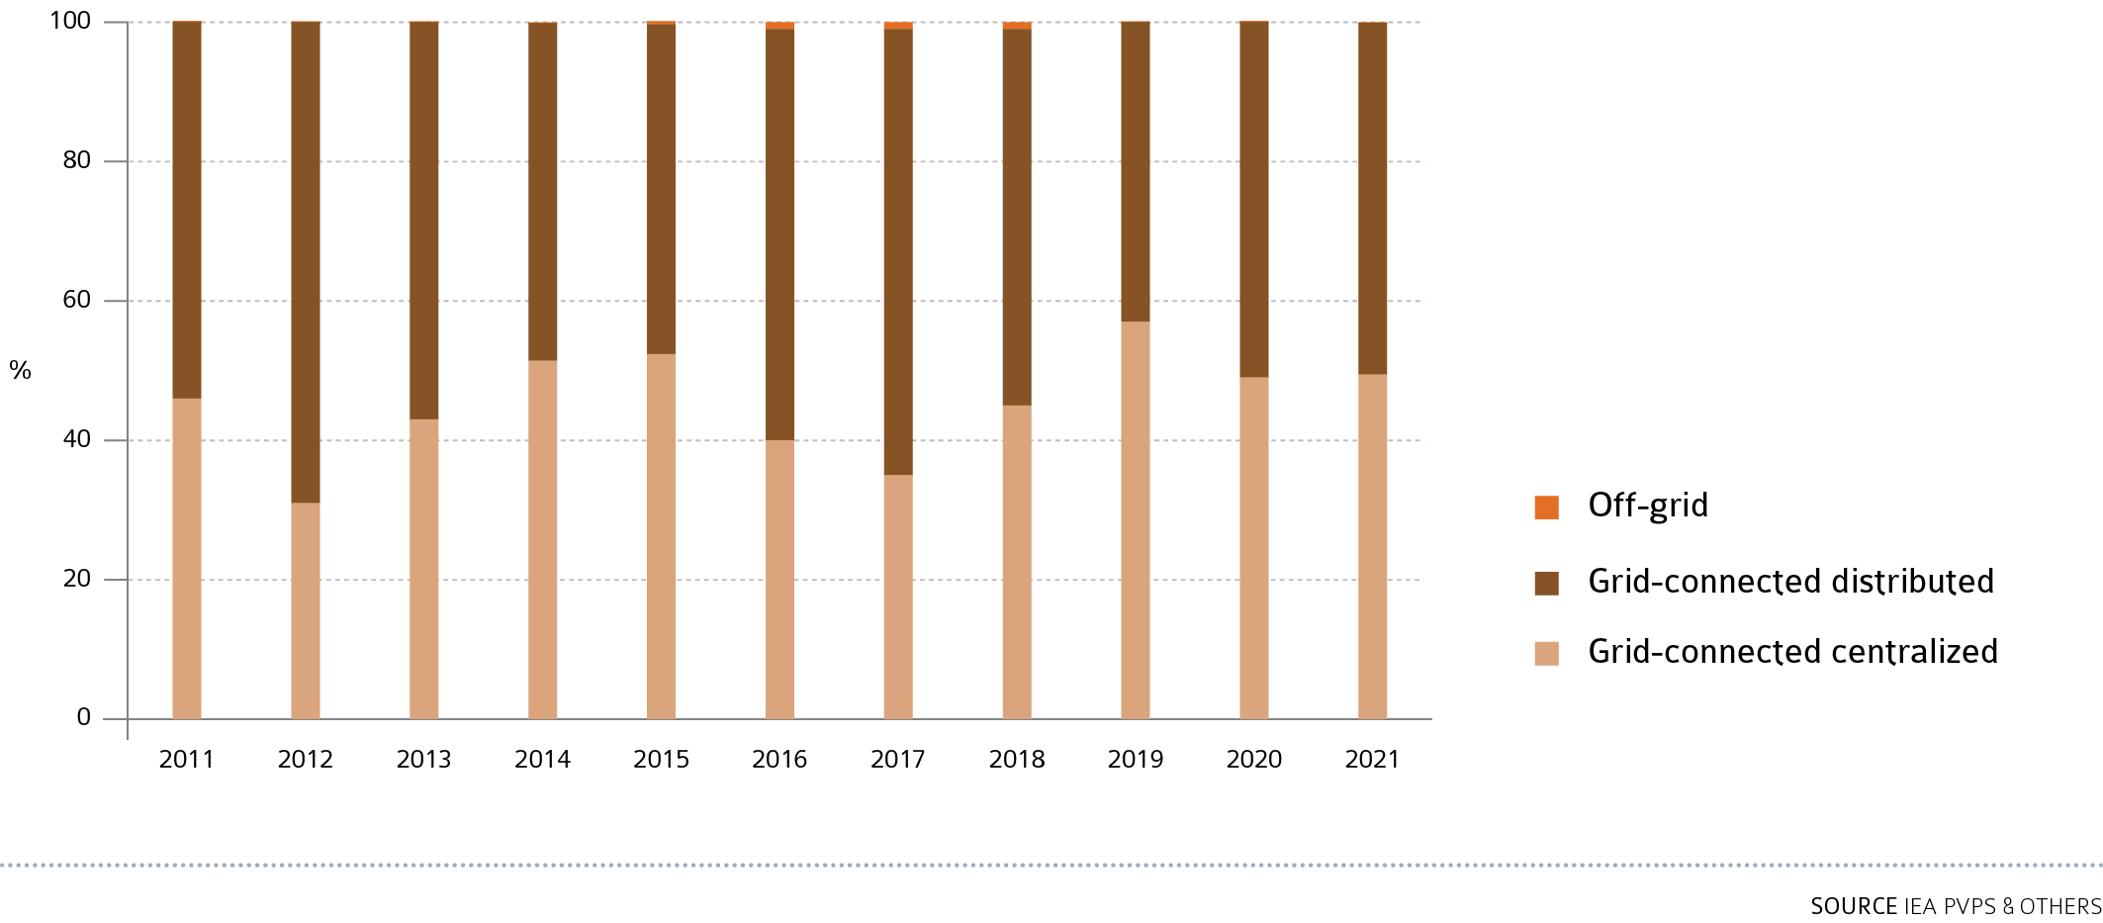
EVOLUTION OF PV INSTALLATIONS IN EUROPE per segment

Slide 22
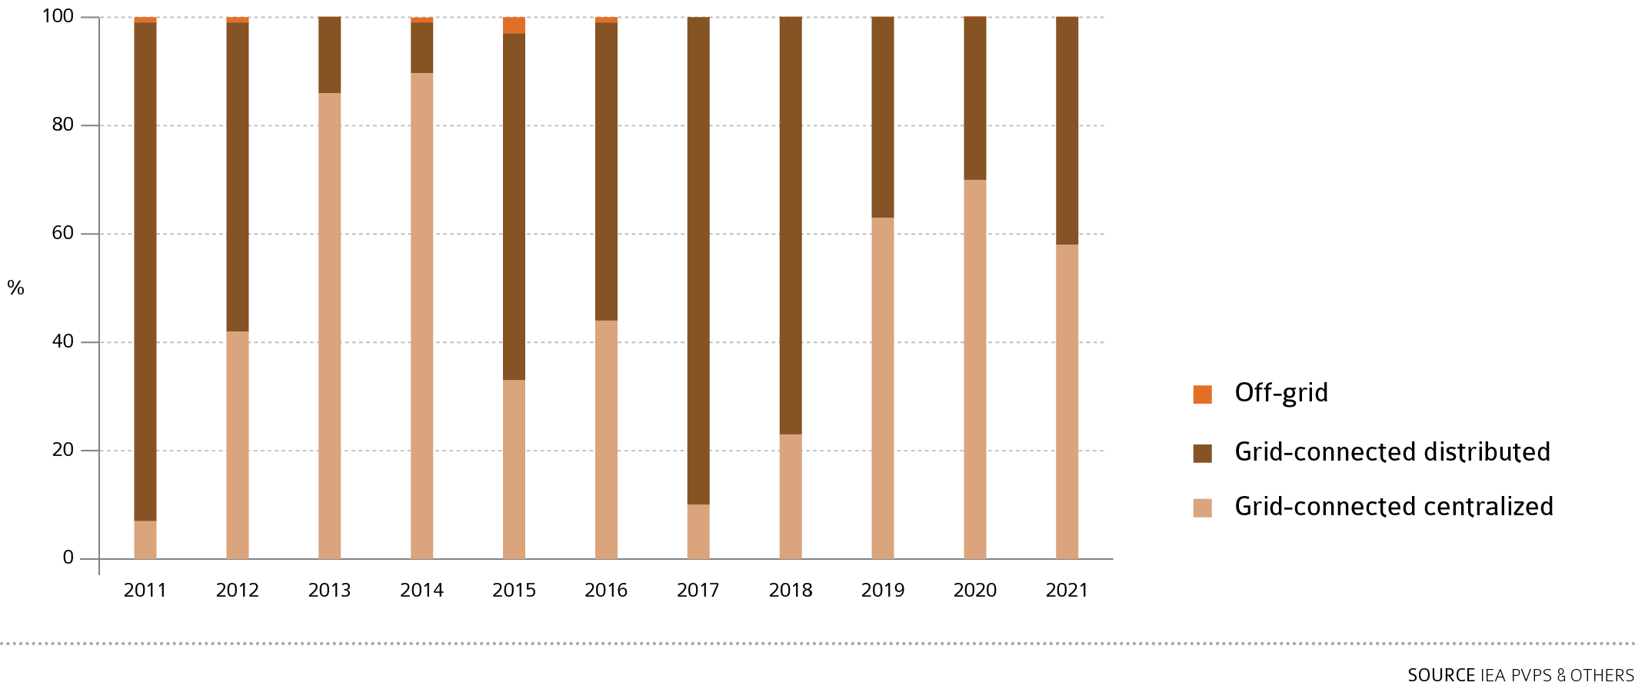
EVOLUTION OF PV INSTALLATIONS IN AFRICA and the middle east per segment

Slide 23
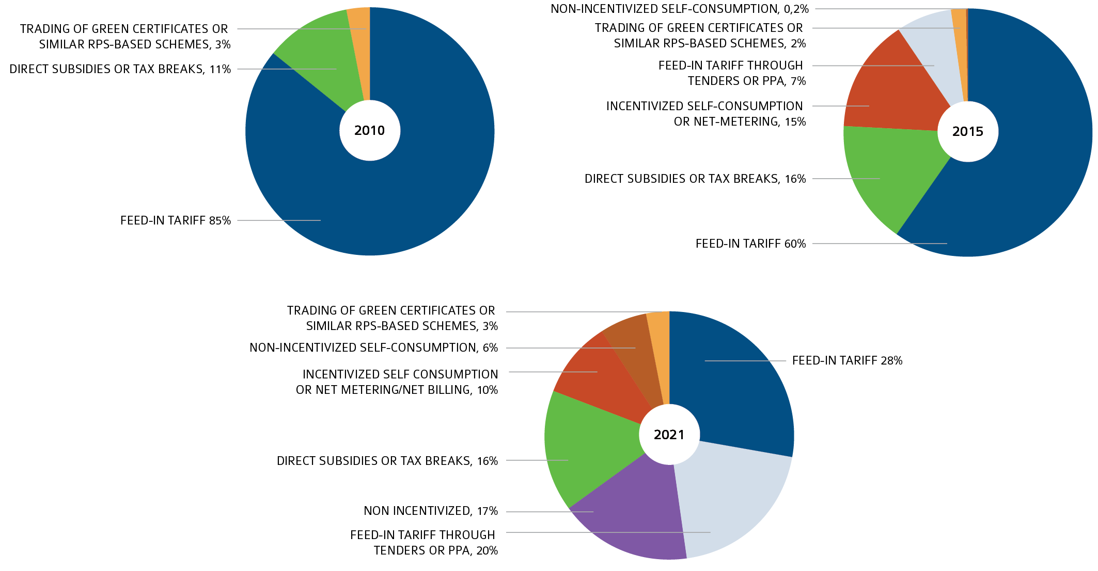
EVOLUTION OF MARKET INCENTIVES AND ENABLERS- 2010, 2015, 2021

Slide 24
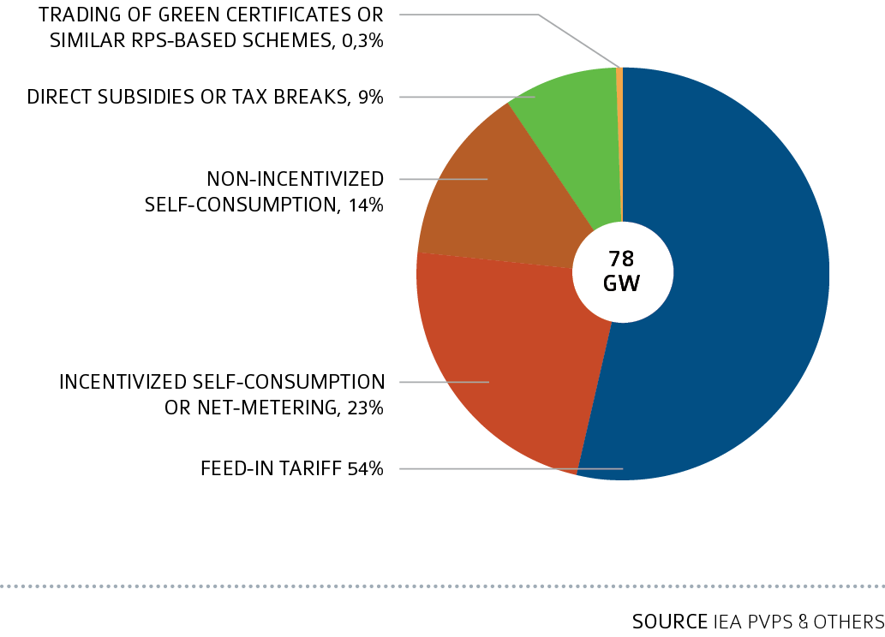
Main drivers of the distributed PV Market in 2021

Slide 25
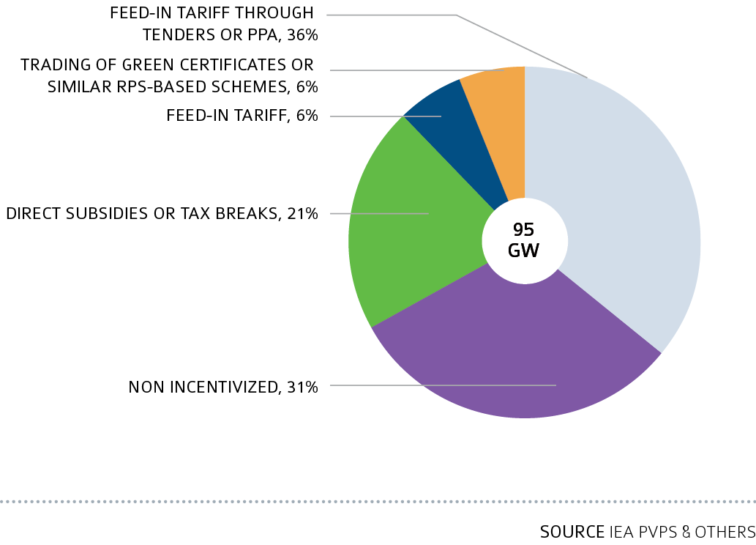
Main drivers of the centralized PV market in 2021

Slide 26
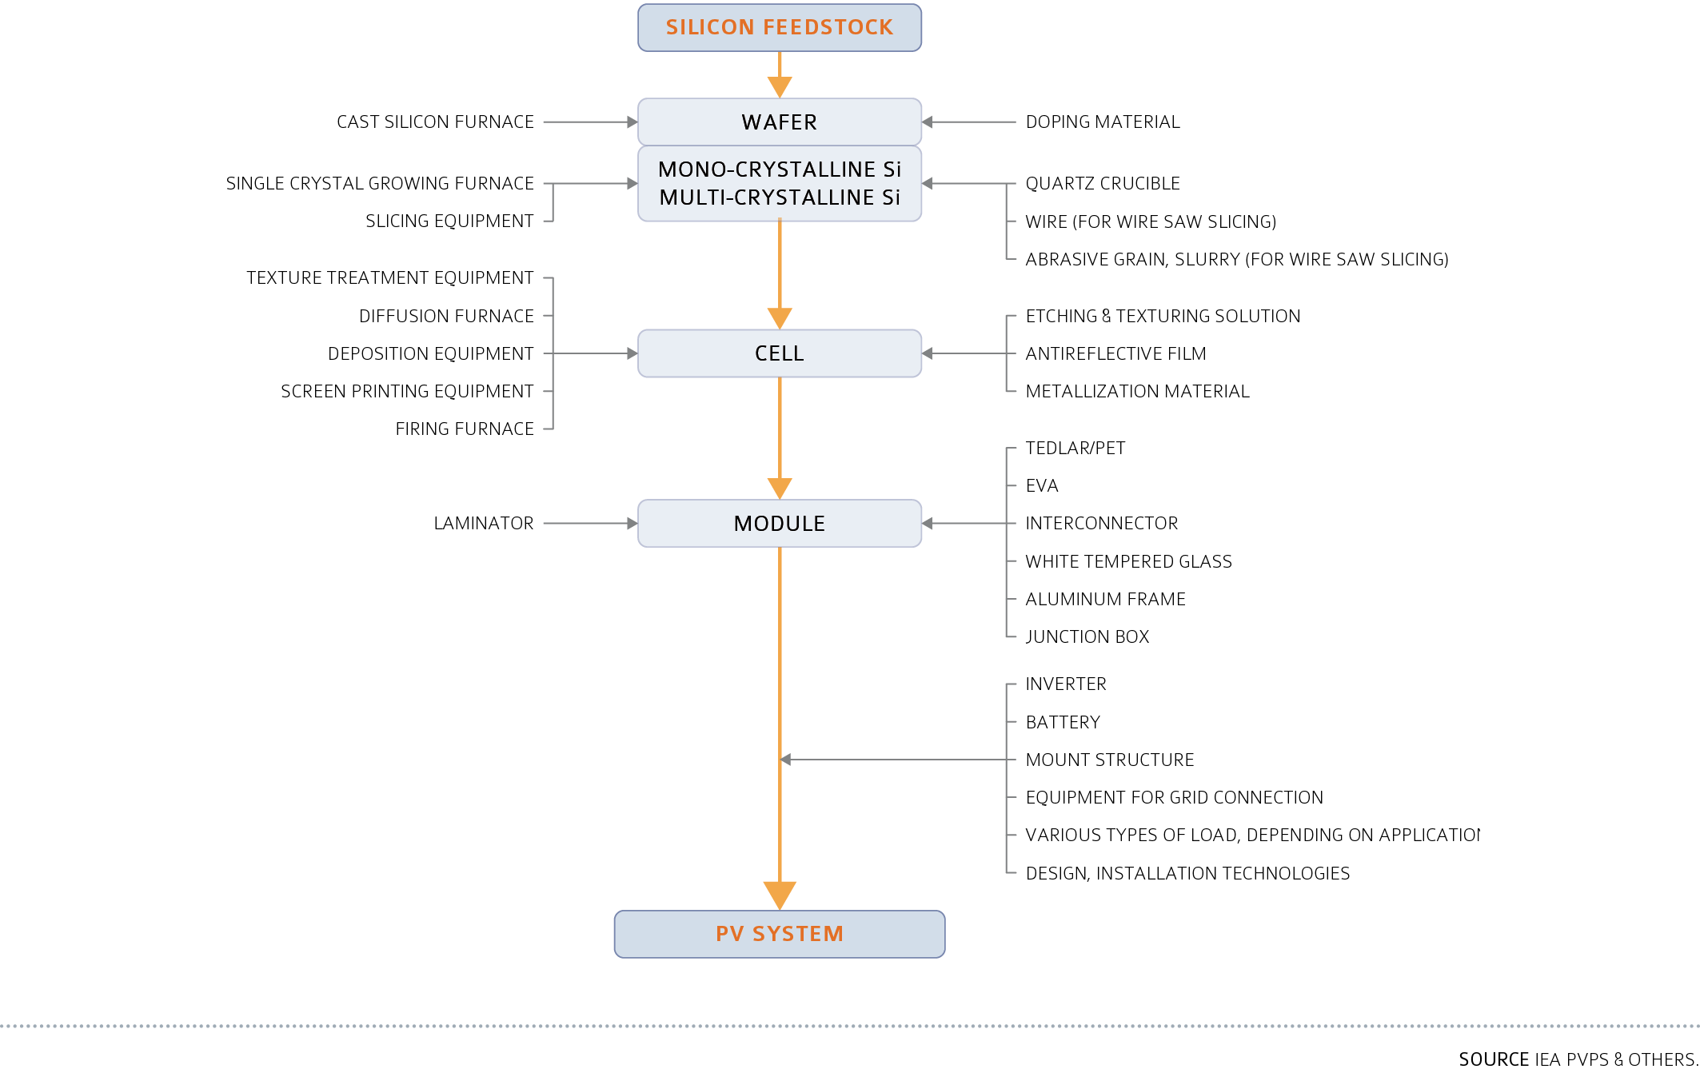
PV SYSTEM VALUE CHAIN (EXAMPLE OF CRYSTALLINE SILICON PV TECHNOLOGY)

Slide 27
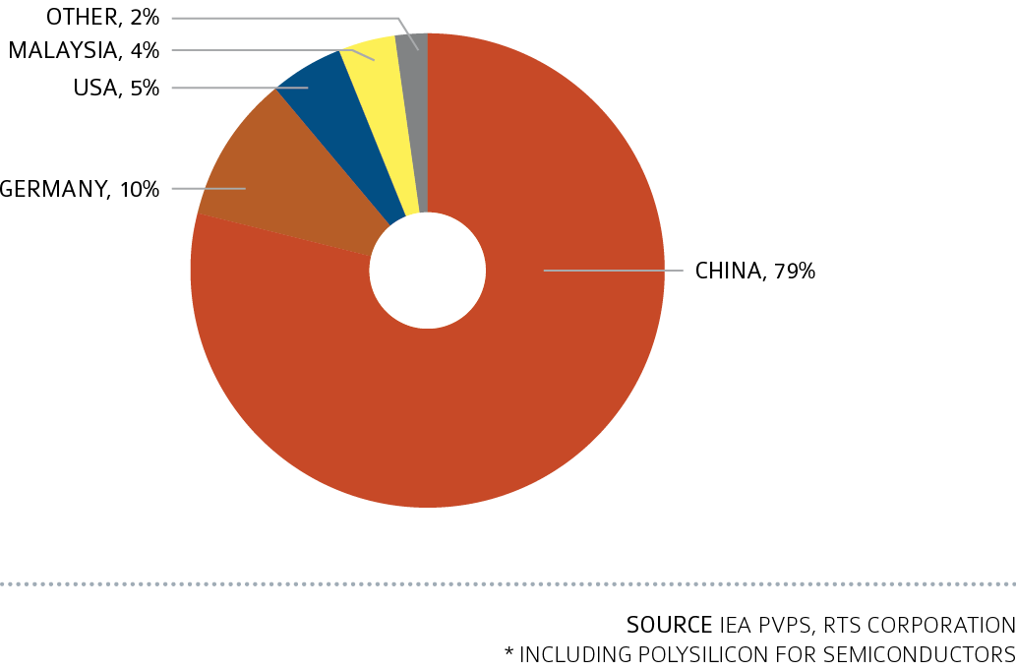
PV SYSTEM VALUE CHAIN (EXAMPLE OF CRYSTALLINE SILICON PV TECHNOLOGY)

Slide 28
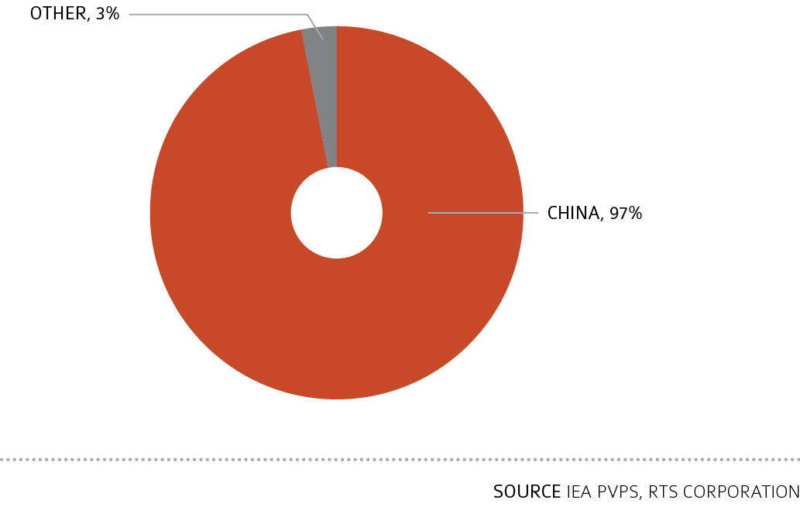
PV SYSTEM VALUE CHAIN (EXAMPLE OF CRYSTALLINE SILICON PV TECHNOLOGY)

Slide 29
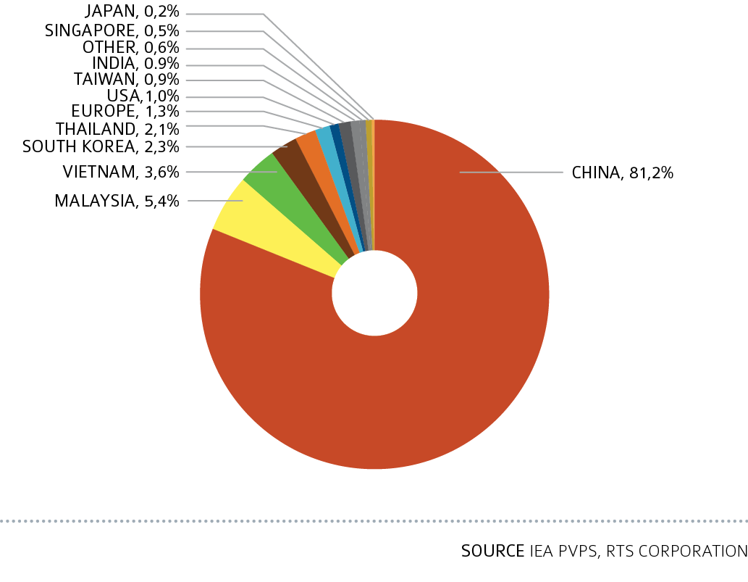
Share of PV Cell Production in 2021

Slide 30
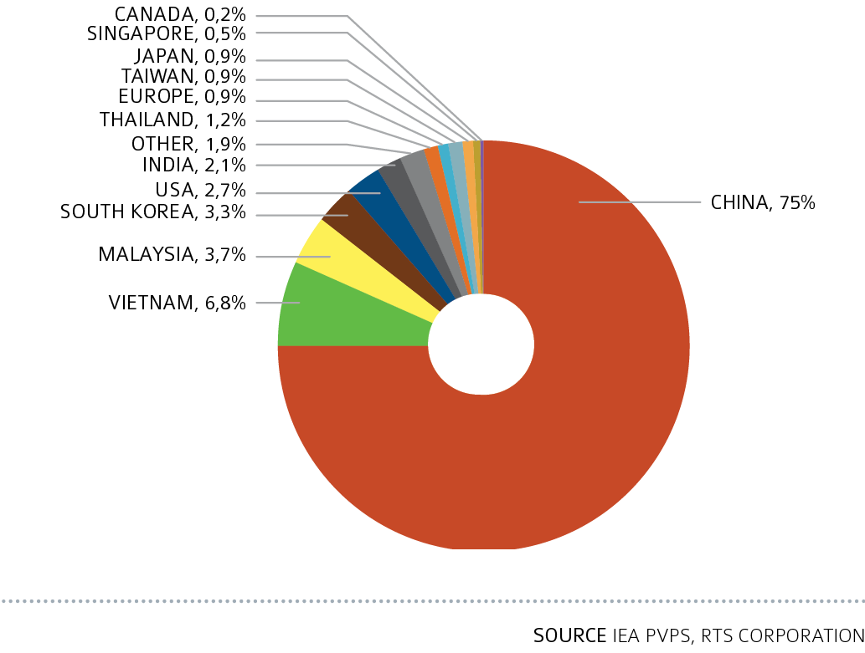
Share of PV Module Production in 2021

Slide 31
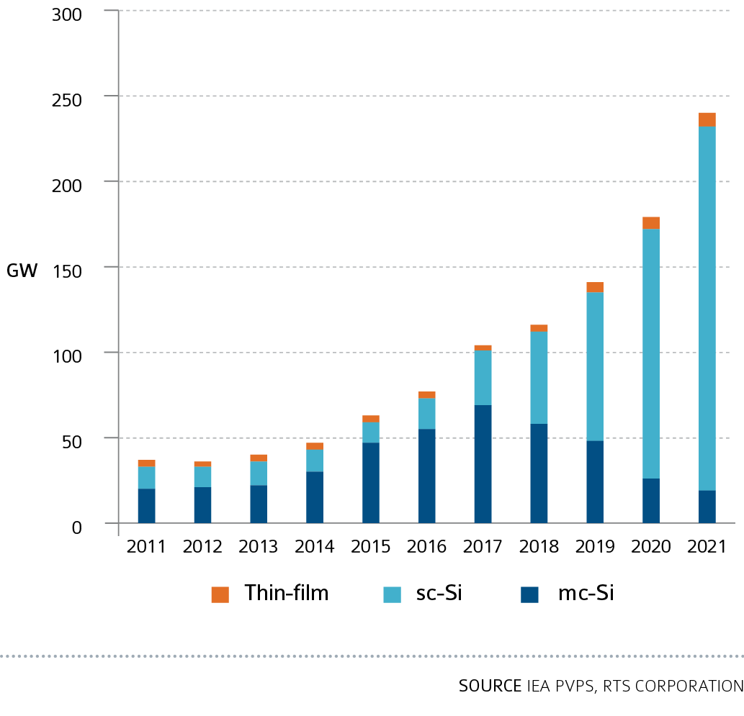
PV MODULE PRODUCTION PER TECHNOLOGY IN IEA PVPS COUNTRIES IN 2021

Slide 32
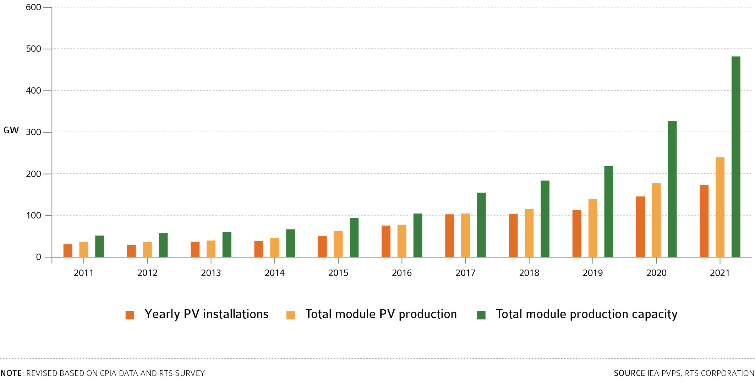
YEARLY PV INSTALLATION, MODULE PV PRODUCTION AND MODULE PRODUCTION CAPACITY 2011-2021 (GWp)

Slide 33
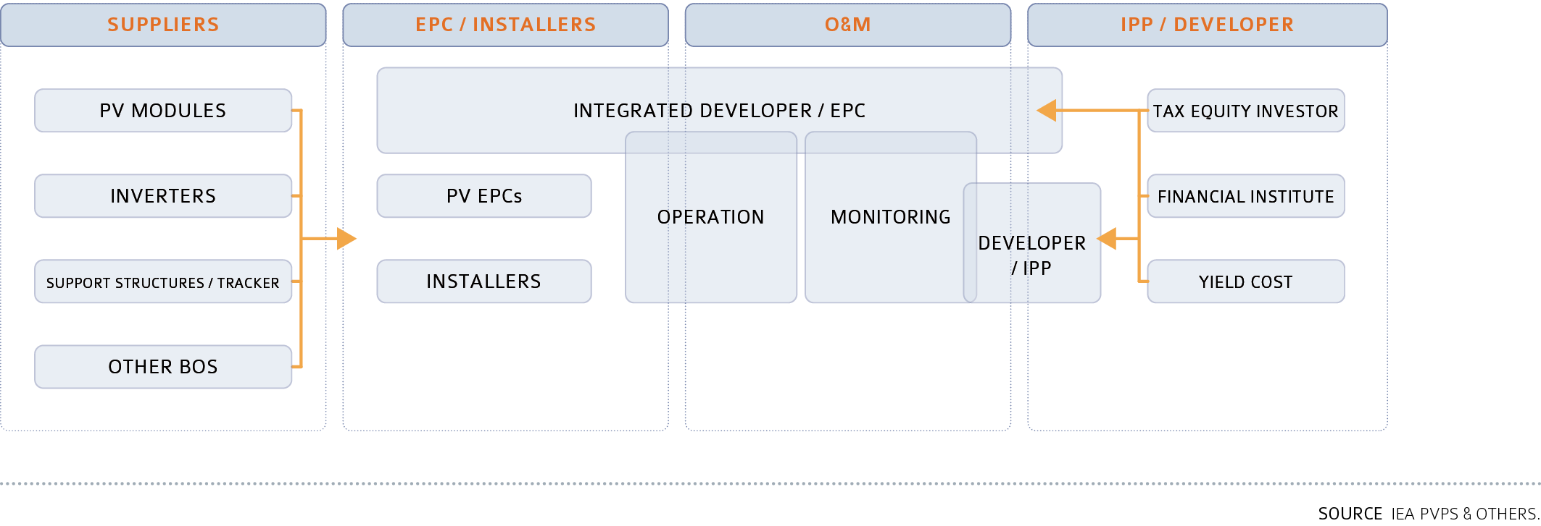
OVERVIEW OF DOWNSTREAM SECTOR (UTILITY PV APPLICATION)

Slide 34
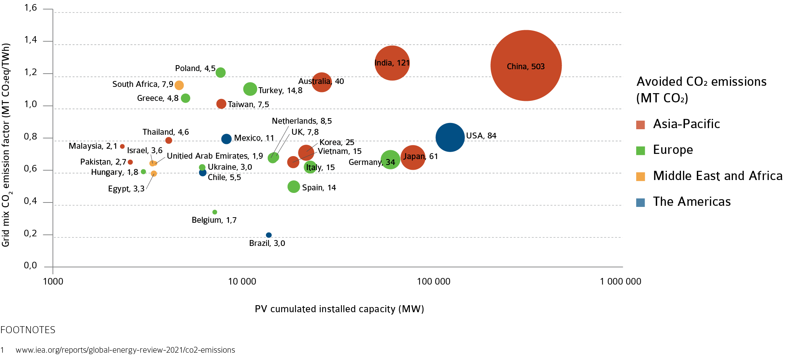
CO² EMISSIONS AVOIDED BY PV [MT CO^{2,eq}]

Slide 35
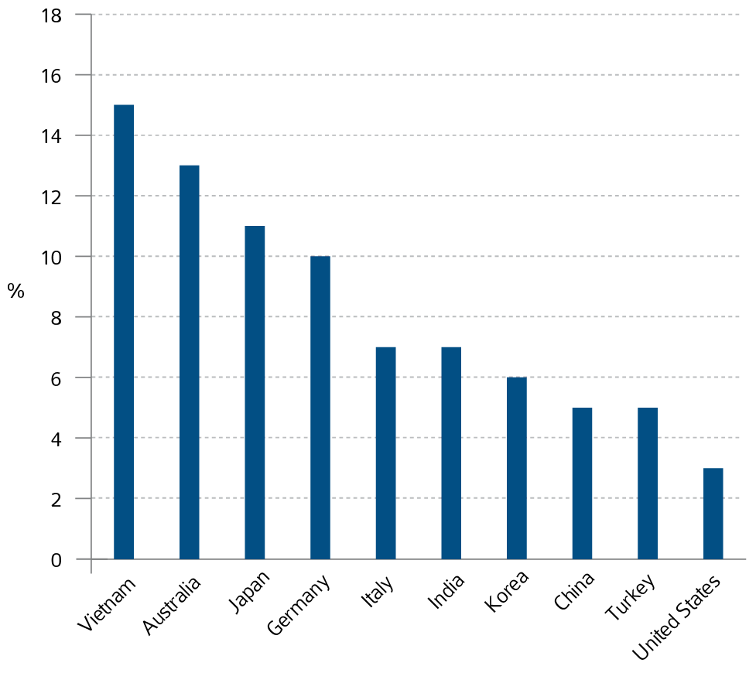
AVOIDED CO² EMISSIONS AS PERCENTAGE OF ELECTRICITY SECTOR TOTAL EMISSIONS

Slide 36
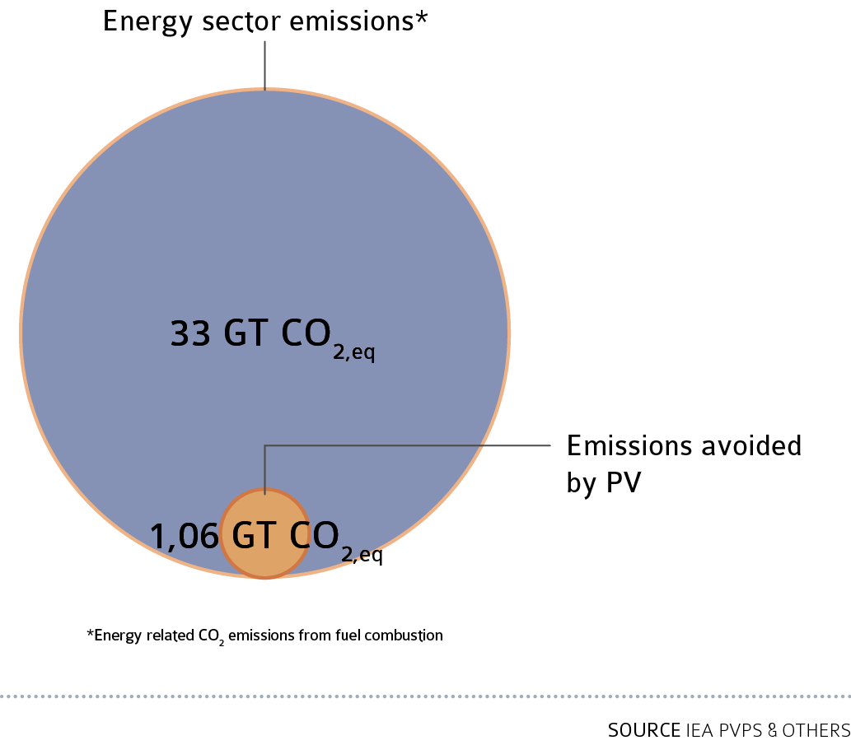
AVOIDED CO² EMISSIONS AS PERCENTAGE OF ENERGY SECTOR TOTAL EMISSIONS

Slide 37
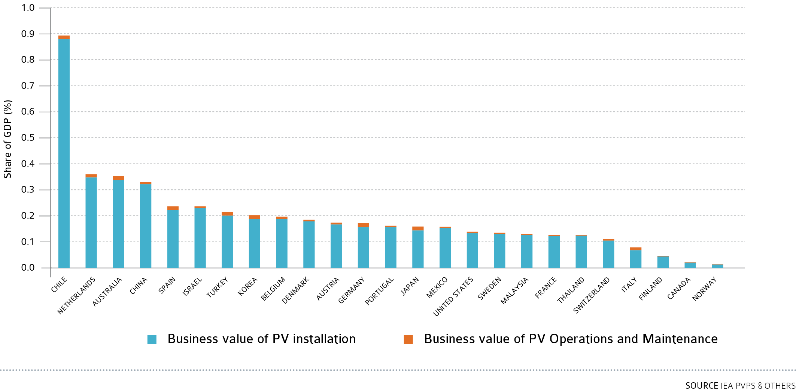
BUSINESS VALUE OF THE PV MARKET IN 2021

Slide 38
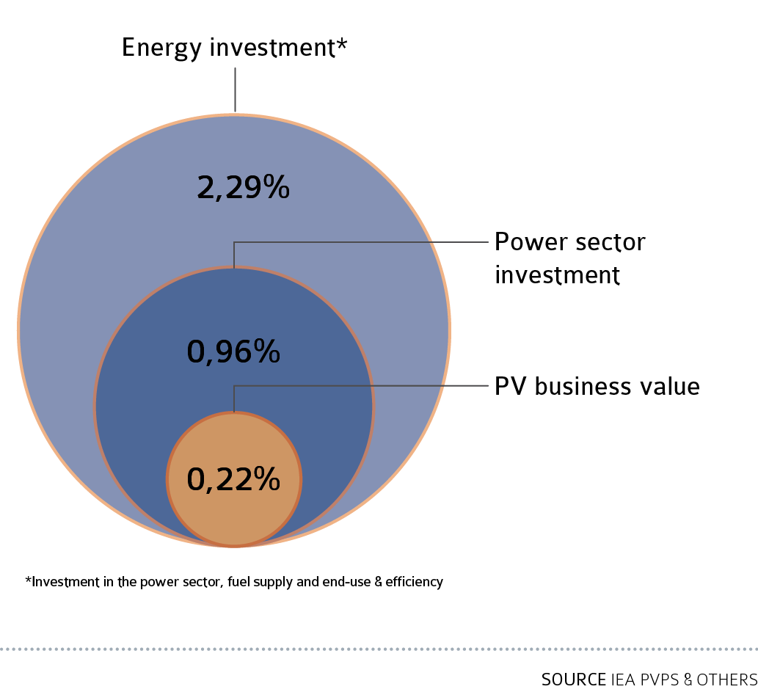
CONTRIBUTION TO GLOBAL GDP OF PV BUSINESS VALUE AND ENERGY SECTOR INVESTMENTS

Slide 39
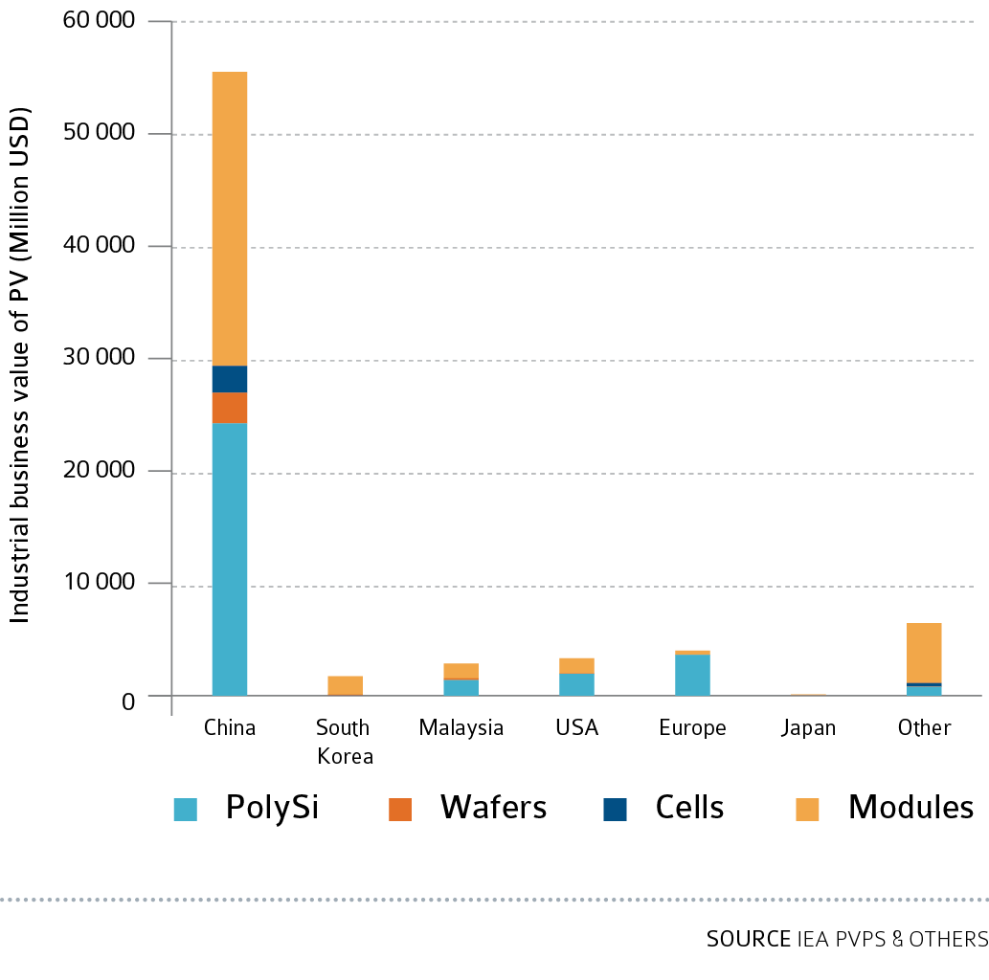
Absolute PV industrial business value in 2021

Slide 40
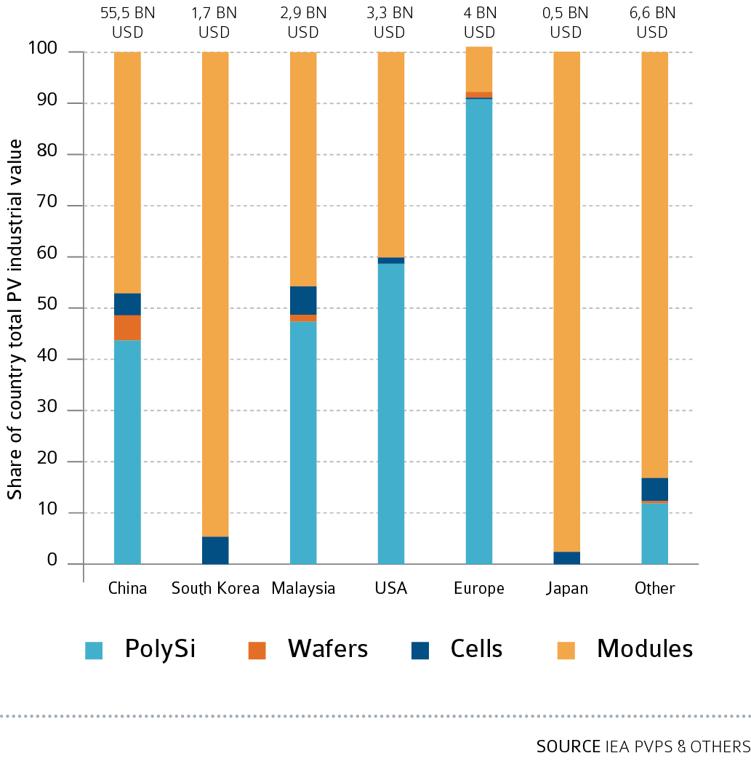
PV industrial business value along the value chain in 2021

Slide 41
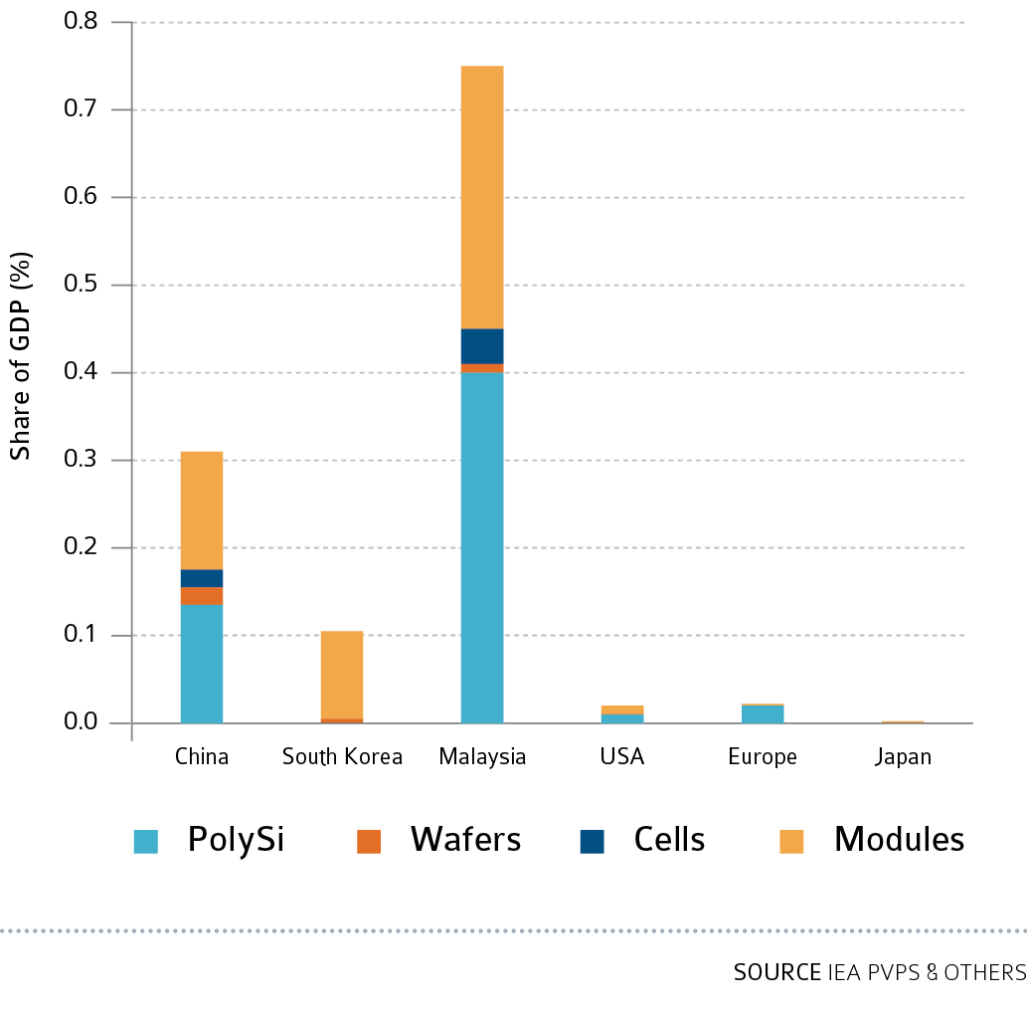
PV industrial business value as share of GDP in 2021

Slide 42
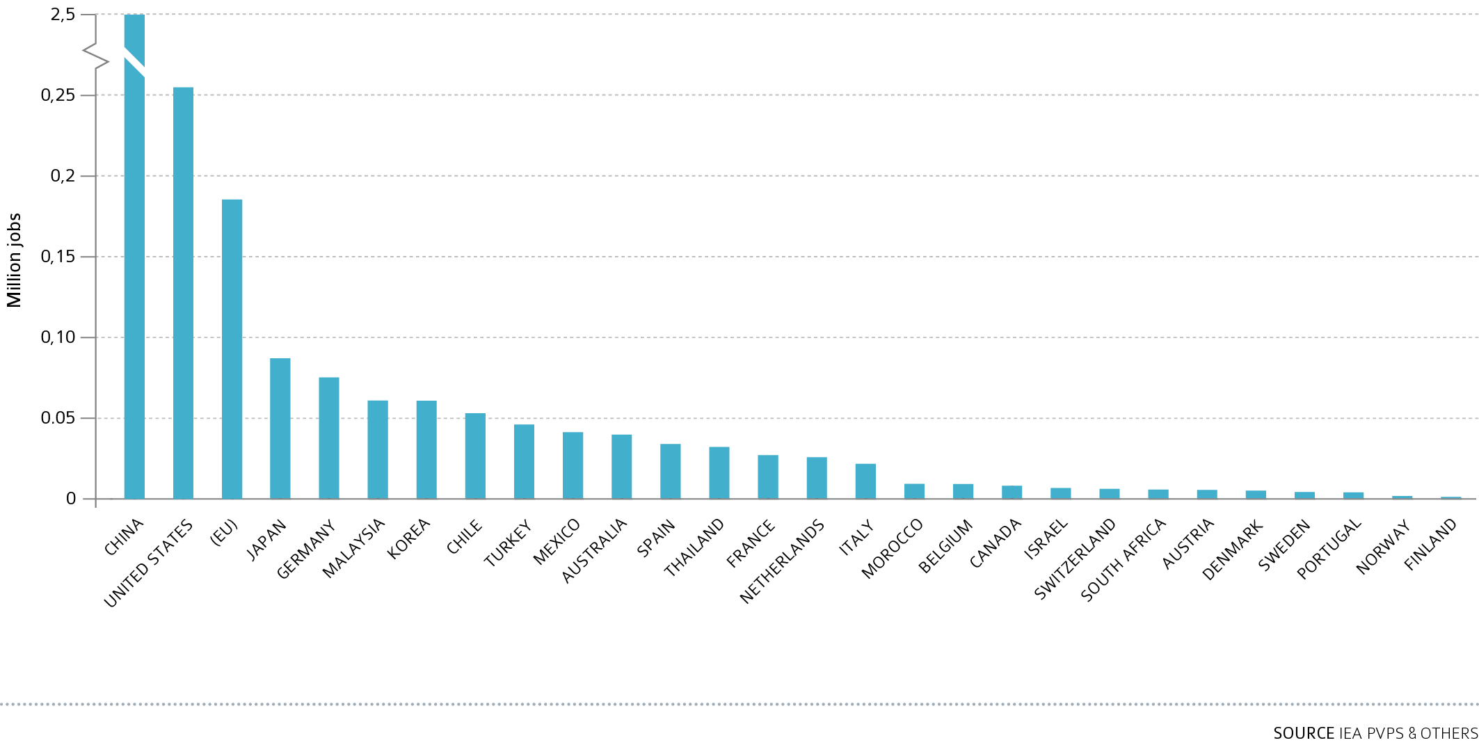
GLOBAL EMPLOYMENT IN PV PER COUNTRY

Slide 43
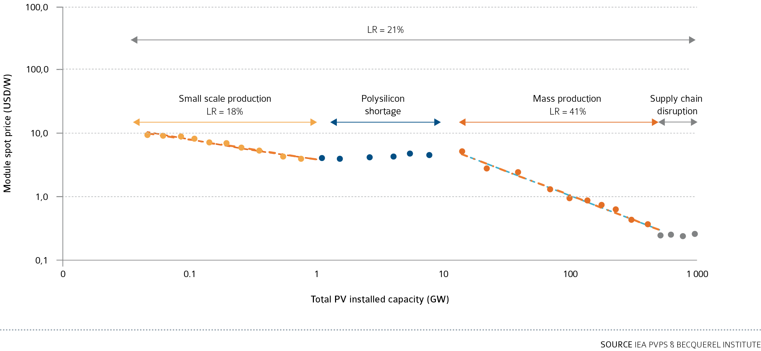
PV MDOULES SPOT PRICES LEARNING CURVE (1992-2021)

Slide 44
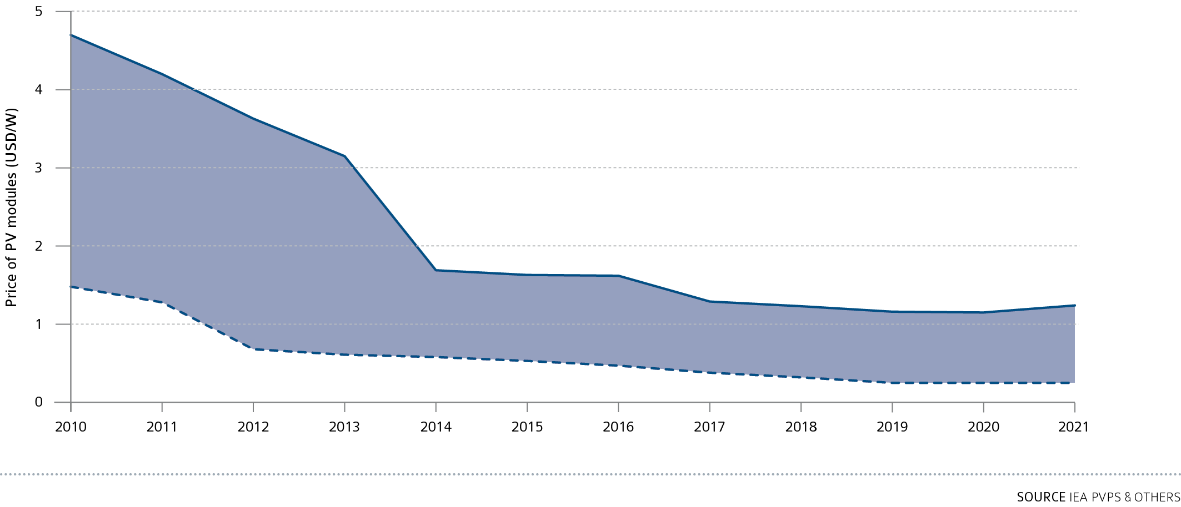
EVOLUTION OF PV MODULES PRICES RANGE IN USD/W

Slide 45
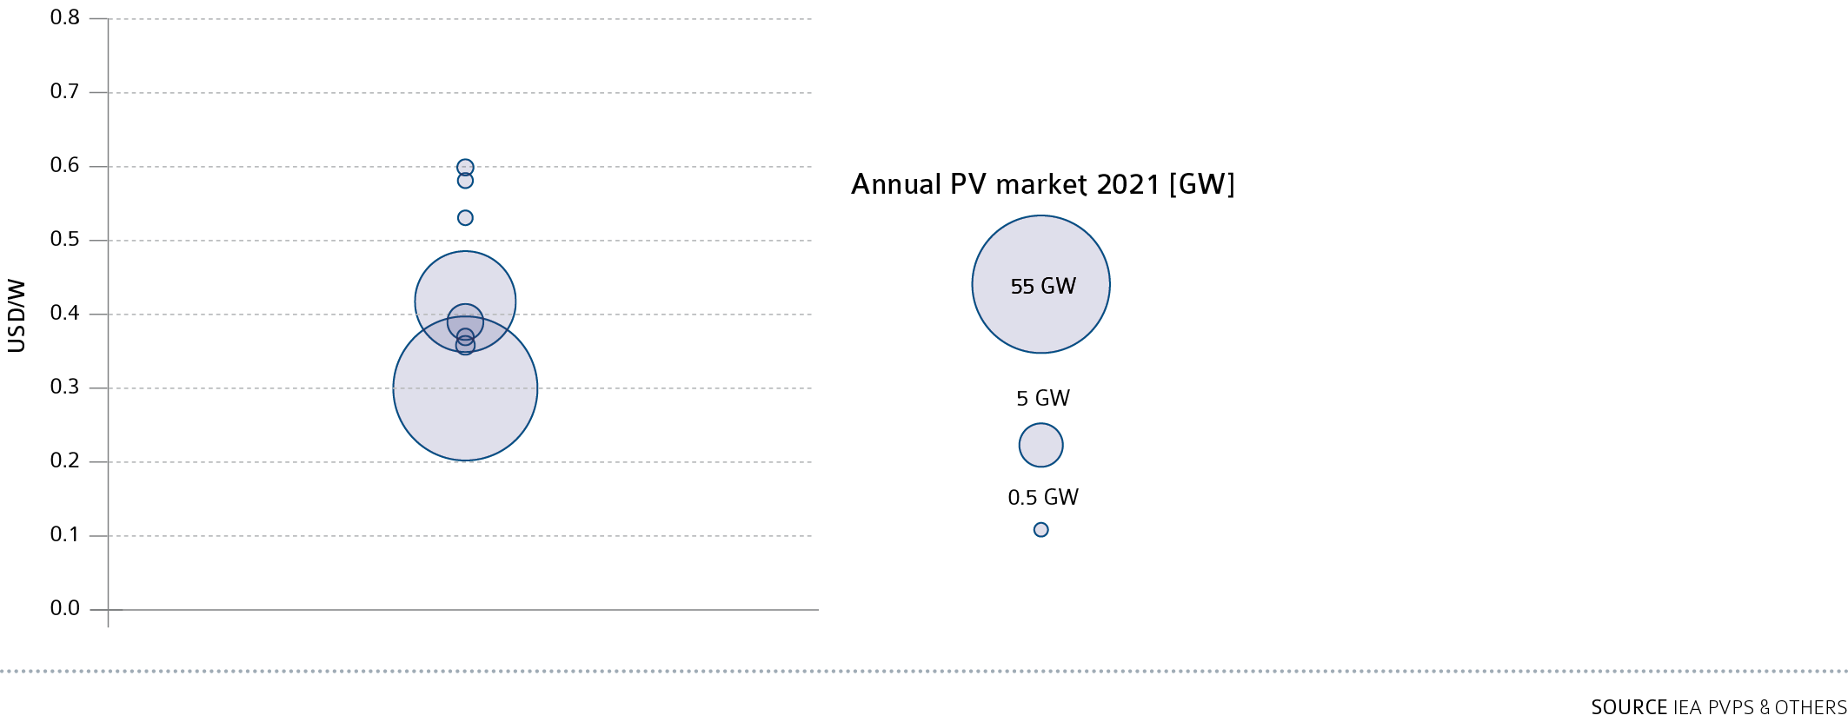
INDICATIVE MODULE PRICES IN REPORTING COUNTRIES

Slide 46
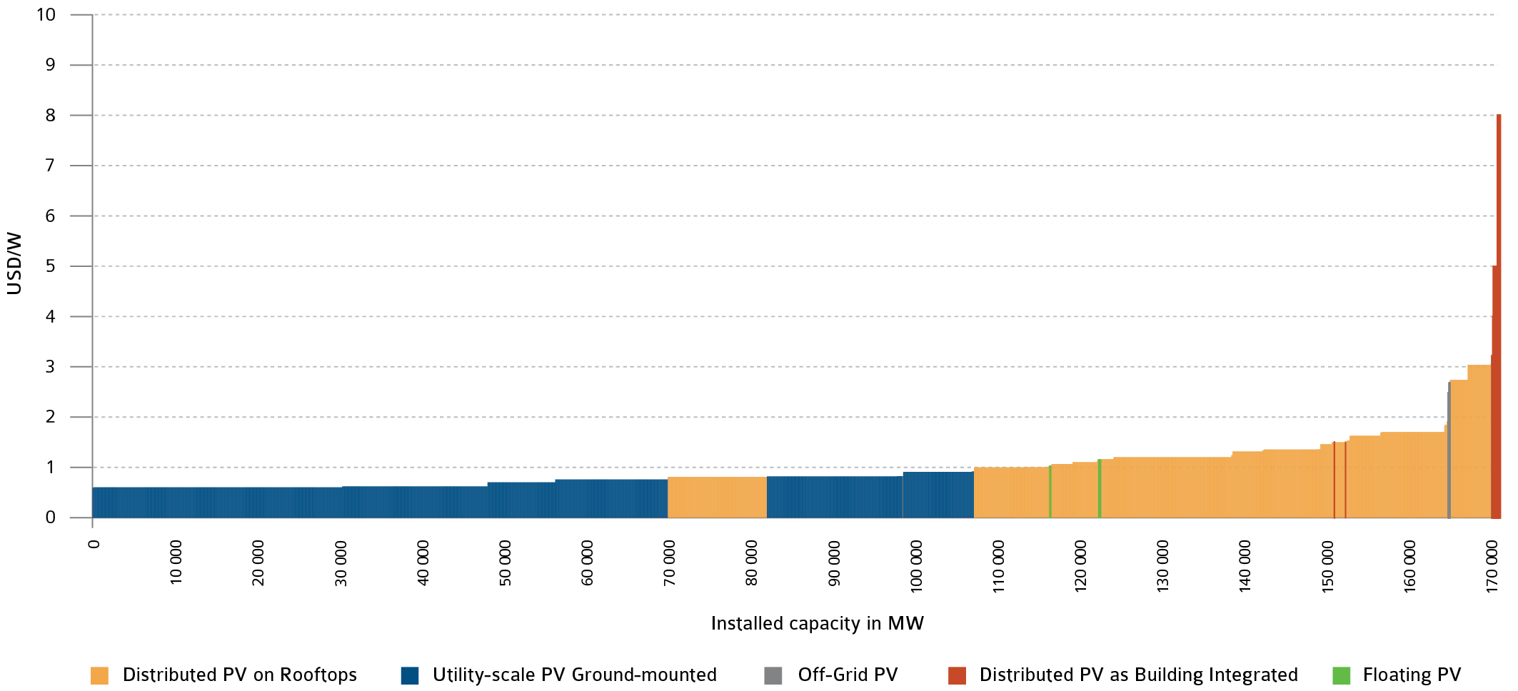
2021 PV MARKET COSTS RANGES

Slide 47
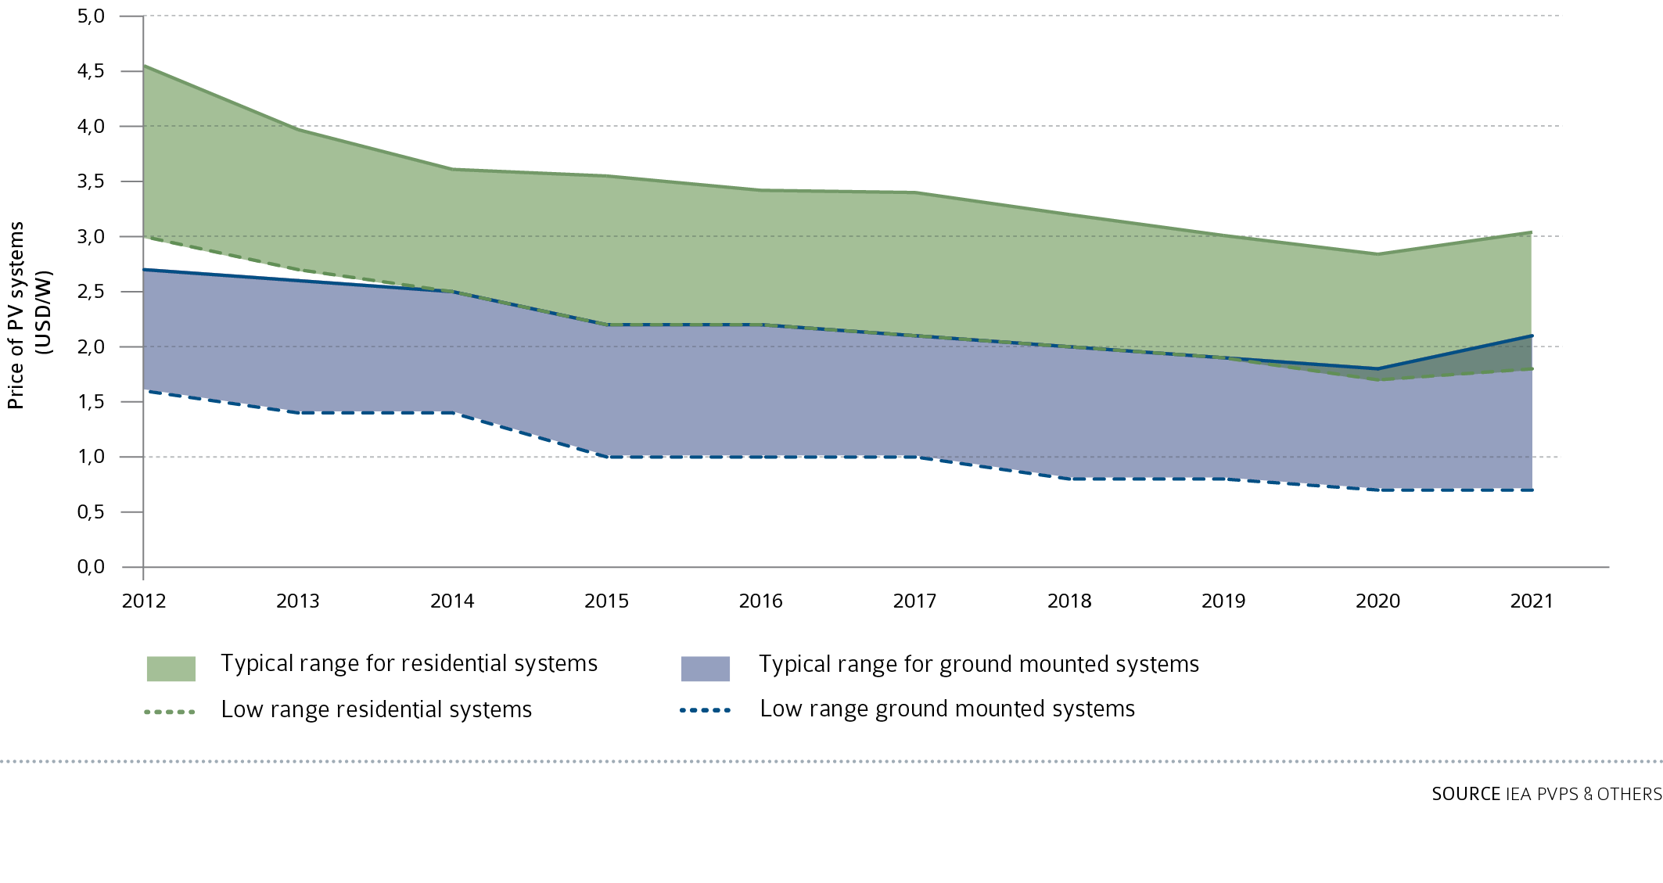
EVOLUTION OF RESIDENTIAL AND GROUND-MOUNTED SYSTEMS PRICE RANGE 2012 - 2021 (USD/W)

Slide 48
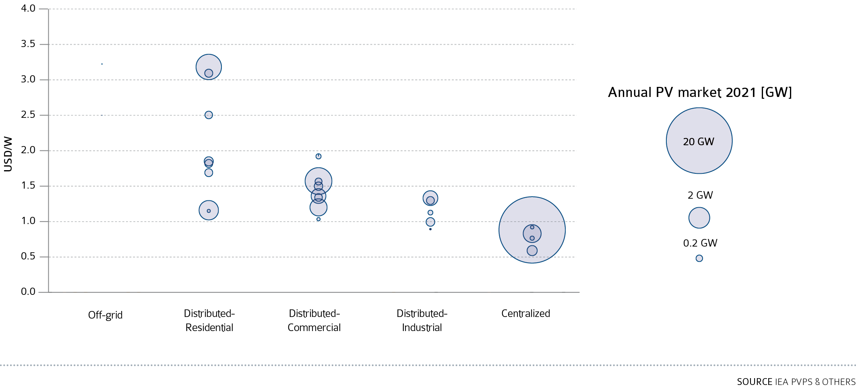
INDICATIVE INSTALLED SYSTEM PRICES IN SELECTED IEA PVPS REPORTING COUNTRIES IN 2021

Slide 49
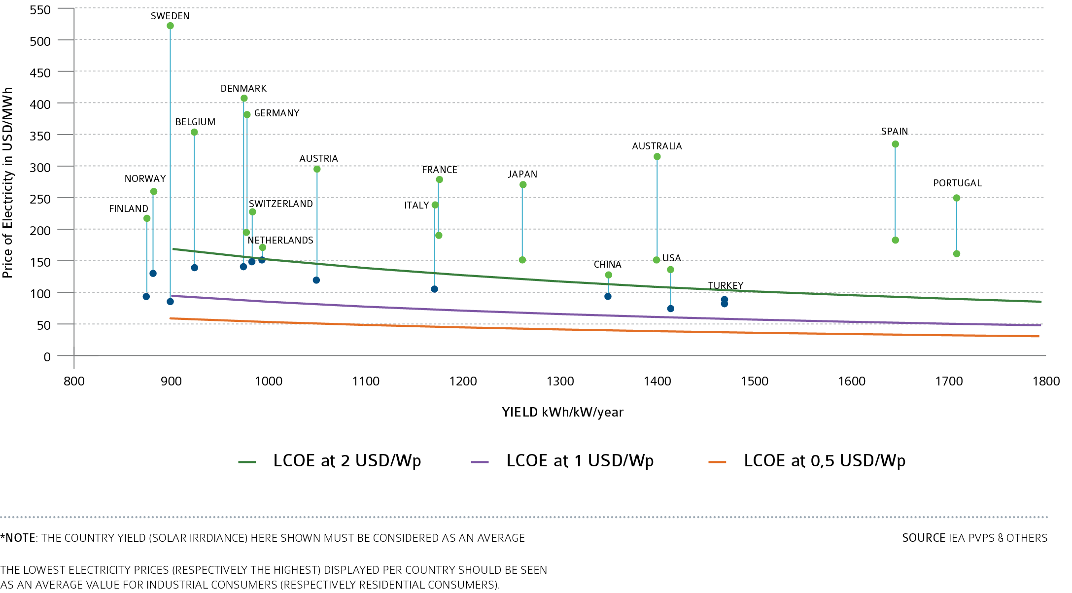
LCOE OF PV ELECTRICITY AS A FUNCTION OF SOLAR IRRADIANCE & RETAIL PRICES IN KEY MARKETS*

Slide 50
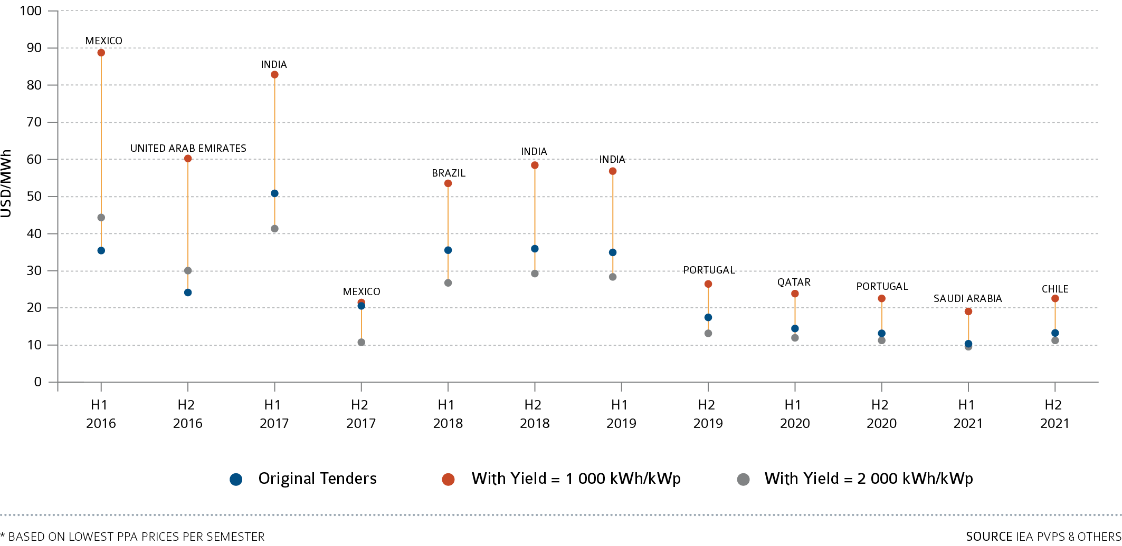
NORMALISED LCOE FOR SOLAR PV BASED ON LOWEST* PPA PRICES 2016 - Q4 2021

Slide 51
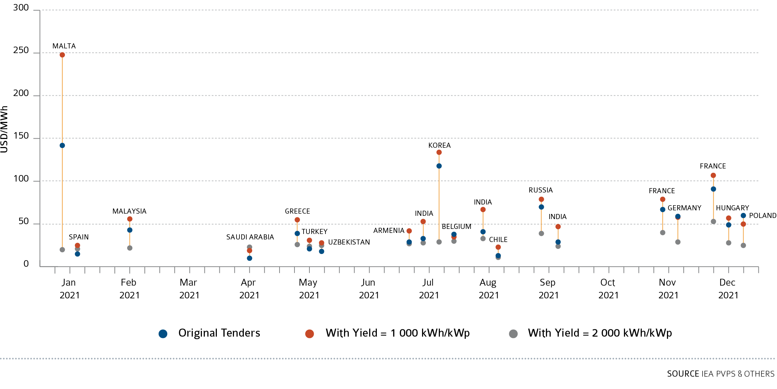
NORMALISED LCOE FOR SOLAR PV BASED ON RECENT PPA PRICES 2021

Slide 52
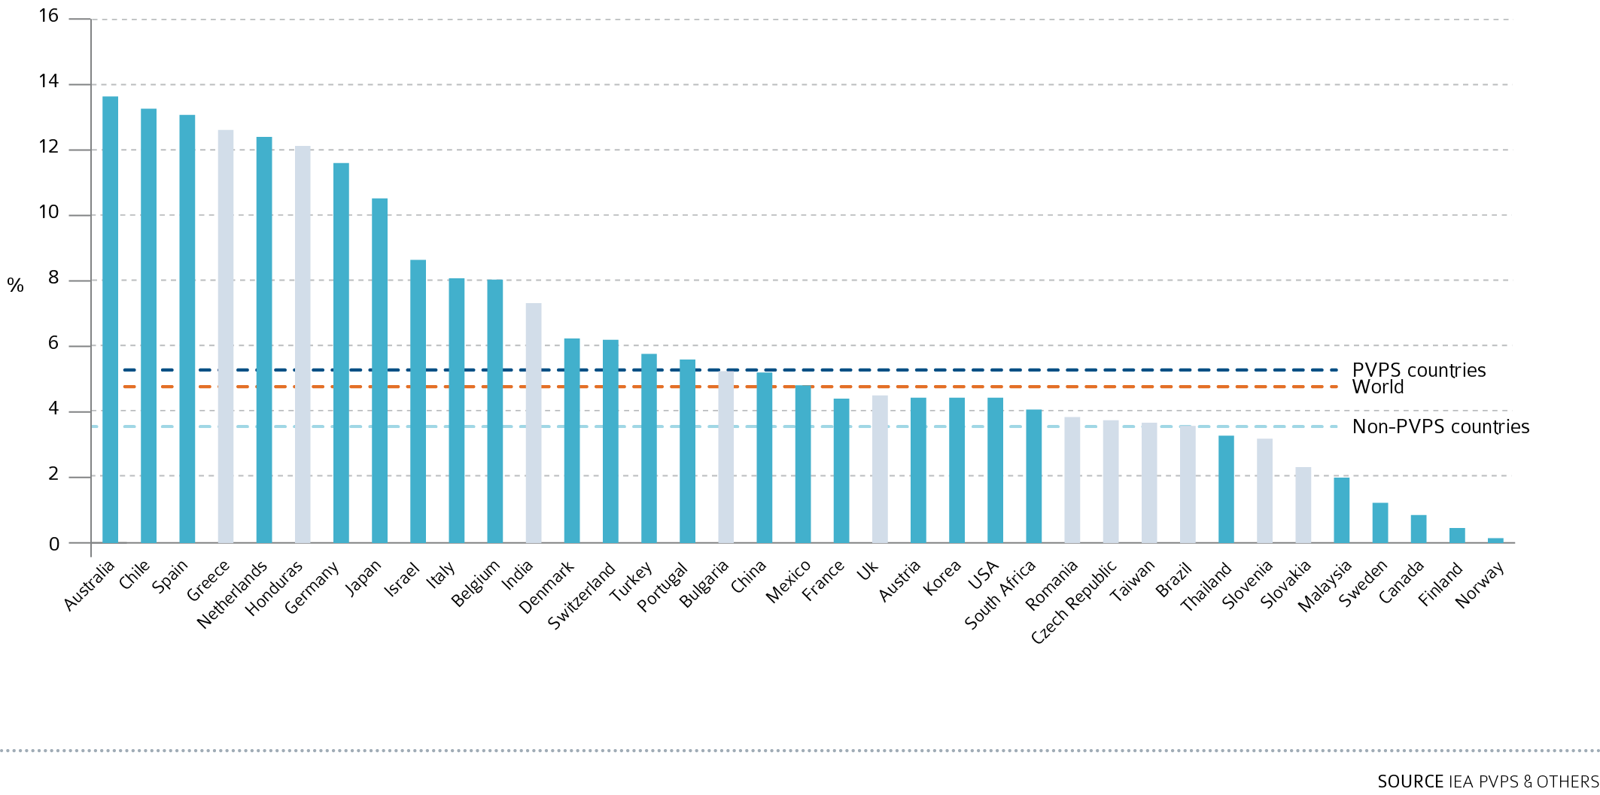
PV CONTRIBUTION TO ELECTRICITY DEMAND 2021

Slide 53
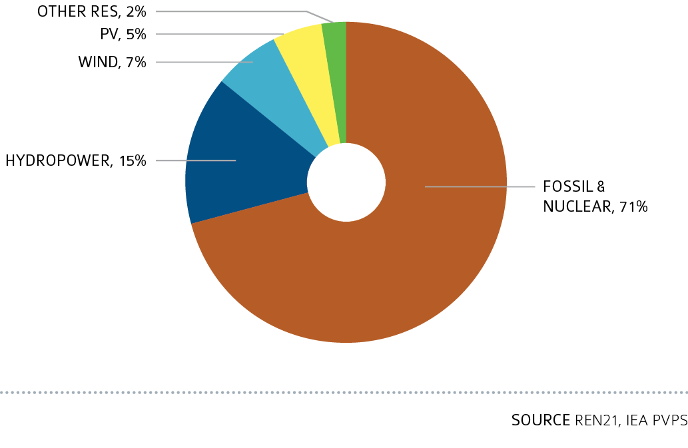
SHARE OF RENEWABLE IN THE GLOBAL ELECTRICITY PRODUCTION IN 2021

Slide 54
NEW RENEWABLE INSTALLED CAPACITY IN 2021

Slide 55
EVOLUTION OF TOP 10 MARKETS

Slide 56
TOP 10 COUNTRIES FOR CENTRALIZED PV INSTALLED IN 2021

Slide 57
TOP 10 COUNTRIES FOR CUMULATIVE CENTRALIZED PV INSTALLED CAPACITY IN 2021

Slide 58
TOP 10 COUNTRIES FOR DISTRIBUTED PV INSTALLED IN 2021

Slide 59
TOP 10 COUNTRIES FOR CUMULATIVE DISTRIBUTED PV INSTALLED CAPACITY IN 2021

Slide 60
2021 PV MARKET STATISTICS IN DETAIL

Slide 61
GLOBAL TOP FIVE MANUFACTURERS IN TERMS OF PV CELL/MODULE PRODUCTION AND SHIPMENT VOLUME (2021)

Slide 62
EVOLUTION OF ACTUAL MODULE PRODUCTION AND PRODUCTION CAPACITIES (MWp)

Slide 63
TOP 10 RANKING OF PV BUSINESS VALUES

Slide 64
TOP 10 LOWEST WINNING BIDS IN PV TENDERS FOR UTILTY SCALE PV SYSTEM

Slide 65
LOWEST WINNING BIDS IN PV TENDERS FOR UTILTY SCALE PV SYSTEM PER REGION

Slide 66
2021 PV ELECTRICITY STATISTICS IN IEA PVPS COUNTRIES

Slide 67
AVERAGE 2021 EXCHANGE RATES

Slide 68
CUMULATIVE INSTALLED PV CAPACITY (MWp) FROM 1992 TO 2021

Slide 69
ANNUAL INSTALLED PV CAPACITY (MWp) FROM 1992 TO 2021

Slide 70
Infographic

Slide 71
Infographic

Slide 72
Infographic

Slide 73
Gaëtan Masson, T1
g.masson@becquerelinstitute.eu

