Slide 1
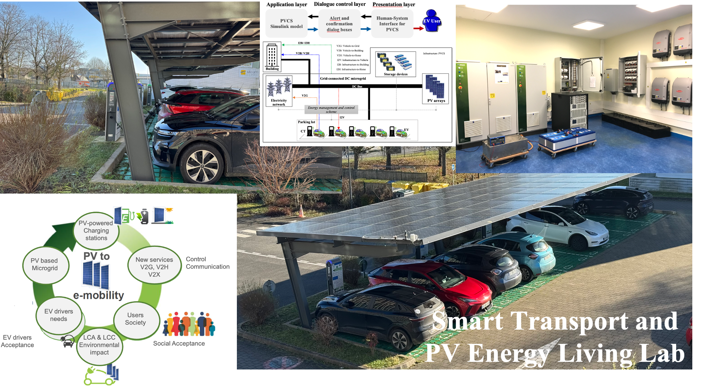
PV Powered Electric Vehicle Charging Stations – Requirements, barriers, solutions and social acceptance
Task 17: PV & Transport
October 2024

Slide 2
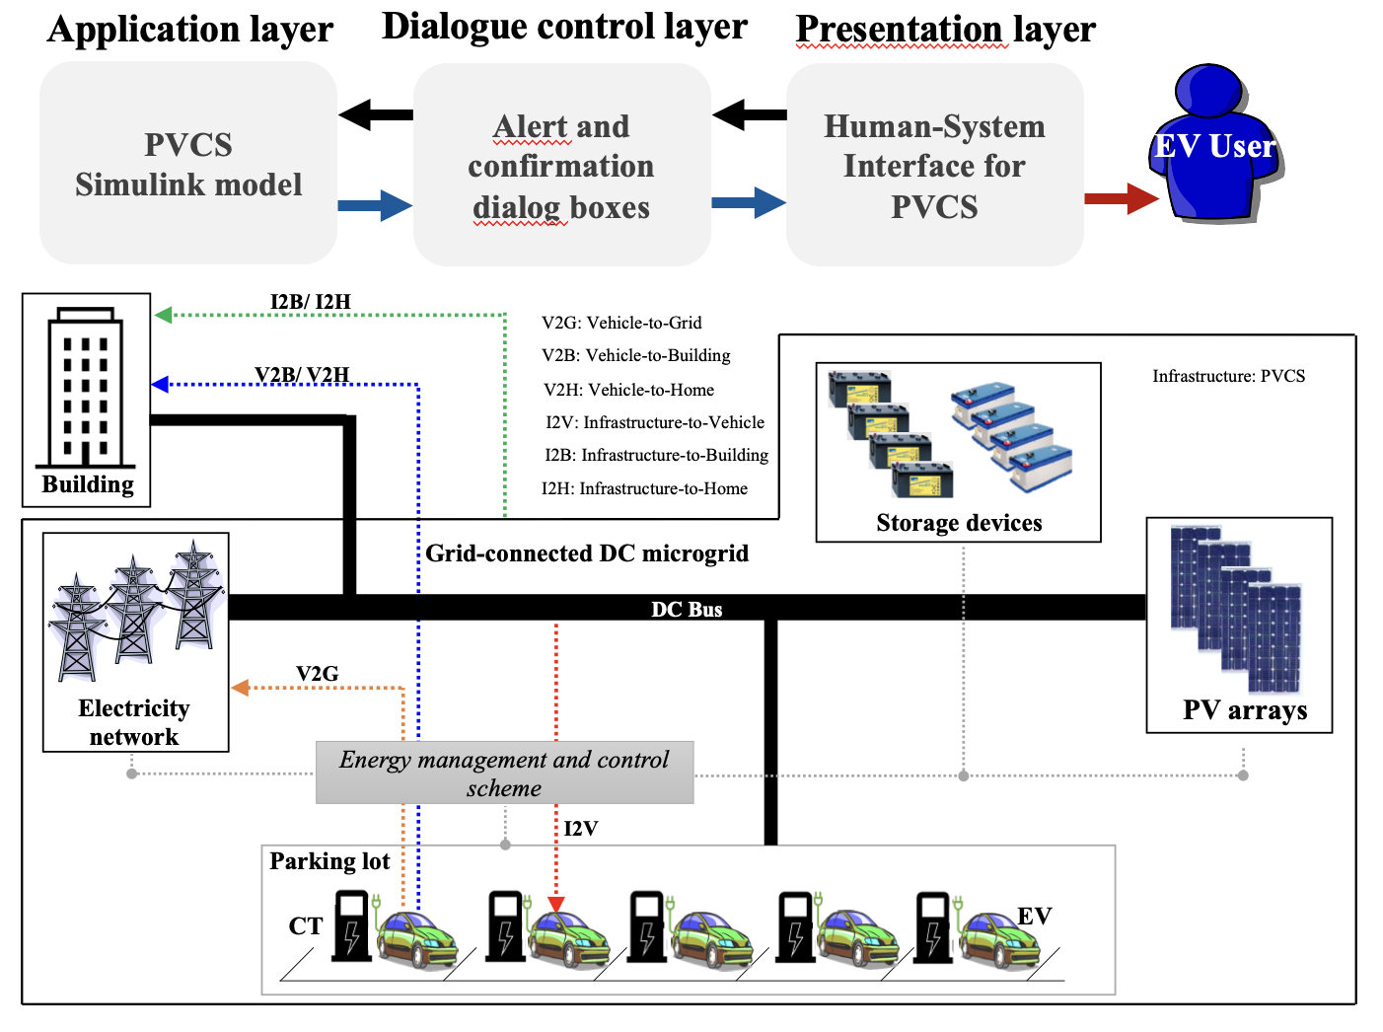
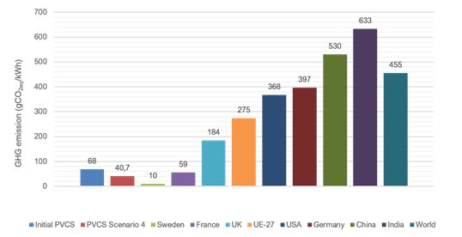
Context and objectives
The first report published by IEA Task 17 Subtask 2 highlights the main requirements and feasibility conditions for increasing the benefits of photovoltaic (PV) energy through PV-powered charging stations (PVCS).
This second report delves into the technical, economic, environmental, and social dimensions of EV charging infrastructure, with a particular emphasis on the smart energy management of PVCS. Furthermore, it explores the socio-technical challenges surrounding user acceptance and the social acceptability of PVCS, reflecting on how these factors impact the successful implementation of electromobility solutions.

Slide 3
Key results
Public grid impact
  Considering the possibility that 10% of 5 million EVs could simultaneously use rapid charging (50kW), the grid must allocate at least 19% of its total installed power. Smart charging is essential and must go beyond the usual reduction of power available at charging terminals.
Optimized Energy Use
  Based on users' forecasted departure times, real-time control is able to fully recharge EV batteries while maximizing the use of PV energy during recharging. Depending on departure times, most EVs can be charged with more than 80% PV energy.
  Using real parking occupancy data over a full year, smart charging for a PV-powered parking lot near a suburban train station on the outskirts of Lisbon, Portugal, revealed a significant reduction in electricity imports from the grid (by more than 35%).
Global Cost and Carbon Impact Assessment
  For a 30-year life cycle for PVCS
    Global cost includes approximately 40% investment costs and 49% maintenance costs.
    Compared to traditional charging stations powered by grid electricity, the PVCS carbon impact is between 1,5 and 10 times smaller, depending on the energy mix implemented in the electricity grid.
Social acceptance
    The PVCS is socially acceptable to a large majority, although aspects such as location, business model, and design require careful consideration. Notably, more than 83% of the 864 respondents agree with the V2G service. The main obstacles to the use of PVCS are often related to PV panel efficiency, the recycling process, and pollution during the production phase.

Slide 4
Key recommendations
Public grid impact
  Using PV sources during daytime EV charging can reduce stress and energy allocation from the power grid.
Optimized Energy Use
  Based on human-system interfaces for PVCS and real-time control, smart charging adjusts the charging power and timing based on PV energy availability, grid conditions, and user preferences, ensuring efficient use of PV energy.
  PVCS with intelligent control implemented near a commuter train station significantly reduces electricity imports from the grid.
Global Cost and Carbon Impact Assessment
  Based on the LCA, a specific calculation methodology is necessary to assess the overall cost and carbon impact of PVCS.
  To reduce the carbon impact of PVCS, it is necessary to use PV panels with the lowest possible carbon impact. The carbon impact of PV panels strongly depends on the electricity mix used during their production.
Social acceptance
    To increase the social acceptance of PVCS, the choice of PV panels must be judicious in terms of efficiency, recycling and pollution during the production phase.

Slide 5
The way forward
PVCS offer significant benefits to drivers and make an important contribution to the energy transition. Their large-scale implementation will require technical and sizing optimization of the system, including stationary storage and grid connection, as well as changes in driver behavior.
Long parking times for EV charging (several hours), short driving distances (around 45 km), and slow charging modes are the most realistic requirements for maximizing the benefits of PVCS.
Real-time control of EV charging, which allows intelligent communication between operators and end-users based on powerful optimization algorithms, remains essential for increasing PV benefits and reducing total energy costs.
PVCS have a smaller carbon impact than public grid charging stations. To implement PVCS effectively, techno-economic and environmental approaches, including life cycle analysis, are necessary.
Key questions include how to directly use and manage PV electricity for different types of PVCS, driving profiles, and locations with varying solar irradiance, and how to integrate PVCS components while maintaining mechanical and physical reliability, safety, and standardization. These are critical first steps for the real-world deployment of PVCS.
Regarding the social acceptance of PVCS and V2G/V2H services, results indicate that PVCS are widely accepted by the majority, although factors such as location, business model, and design require careful consideration

Slide 6
Manuela SECHILARIU, Task 17
manuela.sechilariu@utc.fr

