Slide 1
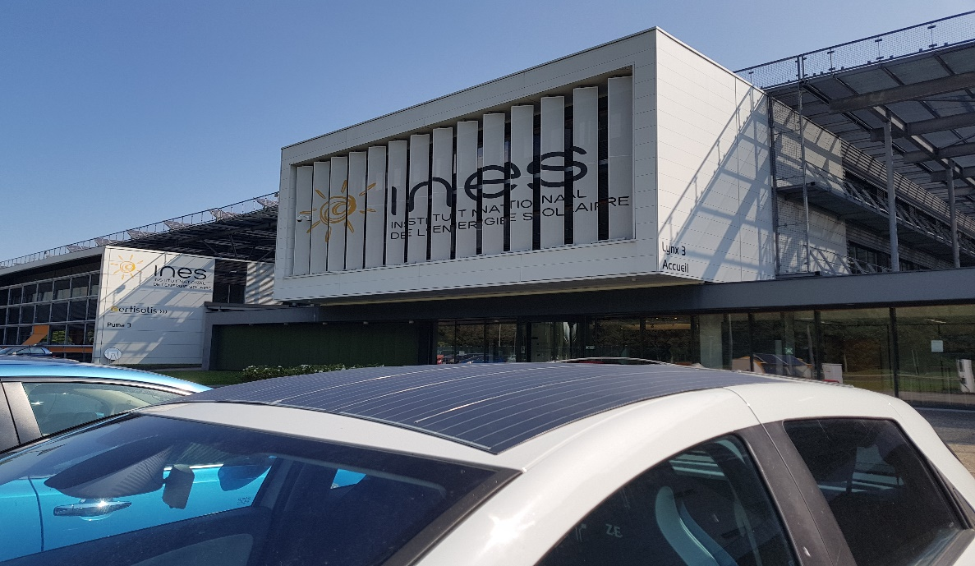
Irradiance and Temperature Uniformity on vehicle roof
Task 17: PV & Transport
Bertrand Chambion, Shehrazade Nassibi, Lionel Serra, Aurélien Raddenzati, Ya-Brigitte Assoa, CEA, France
October 2024

Slide 2
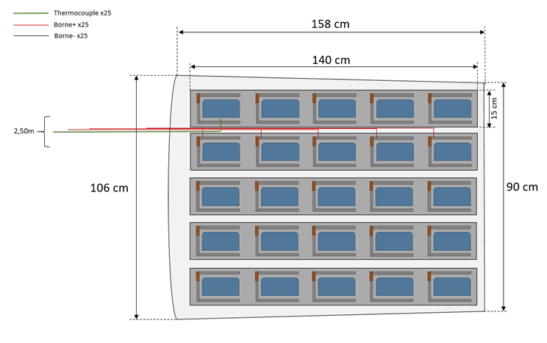
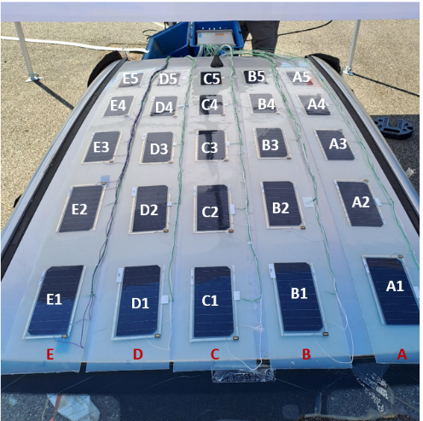
Context, Objectives, Methodology
Context: VIPV Energy prediction model and roof curvature influence on energy collection
Objectives: Characterization of Irradiance and Temperature Uniformity on real roof, and compare with the standard x% loss approach used due to PV surface curvature
Methodology: Specific and curved PV roof, with data monitoring and processing during one week, in Le Bourget du Lac, France
Data monitoring :
Cells temp, Irradiance
South
PV Cells
Specific PV module : 5x5 matrix
5x5 matrix setup on levelled vehicle roof (radius of curvature ~ 3 m)

Slide 3
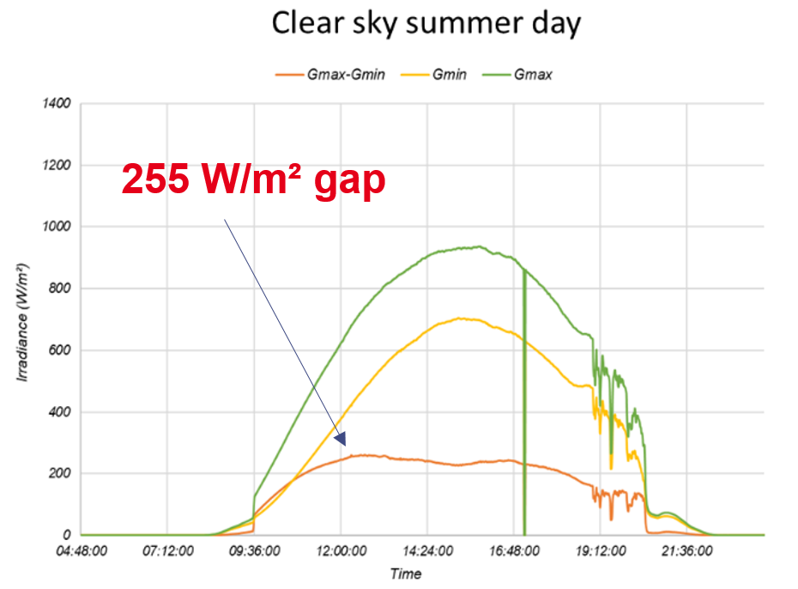
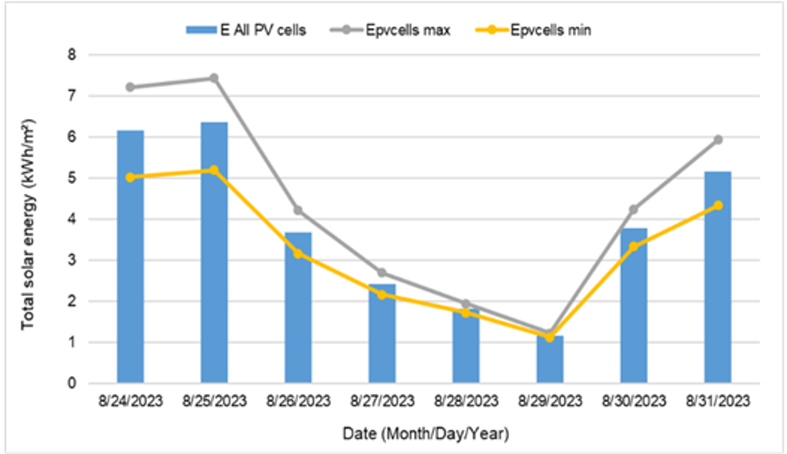
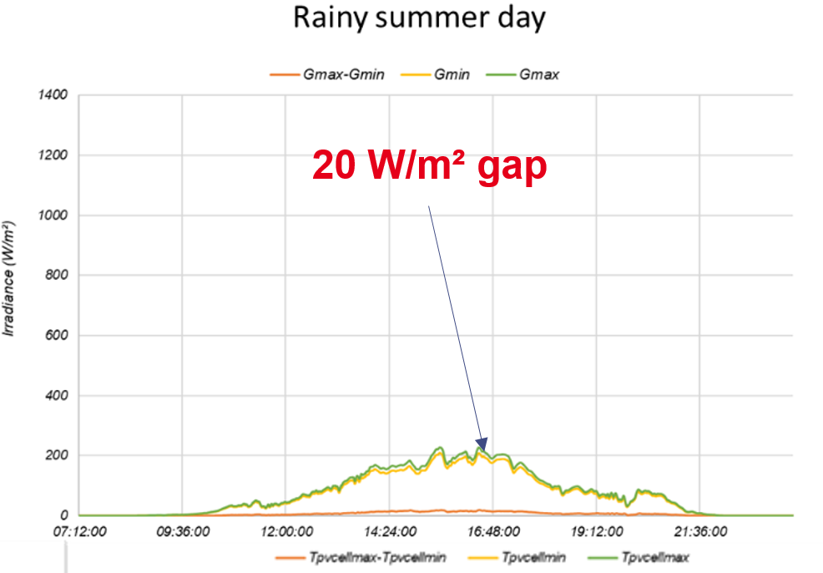
Results
Data collection: Individual cell Irradiance (G) & Temperature (T), every minute
Data processing: Irradiance non-uniformity G_{max}-G_{min} ,Temperature non-uniformity T_{max}-T_{min}
Energy collection projection (hypothesis : all cells in serial connection) : for each day, integration of G_{min} (t) for real curved module to predict PV energy collection
Due to curvature:
Up to 261 W/m² mismatch
Up to 13 °C difference

Slide 4
Key Takeaways
Curved PV roof for VIPV triggers Irradiance and Temperature non-uniformity (respectively up to 261W/m² and 13°C)
In case of cells standard serial connection, it results in 17% (sunny day) and 6% (rainy day) energy loss compared to a flat PV surface
➔ In order to optimize VIPV energy collection :
Increase the number of MPPT channels / PV curved surfaces (cost issues)
Think about flat PV surface to naturally optimize the energy collection (aesthetic issues)

Slide 5
Bertrand Chambion, T17
bertrand.chambion@cea.fr

