Slide 1
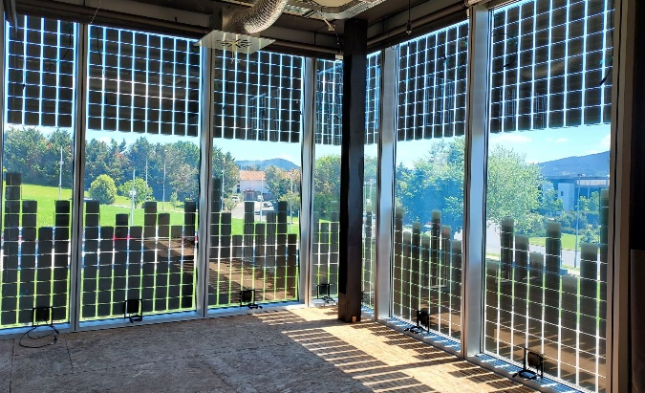
Determination of Solar Heat Gain Coefficient (SHGC) / g value,
taking generated and extracted electricity into account
Hisashi Ishii (LIXIL Corporation, Tokyo Japan)
01/2025

Slide 2
Report overview
Solar Heat Gain Coefficient of BIPV modules for electricity-generating building envelopes
Existing calorimetric and component-based methodologies to determine the Solar Heat Gain Coefficient SHGC of conventional architectural glazing have been successfully modified for application to BIPV modules
Typical features of BIPV glazing units such as electricity generation and optical inhomogeneity are taken into account by these methodologies
The SHGC of a BIPV glazing unit is lower when electricity is generated and extracted; the magnitude of the reduction depends primarily on the PV cell coverage ratio and the thermal resistance of the BIPV glazing unit
Modifications to international standards based on these results have been proposed and are currently in the public enquiry phase

Slide 3
Deliverables
Initial technical issues
Clarified issues
1) SHGC evaluation methodology for
BIPV modules is not clearly specified.
2) There are differences in the test
equipment used by major participating
countries.
3) BIPV modules are often optically inhomogeneous, with transparent and opaque regions.
4) The effect of power generation on the SHGC had not been investigated in an inter-laboratory comparison.
5) A method for predicting the effect of
power generation had not been established.
An inter-laboratory comparison was carried out in preparation of IEC NP 63092-3.
Prospect for use as a reference for IEC 63092-3.
The test equipment was compared and analyzed to clearly identify the differences.
Prospect for use as an Annex for IEC 63092-3.
Linear dependence of SHGC on the PV cell coverage ratio was confirmed.
Prospect for use as a reference for IEC 63092-3.
A clear difference in SHGC between the MPP and open circuit states was confirmed in all laboratories.
Prospect for use as a reference for IEC 63092-3.
Component-based calculation approach is practicable.
Prospect for use in an Annex of revised EN 410.

Slide 4
Hisashi Ishii (LIXIL Corporation, Tokyo Japan)
hisashi.ishii@lixil.com;

