Slide 1
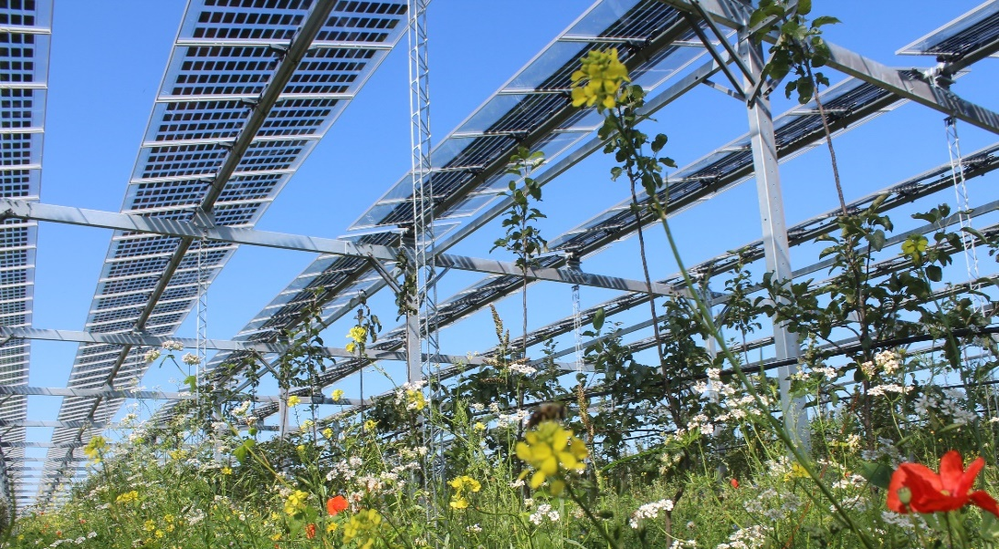
Dual Land Use for Agriculture and Solar Power Production: Overview and Performance of Agrivoltaic Systems
Max Trommsdorff, Fraunhofer ISE; Pietro Elia Campana, Mälardalen University;
Ulrike Jahn, Fraunhofer CSP, Germany; March 2025
Task 13 Reliability and Performance of PV Systems

Slide 2
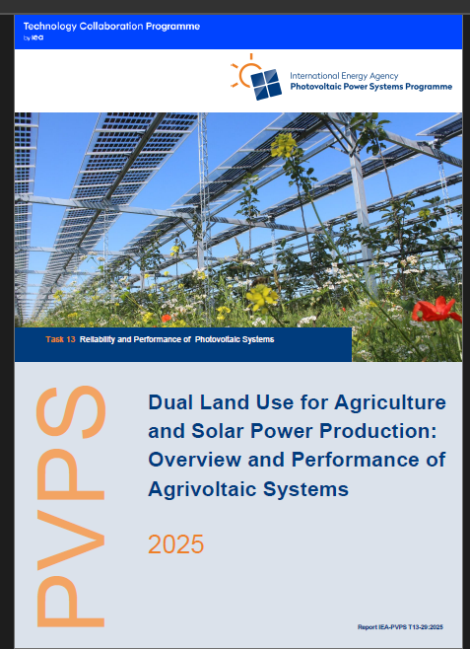
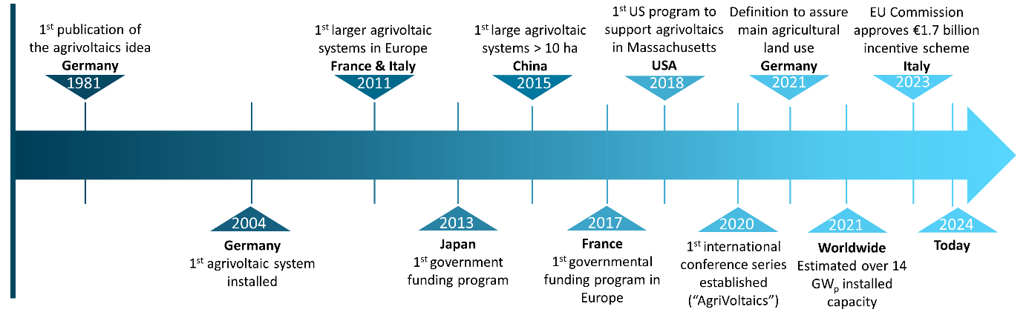
Dual Land Use for Agriculture and Solar Power Production: Overview and Performance of Agrivoltaic Systems
Overview of Agrivoltaics
A dual land use for agriculture and solar power production provides several possible co-benefits.
Dynamic development of the concept in the last years worldwide.
There are different definitions of agrivoltaics highlighting the need for communication efforts between involved stakeholders.
Timeline of agrivoltaics development
Report IEA-PVPS T13-29:2025
© Fraunhofer ISE

Slide 3
Dual Land Use for Agriculture and Solar Power Production: Overview and Performance of Agrivoltaic Systems
Modelling and Simulation
Modelling and simulation represents an important task to reliably predict agricultural and electrical performance and to optimize system design.
In several countries, the prediction of the agricultural yield is crucial for proving that the project meets the respective legal standards for agrivoltaics.
There is still a lack of comprehensive simulation tools that simultaneously analyze PV performance, and microclimatic factors, and their effects on crop yield.
Simplified
workflow for agrivoltaic systems simulation

Slide 4
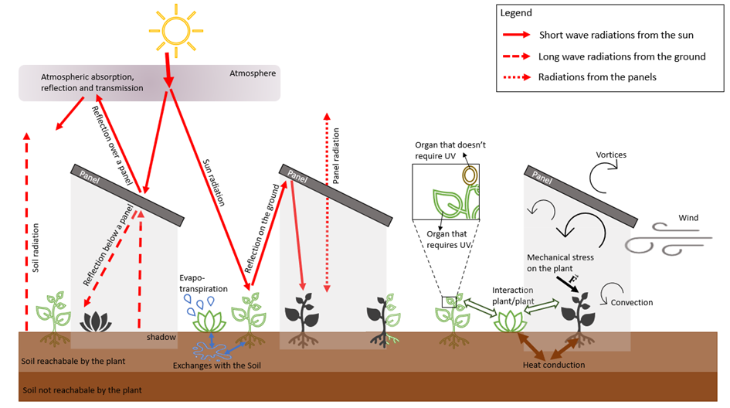
Dual Land Use for Agriculture and Solar Power Production: Overview and Performance of Agrivoltaic Systems
Monitoring and Operation and Maintenance (O&M)
Monitoring microclimatic parameters and the agricultural and PV performance is key to better understand interactions and synergies between the agricultural and PV land use.
Physical interactions within an agrivoltaic system
Main O&M aspects are soiling and increased damages or corrosivity of PV components due to farming activities and plant protection agents.
Due to the few performed R&D works on existing projects and the resulting thin database, many questions remain still open:
Effects of shading on crop properties and qualities
Synergies between crop development and PV performances.
J. Vernier, “A coupling method using CFD, radiative models and a surface model to simulate the micro-climate.,” Master Thesis, Engineering Mechanics, School of Engineering Sciences (SCI)., KTH, 2023. Accessed: October 2024. [Online]. Available: https:// www.diva-portal.org / smash/ record.jsf? pid= diva2%3A1819058& dswid= 7740

Slide 5
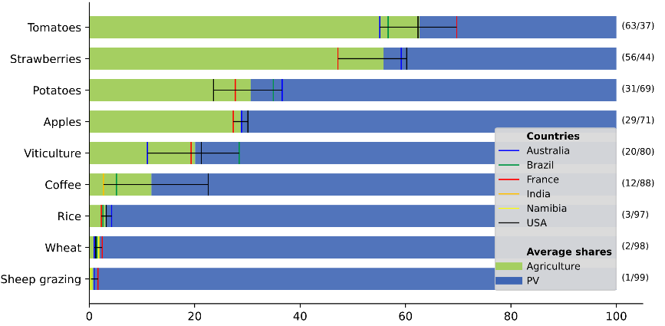
Dual Land Use for Agriculture and Solar Power Production: Overview and Performance of Agrivoltaic Systems
Legal and Socio-Economic Aspects
Relevant identified key drivers for successful project implementation are stakeholder involvement in an early stage, a supportive policy environment and incentive programs, and transparent performance standards.
The increasing importance of societal acceptance underpins the need to address existing limitations, gaps, and future opportunities of socio-economic and legal frameworks in the field of agrivoltaics.
While - compared to PV - revenues of the agricultural activity are neglectable for arable and permanent grassland farming, applications in horticulture and cash crops make up a relevant share of the overall cashflows.
Revenue shares of agriculture and PV production. Coloured lines indicate variations for the considered countries.
Source: Trommsdorff et al. (2024): Economic performance of agrivoltaic systems: A comprehensive analysis. In: Agrivoltaics: Technical, ecological, commercial and legal aspects. Institution of Engineering and Technology, United Kingdom. ISBN 9781839537974. Book DOI: 10.1049/PBPO245E, Chapter DOI: 10.1049/PBPO245E, ISBN: 9781839537974

