Slide 1
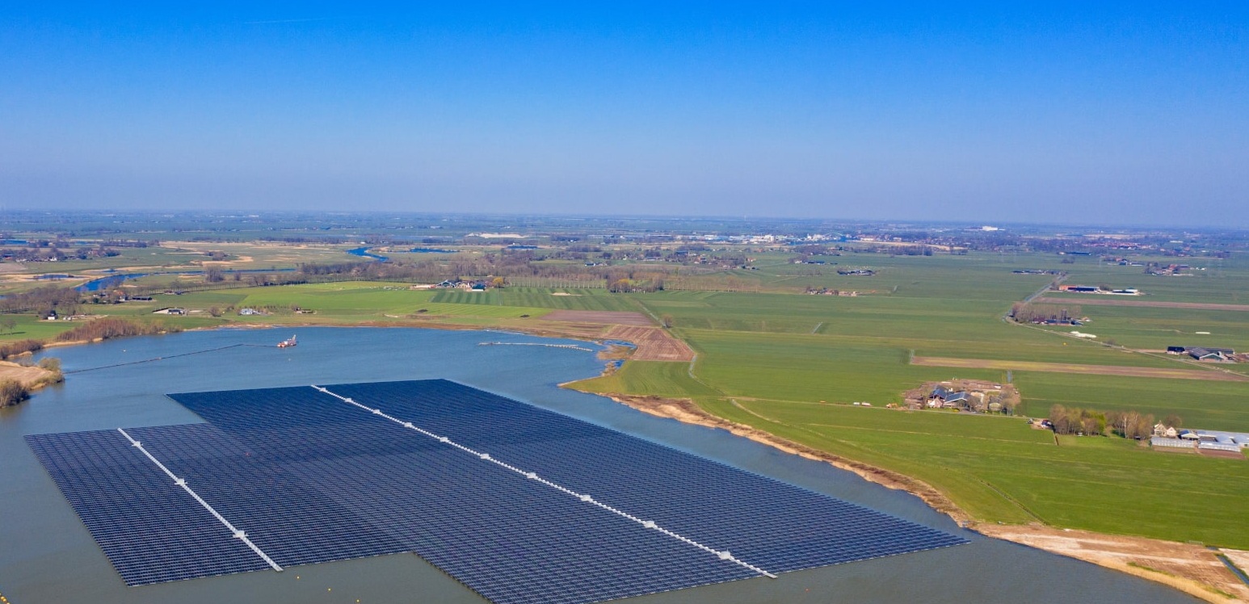
Floating Photovoltaic Power Plants: A Review of Energy Yield, Reliability, and Maintenance
Josefine Selj, IFE; Ulrike Jahn, Fraunhofer CSP; Maugeri Giosuè, RSE
Report IEA-PVPS T13-31:2025, April 2025
Task 13 Reliability and Performance of PV Systems

Slide 2
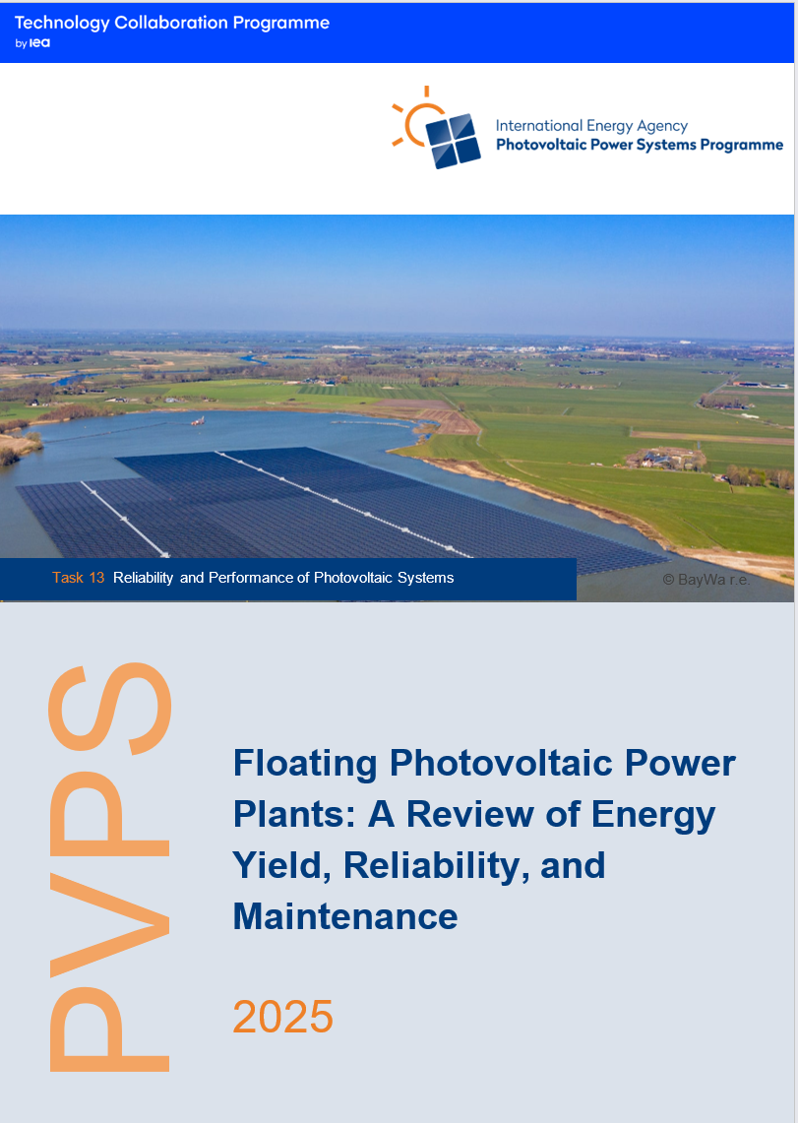
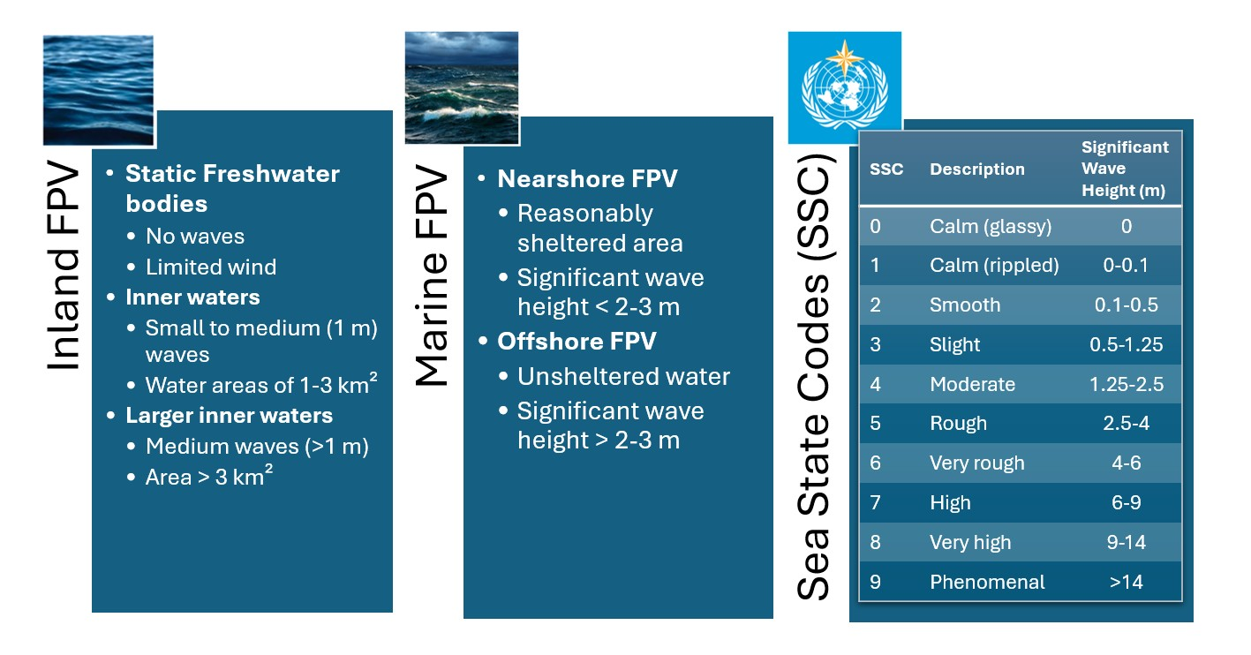
FPV Power Plants: A Review of Energy Yield, Reliability, and Maintenance
Introduction to FPV
Providing recent market- and technology trends
Report IEA-PVPS T13-31:2025

Slide 3
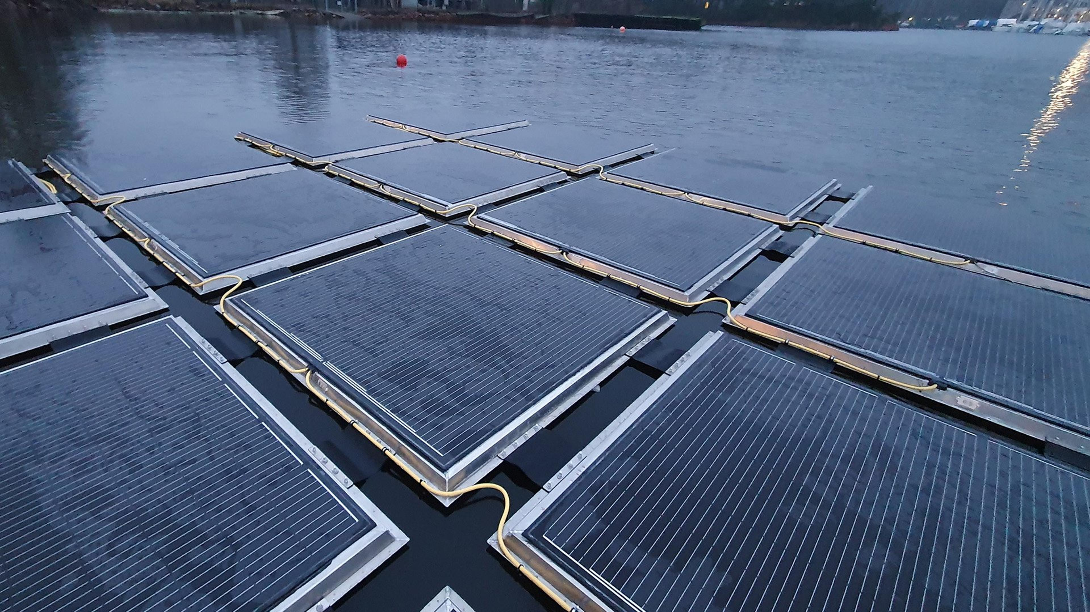
FPV Power Plants: A Review of Energy Yield, Reliability, and Maintenance
How we contribute on the topic of FPV Performance
Summary of existing values for FPV specific losses
Clear statements of knowledge gaps
Technology specific values provided whenever possible supporting more precise engineering judgements in Energy Yield Assessment (EYA)
How we contribute on the topic of FPV Reliability
Review and systemize the information that do exist on FPV reliability
Highlight work to map the climatic stressors - a precondition for the creation of meaningful service life prediction or degradation data
How we contribute on the topic of FPV O&M
Review of FPV specific O&M actions
Practical and concrete ("actionable") information
Failure Modes and Effects Analysis – valuable tool to harvest from previous experience
Challenges or innovation opportunities within the field of O&M for FPV
Report IEA-PVPS T13-31:2025
Photo credit: Sunlit Sea

Slide 4
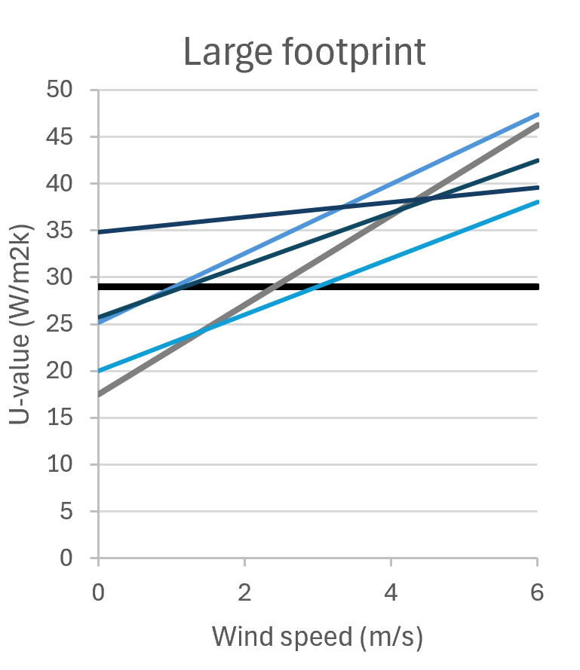
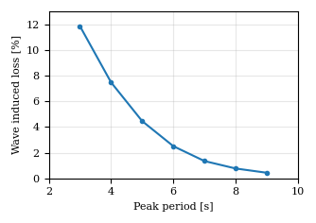
FPV Power Plants: A Review of Energy Yield, Reliability, and Maintenance
Highlight 1 - Support for more precise engineering judgments
When estimating thermal -, wave-induced – and soiling losses, one should consider the impact of these factors:
Wave-induced losses
Number of modules per float
Float interaction with waves
Height and steepness of waves
Latitude and POA vs optimal angle
Soiling losses
Depending on site conditions and cleaning. Very little has been published on soiling levels for FPV.
Thermal losses
Air flow beneath PV modules
Wind conditions at site
-

Slide 5
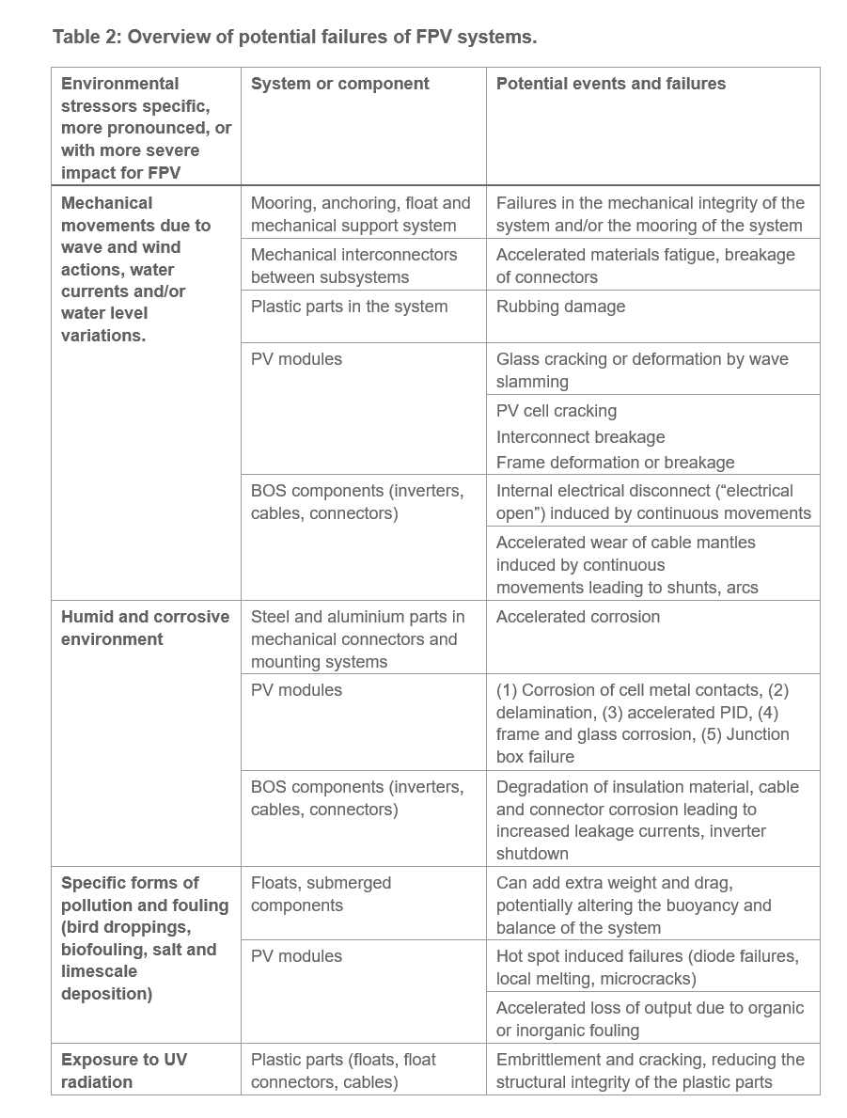
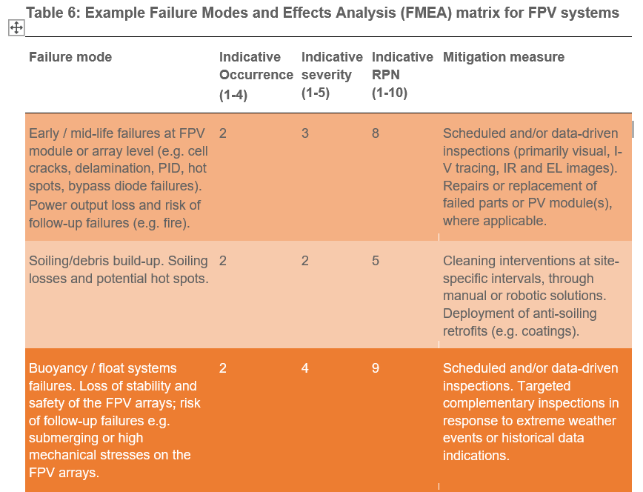
Highlight 2 - Overview of Potential Failures
FPV Power Plants: A Review of Energy Yield, Reliability, and Maintenance
Highlight 3 – Preliminary Failure Modes and Effects Analysis
A sample of the FMEA table, full table is given in the report
Report IEA-PVPS T13-31:2025

