Slide 1
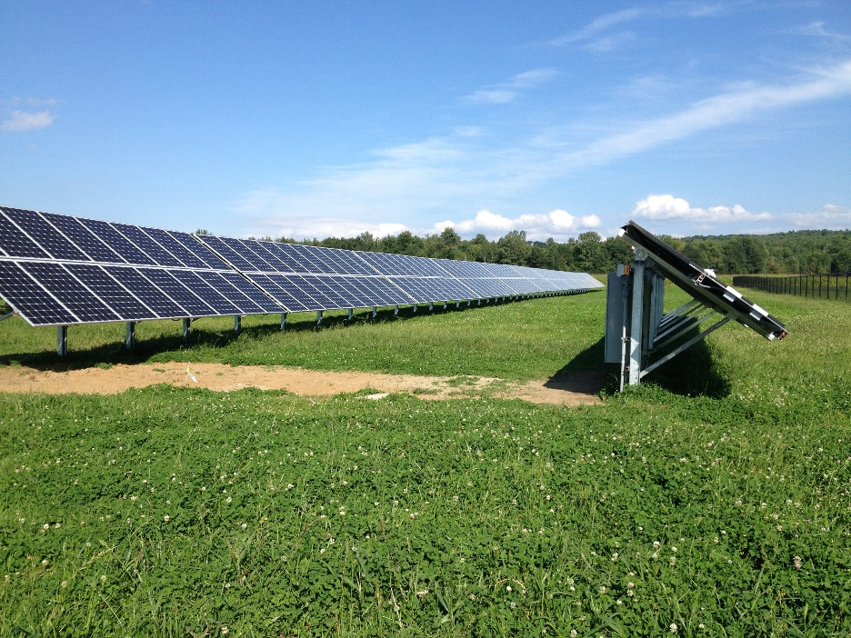
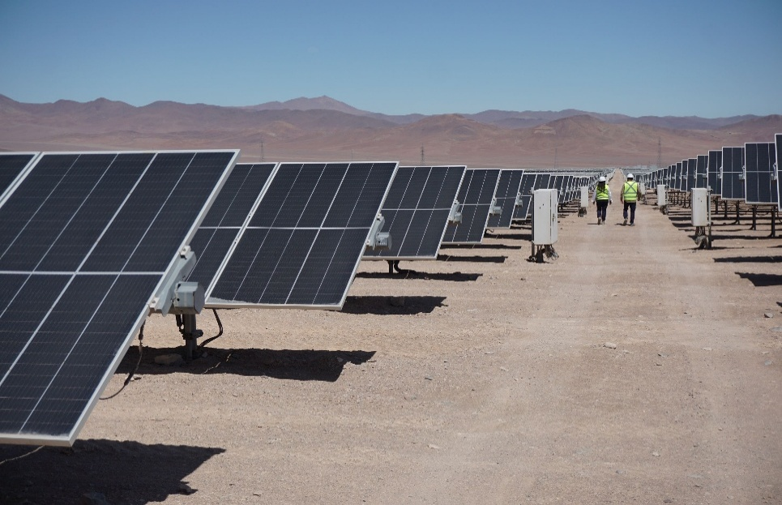
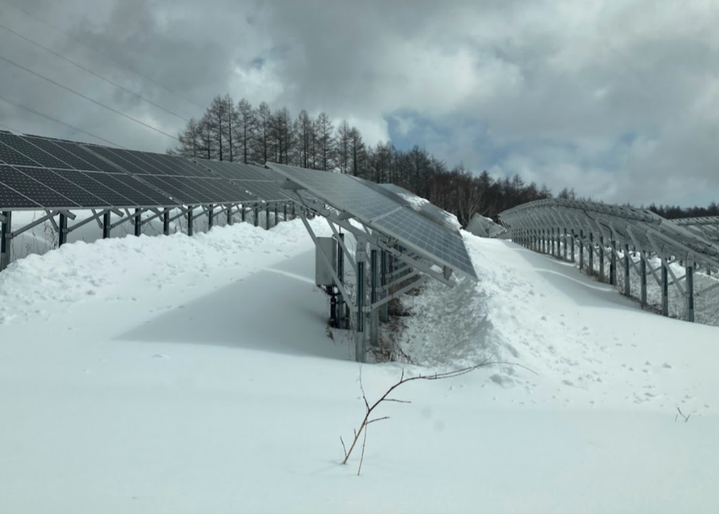
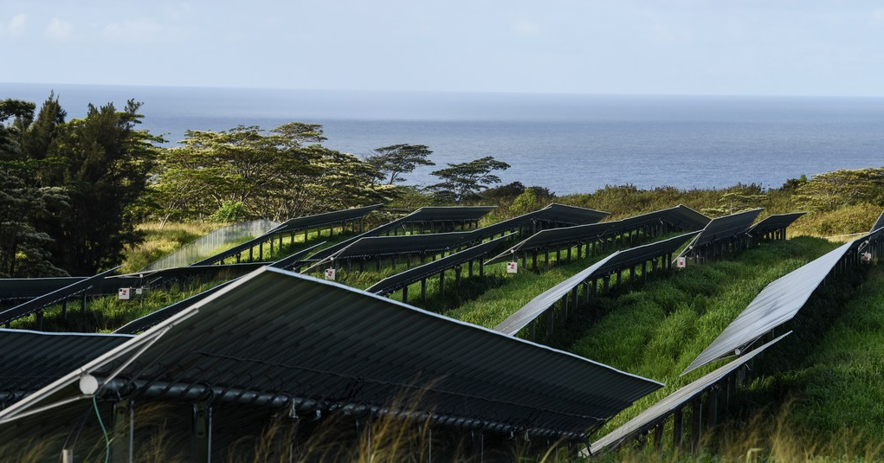
Optimisation of Photovoltaic Systems for Different Climates
Gabi Friesen, SUPSI, CHE & Leonardo Micheli, Sapienza University, Italy; Ulrike Jahn, Fraunhofer CSP, Germany, June 2025
Task 13 Reliability and Performance of PV Systems

Slide 2
Optimisation of Photovoltaic Systems for Different Climates
Introduction
The rapid global expansion of photovoltaic (PV) capacity, together with the urgent need to address climate change and reduce dependence on fossil fuels has led to an increased interest in the deployment of PV in regions before not considered because of their harsh environments.
The growth of PV in extreme climates, such as deserts, snow-rich and tropical regions, is mainly driven by cost reductions in PV modules and the introduction of new PV technologies like bifacial modules.
Some examples of governmental-driven PV deployments in extreme environments are Chile, Alaska, and the Swiss Alps.
The report explores strategies for enhancing the performance of PV systems in 'Cold & Snowy', 'Hot & Dry', and 'Hot & Humid’ climates.
Report IEA-PVPS T13-32:2025, June 2025
Notes:
Add new cover image!

Slide 3
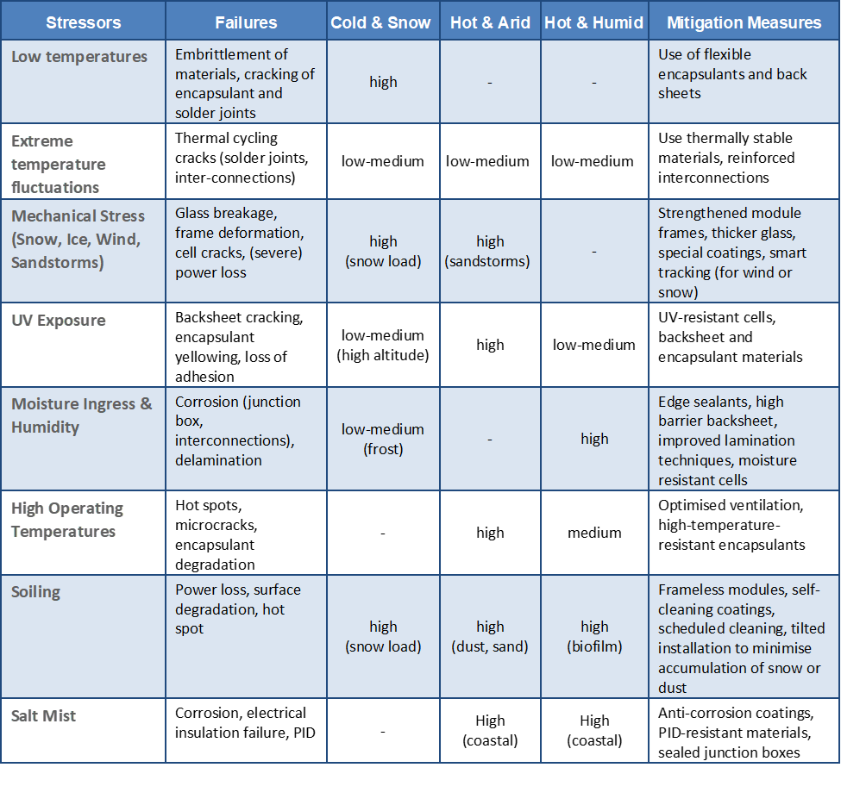
Optimisation of Photovoltaic Systems for Different Climates
The Report aims to…
Climate specific stressors, failures and mitigation measures
raise awareness about the risks associated with specific stressors,
highlight how developing climate-specific strategies is essential to enhance the reliability and cost-effectiveness of PV systems worldwide,
and show how innovation in module design, adaptation of bill of materials, and system configurations can support the further deployment of PV systems in harsher climates.
Report IEA-PVPS T13-32:2025, June 2025

Slide 4
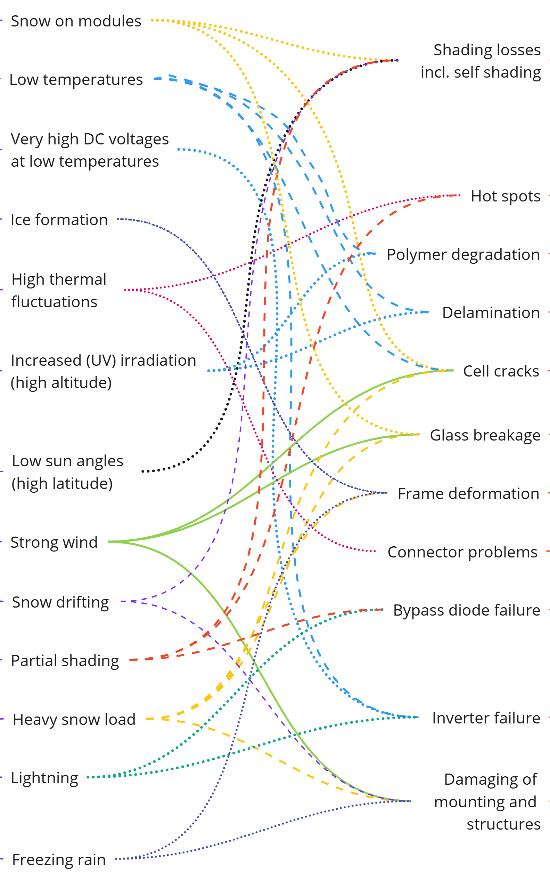
Optimisation of Photovoltaic Systems for Different Climates
The Report identifies key stressors in three different climates and provides recommendations to address them.
Cold & Snowy
Climate
Site Assessment
Assess local snow, wind, UV, fog, and terrain conditions.
Optimisation of module design and BOM
Use designs that facilitate snow shedding (e.g., frameless, glass/glass…).
System Design
Use steep tilt and high clearance for snow shedding
Evaluate risks like avalanches, ice, frost, and site accessibility.
Consider components & designs less prone to high-UV, snow and/or cold induced stress (e.g., multi wire/busbar modules, thicker joints).
Choose structures adapted to frost heave; consider snow fences.
Report IEA-PVPS T13-32:2025, June 2025

Slide 5
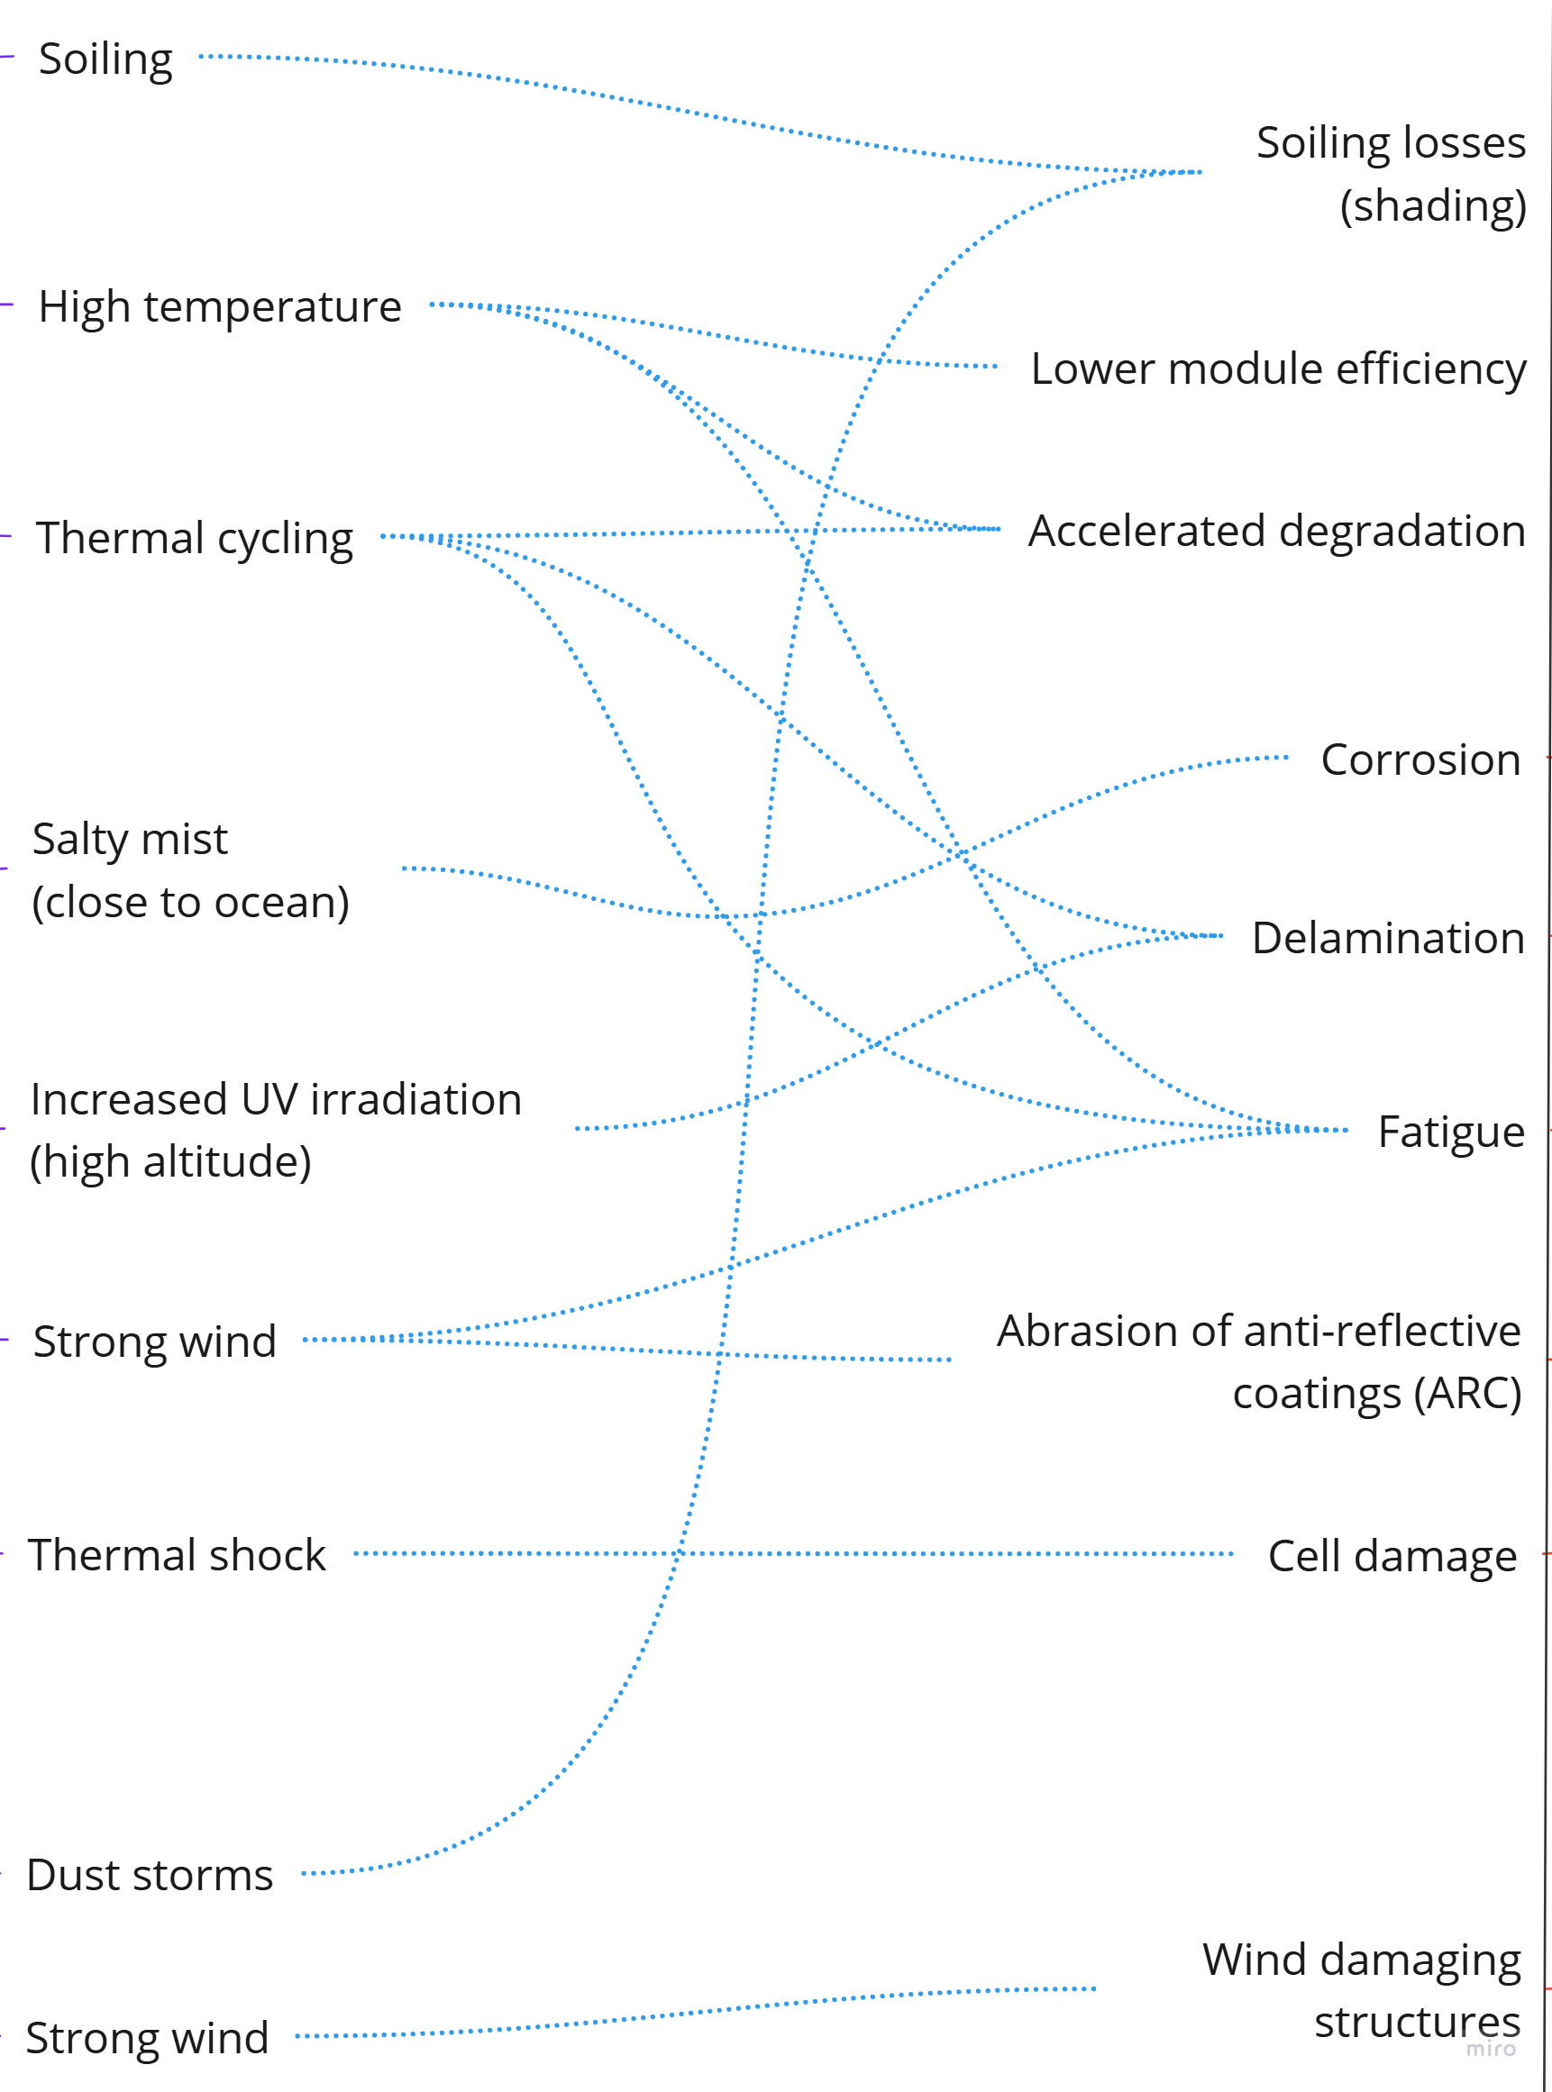
Optimisation of Photovoltaic Systems for Different Climates
The Report identifies key stressors in three different climates and provides recommendations to address them.
Hot & Arid
Climate
Site Assessment
Assess soiling, temperature, wind, and soil properties early.
Optimisation of module design and BOM
Use heat/UV-resistant modules with low temperature coefficients.
System Design
Choose cleaning model (own vs. service) & design layout for easy cleaning.
Prefer POE/TPO over EVA to avoid corrosion.
Test components under desert-specific stress conditions.
Adapt system design to local wind conditions and soil corrosion.
Report IEA-PVPS T13-32:2025, June 2025

Slide 6
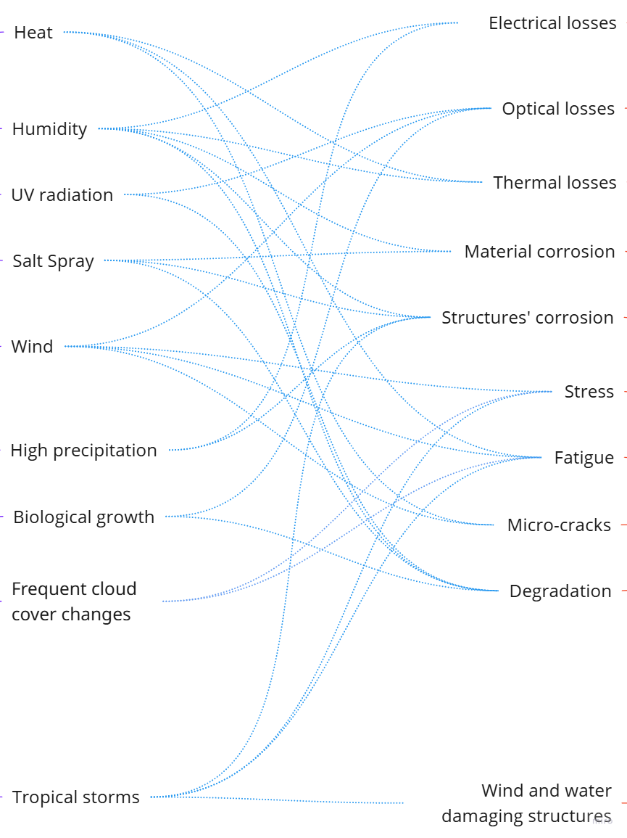
Optimisation of Photovoltaic Systems for Different Climates
The Report identifies key stressors in three different climates and provides recommendations to address them.
Hot & Humid
Climate
Site Assessment
Assess cloud cover, aerosols, and pollution data.
Optimisation of module design and BOM
Use low temperature coefficient and humidity-resistant cells.
System Design
Consider non-optimal tilt angles to facilitate self-cleaning.
Evaluate temperature and humidity cycles.
Consider anti-soiling coatings, self-cleaning glass, and impact-resistant frames.
Select UV- and moisture-resistant materials and connectors.
Report IEA-PVPS T13-32:2025, June 2025

Slide 7
Optimisation of Photovoltaic Systems for Different Climates
Key Takeaways
In cases of limited knowledge about site-specific requirements and/or unavailability of climate-specific PV modules, standard products are often deployed. Furthermore, the push for cheaper modules has driven the trend toward larger PV modules with thinner glass, cheaper encapsulants and backsheets, and reduced frame thickness, which are nowadays increasing the degradation and failure rates in harsh environments.
Reinforced front glass, improved frame geometries, micro-crack-resistant interconnections, and advanced encapsulants like POE or silicone enhance durability in harsh conditions. Special coatings for soiling, heat, snow, or corrosion are being explored but further studies are needed to confirm their longevity and cost-effectiveness.
Very often, mitigation measures aimed at addressing one issue can inadvertently exacerbate another, making it essential to conduct thorough testing or gain a deeper understanding of actual load conditions to identify the most effective solution.
Experience with climate-optimised PV modules is still limited, requiring more field data and lessons learned to be exchanged within the PV community.
Report IEA-PVPS T13-32:2025, June 2025

