Slide 1
Status of PV Module Recycling in IEA PVPS Task 12 Countries
K. Komoto, C. Agraffeil, C. Alonso-Garcia, D. Costa, T. Curtis, A. Danelli, R. Deng, N. Defrenne, K. Drozdiak, B. Ebin, N. Espinosa, A. Gassner, G. Heath, M. Held, J.-S. Lee, C. Libby, F. Lyu, H. Mirletz, M. Penn, Y. Shen, L. Smith, M. Stucki, M. Tammaro, M. Theelen, M. R. Vogt,
C. Wessendorf, R. Woods-Robinson

Slide 2
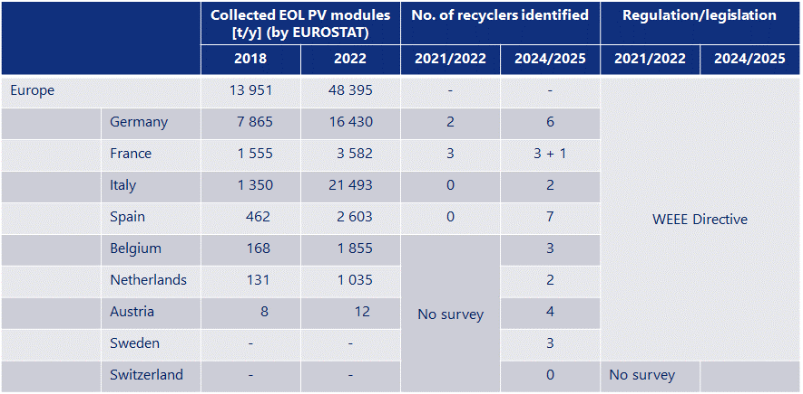
Status of PV module recycling in IEA PVPS Task12 countries
    The amount of PV module waste is increasing, relevant regulations have become or are likely to become effective in other regions, and new facilities and equipment for PV module recycling—mainly for delamination—are being operated.

Slide 3
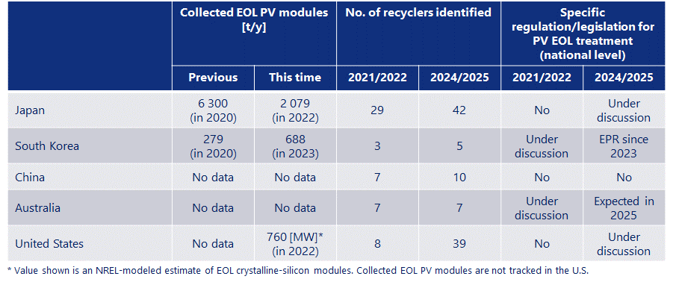
Status of PV module recycling in IEA PVPS Task12 countries
    A few years ago (2020/2021), although the WEEE Directive in Europe has come into force in the market since the 2010s, specific regulations for PV were not yet introduced in other countries. Since then, in South Korea, a PV EPR regulation has been enforced starting in 2023, and relevant political deliberations are being implemented in Japan, Australia, and the United States.

Slide 4
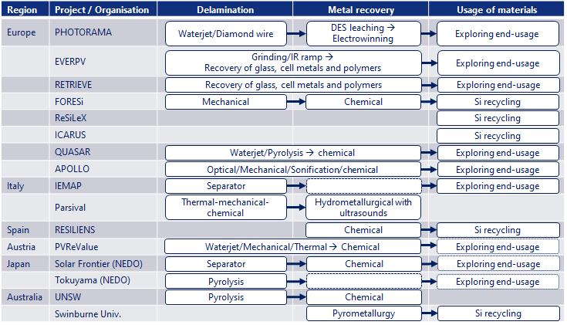
Status of PV module recycling in IEA PVPS Task12 countries
    Technology R&D for PV module recycling
    Over the past decade, recovery of high-weight components like glass at lower costs was the focus of technical innovations. Now, recovery of low-weight valuable materials for increasing recovery and recycling rates is focused, and improving the quality of recovered materials to improve their secondary use is an issue to be addressed.
    Treatment steps for high value recycling and circulating materials are
      : delamination,
      : metal recovery, and
      : preparation of materials for markets.
    Novel delamination approaches include
      : diamond wire,
      : water jet, and
      : infrared lamps.
    Advanced chemical approaches for metal include environmentally friendly solvents that can replace acids.

Slide 5
Status of PV module recycling in IEA PVPS Task12 countries
    Conclusions
    The EU has adopted the WEEE Directive for PV waste. In other parts of the world, legislative and regulatory frameworks for PV module waste are installed or in preparation. Regardless of whether there are PV-specific waste regulations, many companies are treating PV module waste for proper EOL management and recycling, and the number has increased since the last time IEA PVPS Task 12 surveyed three years ago.
    The current low volumes, limited recycling technologies, logistics challenges, and underdeveloped markets for recovered materials result in a high-cost, low-revenue scenario for PV module recycling today. Further improvement in the PV recycling capacity and technology is needed to meet future increased demand and to realize the goal of high-value, low-cost recycling. To improve economic aspects of PV module recycling, considering values of recovered materials such as critical minerals would be also necessary.
    PV module recycling technology is expanding from delamination to metal recovery as well as exploring more valuable markets for recovered materials. Enabling the use of recovered materials in new PV cells/modules and other high-value markets are ultimate targets, whereas impurities and additives remain issues to be solved. Recycled materials from PV module waste could play a significant role in material supply for PV module production and other industries.
Added this sentence based on ExCo comments.

Slide 6
Garvin Heath (Task Manager) : Garvin.Heath@nrel.gov
Etienne Drahi(Deputy Task Manager) : etienne.drahi@totalenergies.com
Keiichi Komoto : keiichi.komoto@mizuho-rt.co.jp

