Slide 1
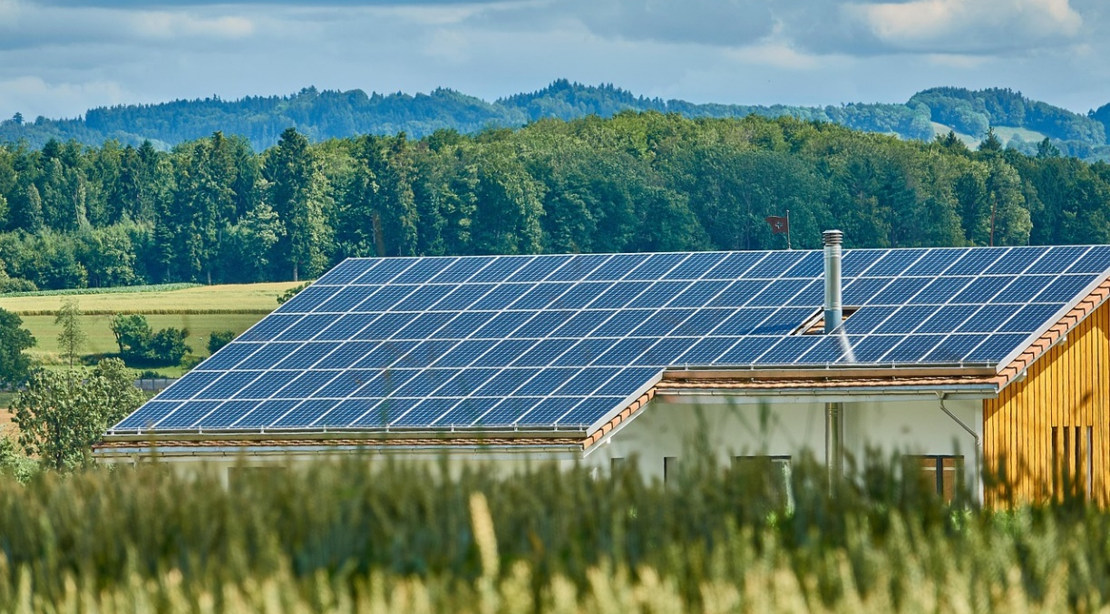
Review of PV Sustainability Standards
Task 12: Sustainability of Photovoltaic Systems
August 2025

Slide 2
Comprehensive Analysis of Sustainability Standards in the PV Sector
Goal & scope
  Holistic Review of sustainability standards across the entire PV value chain, highlighting gaps, overlaps, and the maturity of different standards.
  Provide actionable insights and recommendations for industry stakeholders, policymakers, and researchers to better align the PV sector with global sustainability goals.
35 frameworks analyzed
  Sectoral Reporting and Disclosure: Industrial reporting obligations, environmental performance declarations.
  Product-Related Standards: Standards for production, processes, and services.
  Regulatory Frameworks: Mandatory, voluntary, and waste-related standards
  Methods:
  Evaluative frameworks employed
    OECD 6 Criteria: Relevance, Effectiveness, Efficiency, Impact, Sustainability, Coherence.
    2DII Initiative: Focus on environmental performance and greenhouse gas reduction.
  Mapping the connections of standards with SDGs

Slide 3
Corporate responsibility – Environmental & Social Governance
Solar Energy Sustainability Accounting Standard (SASB)
Global Reporting Initiative (GRI)
Carbon Disclosure Project (CDP)
Valuation of Energy Related Investments (VALERI) standard
Responsible Business Alliance (RBA)
Climate risks- financial disclosure
Renewable electricity criteria RE100 Criteria
Social responsibility
Standards and Frameworks
Sectoral reporting standards
Corporate responsibility – Environmental, Social, and Governance
Environmental performance declarations
Other industry benchmarks & best practices
Environmental performance declarations
Product category rules (PCRs)
Sustainable Finance Taxonomy
Product Standards
Quality assurance standards
NSF 457 solar ecolabel
Cradle to Cradle standard
Horizontal standards series 4555x
IECRE / TEXXECURE rating scheme
Reemployment / reuse standard for PV modules
Standards on PV modules recycling
Blue Angel standard on PV inverters
Other industry benchmarks and best practices
Carbon accounting ISO 14060 family standards PAS 2050 GHG Protocol ISO 14040 family Product Environmental Footprint (PEF) BP X30-323-0(AFNOR) EN 15804:2012+A2:2019/AC:2021
Solar Bankability TÜV SÜD Intertek PV ModuleTech Organization
Business & Human Rights
Silicon Valley Toxics Coalition scorecard
Solar Power Europe Sustainability Best Practices Report
….
…
Mandatory tools
…
…
Regulatory frameworks
Mandatory tools
Voluntary tools
Waste-related frameworks
Voluntary tools
…
…
Waste frameworks
…
…

Slide 4
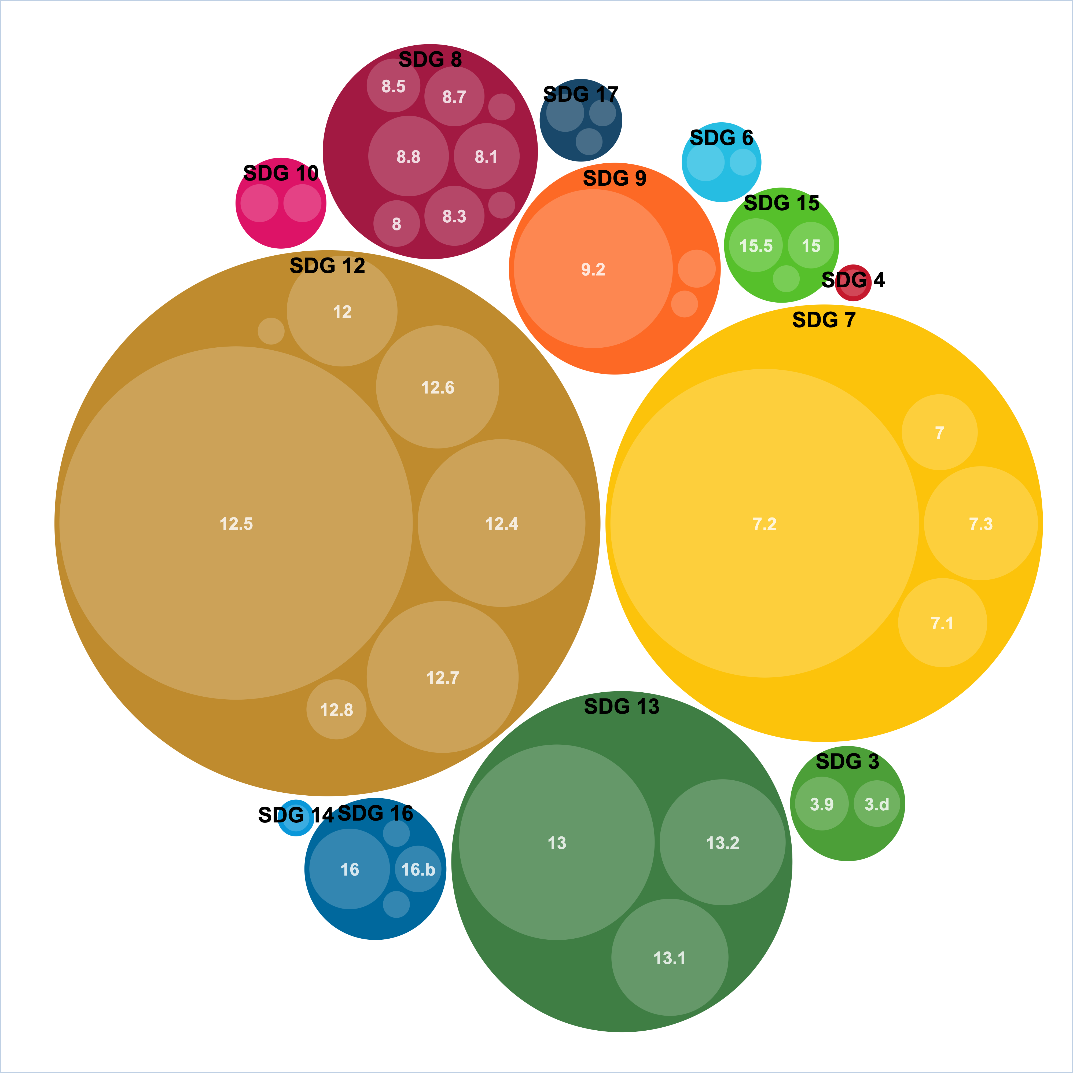
Main Findings and Conclusions
Findings
Gaps & Inefficiencies: Significant gaps exist, especially in end-of-life management, alongside both helpful and burdensome overlaps in reporting requirements.
  Streamlining overlaps could enhance efficiency without sacrificing comprehensiveness.
Uneven Maturity: Standards range from robust regulations like EU Ecodesign to emerging ecolabels, reflecting the sector's evolving approach to sustainability.
Lag Behind Other Sectors: Compared to automotive or electronics, PV life cycle standards are less mature and still developing.
Conclusion
This first-of-its-kind report is a resource for industry, policymakers, and researchers, providing a structured overview of sustainability standards in the PV sector, setting the stage for future research and development harmonizing and advancing sustainability standards within the PV industry.
Bubble chart of SDGs and targets detected in PV sustainability standards. The SDG Mapper tool (from European Commission) identifies SDG 12 (Responsible Consumption & Production) as the most frequently referenced goal in this report, representing 43% of linkages. This highlights the sector’s focus on resource efficiency, waste reduction, and circularity. SDG 7 (Affordable & Clean Energy) and SDG 13 (Climate Action) follow, reflecting PV’s role in clean energy and climate mitigation.

Slide 5
N. Espinosa, P. Sinha, K. Drozdiak, A. Wade, Task 12
nieves.espinosa@um.es

