Slide 1
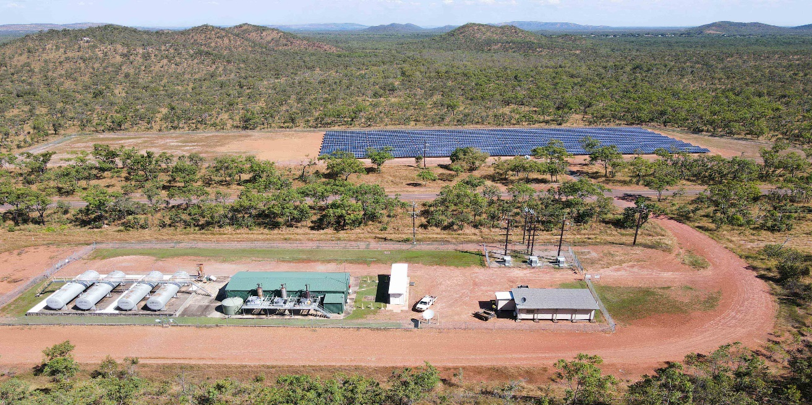
INSERT A PICTURE THIS SIZE
Lithium-Ion Battery Systems in PV off-grid Applications
Task 18: Off-Grid and Edge-of-Grid Photovoltaic Systems
February 2025

Slide 2
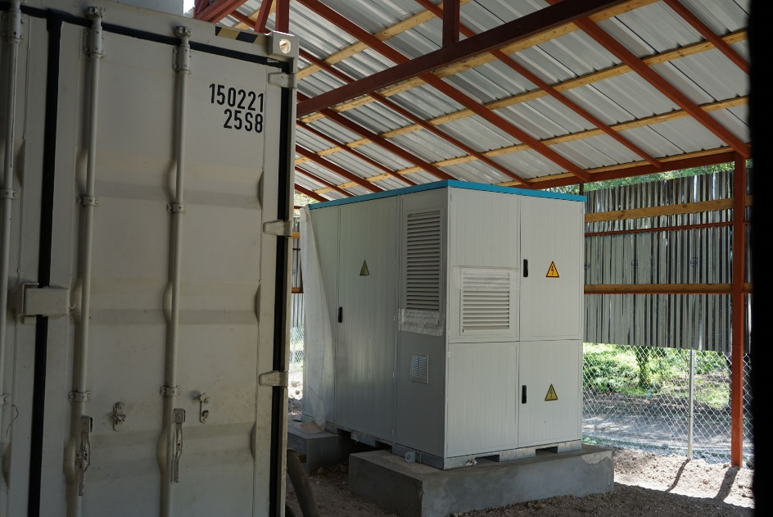
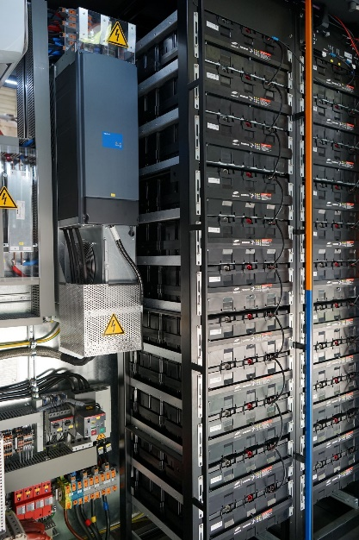
Case Study Haiti
The system supplies a hospital in Dechapelles, Haiti with 24/7 reliable power supply.
PV is the main electricity source supported by diesel backup
Two Containers based on LFP cells
Clinic average load : 130kW
PV : 440kWp, Genset : 3 * 440kVA
Lithium-Ion storage : 224kWh + 332kWh

Slide 3
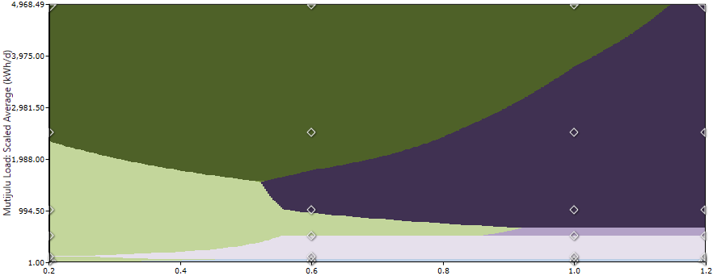
Li-Ion vs. Lead-acid battery simulations
Small systems can be cost effective with lead-acid batteries
System above 1MWh can only be done with Lithium-Ion batteries
Currently both technologies can be applied in a certain area
Green : Lithium-Ion, Purple : Lead-acid batteries
X-Axis : Relative costs of Lithium-Ion systems
Y-Axis : Scaled load size

Slide 4
Success Factors
Lithium-Ion systems can operate with high performance and be cost effective in PV off-grid systems. To ensure a sustainable operation:
The system needs to be sized carefully according to the local conditions
The Lithium-Ion battery storage must contain a professional and reliable Battery Management System
Maintenance and Operation need to be performed in serveral levels:
By Local staff who are permanently available
Through data transmission and system supervision by the manufactuerer

Slide 5
Michael Müller, Task18
mm@ofres.org

