Slide 1
Operational and Economic Impacts of Extreme Weather on Photovoltaic Power Plants
Laurie Burnham, SNL, USA & Tadanori Tanahashi, AIST, Japan;
Ulrike Jahn, Fraunhofer CSP, Germany, December 2025
Task 13 Reliability and Performance of PV Systems

Slide 2
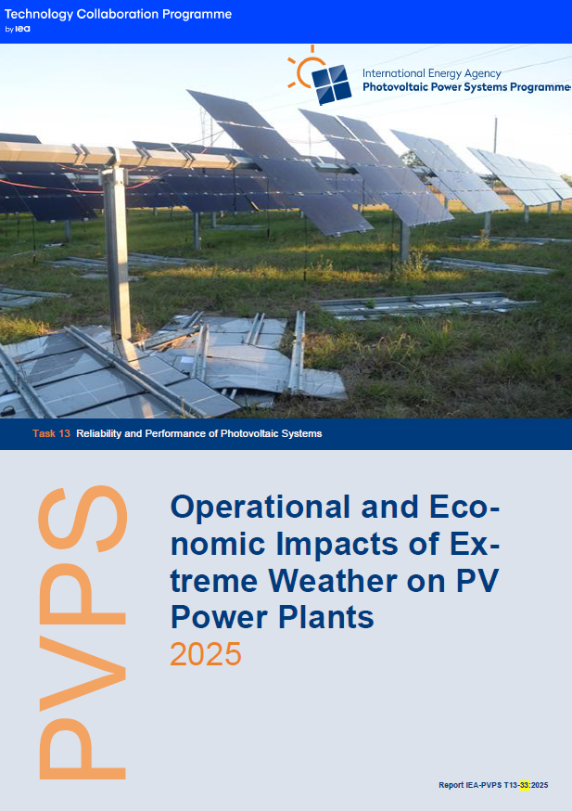
Operational and Economic Impacts of Extreme Weather on PV Plants
Background
Extreme weather is defined by economic impact, recurrence probability, intensity compared to historical data, and deviation from the mean.
Key performance indicators (KPIs) include resource availability, energy losses, mitigation and O&M costs, and indirect economic impacts related to litigation and insurance premiums.
Damages from extreme weather events include physical destruction, component exposure and accelerated module degradation; associated economic losses range from restoration costs to lost generation to higher insurance rates.
Despite numerous case studies, comprehensive assessments of cumulative impacts and mitigation strategies are lacking; this report is a first step toward bringing a global perspective to the topic.
Report IEA-PVPS T13-33:2025, December 2025

Slide 3
Operational and Economic Impacts of Extreme Weather on PV Plants
Overview:
This report reviews seven categories of extreme weather: tropical cyclones, convective storms, snowstorms, dust storms, heat waves, floods, and wildfires.
The objective is to disseminate information needed to support more resilient PV systems that are designed to withstand extreme weather threats.
Both acute (lost energy generation and physical damage) and chronic (accelerated degradation of components and systems) impacts are examined for each storm category.
Mitigation strategies are detailed—including both predictive and corrective maintenance strategies—and reflect common resilience principles that apply across different types of extreme weather.
Report IEA-PVPS T13-33:2025, December 2025

Slide 4
Operational and Economic Impacts of Extreme Weather on PV Plants
Key Takeaways (1)
Extreme weather events exhibit distinctive characteristics (summarized in Table 5) and fall into two categories: 1) those that are short-term in duration and occur sporadically, e.g., tropical cyclones, convective storms, and floods; and 2) those that are of longer duration and tend to be repetitive, e.g., snow, dust storms, heatwaves, and wildfires. Risk assessment for PV plants in the first category is critical; design optimization is the priority for PV plants in the second category.
Table 5: General Aspects of Extreme Weather Events
Weather Event | Duration (annually) |  | Predictability Window
Tropical Cyclones |  | 1 – 2 days | ‡ |  |  |  | 2 – 3 days in advance
Hailstorms |  | 1 – 2 days | ‡ |  |  |  | < 24 hours in advance
Snowfalls |  | 3 – 6 months (multiple distinct events) | ‡ |  |  |  | (heavy case) several days in advance
Dust Sandstorms |  | several days – 1 month | ‡ |  |  |  | ≤ 5 days in advance
Heat Waves |  | 1 – 6 months (multiple distinct events) | ‡ |  |  |  | ~7-10 days in advance
Floods |  | several days | ‡ |  |  |  | 1 day in advance
Wildfires |  | 1 day – several months | ‡ |  |  |  | ≤ 5 days in advance
Double dagger marks (‡) in the Predictability Window column denote events that can be forecasted within the specified time frame. Note: AI may increase these time frames.
Report IEA-PVPS T13-33:2025, December 2025

Slide 5
Operational and Economic Impacts of Extreme Weather on PV Plants
Key Takeaways (2)
From a resilience and mitigation standpoint, strategic site planning is essential. At a minimum, a detailed review of historical weather data and future projections of extreme weather events for each location is required.
After assessing the threat probability, developers and asset owners must make informed design and procurement choices, considering site terrain, geological conditions and available component and system technologies, including module ratings and other certified specifications.
Report IEA-PVPS T13-33:2025, December 2025

Slide 6
Operational and Economic Impacts of Extreme Weather on PV Plants
Key Takeaways (3)
Resilience in the face of extreme weather is possible if PV plants:
1. Are appropriately sited and designed; and
2. Operated according to robust operation and maintenance (O&M) protocols, incl.:
Proactive maintenance ahead of extreme weather events, customized for the type and predictability of each threat. Checking the torque on bolts and fasteners and reviewing stow strategies for tracker systems is a top priority.
Corrective maintenance should start immediately after damage occurs and include the following, in order of priority: secure the site, inspect systems, and replace damaged components before re-energizing.
Report IEA-PVPS T13-33:2025, December 2025

