Slide 1
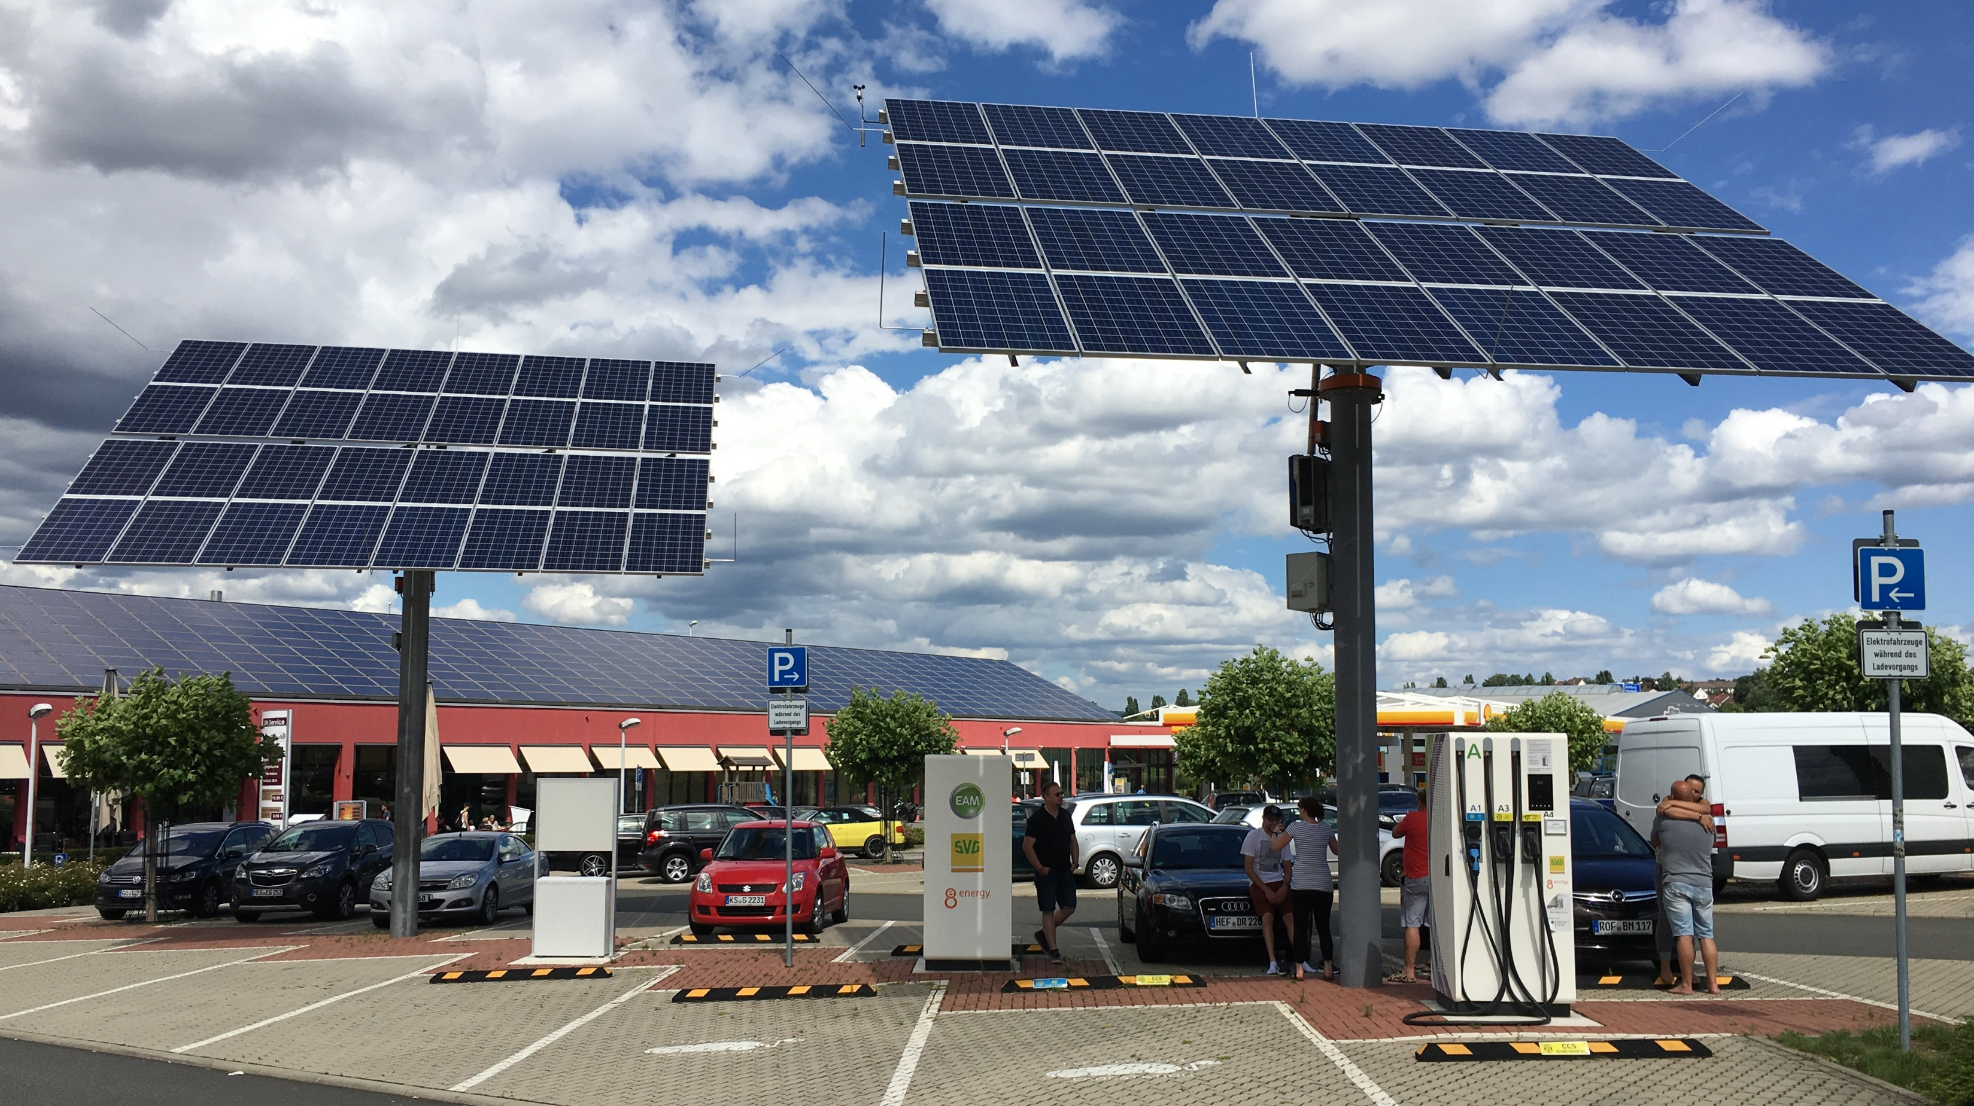
PV Powered Electric Vehicle Charging Stations
Sizing, Optimization and Control
Task 17: PV & Transport, January 2026

Slide 2
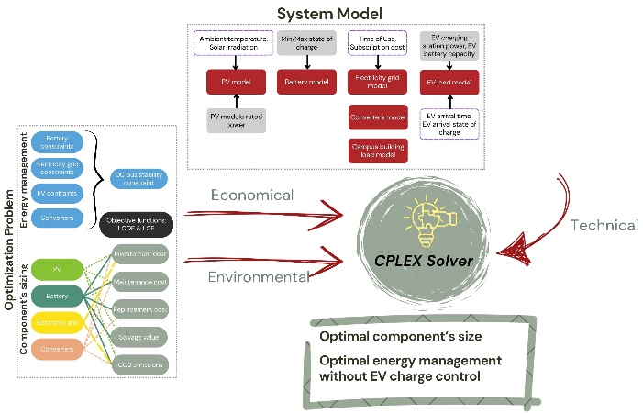
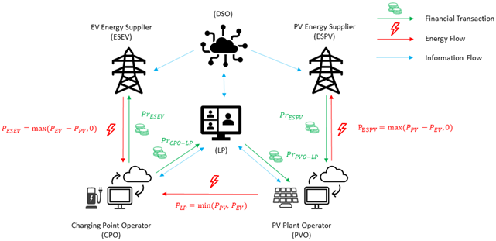
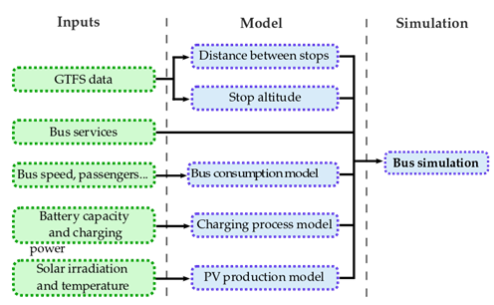
Context and Objectives
IEA Task 17 – PV-Powered Charging Stations (PVCS)
The first two IEA Task 17 Subtask 2 reports examined the feasibility, technical requirements, and key conditions for PVCS, as well as their technical, economic, environmental, and social impacts.
This third report builds on the previous work and focuses on the deployment challenges of PVCS, with particular attention to system sizing, optimization, and control strategies.
The objective is to enhance sustainability, reliability, and economic viability by ensuring system stability, operational efficiency, and user satisfaction.
It explores the deployment of PVCS within microgrid-based architectures, the integration of smart energy management and charging systems, and the incorporation of emerging services such as Vehicle-to-Grid (V2G) and battery swapping.

Slide 3
Goals and Methodology
Sizing for EV Workplace Charging Station
  Maximize on-site solar energy use for Electric Vehicles (EV) charging through a dedicated control system
  Develop a modular sizing methodology based on four independent relationships
  Allows flexibility in business models, charging strategies, and demand profiles
  PVCS: Sizing & Energy Cost Optimization
  PVCS sizing in microgrid environments requires balancing technical, economic, and environmental objectives
  A multi-objective MILP optimization framework was developed to minimize both the Levelized Cost of Energy (LCOE) and the Life Cycle Emissions (LCE)
  PVCS: Integration of V2G Services
  Leverage parked EVs to provide V2G services
  Develop a MILP-based optimization algorithm to control EV battery charging and discharging
  Aim to minimize energy costs and maximize solar energy utilization
  PVCS for Electric Buses
  Assess the deployment of electric buses and their integration with PVCS
  Evaluate different charging strategies
  Analyze impacts on grid performance, emissions, and service reliability

Slide 4
Key Results
Sizing for EV Workplace Charging Station
  Aligning EV charging with PV generation significantly reduces infrastructure size and costs
  Workplace parking lots are ideal, as charging demand aligns well with daytime solar production
  PVCS: Sizing & Energy Cost Optimization
  Higher solar irradiation improves both cost efficiency and emission reductions
  Site-specific conditions (climate, demand, grid access) require customized system designs
  The selection of PV panels and battery technologies is critical to achieving optimal performance
  PVCS: Integration of V2G Services
  Dynamic scheduling strategies outperform static control methods
  Provides economic benefits for users and grid operators
  Maintains driver comfort and mobility requirements
  PVCS for Electric Buses
  Charging strategies involve trade-offs in battery sizing, infrastructure needs, and operational flexibility
  Opportunity charging reduces battery size and energy use but increases grid stress and infrastructure costs
  PV integration lowers emissions and reduces peak grid load
  Seasonal variability limits solar contribution in winter, increasing the need for energy storage

Slide 5
The Way Forward
Use modular, flexible sizing methodologies for PVCS to adapt to different demand profiles, business models, and site conditions.
Leverage data-driven approaches to optimize infrastructure needs, reduce costs, and maximize solar utilization.
Integrate dynamic charging algorithms to align EV charging with solar production.
Implement real-time energy management for microgrids to optimize PV generation, storage, and grid interactions.
Expand V2G services for large-scale deployments (workplaces, campuses, fleets) to provide flexibility and economic benefits.
Use optimization algorithm to schedule charging/discharging without compromising driver mobility.
Optimize charging strategies (depot, terminal, opportunity) to balance battery size, infrastructure cost, and grid load.
Combine PV integration and energy storage to reduce emissions and manage seasonal solar variability.
Ensure PVCS designs minimize LCOE and life cycle emissions while maintaining system reliability.
Encourage customized, site-specific solutions to maximize environmental and economic benefits.
Explore new PV and battery technologies, modular microgrid architectures, and emerging services to further improve efficiency and resilience.
Promote scalable approaches to accelerate global PVCS adoption for both private EVs and public transport.

Slide 6
Amalie ALCHAMI, Task 17
amalie.alchami@utc.fr

