Slide 1
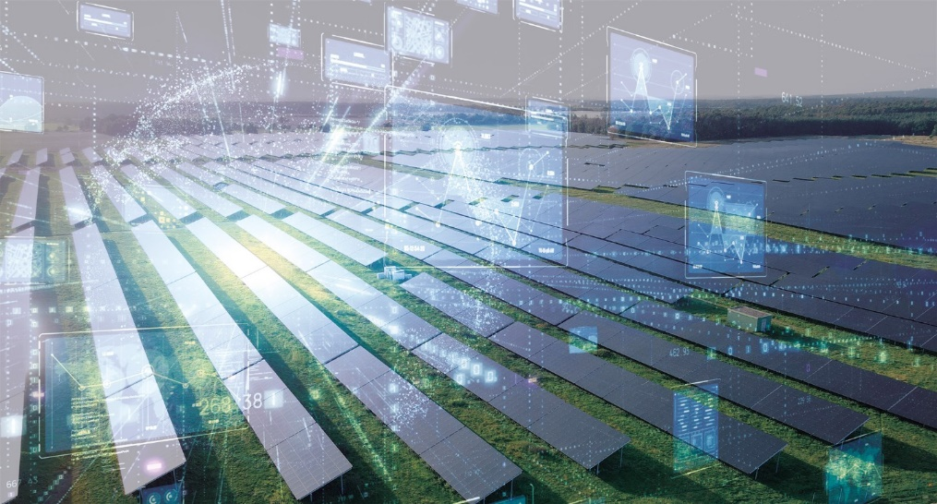
© Foto: Fraunhofer ISE, Overlay: / metamorworks Shutterstock
Digitalisation and Digital Twins in Photovoltaic Systems
Atse Louwen, EURAC Research, Italy, Christian Schill, Fraunhofer ISE, Germany
Ulrike Jahn, Fraunhofer CSP, Germany, January 2026
Task 13 Reliability and Performance of PV Systems

Slide 2
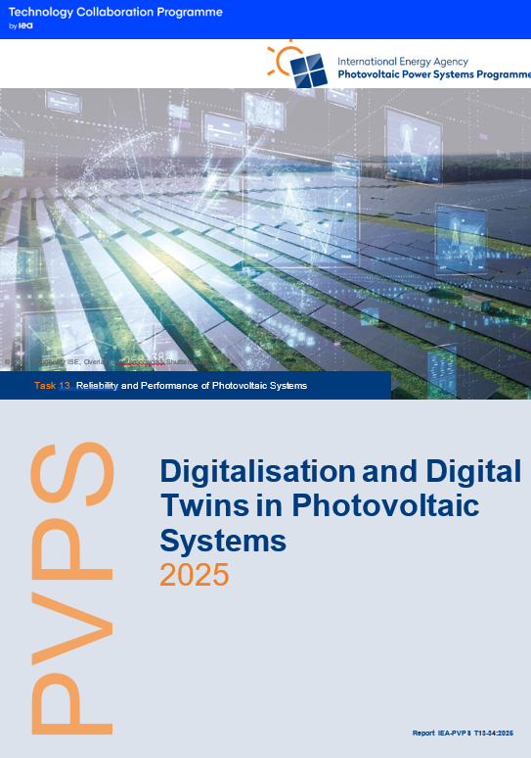
ST2.4 Digitalisation and Digital Twins in Photovoltaic Systems
Background
Digitalisation is increasingly recognised as a crucial driver in the evolution of the PV industry, enabling stakeholders to improve decision-making processes, optimise system designs, and facilitate predictive maintenance.
By integrating and leveraging vast amounts of data generated during the lifecycle of PV systems—from manufacturing through to operation and maintenance—digitalisation helps ad-dress critical challenges related to efficiency and sustainability in energy production.
Digital twins enable stakeholders to simulate various operational scenarios, analyse performance under different conditions, and predict maintenance needs.
Report IEA-PVPS T13-34:2026, January 2026

Slide 3
ST2.4 Digitalisation and Digital Twins in Photovoltaic Systems
What we do…
First, automation has revolutionised PV manufacturing, using robotics and artificial intelligence to streamline production processes and reduce costs.
Next, data analytics plays a crucial role, enabling real-time system performance monitoring and predictive maintenance through the analysis of large datasets.
Digital twins serve as virtual replicas of PV systems, allowing for real-time performance monitoring and the simulation of various operational scenarios
Risk management is enhanced through digitalisation, as advanced monitoring systems collect and analyse data to quantify risks associated with component failures.
Report IEA-PVPS T13-34:2026, January 2026

Slide 4
ST2.4 Digitalisation and Digital Twins in Photovoltaic Systems
Key Takeaways (1)
Digitalisation significantly contributes to risk analysis in PV projects, allowing stakeholders to quantify and mitigate risks associated with component failures, design flaws, and environmental factors.
“A digital twin is a virtual representation of a PV system or systems, at the appropriate level of detail, that can span its lifecycle, is updated from real data, and uses simulation, machine learning or reasoning to help decision making.”
The emphasis on the digital twin as a core concept signals its potential to revolutionise how PV systems are designed, operated, and maintained, ultimately contributing to the sector's growth and sustainability in the energy transition.
Report IEA-PVPS T13-34:2026, January 2026

Slide 5
ST2.4 Digitalisation and Digital Twins in Photovoltaic Systems
Key Takeaways (2)
Two approaches to digital twinning are discussed: physics-based digital twins, which use physical models to simulate behaviour, and data-driven digital twins, which rely on real-world data to model system performance.
By leveraging data from both the physical and virtual entities, digital twins enable detailed simulations of expected power outputs and help identify deviations from anticipated performance.
The integration of artificial intelligence (AI) and the Internet of Things (IoT) are key components in optimising operations and maintenance (O&M) processes for PV systems.
Cyber Security is of utmost importance to be considered at all levels of digitalisation.
Report IEA-PVPS T13-34:2026, January 2026

