Slide 1
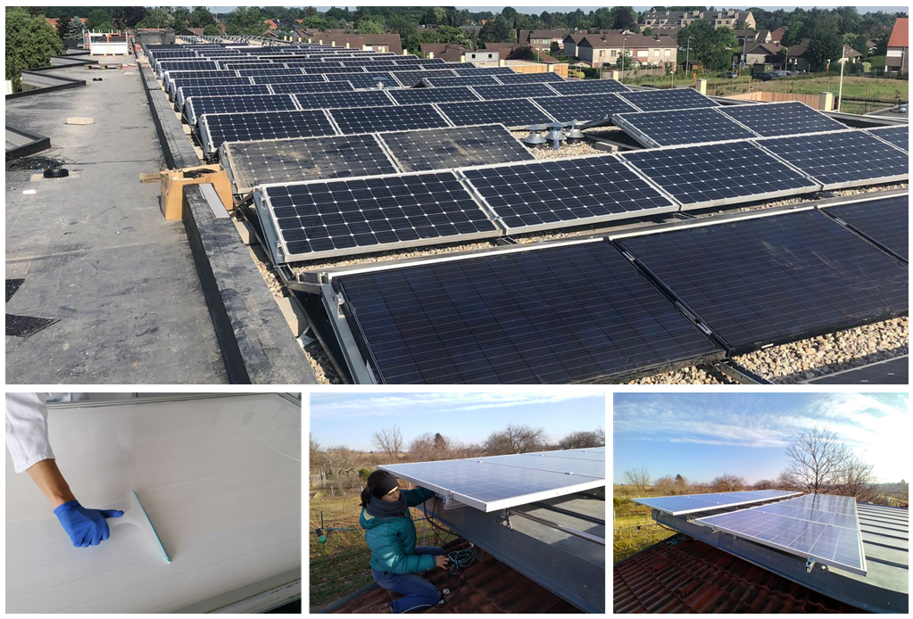
Performance and Reliability Aspects of 2nd Life Photovoltaic Modules
Gernot Oreski, PCCL, Ioannis Tsanakas, CEA-INES
Ulrike Jahn, Fraunhofer CSP; February 2026
Task 13 Reliability and Performance of PV Systems

Slide 2
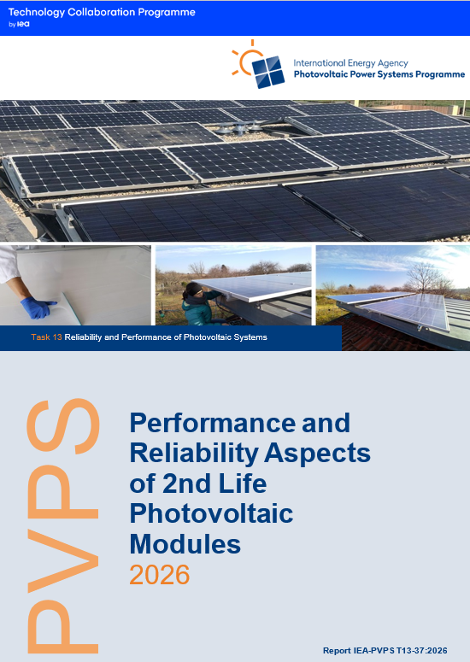
Performance and Reliability Aspects of Second Life Photovoltaic
Status of the Second Life PV Market
The lack of harmonized qualification criteria, standardized testing protocols, and repair guidelines significantly limits transparency, comparability, and overall confidence in reused products.
Without clear technical standards, second-life PV modules face barriers to large-scale adoption, insurance/warranty coverage, and bankability.
Alignment with international frameworks (e.g., IEC standards) and the development of robust pass/fail criteria are essential to ensure safety, reliability, and traceability.
Report IEA-PVPS T13-37:2026

Slide 3
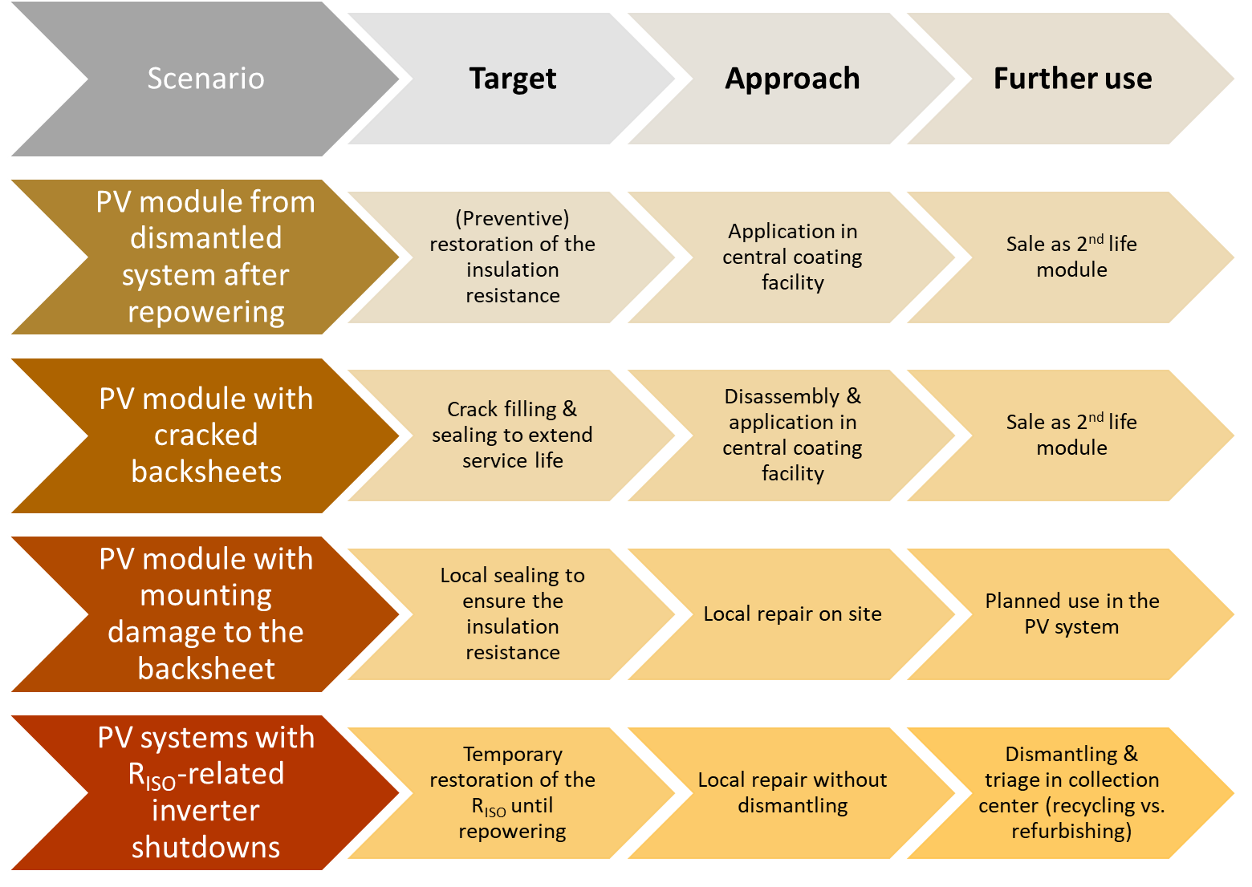
Performance and Reliability Aspects of Second Life Photovoltaic
Repair Feasibility and Limitations
Repair of PV modules - whether addressing solder bond failures, cracked backsheets, or junction box issues - has been demonstrated as technically feasible.
However, field experience shows that repair is often labour intensive, costly, and difficult to scale without automation.
Thus, repair is best reserved for specific contexts such as remote areas or where logistics make replacement prohibitive.
For the broader market, testing- and sorting-based reuse strategies are generally more cost-effective and scalable.
Repair scenarios for 2nd life PV modules with backsheet issues

Slide 4
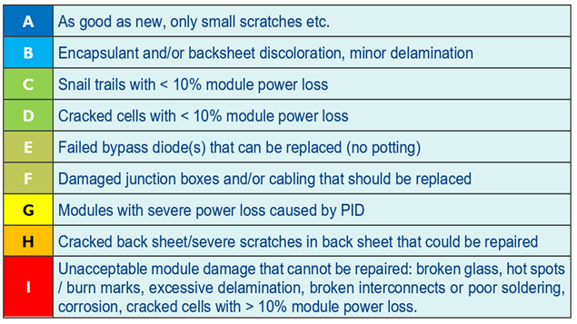
Performance and Reliability Aspects of Second Life Photovoltaic
Testing and Automated Triage as Enablers
Automated testing systems capable of IV characterization, electroluminescence imaging, and insulation resistance testing provide a scalable path for reliable large-volume triage.
This approach allows efficient classification into “reuse,” “repair,” or “recycle” streams, minimizing labour costs and ensuring greater consistency.
Advances in aerial inspection, AI-based diagnostics, and mobile test labs can further reduce costs and risks, while increasing throughput.
The creation of centralized or semi-automated reuse hubs is a promising strategy to strengthen the economic viability and traceability of second-life PV.
Classification matrix for PV module triage and eligibility for repair/reuse [1]
Source [1]: Tsanakas et al. (2024): Tsanakas IA, Oreski G, Eder G, Gassner A, van der Heide A, Ariolli DMG, Hernandez GO, Moser D, Wambach K. Toward Reuse‐Ready PV: A Perspective on Recent Advances, Practices, and Future Challenges. Adv. Energy Sustainability Res. 2024, DOI: 10.1002/aesr.202400237.

Slide 5
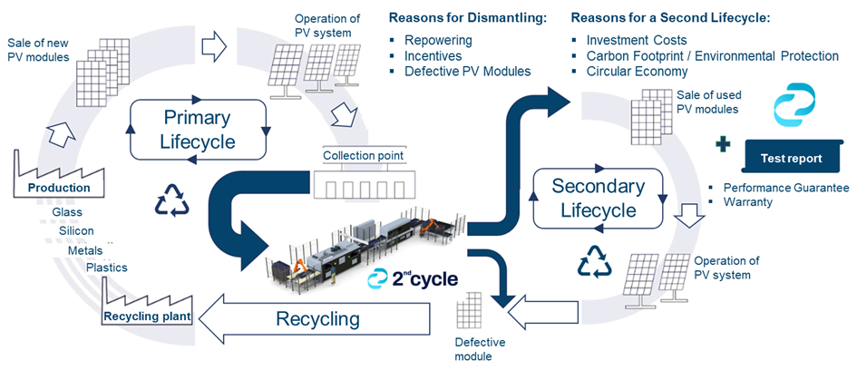
Performance and Reliability Aspects of Second Life Photovoltaic
Field Experience and Demonstration Projects
Pilot projects confirm that second-life PV and battery systems can deliver tangible benefits in energy autonomy, emissions reduction, and protection against electricity price volatility.
However, they also underline persistent challenges: technical compatibility issues arising from heterogeneous module batches, evolving grid compliance requirements, and the limited economic advantage of second-life batteries compared to new ones.
Harmonized standards and clearer qualification frameworks remain key to scaling the second-life PV market.
These experiences highlight the need for robust system integration guidelines and regulatory flexibility to unlock wider adoption.
Challenges in establishing a viable business model remain.
Business approach of 2nd Cycle: (https://www.2ndcycle.at/en)

