Slide 1
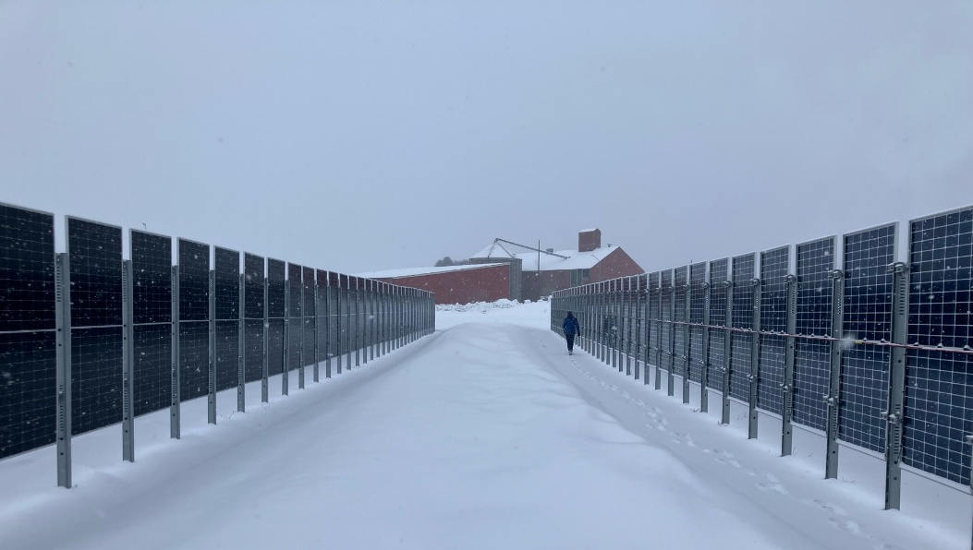
Photovoltaics and Energy Security in the Greater Arctic Region
Joshua S. Stein, SANDIA, USA, et al.
Report IEA-PVPS T13-40:2026, January 2026
Task 13 Reliability and Performance of PV Systems

Slide 2
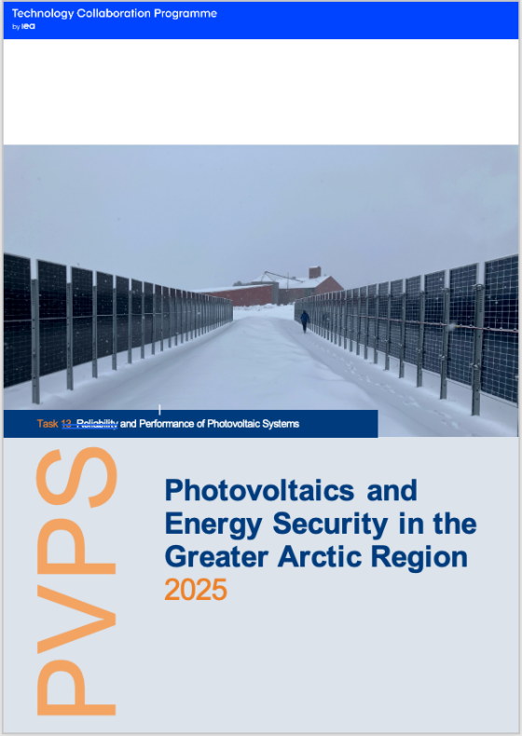
Photovoltaics and Energy Security in the Greater Arctic Region
Introduction
To ensure the successful deployment of photovoltaic (PV) systems in the greater Arctic region (latitudes above 60°N), installations must be specifically adapted to the region’s distinctive geographic and environmental conditions. These include wide variations in solar angles, high seasonality, low temperatures, snow and ice accumulation, permafrost and frost heave effects, as well as resource data scarcity.
This report examines the specific opportunities and challenges associated with deploying PV systems at high latitudes. It outlines practical solutions and best practices aimed at maximizing system performance, reliability, and long-term resilience under Arctic conditions.
Additionally, it provides an up-to-date overview of PV development across Arctic countries, offering a country-by-country perspective on current progress and trends.
The report explores opportunities and challenges of deploying PV systems in the greater Arctic region.
Report IEA-PVPS T13-40:2026, January 2026
Notes:
Add new cover image!

Slide 3
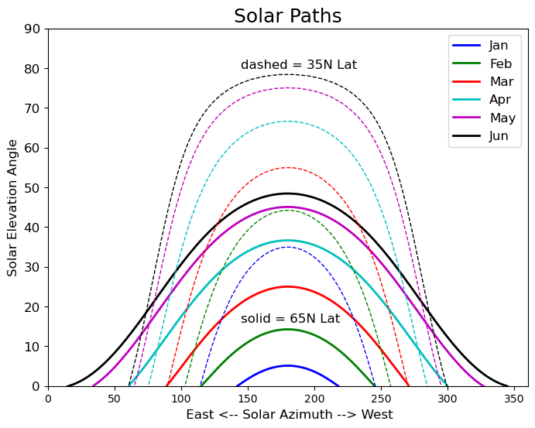
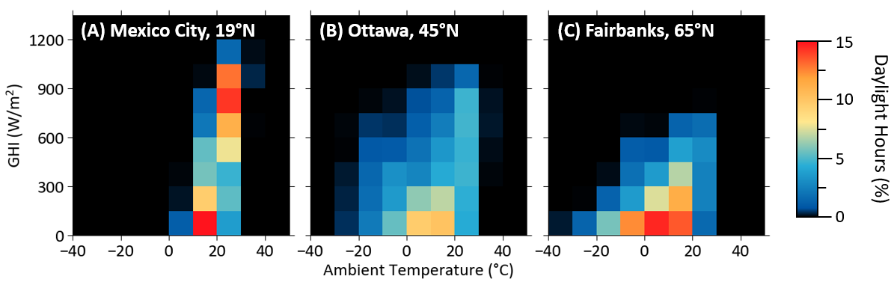
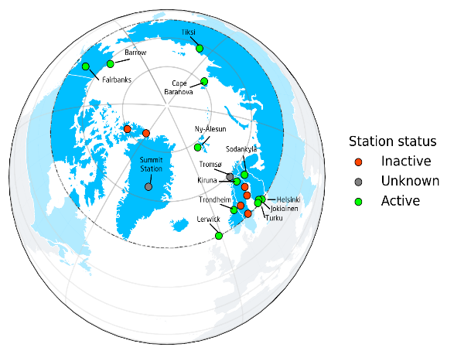
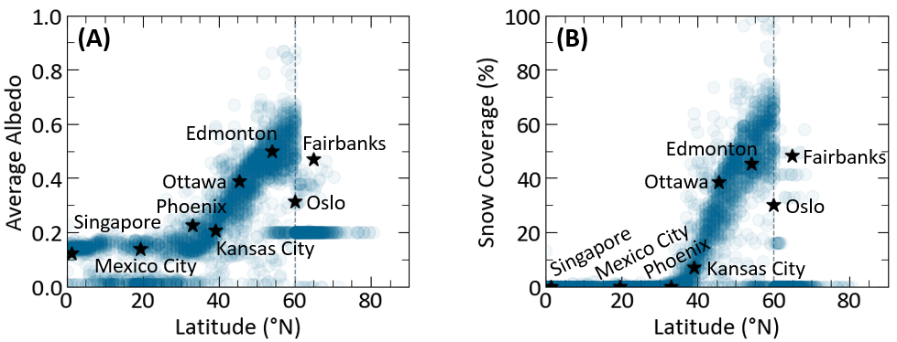
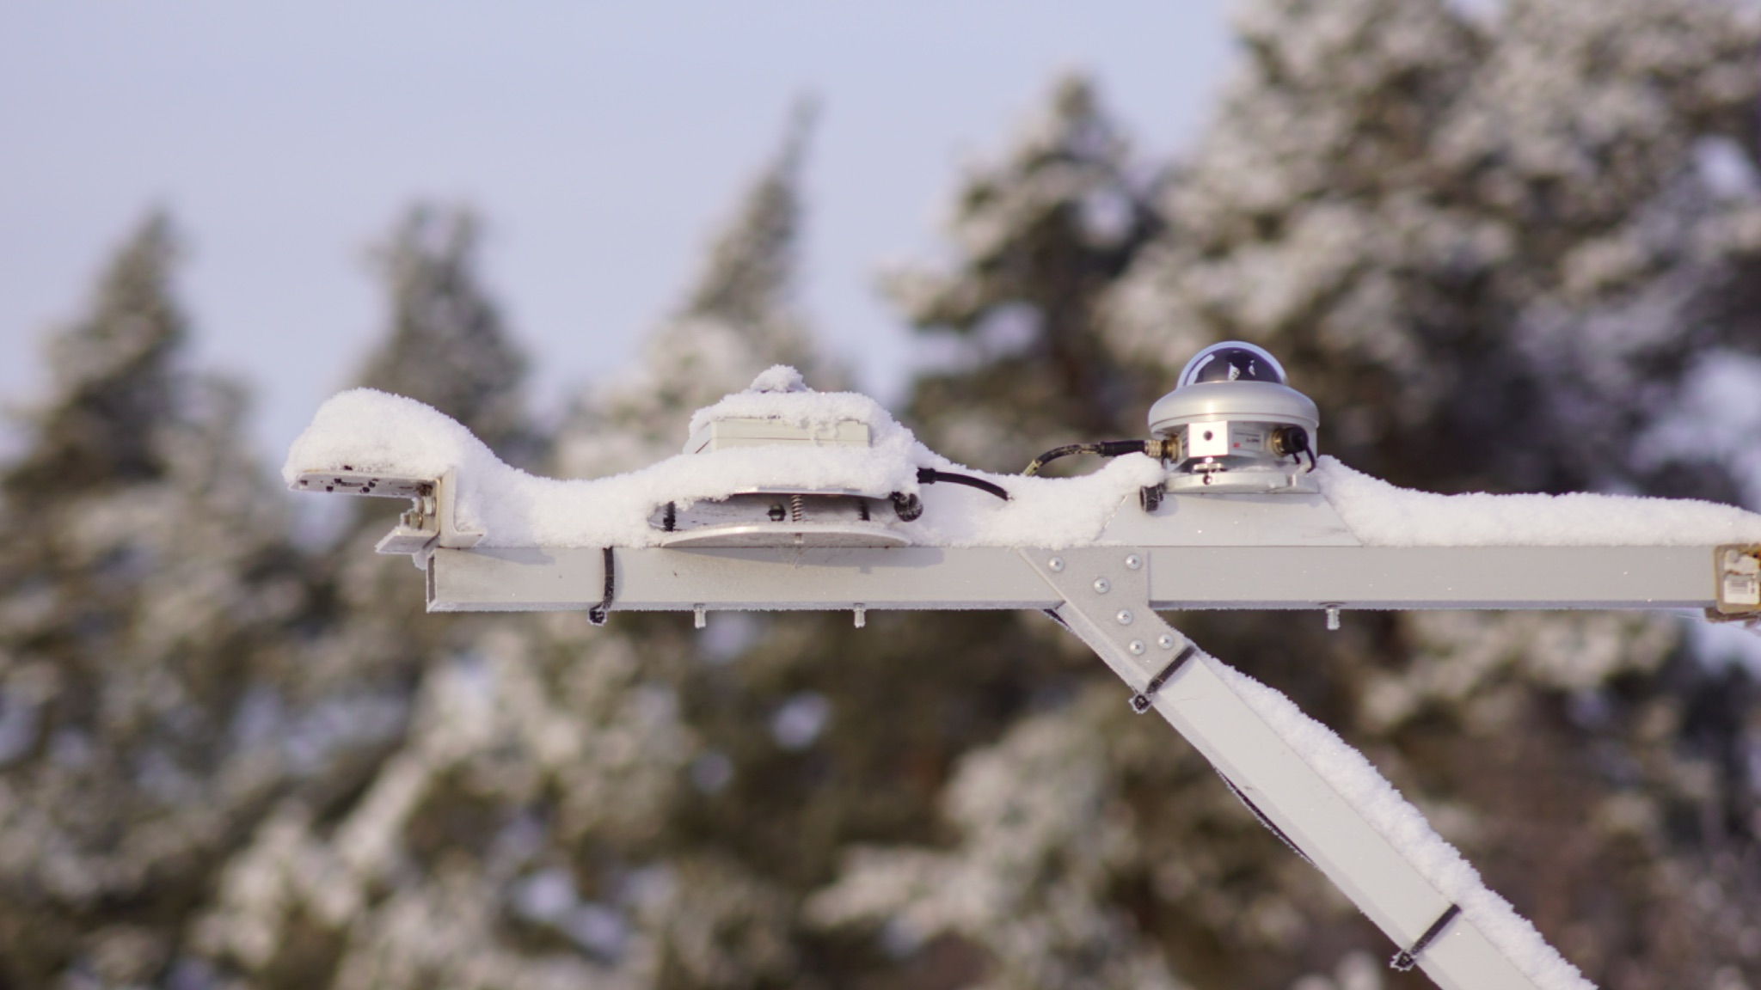
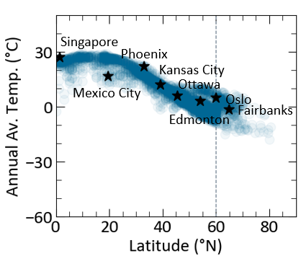
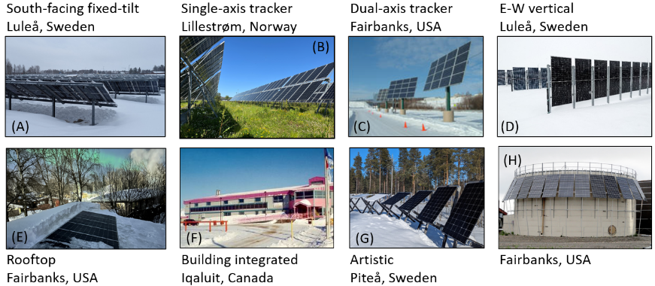
Photovoltaics and Energy Security on the Greater Arctic Region
Solar Paths
Solar Resource Stations
Irradiance vs. Temperature
Albedo and Snow vs. Latitude
Challenging Measurement Environments
Temperature vs. Latitude
Example System Designs

Slide 4
Photovoltaics and Energy Security on the Greater Arctic Region
Key Takeaways
High-latitude solar resources are characterized by high seasonality, low sun elevations and a wide azimuth angle variations, meaning fixed arrays experience extended periods with the sun behind the modules compared to lower latitudes
Bifacial modules & vertical PV arrays offer significant performance advantages by capturing more direct, diffuse, and reflected light while also improving snow shedding.
While lower temperatures enhance PV efficiency and may slow degradation, Arctic installations require tailored designs—frost-resistant foundations, snow-aware layouts, and adapted system engineering—to ensure long-term reliability; encouragingly, several Arctic countries are already deploying PV with climate-specific solutions..
Report IEA-PVPS T13-40:2026, January 2026

