Slide 1
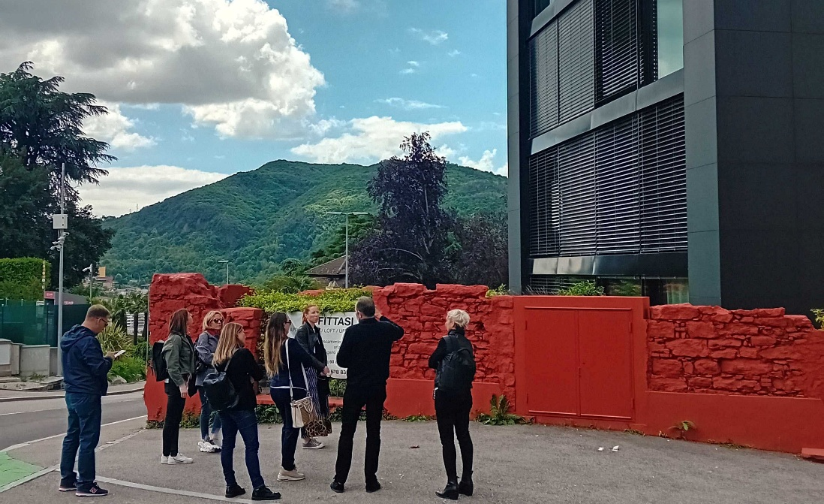
INSERT A PICTURE THIS SIZE OR LEAVE BLANK
BIPV: Education and Training Activities for Solar Architecture
Pierluigi Bonomo (SUPSI, Switzerland)
February 2026

Slide 2
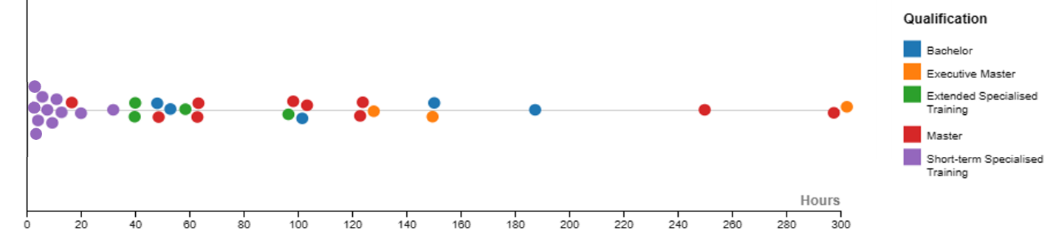
BIPV Education & Training: Key Insights
This report provides a first international overview of education and training activities related to Building-Integrated Photovoltaics (BIPV) and solar architecture. Although BIPV represents a significant opportunity for decarbonising the built environment, its market penetration remains limited due to structural barriers, including fragmented value chains, regulatory complexity, and a shortage of adequately trained professionals.
The report maps and analyses 32 academic and professional BIPV-related courses across 14 countries, examining their academic level, duration, learning formats, target audiences, and pedagogical approaches.
Fig. 1: Courses are plotted along the horizontal axis according to their duration, with qualification level indicated by a colour-coded scale.

Slide 3

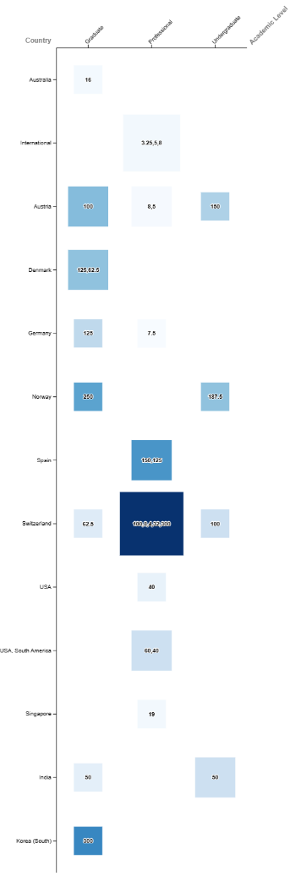
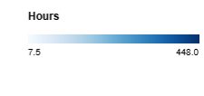
Key takeaways 1/2
The report identifies lack of integrated education, fragmented value chains, and insufficiently trained professionals as major structural barriers limiting investor confidence and large-scale deployment.
The study maps 32 BIPV-related courses across 14 countries, spanning undergraduate, graduate, and professional training. While this demonstrates growing international engagement, offerings remain unevenly distributed, limited in number, and poorly standardised, with BIPV often treated as a niche topic rather than a core component of architecture and building curricula.
Fig. 2: Heatmap showing countries (vertical axis) versus academic level (horizontal axis). Course duration is visually represented by the colourmap intensity, while the number of courses is visualised by square size (1–5).

Slide 4
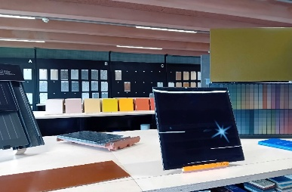
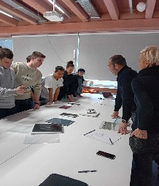
Key takeaways 2/2
Training programs primarily target architects, students, and engineers (over 70% of participants). Critical stakeholders such as contractors, developers, entrepreneurs, facility managers, and policymakers are significantly underrepresented, indicating a misalignment between education efforts and the full set of actors needed for market-scale BIPV adoption.
Effective programs combine technical PV knowledge, architectural design, regulatory frameworks, and real-world application through workshops, site visits, and industry engagement. Short-term and modular professional courses are particularly valuable for upskilling, but the report stresses the need for clearer professional pathways, recognised qualifications, and better integration into mainstream education.
Figure 3: Visit to the material library at SUPSI, part of Lecture 6 in the Solar Architecture course: group work focused on exploring solar materials (Photo: SUPSI).

Slide 5
Pierluigi Bonomo Francesco Frontini
Pierluigi.bonomo@supsi.ch Francesco.frontini@supsi.ch

