Slide 1
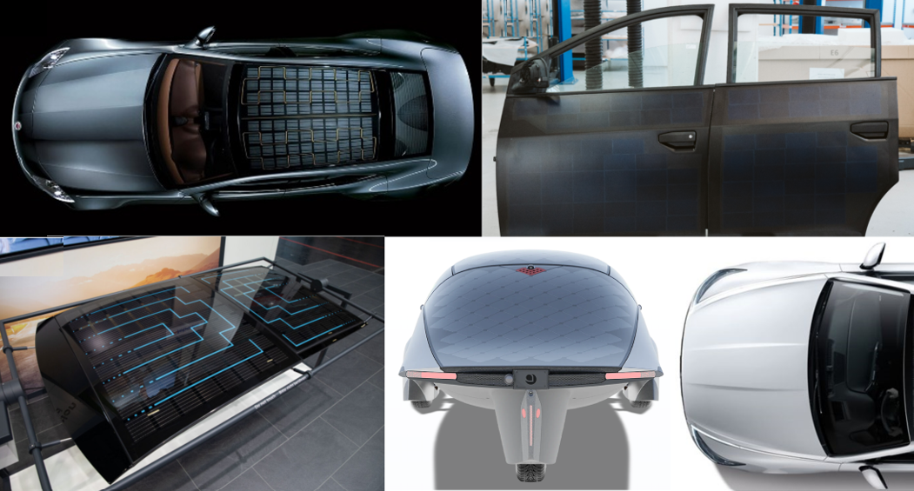
INSERT A PICTURE THIS SIZE
PV System Technology Considerations for PV-Powered Passenger Vehicles
Task 17: PV and Transport
Karsten Bittkau, Forschungszentrum Jülich, Germany, March 2026

Slide 2
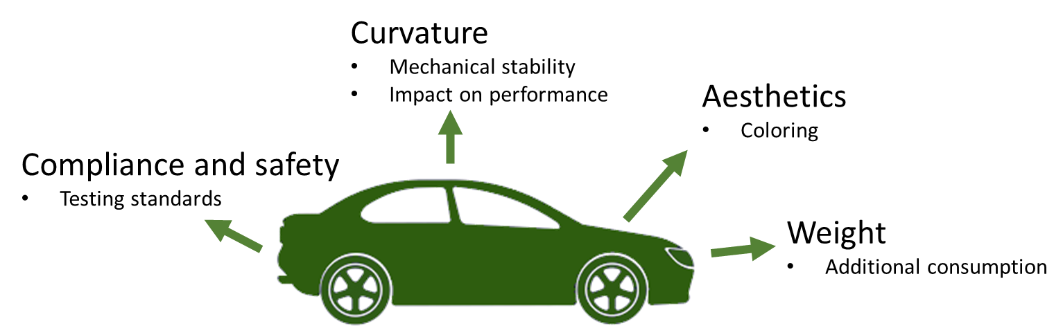
Context
Integration PV modules onto curved vehicle surfaces presents unique challenges
Various manufacturing techniques for both VAPV and VIPV
Mechanical behavior of PV cells under double curvature
Insights into the limits of cell bending to avoid cracks and electrical losses
Impact of curvature on PV performance and yield
Color and surface finish for VIPV
Various coloring techniques for different PV technologies
Challenges of color reproducibility
Demand for specific RAL colors in VIPV applications
Curvature
Aesthetics
Current lack of dedicated standards for VIPV
Safety qualification program based on existing PV and automotive standards
Additional tests specific to VIPV applications
Recent updates to relevant standards and their implications for VIPV testing
Compliance
& Safety
Additional weight of onboard PV systems is a critical factor in evaluating the energy benefits of PV-powered vehicles
Assess the impact of PV weight on the energy balance
Case studies involving different PV technologies and vehicle models
Weight

Slide 3
Key Takeaways
VIPV technology presents unique challenges in terms of curvature, aesthetics, and weight impact that require careful consideration during design and implementation
Standardization efforts are ongoing to develop comprehensive testing and safety qualification programs specific to VIPV applications
The energy balance of PV-powered vehicles depends on various factors, including PV technology, vehicle type, and usage patterns
Aesthetic considerations, particularly color and surface finish, play a crucial role in the acceptance and integration of VIPV systems
Special testing methods and considerations are necessary for curved PV modules to ensure accurate performance evaluation and long-term reliability

Slide 4
Karsten Bittkau, T17
k.bittkau@fz-juelich.de

