Slide 1
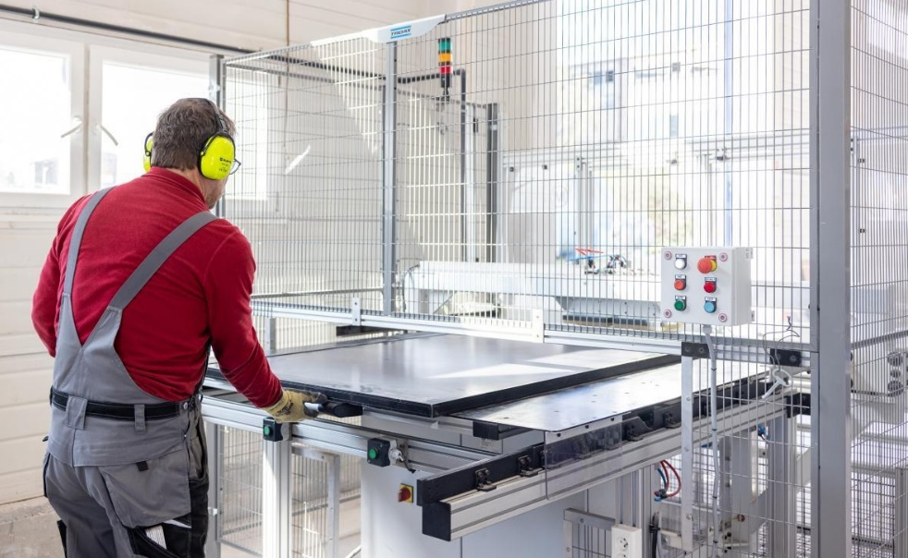
INSERT A PICTURE THIS SIZE OR LEAVE BLANK
Credit: PHOTORAMA – EU project ©European Union, 2025
Advances in Photovoltaic Module Recycling
K. Wambach, C. Libby
Task 12 Report, April 2026

Slide 2
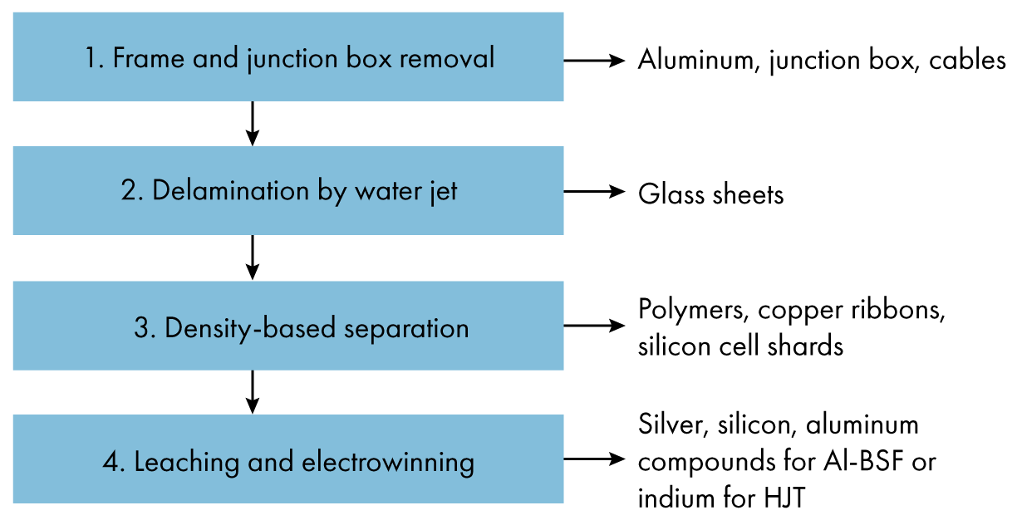
Third Update to Empirical Life Cycle Inventory Data
Study Objective
Provide updated, comparative life cycle inventory (LCI) data for PV module recycling technologies to inform environmental performance assessment, technology benchmarking, and end-of-life decision-making
Scope & Approach
Engage PV module recyclers employing best-available and emerging technologies through an LCI survey
Collect LCI data and interview participating recyclers, including two U.S.-based and one Italian crystalline silicon (c-Si) PV module recycler, a cadmium telluride (CdTe) module manufacturer and recycler previously included in the 2024 Task 12 study, and the EU Horizon 2020 PHOTORAMA project consortium
Compile LCI data, including material recovery rates and energy consumption, and compare new and updated recycler results with prior Task 12 studies to assess technology advances, emerging trends, and data gaps
Example novel recycling approach:
PHOTORAMA’s mechanical and chemical treatment of crystalline-silicon PV modules recovers high-quality glass, silicon, and silver

Slide 3
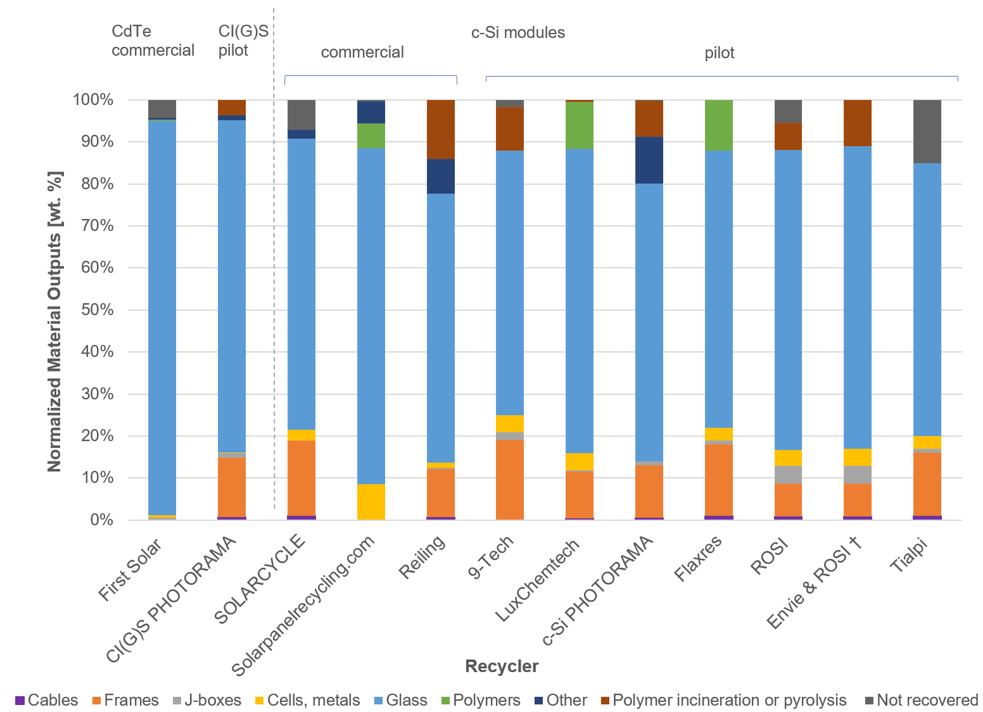
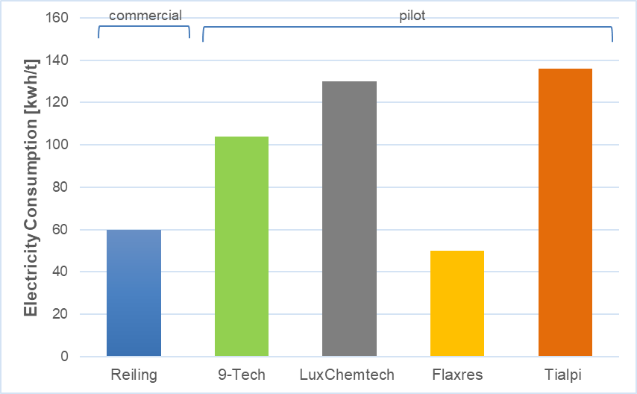
Summary of Recycling LCI Data
Relative Output Composition
Electricity Consumption
Notes on LCI data interpretation
Sources
Reiling, LuxChemtech, Flaxres, and Tialpi are from the 2024 Task 12 LCI report
LuxChemtech data do not reflect PHOTORAMA’s current facilities or maturity
Module assumptions
Input modules include frames except for First Solar
PHOTORAMA CI(G)S modules include back rails (counted as frames)
SPR aluminum frames are reported within metals
Limitations
Electricity consumption was not reported by most recyclers
Direct comparison is constrained by differences in scale, module composition, projected vs. measured values, and full vs. partial treatment pathways
Note: To enable comparison, the y-axis is normalized to 100 wt. % for each recycler, ensuring that the cumulative material fractions sum to the weight of one module or one metric ton of input
† Envie uses NPC’s commercial process, but the combined Envie & ROSI process is considered a pilot.
System boundaries
c-Si: up to separation of the cell fraction (incl. metals) from glass and polymers
PHOTORAMA CI(G)S: up to and including recovery of unrefined semiconductor material (Cu, In, Ga, Se)
First Solar: up to and including unrefined CdTe recovery and third-party refining to semiconductor-grade CdTe.

Slide 4
Key Takeaways
New and updated LCI data show measurable advances relative to prior Task 12 studies, including higher material recovery rates, process yields, and output purity; notably, mechanical recycler Solarpanelrecycling.com reports ~98 wt. % recovery of input Si, whereas the 2024 mechanical benchmark did not recover Si.
Material quality outcomes vary by process design, with thermal and chemical process combinations enabling higher recovery rates and material purities for Si, Ag, and Cu. ROSI reported 5-6N-pure Si through pyrolysis in the 2024 study. New examples include PHOTORAMA achieving 5N-pure Si and >2N Ag (leaching + electrowinning); Solarpanelrecycling.com reporting 99%-pure Cu (mechanical processes); and 9-Tech achieving ~95%-pure Cu and Ag (combined mechanical, thermal, and chemical treatments).
Advanced treatments can preserve high-quality glass, with PHOTORAMA’s high-pressure water jet and flash-light processes and Flaxres’ light pulse treatment (reported in the 2024 study) producing intact, high-purity glass sheets.
Commercial maturity differs by technology: mechanical recycling remains the dominant commercial approach for c‑Si modules, optimized for cost, capacity, and throughput, with some material downgrading. Thin‑film recycling is commercially established, with First Solar demonstrating >90 wt. % material recovery, including closed‑loop semiconductor recovery for use in new modules, across six global facilities.
Continued collaboration is essential to address data gaps in material recovery reporting, system boundary harmonization, and energy-use characterization to further strengthen comparative assessment and decision-making.

Slide 5
C. Libby, Task 12
clibby@epri.com

