Slide 1

VIPV as Energy Sources in Disaster Zones
Task 17: PV & Transport
Kenji Araki, University of Miyazaki, Japan
May 2026

Slide 2
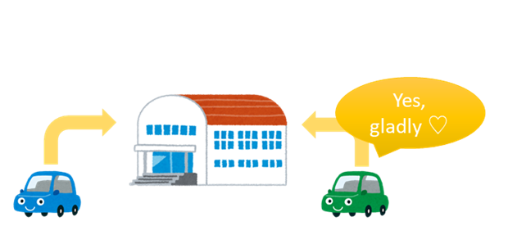
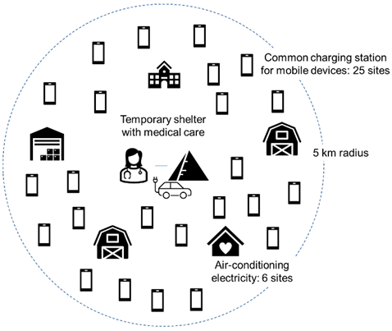
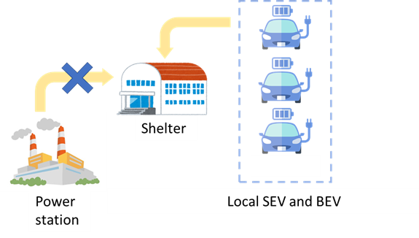

Case Studies and Social Science Dynamics
Q1: To what extent can SEVs and BEVs provide energy in isolated disaster zones through surplus battery donations?
Q2: Is it feasible for voluntary contributions from SEVs and BEVs to supply enough electricity for seven days with over 95% probability until critical infrastructure is restored?
Essential electricity through voluntary contributions from drivers of SEVs and BEVs.
While some drivers are willing to share the electricity required by the community, others prefer to keep it for themselves.
Energy sharing that takes advantage of the mobility of BEVs and SEVs.

Slide 3
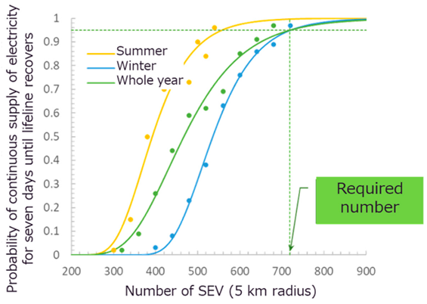
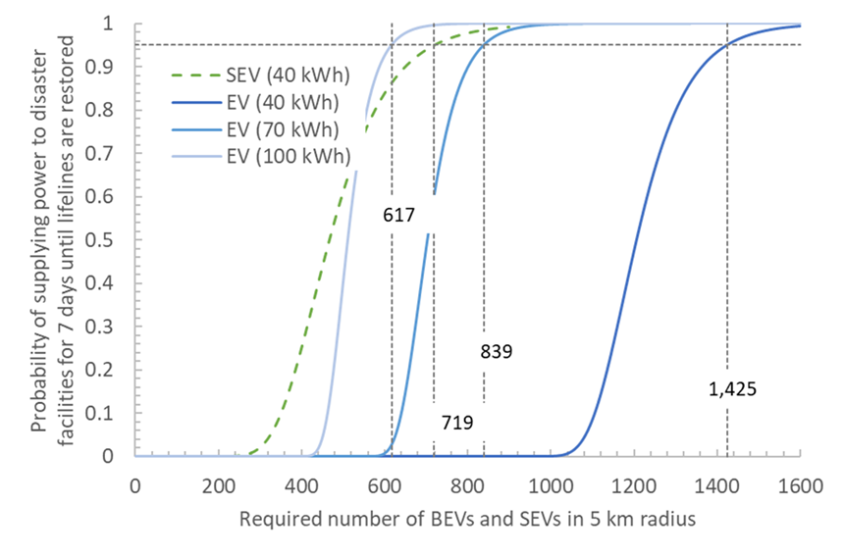
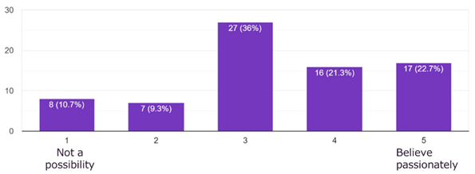
Probability Modeling Using Monte Carlo Methods
Resilience advantages of SEVs compared to BEVs and other PV-based energy sources.
Resilience scenario using VIPV using a simple voluntary model.
Resilience scenario using VIPV with selfish power hoarding.
Guidelines considering regional VIPV energy generation.
Q: If you own an EV, would you be willing to supply electricity to shelters without power?
A: In our study, 40% responded affirmatively to the idea of voluntary donation.
Probability illustrating the likelihood of maintaining success for 7 days.
Seasonal variation SEV compared to BEV

Slide 4
Key Takeaways (1)
Role of Solar Electric Vehicles (SEVs) in disaster resilience
SEVs can enhance disaster energy resilience by providing decentralized, flexible power support.
Value of vehicle-integrated photovoltaics (VIPV) & stationary PV systems
VIPV offers a continuous energy supply during outages, reducing the risk of full battery depletion. This enables EVs to function longer as emergency energy resources. The spatial flexibility diversifies risk and increases overall system robustness compared with fixed, stationary PVs.
Importance of voluntary energy sharing
Voluntary energy sharing can help sustain essential services during prolonged outages. However, its effectiveness depends on participation levels and cannot be assumed in the absence of supportive social and institutional conditions.
Behavioral uncertainty and policy implications
More self-protective behavior significantly reduces system effectiveness, requiring more participating vehicles. This highlights the need for incentives, clear communication, and trust-building policies rather than reliance on assumed altruism.

Slide 5
Key Takeaways (2)
Usefulness of probabilistic planning approaches
Monte Carlo–based modeling helps policymakers assess resilience under uncertainty by capturing variability in weather, infrastructure damage, and human behavior, rather than relying on average-case assumptions.
Case study: Trucks and PV
How fleet integration can enable logistics operations to provide emergency power without relying on dedicated equipment and to reliably generate 30–45 kWh of daily energy.
Priorities for future policy-relevant research
Further work should integrate behavioral data, advanced modeling, and detailed technical assessments of EV and PV performance. Cross-regional comparisons are essential to design adaptable, evidence-based EV resilience policies.

Slide 6
Kenji Araki, Task17
araki.kenji.j4@miyazaki-u.ac.jp

