Slide 1
Advancing Large Scale H2 Green in Energy Hubs
PVSEC16 Sept 2026
Otto Bernsen
Coordinating Advisor, Team Energy Innovation
Netherlands Enterprise Agency
Part of the Ministry of Economic Affairs

Slide 2
Summary what’s next for the solar community
Grid congestion forces energy hubs as the delivery vehicle > integrated solutions in products, infrastructure and size up
Solar, wind & battery > followed by large scale H2 deployment
EU made Perovskites lead to higher efficiencies per square meter, less international dependencies and eventually lower energy prices

Slide 3
Major Cross Border Hydrogen Projects NW Europe
Germany and the Netherlands:
Emden Elektrolyser (EWE): 320 MW PEM-elektrolyser 2025 2028 commerial capacity 26.000 ton/year.
H2CoastLink 1 & Gasunie Backbone: 24 km H2 backbone delivery 2027. International corridor (Hynetwork) between Groningen and Nieder Sachsen. Connects Eems harbor to national gas infrastructures.
Salt caverns Huntorf: Large scale storage by 2030** commercial use to compensate for the “DunkelFlaute”.
GET H2 (Lingen): large scale green H2 production for industry by electrolysis, connects to Drenthe Province
GreenMotionSteel (Duisburg): Green H2 for steel production connects to Limburg Province and Rotterdam Hydrogen Hub.
Antwerp – Rotterdam Hydrogen backbone expected to be delivered by 2030

Slide 4
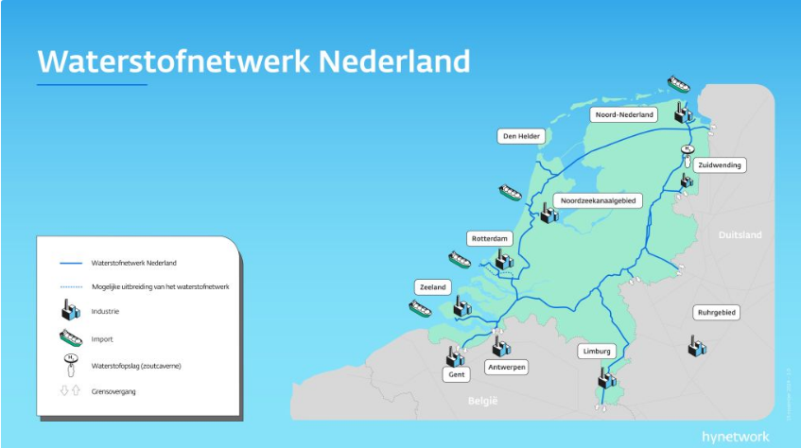
H2 Backbone Nl Connecting NW Europe
In
Source graph: Gasunie / Hynetwork

Slide 5
Drivers and next phases
2025 - 2026 Bottlenecks
Netcongestion peaks, Solar and Wind parks are curtailed for lack of transport capacity. Infrastructure needs long term planning and permissions.
2027 - 2030 Release & Relief
Emden & H2CoastLink go online. Surplus (offshore) wind and solar are localy conversed into Hydrogen and transported by the gaspipes.
2030 - The Seasonal buffer or overcomming the Dunkelflaute
The underground safe storage of Hydrogen enables massive long term storage of solar/wind for balancing and winter demand.

Slide 6
Drivers and next phases
Slow move from 1 climate goals to 2 system integration, 3 energy security, 4 resilient energy systems and finally 5 affordable energy prices.
Strict national and European norms set the preconditions
Infrastructure costs are mostly socialised and already constructed
Next is the cyber security (CBW & Cyber Resilience act CRA) for anything connected to the grid.

Slide 7
Some European dynamics or why D-NL?
UK as huge wind potential but first national goals and Brexit
Spain has huge solar and wind potential but infrastructure delays but could transport by sea to Rotterdam hub
China has scale but beware of new dependencies
USA has scale but targets grey and blue hydrogen first
Germany and Netherlands comply with EU and national regulation, quality above quantity and infrastructure is nearly completed

Slide 8
Possible role of perovskite solar cells
Higher efficiencies, less environmental pressure & CO2 footprint.
Possibly less technological dependencies outside Europe
Possibly direct conversion with solar and carbon capture
Solar need to become H2 ready!

Slide 9
The solar paradoxes to be solved
Great future prospect, little future or realistic planning
Aims at large scale roll out but targets very specific markets
Solar growth is not matched by grid infrastructure hence dependency on (Offshore) Wind
Solar growth is not yet matched by advances in EMS systems and inverter technology to meet cyber security standards
Solar growth without timing and new venues leads to negative prices
Solar depends still heavily on China for scaling up production so many subsidies end up there

Slide 10
International Energy Agency (IEA)
PVPS
This PVPS task 20 is in collaboration with TCP Hydrogen and Wind.
Its goal is policy recommendation based on information gathering and design for hybrid wind-solar-hydrogen plants.
18 TCP’s including Biomass, Geothermal, Storage, Hydrogen, Solar and EV’s.
Energy Hubs & Green Hydrogen
2025

