Slide 1

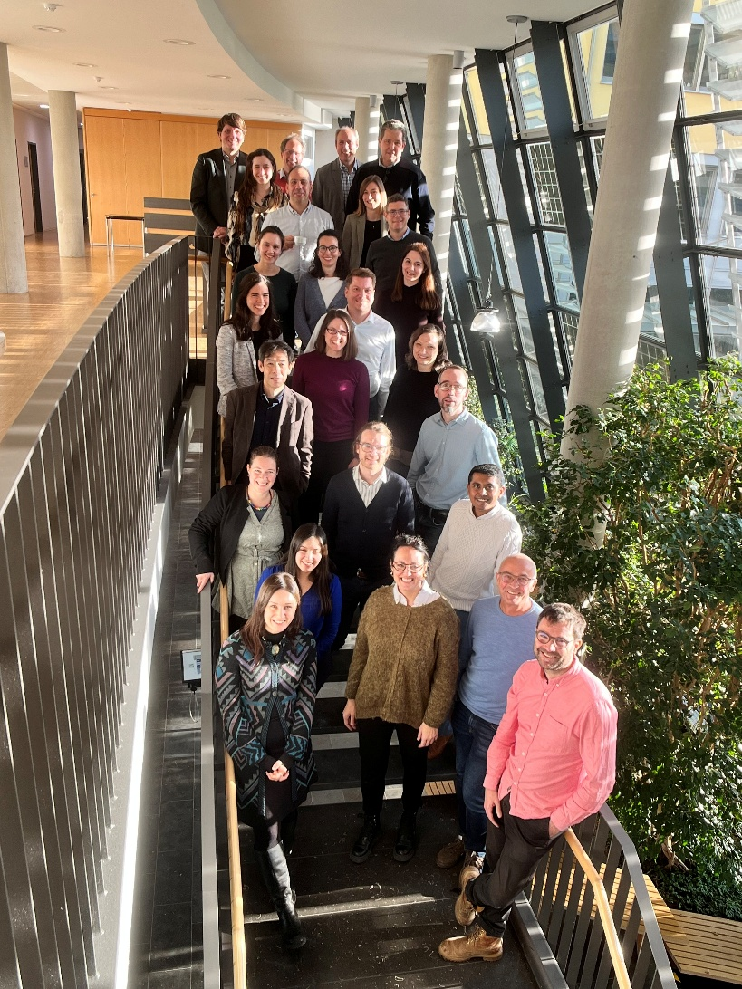
Task 12 – PV Sustainability
Garvin Heath
Task Manager
National Laboratory of the Rockies
Etienne Drahi
Deputy Task Manager
TotalEnergies
EUPVSEC – Sep 16, 2026

Slide 2





























What is IEA PVPS?
The International Energy Agency (IEA), founded in 1974, is an autonomous body within the framework of the Organization for Economic Cooperation and Development (OECD).
The IEA Photovoltaic Power Systems Programme (PVPS) is one of
the Technology Collaboration Programme established within the
International Energy Agency in 1993
32 members - 27 countries, European Commission, 4 associations
“To enhance the international collaborative efforts which facilitate the role of photovoltaic solar energy as a cornerstone in the transition to sustainable energy systems”
Slovakia just joined!

Slide 3
IEA PVPS Task 12 – PV Sustainability
The goal of Task 12 is to foster international cooperation and knowledge sharing on the sustainable aspects of PV technology, emphasizing environmental and social factors. Its mission is to provide essential information to stakeholders, enhancing consumer and policy-maker confidence in PV systems, and thereby accelerating the shift towards sustainable energy.
Task 12 Subtasks
    Circular Economy
    Environmental Life Cycle Assessment (LCA)
    Ecosystem-integrated PV
    Other PV sustainability topics

Slide 4
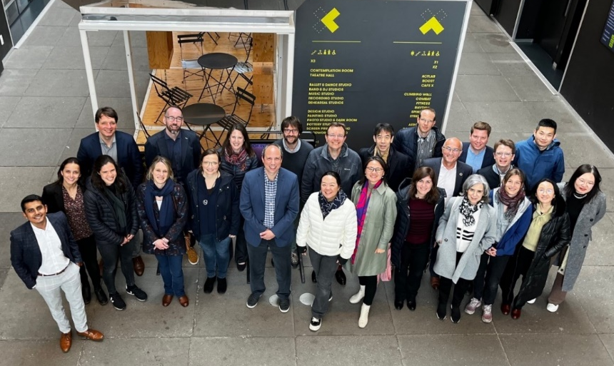
IEA PVPS Task 12 – PV Sustainability
Task 12 is operated jointly by the National Laboratory of the Rockies (NLR) and TotalEnergies. Support from the United States’ Department of Energy (DOE) and TotalEnergies are gratefully acknowledged.
Participants: country and industry
    Australia, Austria, Belgium, Canada,
    China, France, Germany, Italy, Japan,
    Spain, Sweden, Switzerland,
    the Netherlands, United Kingdom,
    United States
    SolarPower Europe, First Solar,
    Jinko Solar, PV Cycle, TotalEnergies,
    SOREN
    35 experts and counting

Slide 5
Task 12 Activities (2024-2028 workplan)
Subtask 1 Circular Economy | Subtask 2 Life Cycle Assessment | Subtask 3 Ecosystem-integrated PV
Global PV recycling status | 5th and 6th Edition of LCA Methodology Guidelines | Biodiversity and management in different PV systems and soils in solar parks
Patent review of PV recycling methods | LCI data and report (2025 and 2027 update) | Field research methods for Agrivoltaic applications
PV circular economy status | Study and comparison life cycle indicators from commercial PV recycling pilots and plants | Agrivoltaics Action group Task 12 Contribution
Repair of PV-Panels | 2nd edition Net Energy Analysis methodological guidelines | Environmental impacts of floating PV on coral reef: A Case Study in a French Polynesian Atoll
Towards PV Data Standardization – Foundations for EPDs and DPPs | Report of LCA of PV recycling pathways in France
Critical material demand scenarios for PV in the terawatt era | LCA of IBC PV modules | Subtask 4 Other Sustainability Topics
Status and Trends for PV recycling in - France - China - Spain | LCA of high-altitude PV installations in alpine environments | Studying Public Acceptance of PV modules
Global Circular Economy Policies for Photovoltaics: Comparative Landscape and Design Insights | LCA modelling recommendations for emerging PV tandem technologies
Secondary materials in PV manufacturing

Slide 6
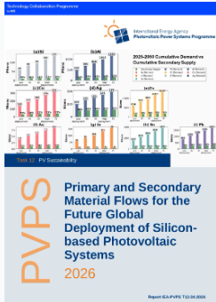
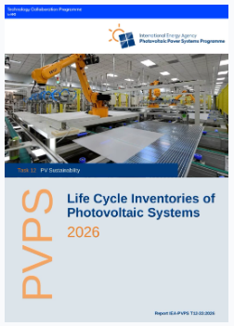
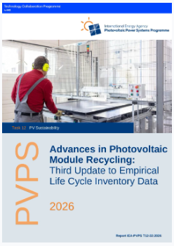
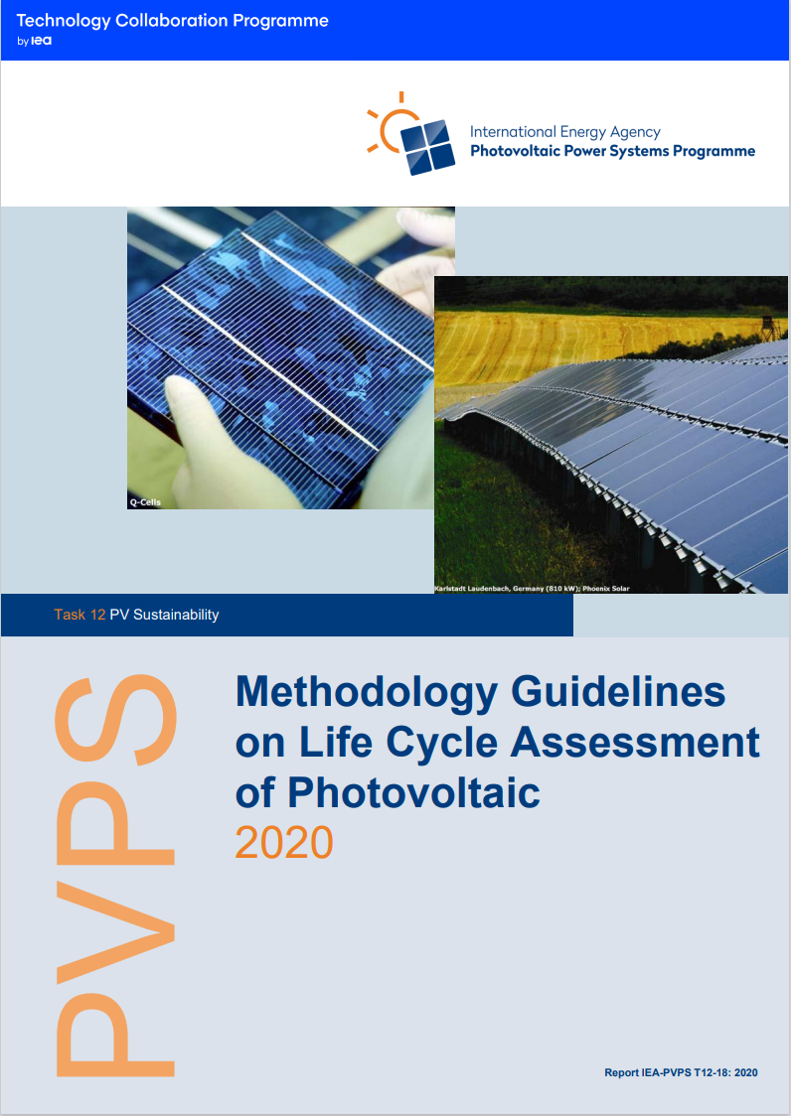
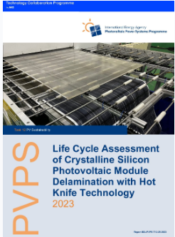
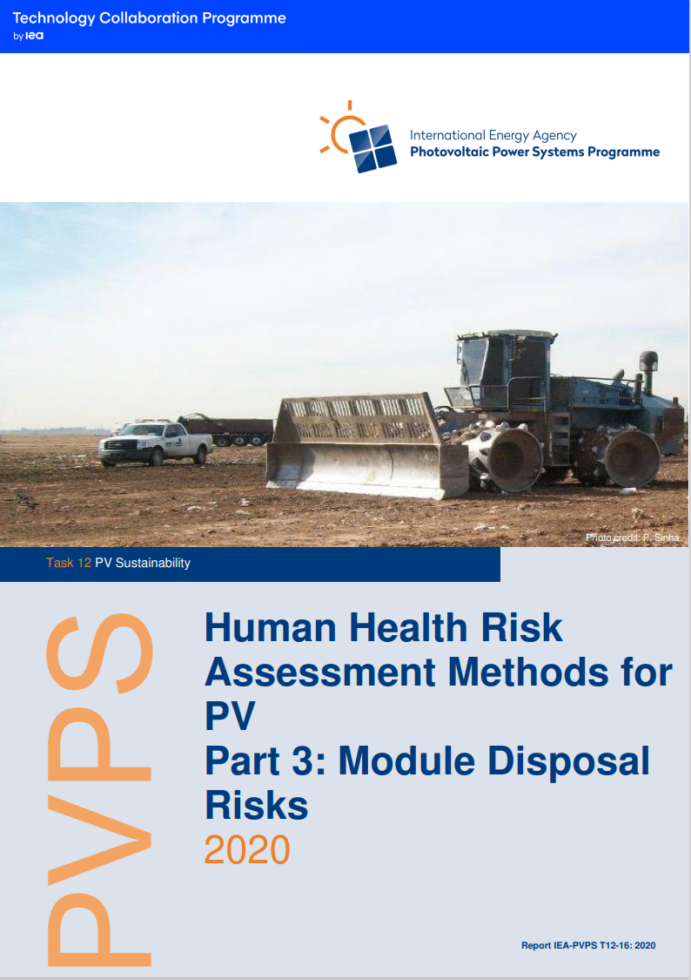
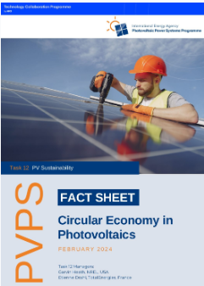
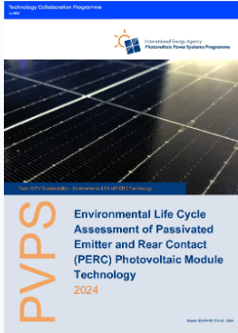
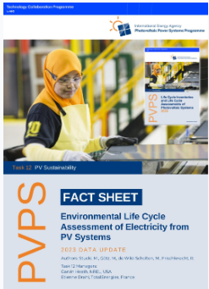
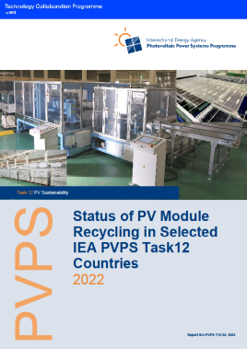
Selected Recent Publications
https://iea-pvps.org/research-tasks/pv-sustainability/

Slide 7
Garvin Heath & Etienne Drahi
Garvin.Heath@nlr.gov
Etienne.Drahi@totalenergies.com

Slide 8
Task 12 in stats
More than 6,000 downloads since Sep 2020
  110 from Africa
  1204 from Americas
  1576 from Asia
  3456 from Europe
  205 from Oceania
Most downloaded reports
  LCA PV and Storage (907 times)
  LCA guidelines – 2020 update (867 times)
  LCI report – 2020 update (888 times)

