Slide 1
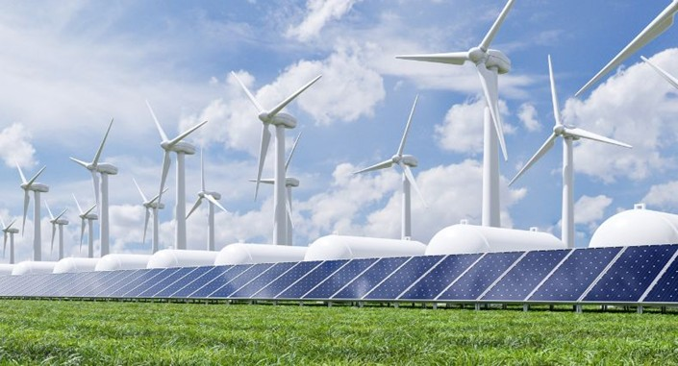
Task 20
A Joint Initiative by TCP’s Wind, Hydrogen and PVPS.
PVSEC 2026, Rotterdam
Veronika Vancheri task leader (RVO)

Slide 2
Hydrogen hubs in Europe
Local flexibility and industrial hydrogen supply
What a hub does
Where the value lies
Coordinates renewable electricity, electrolysis and storage.
Compared to batteries, hydrogen can offer affordable long term storage.
Local scale: flexible operation can relieve specific grid congestion.
Larger scale: Energy storage, as well as supply hydrogen to chemicals, fertilisers and steelmaking.
Capacity labels distinguish production power or output from the amount of hydrogen held in storage.
Notes:
Source deck: Otto Bernsen, Advancing Large Scale PVH2 Energy Hubs in NW Europe, PVSEC, 16 September 2026. User-supplied PDF. Capacity research accessed 16 September 2026. Slides 2, 3 and 7. Business-case statements are analytical synthesis. Electrolyser nameplate MW describe electrical input power. Annual hydrogen output depends on utilisation and efficiency. Storage capacity is an inventory, expressed in tonnes, energy or normal cubic metres, not tonnes per year.

Slide 3
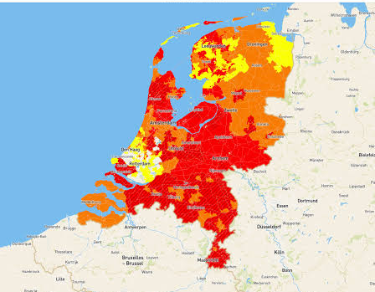
Congestion in the Netherlands
Demand-side constraints
This map shows capacity for electricity consumption.
Absorbing local PV surplus can help where export capacity is the bottleneck.
Source: Netbeheer Nederland, supplied screenshot dated 28 March 2024. Historical snapshot.
Notes:
Source deck: Otto Bernsen, Advancing Large Scale PVH2 Energy Hubs in NW Europe, PVSEC, 16 September 2026. User-supplied PDF. Capacity research accessed 16 September 2026. User-supplied Netbeheer Nederland screenshot: Capaciteitskaart afname elektriciteitsnet, timestamp 28 March 2024. Afname is electricity withdrawal/demand. Historical screenshot, not current available capacity. Electrolyser operation must respond to local congestion direction and timing.

Slide 4
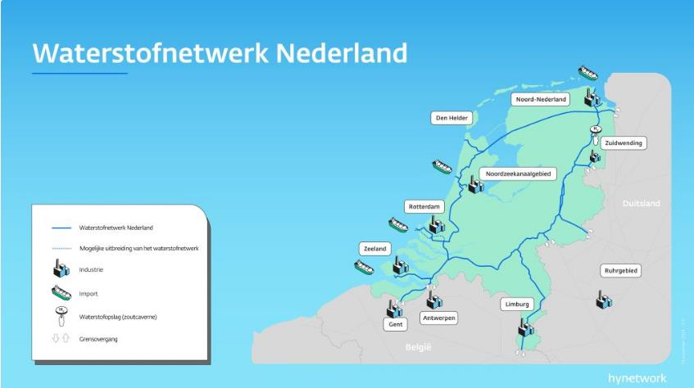
The Dutch hydrogen backbone
Hynetwork backbone
Links ports, industry and cross-border routes.
HyStock storage
Zuidwending
Storage: 20,000 t H₂
Around 700 gWh
Four planned caverns
Sources: Gasunie / Hynetwork map in Bernsen, slide 4; Gasunie HyStock project page. Planned storage capacity.
Notes:
Source deck: Otto Bernsen, Advancing Large Scale PVH2 Energy Hubs in NW Europe, PVSEC, 16 September 2026. User-supplied PDF. Capacity research accessed 16 September 2026. Original map from slide 4, Gasunie/Hynetwork. Planned network view, not evidence of operational access. HyStock salt-cavern storage is a separate project connected to the network. Gasunie specifies 4 caverns and a total 20 ktonnes H2 planned. Source: https://www.gasunie.nl/en/projects/hystock-hydrogen-storage . Capacity refers to the cavern storage development, excluding the separate small demonstration electrolyser. Production and dedicated storage are not capacities of the transport backbone itself.

Slide 5
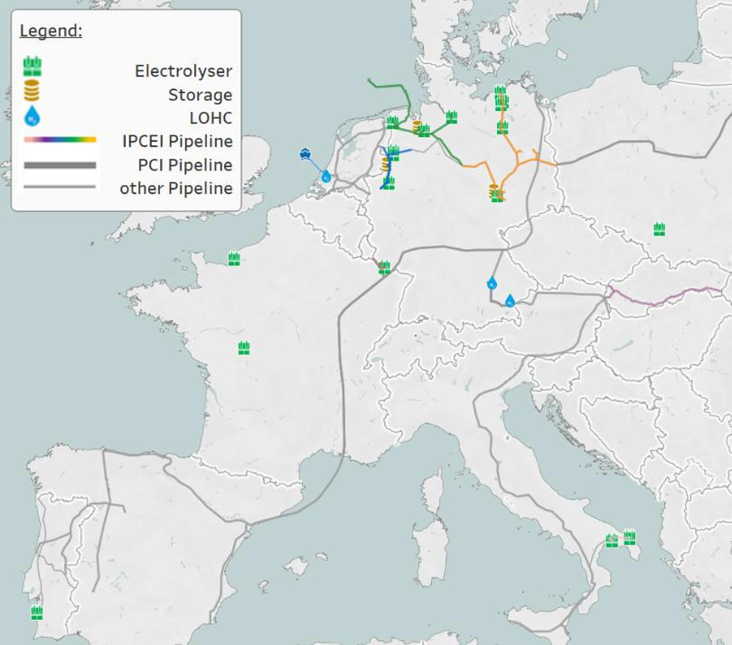
Cross-border hydrogen production projects
EWE Emden
Production: 320 MW
Approx. 25,000–30,000 t H₂/year
Storage: Huntorf, 16 million Nm³,48 GWh
GET H2 Nukleus, Lingen
Production: 300 MW, up to 6 t H₂/hour
Storage: access to Gronau-Epe
3,420 t working gas in the shared site
Announced full-build capacities. Storage sites are separate assets. Sources: EWE and IPCEI project profiles.
Notes:
Source deck: Otto Bernsen, Advancing Large Scale PVH2 Energy Hubs in NW Europe, PVSEC, 16 September 2026. User-supplied PDF. Capacity research accessed 16 September 2026. European map from slide 5. EWE Emden: https://www.clean-hydrogen-coastline.de/erzeugung/elektrolyse-ostfriesland/ specifies 320 MW and approx. 25,000–30,000 tonnes/year depending on renewable electricity supply, under construction with planned completion in 2027. Earlier deck gives 26,000 tonnes/year, within this range. Storage is a separate asset and no dedicated on-site inventory is specified in this project source. RWE GET H2 Nukleus: https://ipcei.observatory.clean-hydrogen.europa.eu/hy2infra/ws1-large-scale-electrolysis/rwe-generation-get-h2-nukleus-de34 specifies 300 MW, up to 6 t/hour at full build and connection to Gronau-Epe. Storage: https://ipcei.observatory.clean-hydrogen.europa.eu/hy2infra/ws3-hydrogen-storage-capacity/rwe-gas-storage-west-rwe-h2-storage-gronau-epe-de24 specifies 3,420 tonnes working gas in a shared separate facility. Do not assign the full shared inventory exclusively to the electrolyser. These are planned full-build capacities, not actual annual production.

Slide 6
Underground hydrogen storage projects
EWE Huntorf
RWE Gronau-Epe
Production capacity
Production capacity
Not applicable: storage facility
Not applicable: storage facility
Storage capacity
Storage capacity
16 million Nm³ H₂
3,420 t H₂
Working gas offered for 2030–2044
July 2026 tender
38 million Nm³ working gas
Planned commercial use from 2027
Sources: EWE Gasspeicher tender and IPCEI project profile. Nm³ = normal cubic metres of gas.
Notes:
Source deck: Otto Bernsen, Advancing Large Scale PVH2 Energy Hubs in NW Europe, PVSEC, 16 September 2026. User-supplied PDF. Capacity research accessed 16 September 2026. Huntorf project general page states approximately 70 GWh but the July 2026 tender markets 11.2 + 4.8 = 16 million Nm3 of working gas for 2030–2044. These are different published scope/basis figures and must not be presented as equivalent. This slide uses the precisely defined marketed working-gas volume. Source: https://www.ewe-gasspeicher.de/en/chc-huntorf-storage/ . EWE page: https://www.clean-hydrogen-coastline.de/speicherung/speicher-huntorf/ . Gronau-Epe source: https://ipcei.observatory.clean-hydrogen.europa.eu/hy2infra/ws3-hydrogen-storage-capacity/rwe-gas-storage-west-rwe-h2-storage-gronau-epe-de24 . Planned working gas 38 million Nm3 / 3,420 tonnes, 135 GWh as stated by source. Commercial use expected 2027. Nm3 is a normal cubic metre, not geometric cavern volume. Production is not applicable to either storage project. Hydrogen inventory is not electricity output.

Slide 7
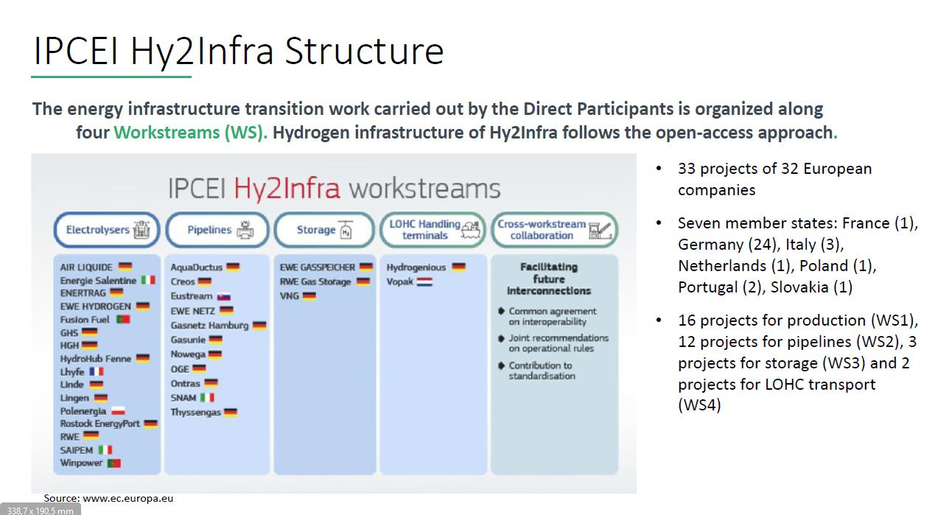
IPCEI Hy2Infra: infrastructure and capacity
2024 approved scope
Production
3.2 GW
Electrolyser capacity
Hydrogen storage
≥370 GWh
Programme total
IPCEI: Important Projects of Common European Interest. Approved portfolio figures, not operating capacity.
Notes:
Source deck: Otto Bernsen, Advancing Large Scale PVH2 Energy Hubs in NW Europe, PVSEC, 16 September 2026. User-supplied PDF. Capacity research accessed 16 September 2026. Original workstream diagram from slide 6, European Commission figure showing 2024 approved programme. Source: https://ipcei.observatory.clean-hydrogen.europa.eu/sites/default/files/2024-11/2024-02-Commission-approves-up-to-6.9-billion-of-State-aid-by-seven-Member-States-for-the-third-Important-Project-of-Common-European-Interest-in-the-hydrogen-value-chain_1.pdf . Approval scope: 33 projects, 32 companies, seven states, 3.2 GW electrolysers, at least 370 GWh hydrogen storage, approx. 2,700 km pipelines. The current IPCEI overview gives approx. 372 GWh. These are programme scope figures rather than operational capacity or additive new capacities on top of individual projects in this deck. Individual projects can evolve or withdraw. Vopak is the Dutch LOHC terminal participant. Gasunie is associated with a German pipeline project, not proof that this programme finances the entire Dutch backbone. IPCEI means Important Projects of Common European Interest.

Slide 8
Other European initiatives and capacity scope
European Hydrogen Bank
Hydrogen Valleys / HEAVENN
Auctions support hydrogen production.
Production / storage: portfolio-specific
Production: ≥4 MW planned at GZI Next,
one HEAVENN component
Storage: no consolidated total published
TEN-E and CEF Energy
EU Hydrogen Mechanism
Support eligible cross-border infrastructure.
Production / storage: project-specific
Helps match hydrogen buyers and suppliers.
Production / storage: not applicable
to the matching platform
Programmes and coordination platforms have no single plant capacity. Sources: European Commission and HEAVENN.
Notes:
Source deck: Otto Bernsen, Advancing Large Scale PVH2 Energy Hubs in NW Europe, PVSEC, 16 September 2026. User-supplied PDF. Capacity research accessed 16 September 2026. European Hydrogen Bank: https://energy.ec.europa.eu/topics/eus-energy-system/hydrogen/european-hydrogen-bank_en . Financing instrument, not an individual plant, with capacity depending on award round. Hydrogen Valleys: https://www.clean-hydrogen.europa.eu/get-involved/hydrogen-valleys_en . HEAVENN published design for GZI Next at least 4 MW: https://heavenn.org/emmen-industry/ . This figure is one component, not a consolidated HEAVENN production total; operation is not verified. No consolidated quantitative H2 storage capacity is stated on the HEAVENN overview or storage-cluster page: https://heavenn.org/storage-and-built-environment/ . TEN-E and CEF: https://energy.ec.europa.eu/topics/infrastructure/projects-common-interest-and-projects-mutual-interest_en . Hydrogen Mechanism is described on the Hydrogen Bank page. These schemes do not own a single plant capacity.

Slide 9
A viable hub needs demand and compliant supply
Commercial foundation
RFNBO requirements
A credible industrial customer
Affordable electricity and enough operating hours
Confirmed network access and storage terms
New renewable supply where required
Time and location matching, with exceptions
At least 70% lifecycle emissions savings
Public support should reward verified benefits and commercial viability.
RFNBO: renewable fuel of non-biological origin. EU rules include exceptions and transitional provisions.
Notes:
Source deck: Otto Bernsen, Advancing Large Scale PVH2 Energy Hubs in NW Europe, PVSEC, 16 September 2026. User-supplied PDF. Capacity research accessed 16 September 2026. Analytical commercial and policy synthesis. Sources: https://energy.ec.europa.eu/topics/eus-energy-system/hydrogen/renewable-hydrogen_en ; https://eur-lex.europa.eu/legal-content/EN/TXT/?uri=CELEX:32023R1184 . RFNBO is renewable fuel of non-biological origin. Main grid-electricity sourcing route includes additionality and temporal/geographical correlation. Monthly matching generally through 2029 and hourly from 2030, with exceptions and transition rules. RFNBOs require at least 70% lifecycle greenhouse-gas emissions savings versus fossil comparator. Capacity figures do not establish bankability, actual production or current access.

