Slide 1
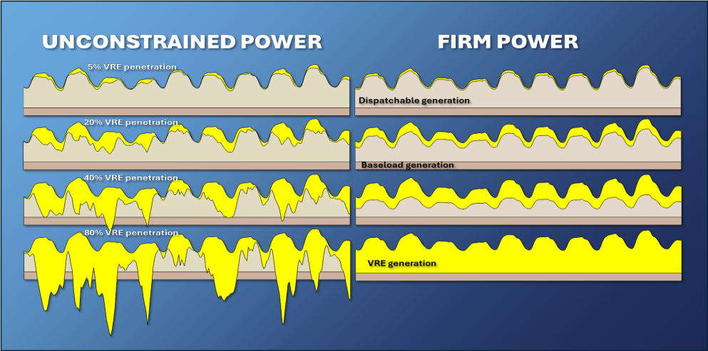

Task 16 – Phase IV – Introduction and work linked to storage
Jan Remund, Task Manager, Meteotest AG
68th Exco – meeting, online, April 20-23 2026

Slide 2
Contents
IEA PVPS, State of work & team
Past, Ongoing and Future work
New Task Phase (IV)
Work related to Battery Storage

Slide 3
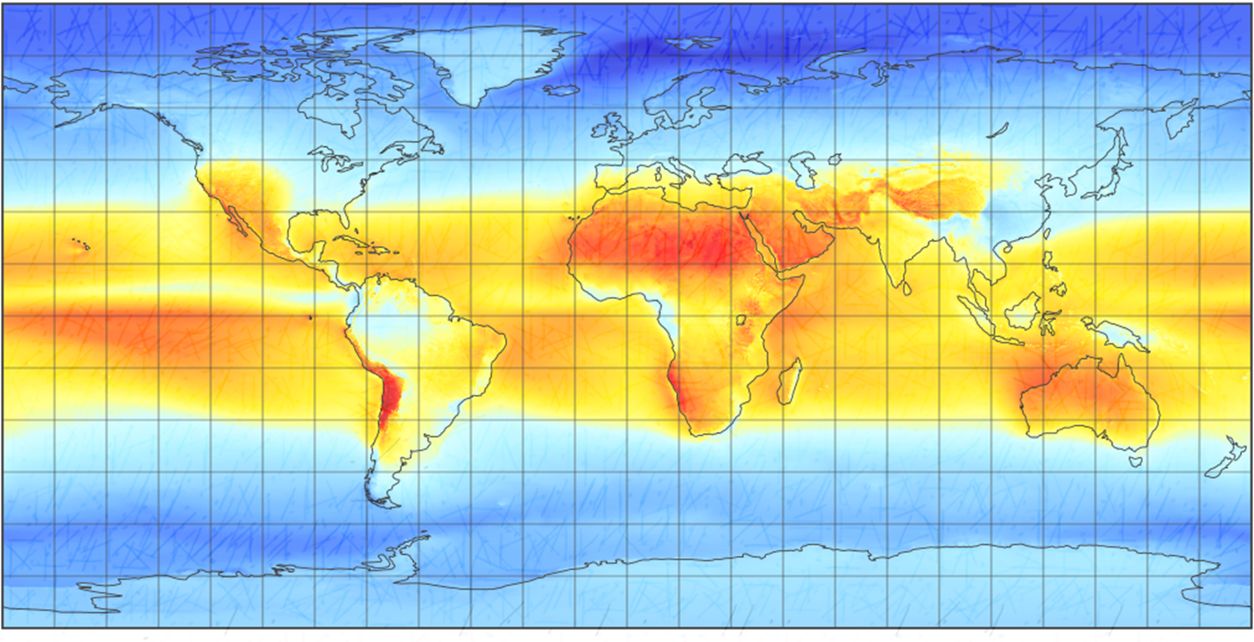






















Current status of team
  Universities, research organizations, met services, and service providers
  New phase → review of participation: 20 countries, 45 organizations, 83 experts
Global horizontal irradiance. Source: www.meteonorm.com (Version 9)
Notes:
Universities, met services, service providers
21 countries, 55 organizations
Asia: missing

Slide 4








































Current status of team
45 institutions
Science
(labs and
universities)
Met Services / utilities
Data & Service providers

Slide 5
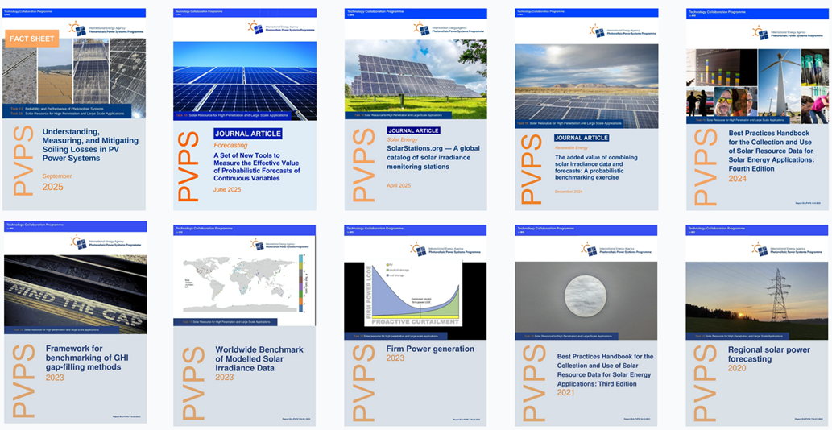
Issues with Exco: Work done in Phase III
  Reports:
  Websites: https://solarstations.org, https://assessingsolar.org/intro.html

Slide 6
Main reports: 5th Edition Best Practices Handbook
The chapters of the handbook will be revised that includes better restructuring:
1. Why Solar Resource Data Are Important to Solar Power | 5. Further Relevant Meteorological Parameters | 9. Forecasting Solar Radiation and Photovoltaic Power
Role of data in power success. | Plan: Soiling, Albedo, and FPV modeling. | Plan: AI-based GHI & probabilistic benchmarks.
2. Overview of Solar Radiation Resource Concepts | 6. Solar Resource Variability | 10. Principles and Practical Methods to Estimate Uncertainty
Plan: Restructuring and alignment with other chapters. | Plan: Volcanic and aerosol effect updates. | Plan: New measurement uncertainty methods.
3. Measuring Solar Radiation | 7. Modeling Solar Radiation: Current Practices | 11. Applying Solar Resource Data to Solar Energy Projects
Plan: Forecasting & BPV monitoring ,e.g. | Plan: New models and Arctic region data. | Plan: Expanded practical application section.
4. Data Quality Assessment and Control | 8. Solar Resource Data | 12. Future Work
Plan: Minor improvements/clarifications. | Plan: Integration of new data sources & models. | Ongoing research and development.
https://iea-pvps.org/key-topics/best-practices-handbook-for-the-collection-and-use-of-solar-resource-data-for-solar-energy-applications-fourth-edition/

Slide 7
Task Organisation: Phase IV
Starts July 2026
Ends June 2029
Task Manager: Jan Remund, Meteotest – Deputy: Manajit Sengupta, NLR
ST1: Solar Resources
Manajit Sengupta, NLR and Stefan Wilbert, DLR
ST2: Irradiance and PV Power Forecasting
Elke Lorenz, Fraunhofer ISE and Rodrigo Amaro e Silva, Univ. Lisbon
ST3: Focus Topics:
Yehia Eissa, Mines Paris PSL, FRA
ST4: Dissemination
Jan Remund, Meteotest and Adam Jensen, DTU

Slide 8
Task 16 - Phase IV – 14 activities – 3 new
Subtasks | Activities | Activities | Activities | Activities
1: Solar Resource | 1.1 Measurements and non-radiation parameters | 1.2 Radiation models | 1.3 Data for Integrated systems (e.g. Agri-PV)
2: Irradiance and PV Power Forecasting | 2.1 Nowcasting | 2.2 Day ahead forecasting | 2.3 Long term forecasting
3: Focus topics | 3.1 Benchmarks and data practices | 3.2 Climate change and extreme events | 3.3 Firm power studies | 3.4 Best practices of AI
4: Dissemination | 4.1 Webinars, workshops, publications | 4.2 Open-source tools and data access | 4.3 Solar resource Handbook | 4.4 Standardisation

Slide 9
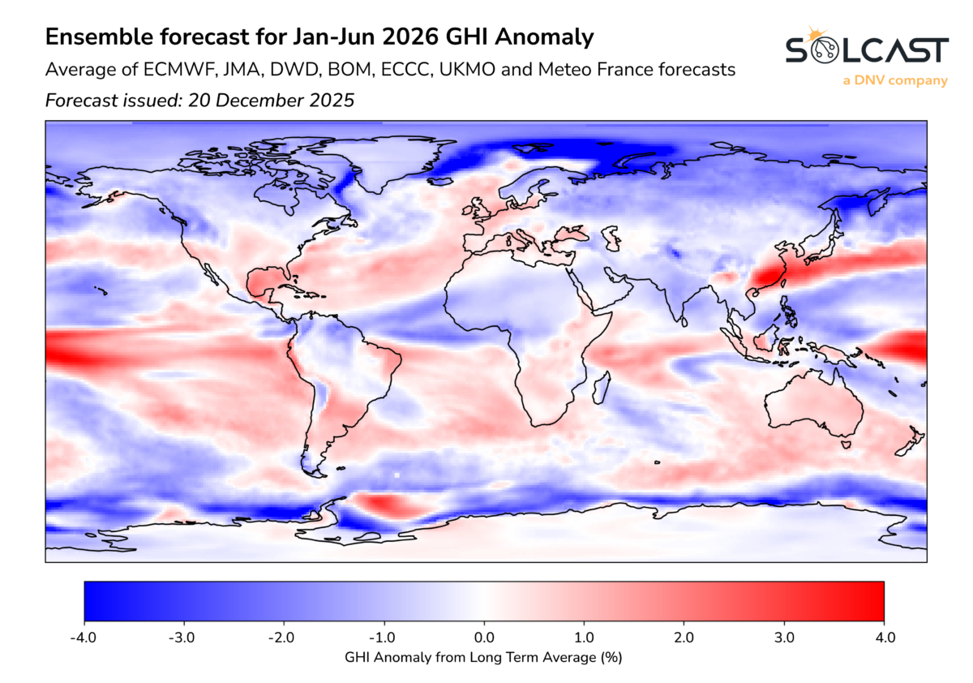
Sub-Seasonal and Seasonal Forecasts
Industry is asking for forecasts of upcoming months / seasons
Numerical models deliver results for such
time horizons
What is the quality of those forecasts?
  Is the uncertainty lower than the anomaly?
  In which region gives long-term forecasts valuable results?
  In which time horizons gives long-term forecasts valuable results?
Activities:
1. State-of-the-art mapping and validation design
2. Harmonised verification framework
3. Simple, targeted post-processing / downscaling experiment
5. Synthesis and guidelines for operations

Slide 10
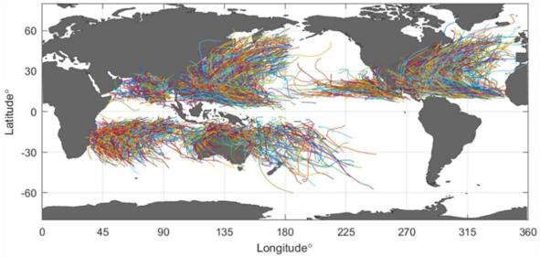
Climate Change and Extreme Events
Ongoing work on the analysis of long term trends and model quality
A new focus on climate SSP scenarios with respect to long term solar resource assessment will be set.
Analysis of quality of results of global and regional climate models.
This includes:
  Extreme Events (Definition, types, trends)
  Dark Doldrums (Dunkelflauten) and Sunny Storms (Hellbrisen)
Figure 3: Tracks of tropical cyclones ex-tracted from IBTrACS [4]. Creative Com-mons License CC BY 4.0.
  Adequacy studies for resilience of infrastructures
  Climate and extreme weather data for PV degradation and durability (in collaboration with Task 13)

Slide 11
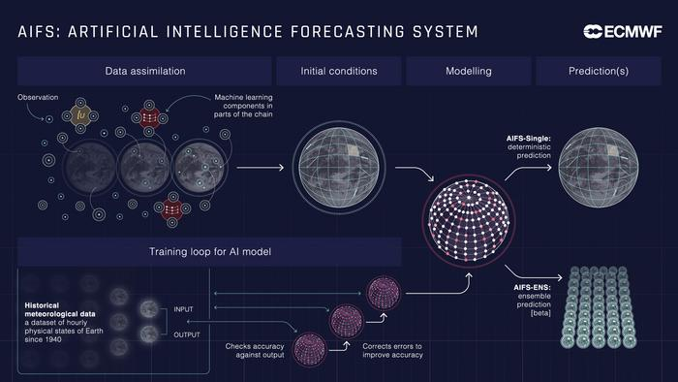
Best practices of AI
AI is widely used also in the field of solar resources and forecasts
ECMWFS AIFS gives better results for temperature or precipitation as physical
model (IFS) but not yet for irradiance
Combination of physical and AI methods
deliver often best results (on all temporal
and spatial scales)
AI is often applied not optimally applied
Guidelines and best practices will be given in the 6th Ed. Of the Solar Res. Handbook
Best practices for ensuring robust and generalisable machine learning model development and testing for forecasting and resource assessment
Potential of AI for emulating physics-inspired GHI retrievals and forecast model
Potential of AI for improving physics-inspired GHI retrievals and forecast models

Slide 12
Subtask/Activity | Leader
Subtask 1: Solar Resources | Stefan Wilbert, DEU and Manajit Sengupta, USA
Activity 1.1: Measurements and non-radiation parameters | Stefan Wilbert, DEU, Vicente Lara Fanego, SVK
Activity 1.2: Radiation models | Manajit Sengupta, USA, Yehia Eissa, FRA
Activity 1.3: Data for Integrated systems (e.g. Agri-PV) | Cristina Cornaro, ITA, Marco Pierro, EURAC, ITA
Subtask 2: Irradiance and PV Power Forecasting | Elke Lorenz, DEU and R. Amaro e Silva, POR
Activity 2.1 Nowcasting | Andreas Kazantzidis, GRE, Khadija Barhmi, NLD
Activity 2.2 Day ahead forecasting | Elke Lorenz, DEU
Activity 2.3 Long-term forecasting | Marcello Pettita, ITA
Subtask 3: Focus topics | Yehia Eissa, FRA,
Activity 3.1 Benchmarks and data practices | Yehia Eissa, FRA, Adam R. Jensen, DNK
Activity 3.2 Climate Change and extreme events | Kristian Nielsen, DNK
Activity 3.3 Firm power | Richard Perez, USA
Activity 3.4 Best practices for AI | Angela Meyer, CHE, Manajit Sengupta, USA
Subtask 4: Dissemination | Jan Remund, CHE and Adam R. Jensen, DNK
Activity 4.1 Webinars, workshops and publications | Jan Remund, CHE
Activity 4.2: Open-source tools and data access | Adam R. Jensen, DNK
Activity 4.3: Solar resource Handbook | Aron Habte, USA and Yehia Eissa, FRA
Activity 4.4: Standardisation | Aron Habte, USA
Activities
&
Leaders

Slide 13
Firm Power 26: Key Takeaways
Firm Power from Variable Renewables is Feasible and Cost-Effective
A 100% renewable grid based on firm wind and solar is technically achievable and economically competitive worldwide. Strategic design choices—blending renewable resources, storage, and flexibility—enable reliable 24/7 power without relying on massive seasonal storage or extensive grid expansion.
Wind/Solar Overbuilding and Curtailment are generally Essential
In the absence of large, low-cost clean demand-side or supply-side flexible resources (e.g. hydro), installing excess renewable capacity and curtailing surplus output (“implicit storage”) is a cornerstone strategy. It significantly reduces the size for costly storage systems lowering overall generation costs.
Market and Policy Reforms are Critical
Current electricity markets reward energy output rather than reliability and availability, penalize curtailment, and fail to value integrated resource systems. New frameworks—such as capacity-based remuneration and dual-market designs—are needed to unlock least-cost firm power configurations.
Case Studies Confirm Practical Viability
Studies from regions such as Nova Scotia, Italy, Switzerland, China, and Australia show firm renewable systems can meet growing demand at competitive costs. For example, Nova Scotia’s optimized mix achieves 100% renewable supply at $0.05/kWh, even with full electrification of buildings and transport.

Slide 14
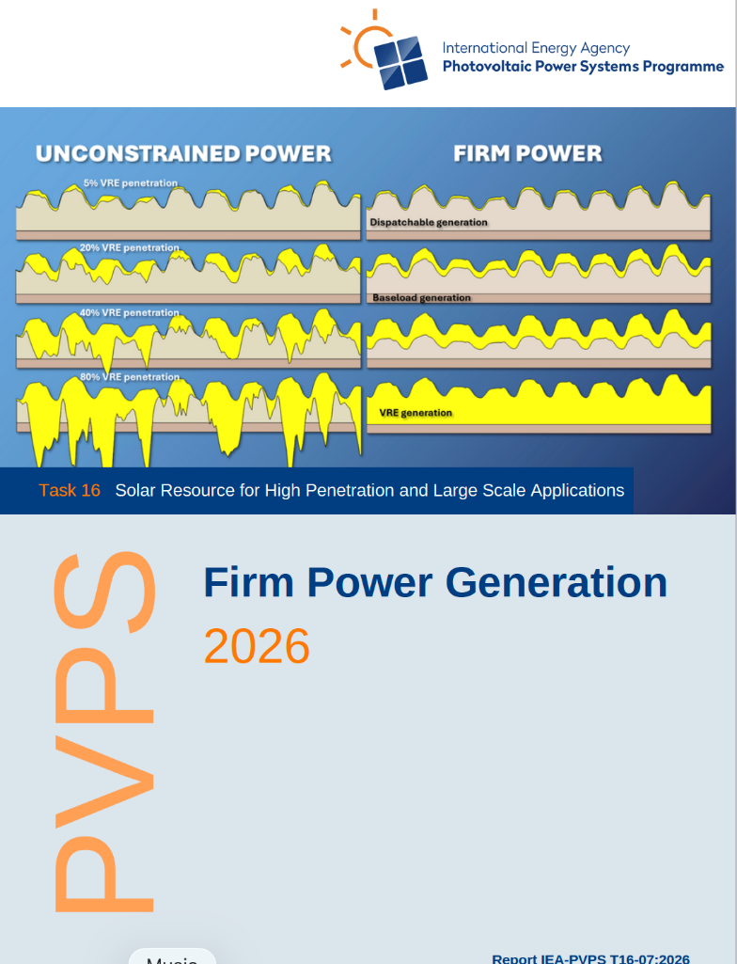
Main reports: Firm Power Generation 2026
https://iea-pvps.org/key-topics/t16-firm-power-generation-2026/
Australia
Canada
China
Denmark
Italy
The Netherlands
Portugal
Switzerland
USA

Slide 15
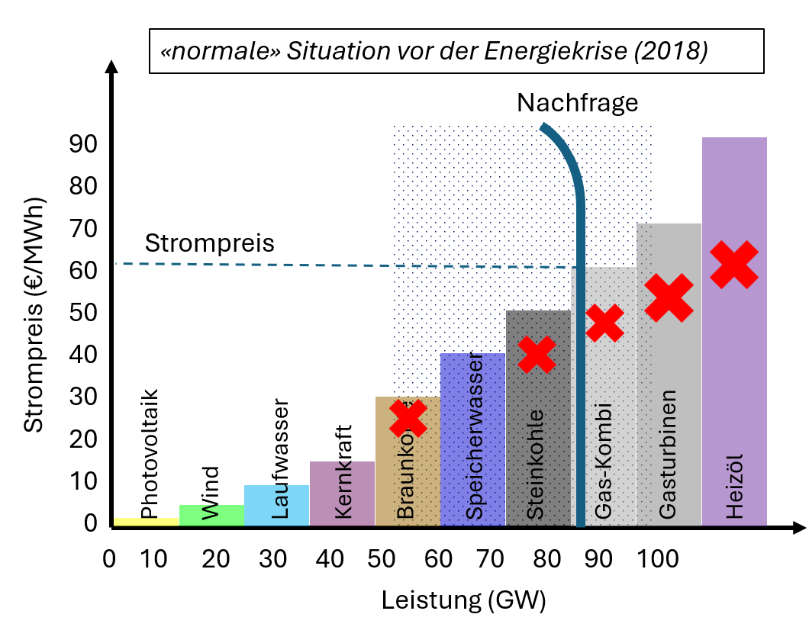
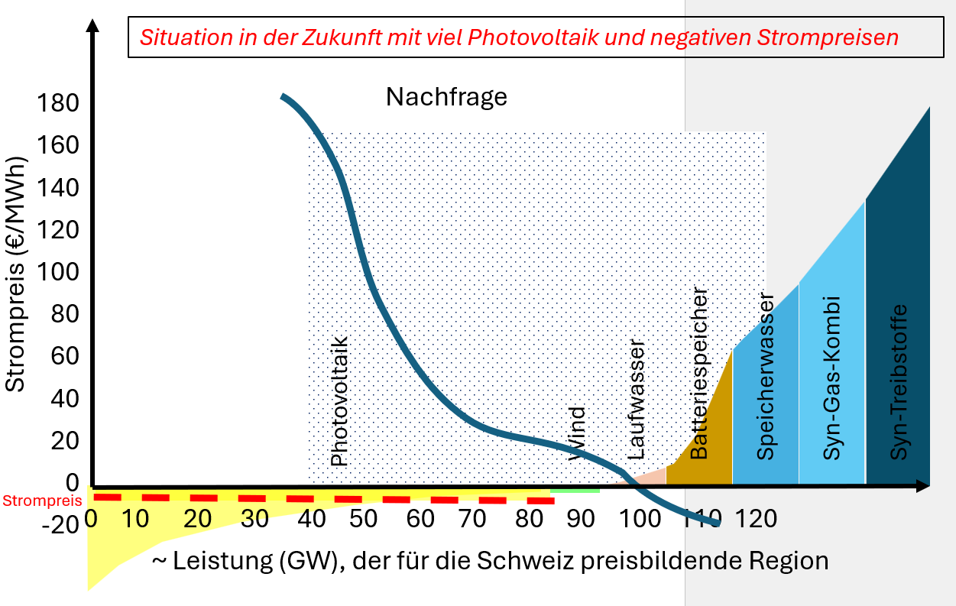
Firm Power: Flexibility is key
Flexibility will be key -> merit-order lines need to get tilted
Activation COST of flexibility will be key and depending storage / curtailment / grid extenson costs
  Major causes of difference to LUT outcomes
Presentations at EU PVSEC 26
5DO.19 (Wednesday)
2020
Future

Slide 16
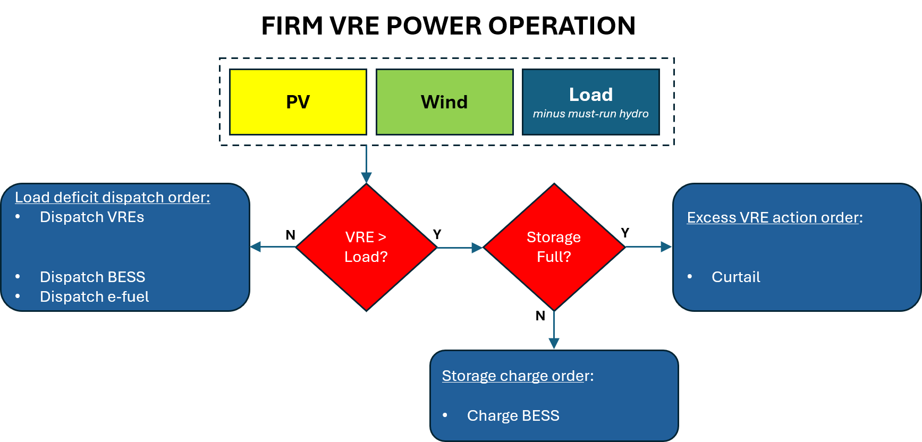
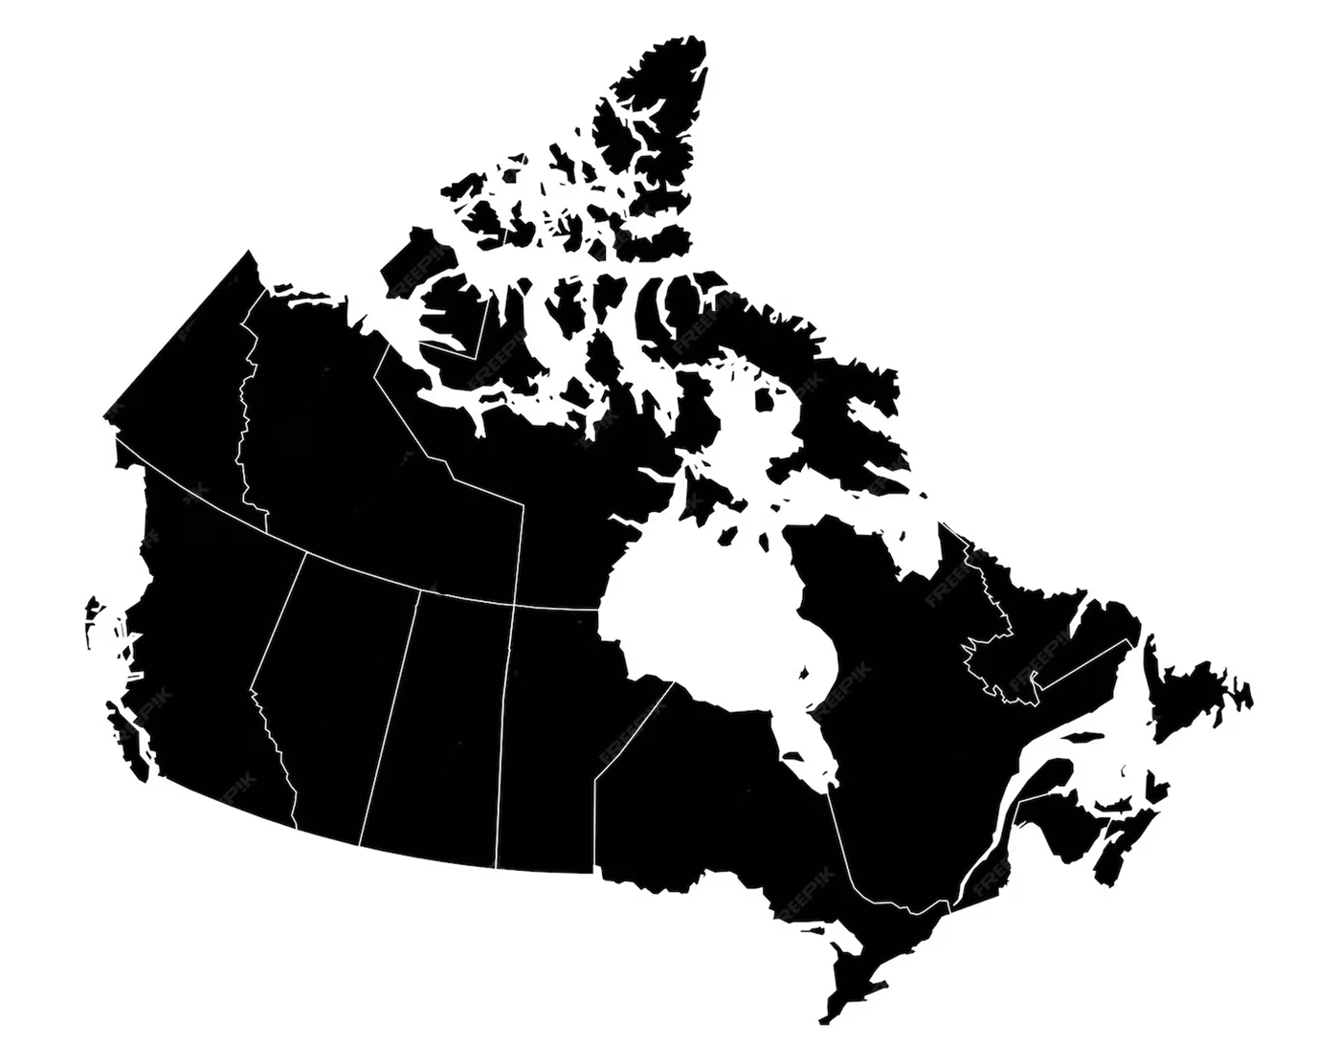
Firm Power: Case Study Nova Scotia, CAN
Firm Power Economics Case Study
Nova Scotia, CAN

Slide 17
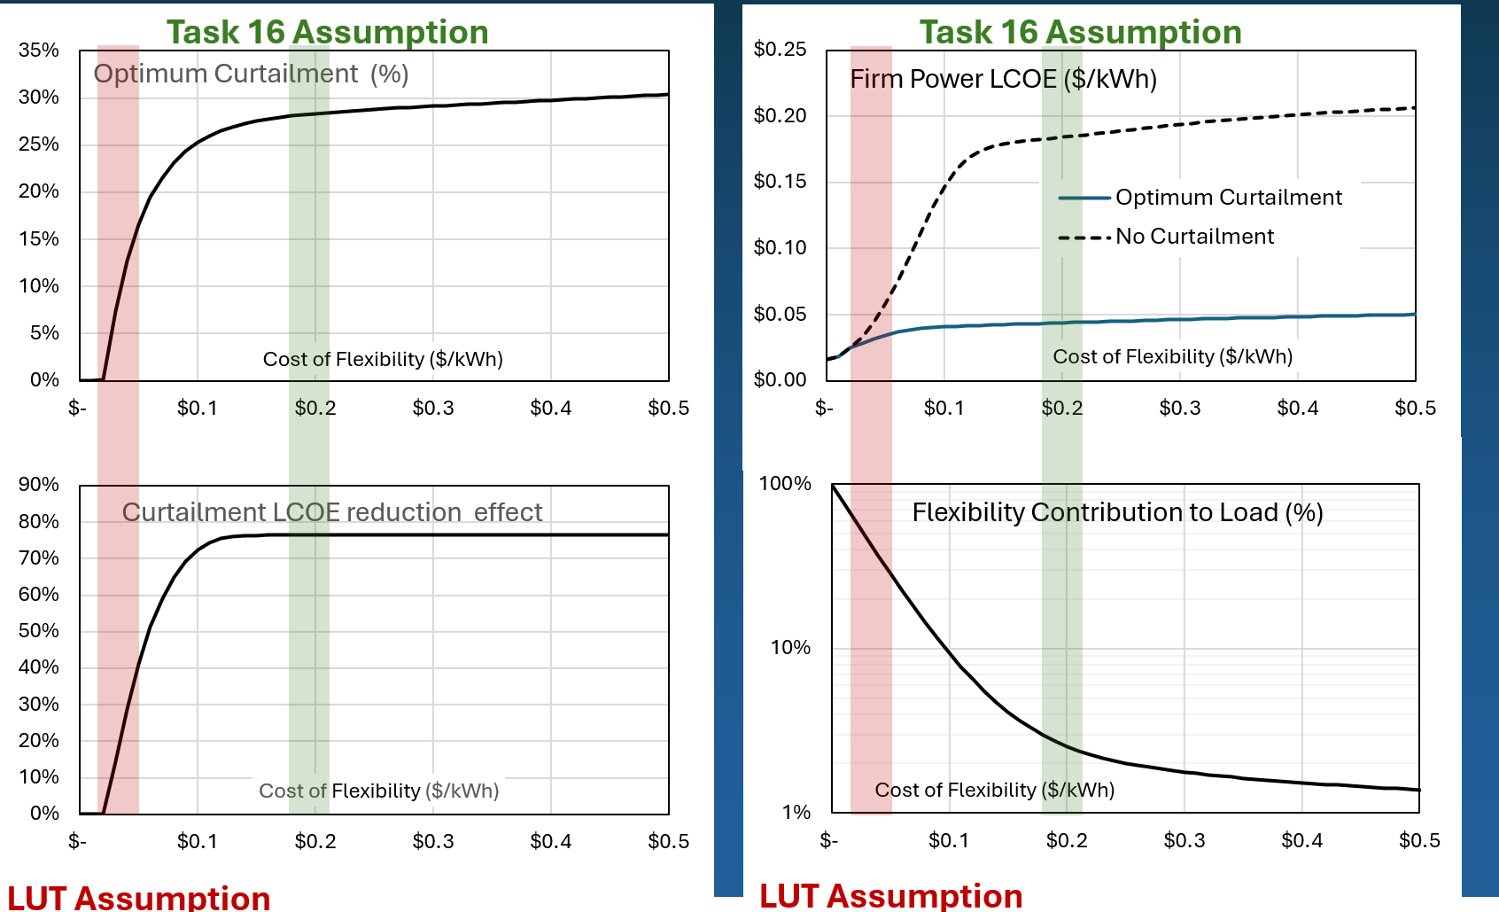
Firm Power: Curtailment vs. Storage / flex. costs
What is the impact of flexibility cost assumptions on firm power LCOE and optimal curtailment?
Cost-optimal curtailment (top left), flexibility contribution (top right), firm power LCOE with and without curtailment (bottom left) and implicit storage effect (bottom right) as a function of flexibility’s OpEx​

Slide 18
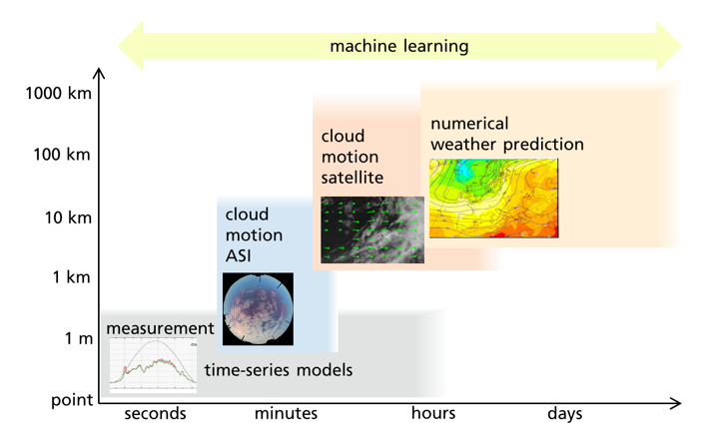
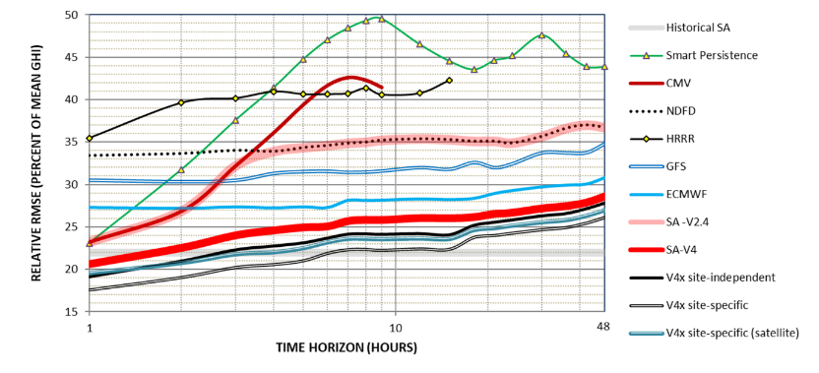
Solar and PV Forecasting remains key
Even in curtailed and managed systems PV forecasting is key to minimize balancing costs
Combining forecasts and adding AI
is best
Snow and fog still difficult to predict
Upcoming issue: Generation different to Feed-in (with EMS, storage and curtailment)
(AI supporter) ASI lowers uncertainty in first 20 min.

Slide 19
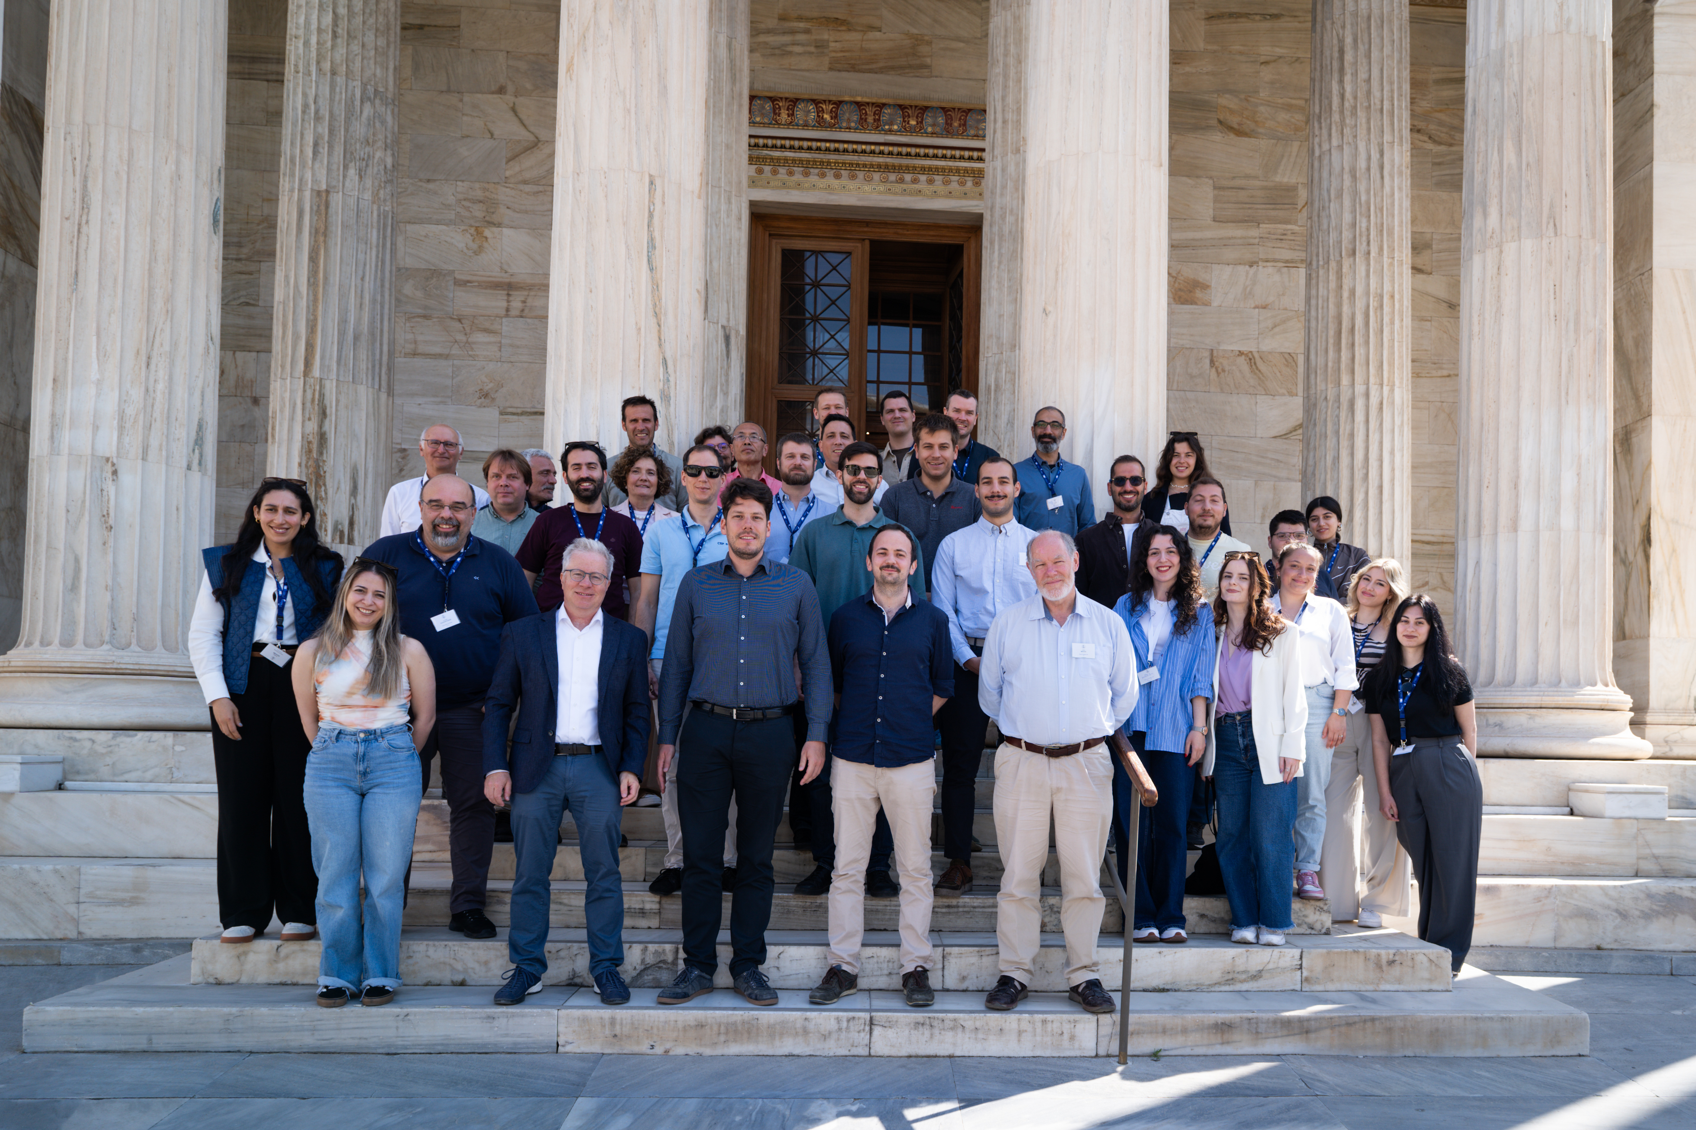
Task 16 meeting Athens
April 2026
Thank you
Jan.remund@meteotest.ch

