Slide 1
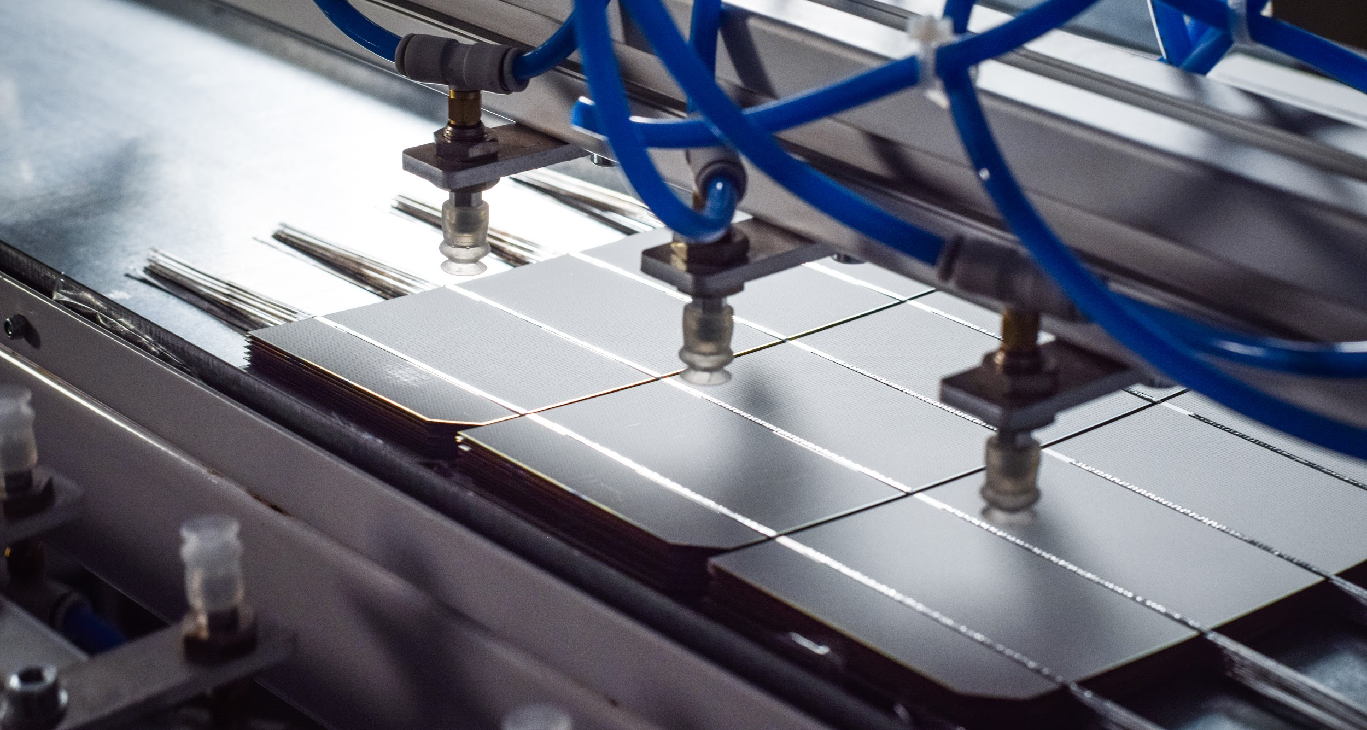

Value, Business Models and Policy: Lithuania case
Dr. Juras Ulbikas
PVPS Task 1, ExCo Lithuania
PVSEC 2026, Sep 14-18, Rotterdam

Slide 2
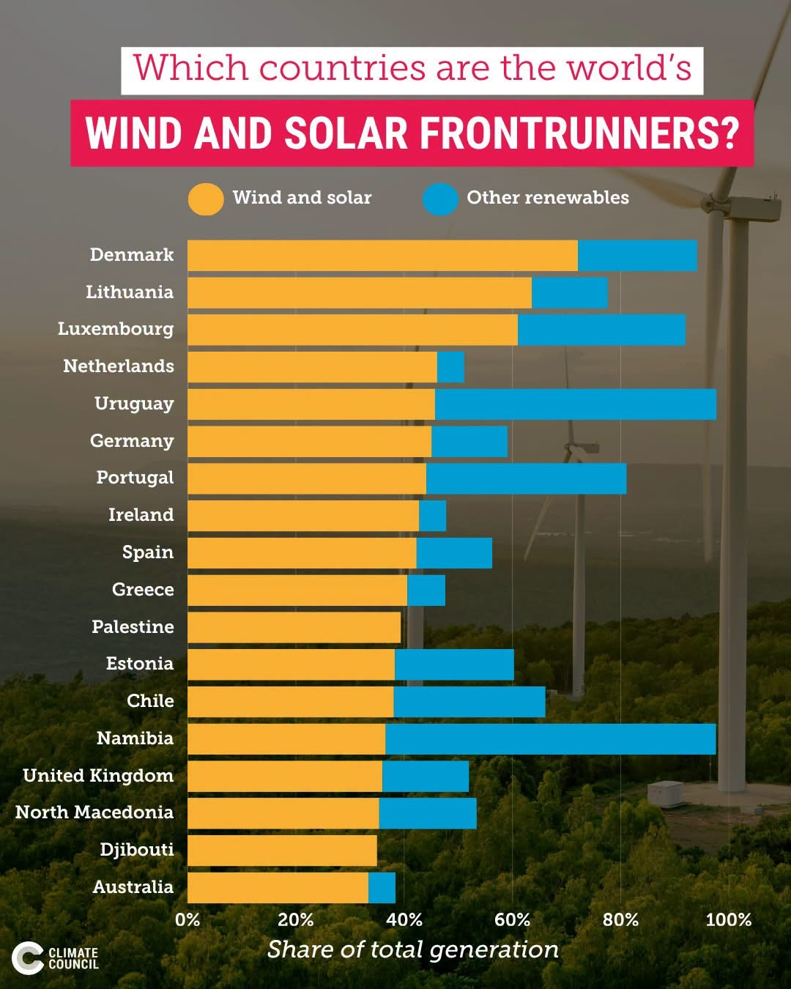
Policy & Grid – main drivers
National Strategy for Energy independence: by 2030 100% electricity to come from RES. According recent trends – target can be reached by 2028
Focus on prosumers support:
Private prosumers still on net-metering, while commercial already on net-billing
Push toward BESS:
Support for hybrid PV+BESS or BESS for those who has already PV systems (700 Eur/kWh – LFP, and 580Eur/kWh – Li-ion)

Slide 3
Policy & Grid – main drivers
Grid: High cohesion and limited points for connection permits
Permits to connect: differentiation between installed generating power and permissible generating power. Permissible generating power limited in line with grid capacity to absorb power.
Market: curtailment or negative prices new normal
Business model: Profitability ONLY in the presence of BESS + EMS working with NORDPOOL market forecasts

Slide 4
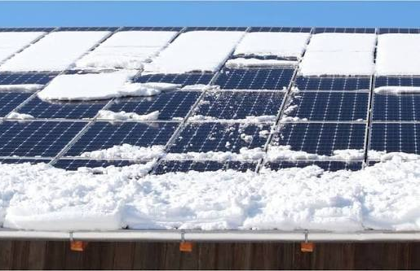
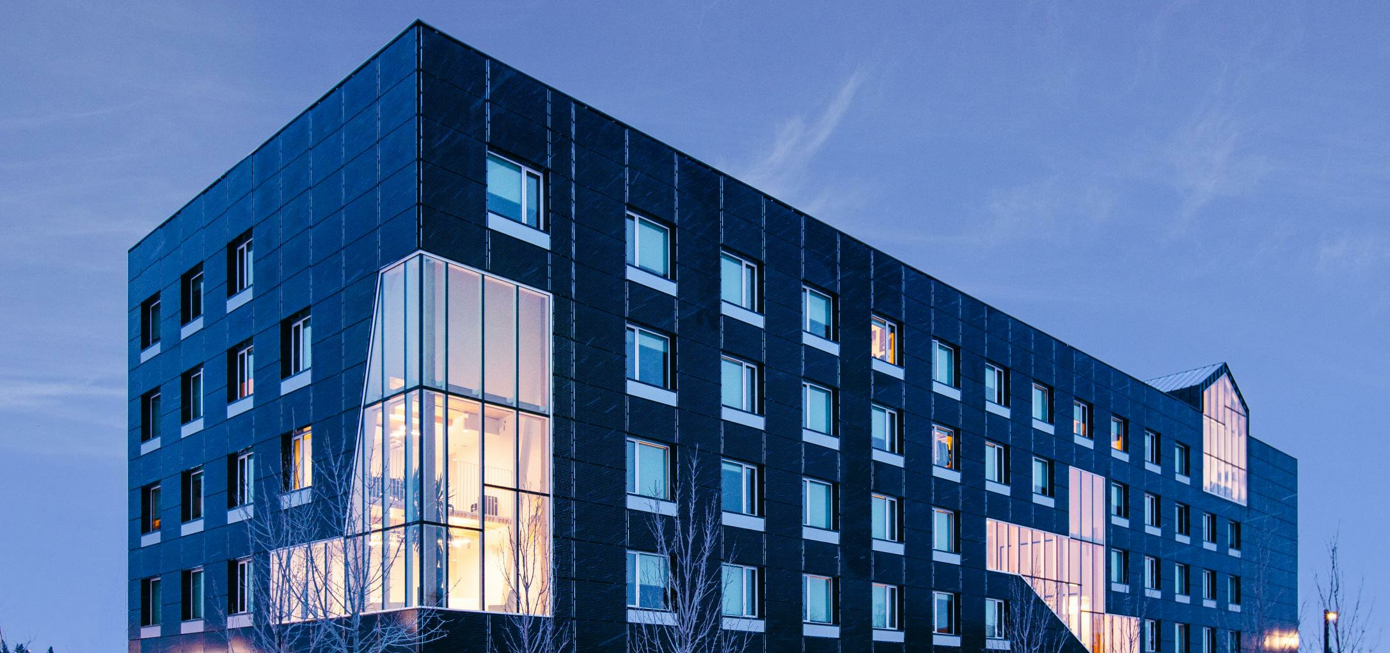
Way forward to 100% RES electricity
BESS is a must!
Which short term storage technology for cold climate: Li vs Na?
Summer curtailment: overcapacity for the sake of winter generation will not work – Nov-Feb ~5% of generation per year (snow + low Sun).
Seasonal/long term storage is a solution. Green Hydrogen? No clear business case for now – ROI under question.
Prosumer based strategy for high cohesion situation: prosumer is a king - local generation + local storage + local consumption, less pressure on the grid, less primary energy.
For PV further deployment: IPV as alternative solution?

Slide 5
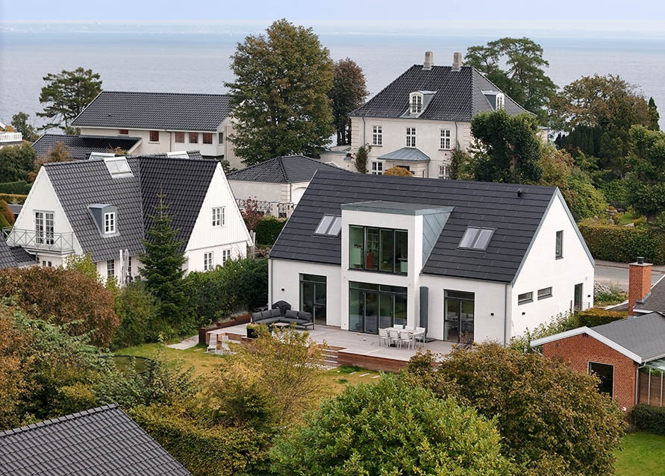
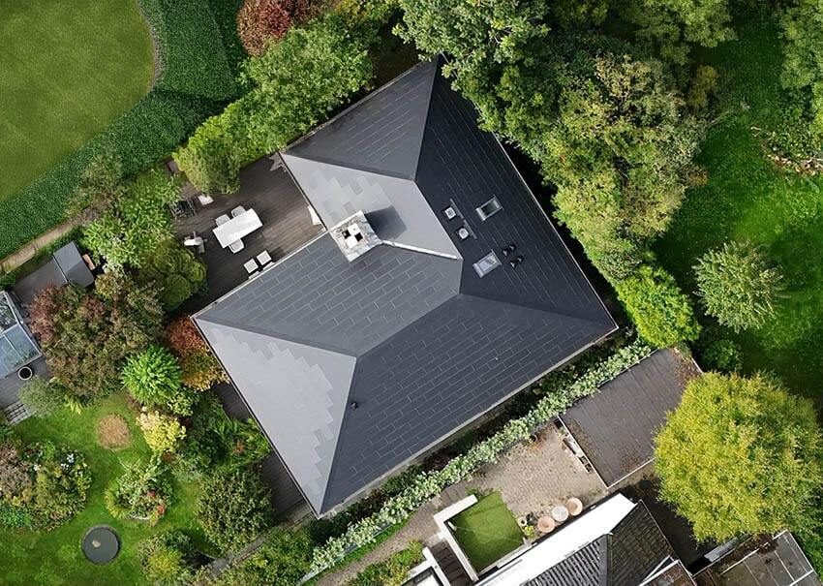
Business case for prosumers with 100% electric house
Energy needs:
Assumptions: 120 m² house, 4 people, good airtightness, Vilnius-like climate, heat pump for space heating (COP≈3) and DHW (COP≈2.5).
So, for a ~120 m² A-class home, expect roughly 5.5–8.8 MWh/year of electricity if using heat pumps for both heating and hot water, with ~6.5 MWh/year a realistic midpoint.
Energy generation (assumption 150 Wp/m²):
Required gross module area (before gaps/clearances):
• 6.5 kWp ÷ 0.150 kWp/m² = ~43.3 m² of active module surface.
~48–52 m² gross surface is needed to cover 100% energy needs (adding ~10–20% for gaps, edges, vents, fire paths).

Slide 6
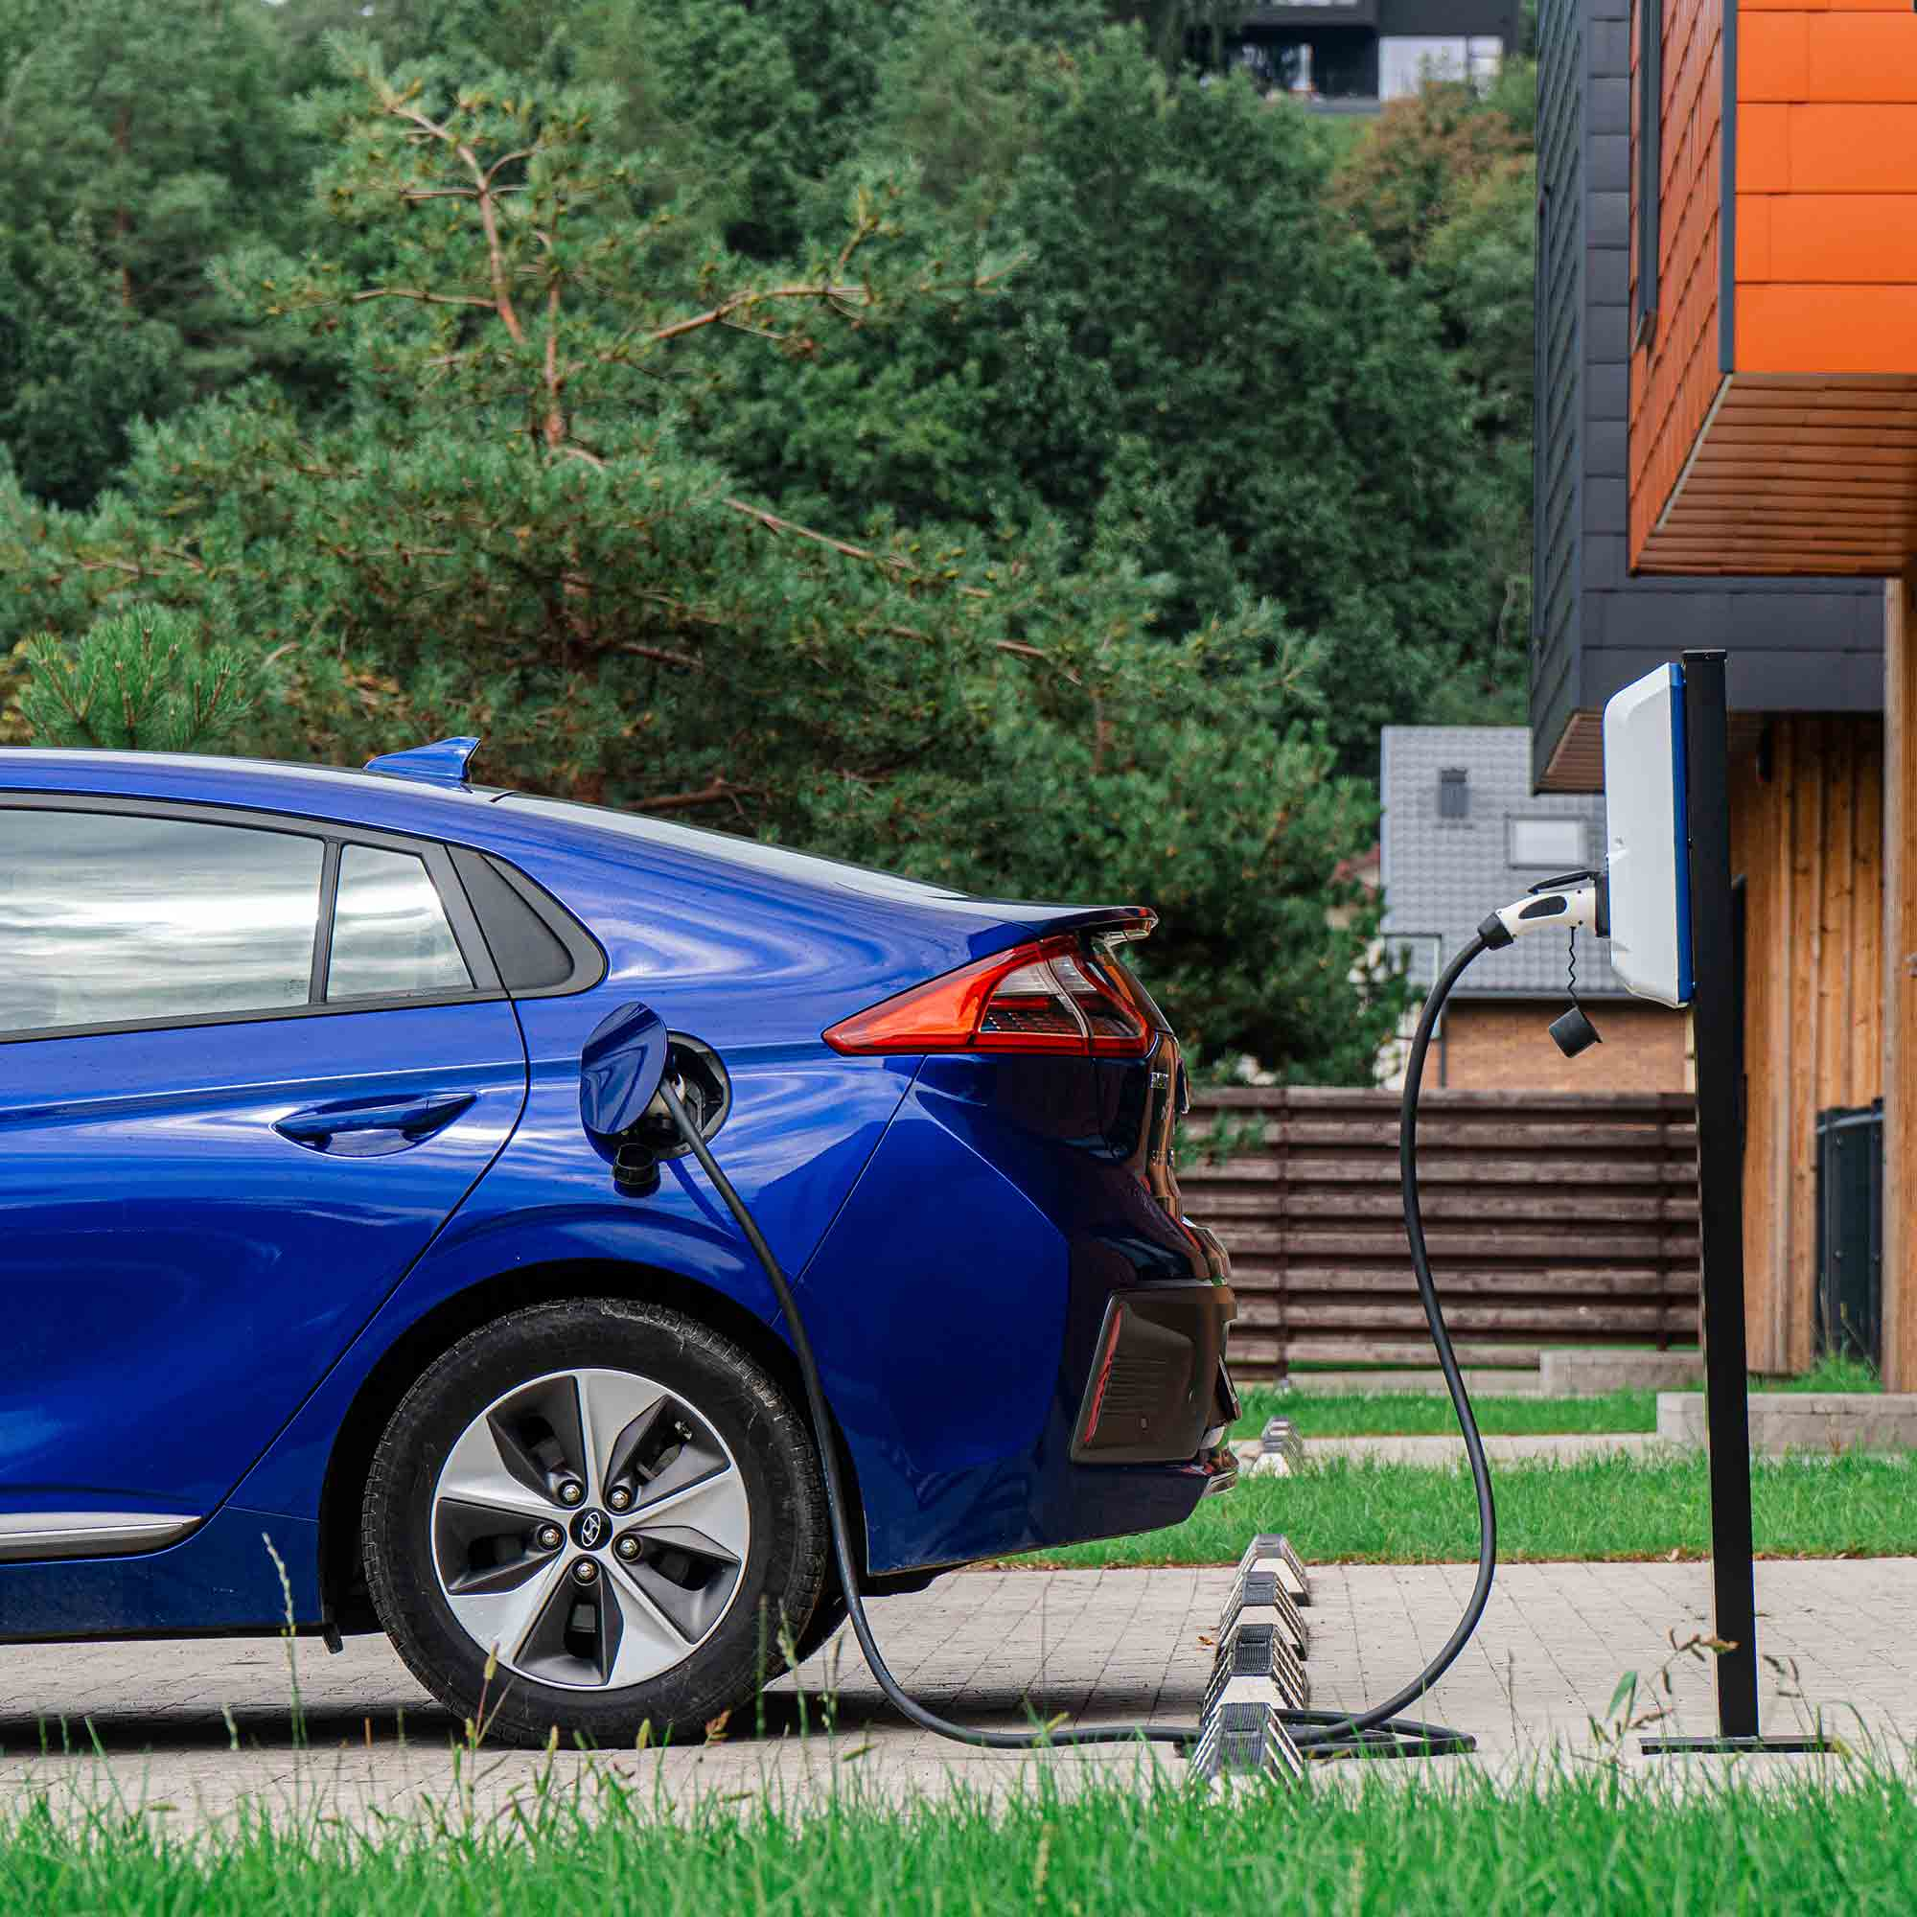
Business case for prosumers in 100% electric economy
Two cars
15,000 km/year per car
EV consumption: 18 kWh/100 km
Energy use | Annual electricity
House | ~6,540 kWh
2 EVs | ~5,400 kWh
Total | ~11,940 kWh/year
So the PV system would need roughly 12 kWp under our 1,000 kWh/kWp/year production assumption.
Conservative 150 Wp/m² panels (due to non optimal inclination, or aestetic colour solutions):
12 kWp ÷ 0.150 = ~80 m²
LT based ELINTA charging station (https://elintacharge.com/ev-chargers/homebox-lite/)

Slide 7
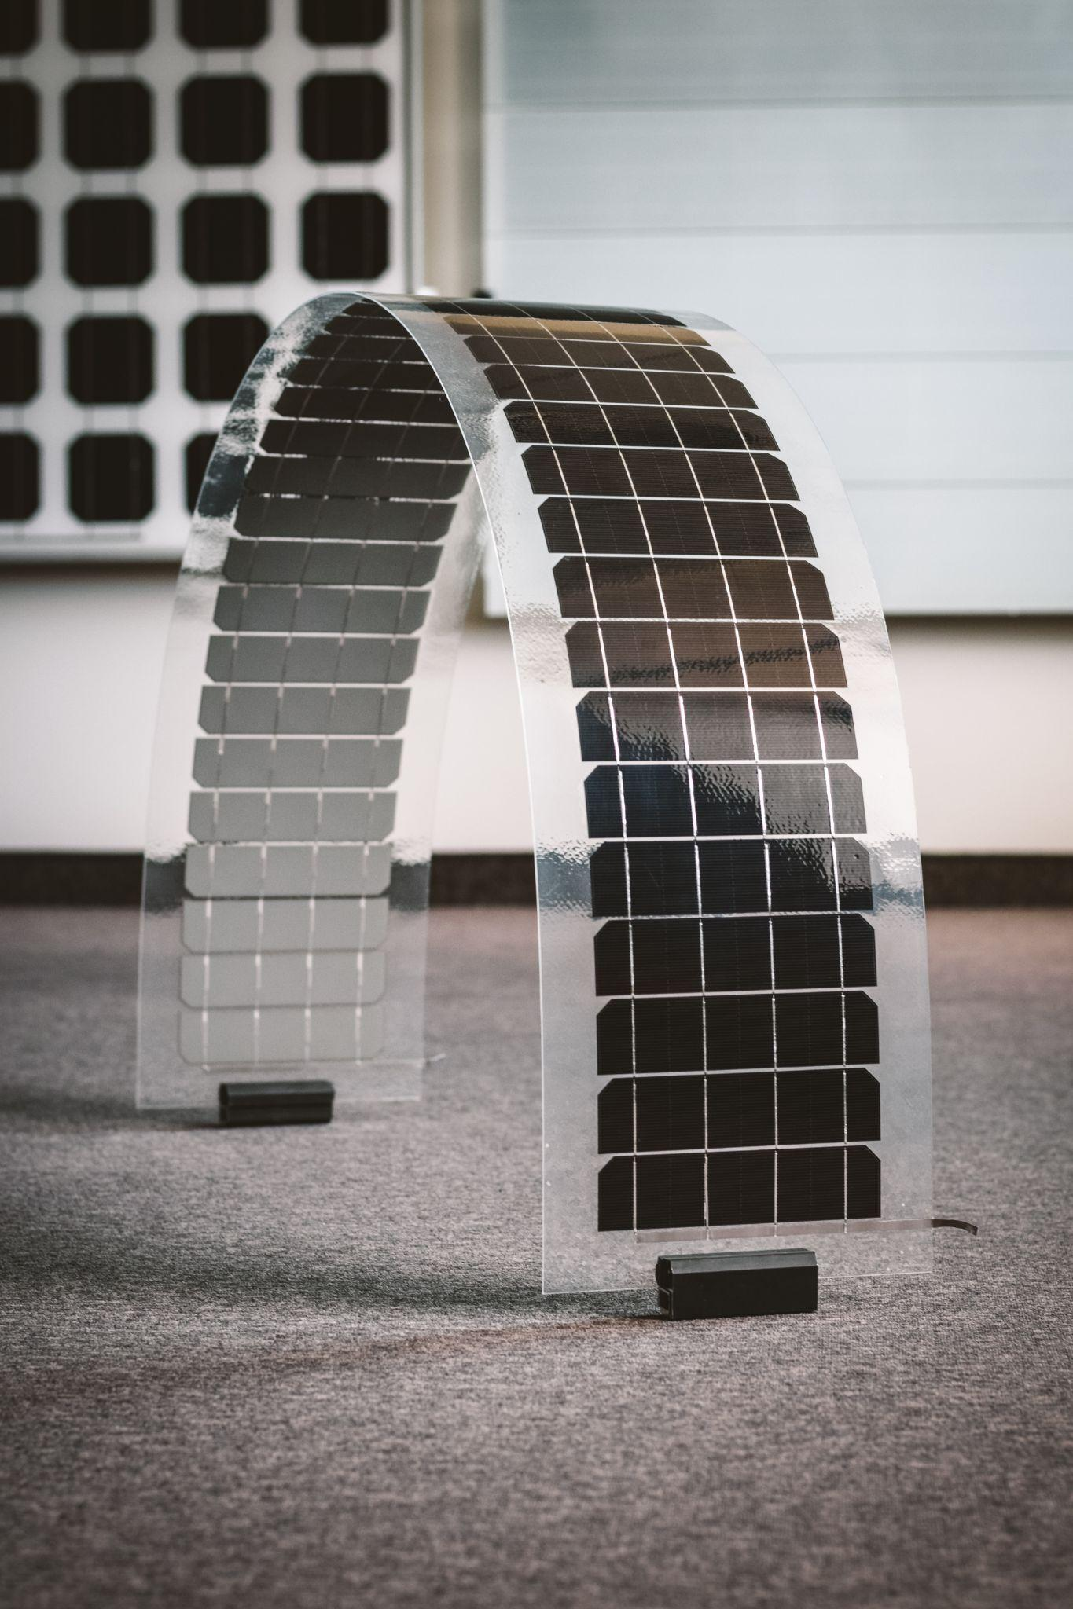
Thank you!
IPV Technology Enablers
The Applied Research Institute for Prospective Technologies, Lithuania
Vismaliukų g. 34, LT-10243 Vilnius, Lithuania
juras.ulbikas@protechnology.lt

