Slide 1
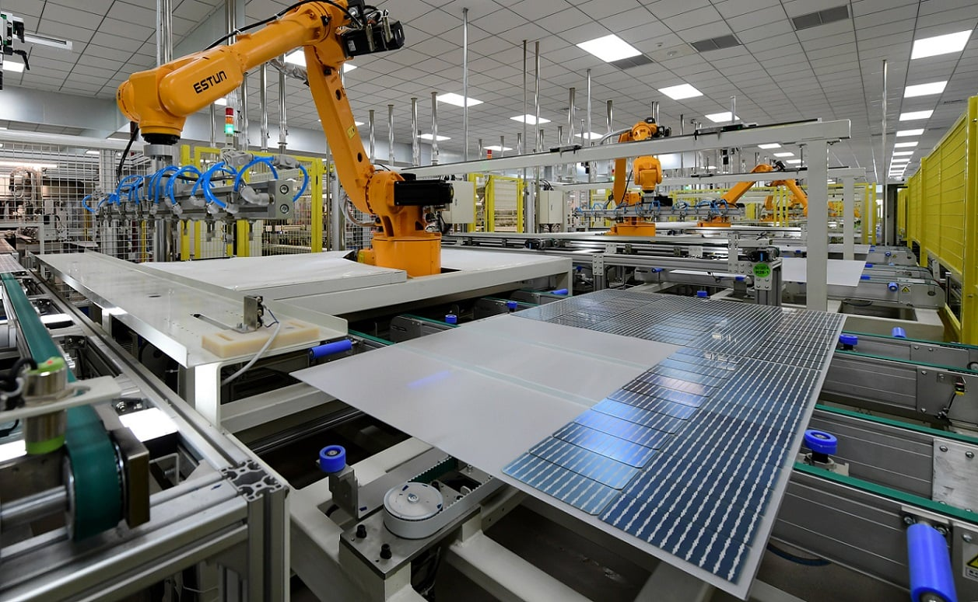
Life Cycle Inventories of Photovoltaic Systems
Authors: Götz, M., Deuber, R., Gazbour, N., Brailovsky, P.H., Nold, S., Marchand-Lasserrre, M., Frischknecht, R., Khan, A.A., Bovo, G. Stucki, M. (2026), Heath, G. (editor),
June 2026

Slide 2
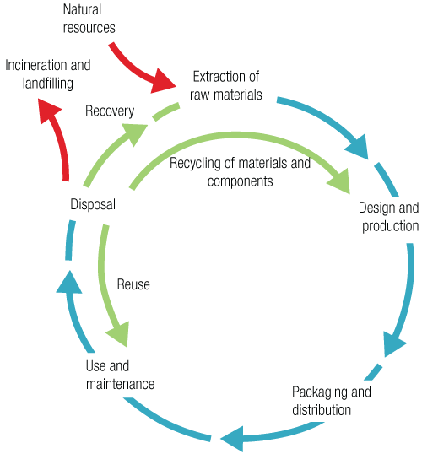
Life Cycle Assessment
Life Cycle Assessment (LCA) is a structured, comprehensive method of quantifying material and energy flows, including the associated emissions caused in the life cycle of goods and services.
The life cycle of goods and services covers raw material and primary energy extraction, material and energy supply, manufacture, use and end of life, including transport and waste management services where needed.
www.lifecycleinitiative.org

Slide 3
Life Cycle Inventories of Photovoltaic Systems
Introduction
The life cycle inventory (LCI) phase of an LCA involves data compilation of material and energy inputs, as well as emissions and product outputs for the complete life cycle of the system, from cradle to grave.
In this report, such data are collected and modeled separately for the PV modules and the balance of system (BOS). The updated datasets have undergone a robust, multi-step quality assurance process.
PV modules
LCI data were updated for commercial PV modules (TOPCon, PERC and thin-film CdTe). For the TOPCon module supply chain, LCI data are based on a large set of LCAs collected between 2022 and 2025 from Chinese manufacturers in the context of the French PV tender process.
Data represent different geographic regions of module production and supply chains (China, Europe, North America, and Asia & Pacific).
Balance of system
BOS data are presented for inverters as well as electrical and structural components of residential, commercial, and utility-scale PV systems.
Citation: Götz, M., Deuber, R., Gazbour, N., Brailovsky, P.H., Nold, S., Marchand-Lasserrre, M., Frischknecht, R., Khan, A.A., Bovo, G. Stucki, M. (2026). Life Cycle Inventories of Photovoltaic Systems, Heath, G. (editor), International Energy Agency (IEA) PVPS Task 12, Report T12-XX:2026..

Slide 4
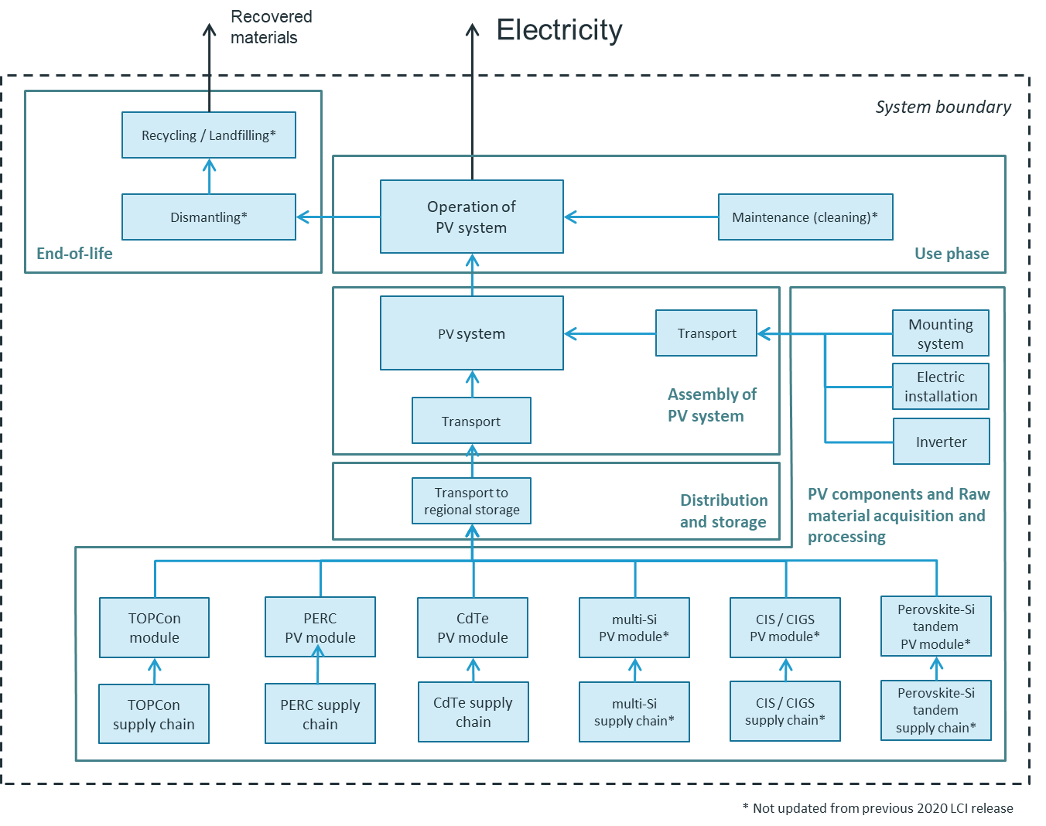
PV Product System and System Boundary
Note: this diagram represents Task 12’s entire LCI, not the specific 2026 update.
IEA PVPS Report T12-XX:2026

Slide 5
Results
This report updates the 2020 version (IEA PVPS Task 12 Report T12-19:2020) and is the most comprehensive IEA PVPS Task 12 LCI update in more than a decade.
Updated LCI data from industry & markets are provided in Chapter 3.
    Crystalline Si modules and supply chain (Section 3.1),
    Thin film CdTe PV module manufacturing (Section 3.2)
    Solar inverters (3 kW, 5.5 kW, 8-10 kW, and 100 kW) (Section 3.7)
    Country-specific PV mixes (Section 3.9)
The report also introduces a new category of data: detailed LCI data based on bottom-up simulations, presented in Chapter 4.
Electronic versions of LCI data tables are available at:
  IEA PVPS (https://iea-pvps.org/research-tasks/pv-sustainability)
  Zurich University of Applied Sciences (ZHAW) doi.org/10.21256/zhaw-2586

Slide 6
Key Messages
This is the most comprehensive IEA PVPS Task 12 LCI update in more than a decade. The monocrystalline silicon supply chain update for TOPCon cell technology is based on 83 screened LCAs of different components from the French PV tender process and provides unusually high market coverage for public PV LCI data, including approximately 29% of global polysilicon production capacity, 16% of global wafer, 7% of global cell, and 9% of global module. CdTe data are based on primary data from the dominant global CdTe producer, representing more than 90% of the CdTe module market. Additionally, new LCI data on string inverters have been added.
The updated datasets have undergone a robust, multi-step quality assurance process.
Users must distinguish between dataset types. This report includes industry-representative measured LCI data, selected product-line industry data (e.g., CdTe modules), retained datasets from earlier report editions, generic BOS component inventories, and—for the first time—industry-validated, modelled LCI data for advanced monocrystalline silicon manufacturing. These categories have different appropriate uses and should not be treated as interchangeable.
Representativeness is strong but not uniform. The monocrystalline silicon and CdTe datasets have high credibility and strong market relevance, and are therefore appropriate for use as generic background data, screening datasets, and harmonised reference inventories. BOS datasets and older technology datasets should be used more cautiously as generic inventories. For manufacturer-specific comparative LCA, specific foreground data remain necessary.

