Slide 1
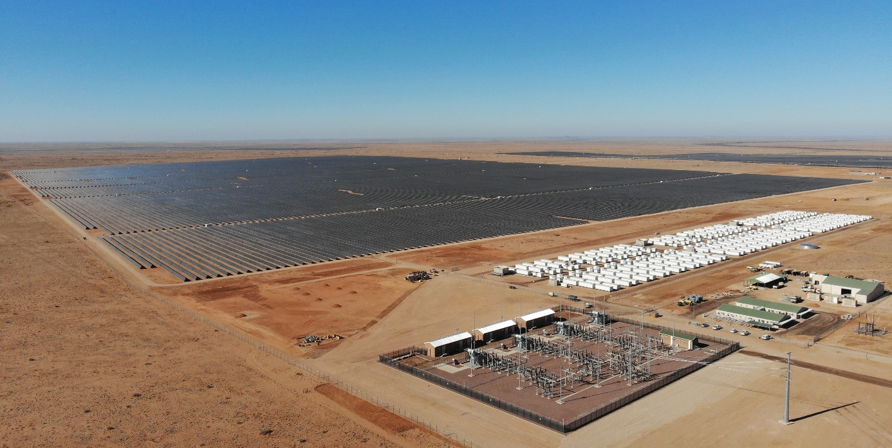
Assessing the Reliability of Battery Systems
in Solar Power Plants in Operation
Erik Stensrud Marstein, IFE, Norway; Marc Köntges, ISFH, Germany; Ulrike Jahn, Fraunhofer CSP, Germany, July 2026
Task 13 Reliability and Performance of PV Systems

Slide 2
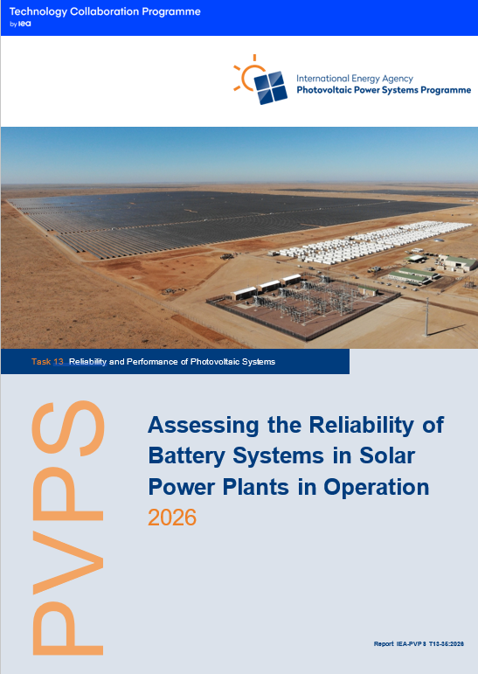
Assessing the Reliability of Battery Systems in Solar Power Plants
Motivation
Rapid global deployment of PV and falling BESS costs are driving large investments in PV + BESS plants, where long‑term performance and reliability are critical for delivering essential services.
PV‑specific duty cycles and operating environments differ markedly from automotive and consumer applications, so existing knowledge on battery ageing (calendar vs cyclic) is not directly transferable.
There is a lack of long‑term field data, validated ageing models and harmonised performance indicators for operational PV + BESS.
The report aims to review current technologies, define suitable metrics and highlight research gaps via selected case studies.

Slide 3
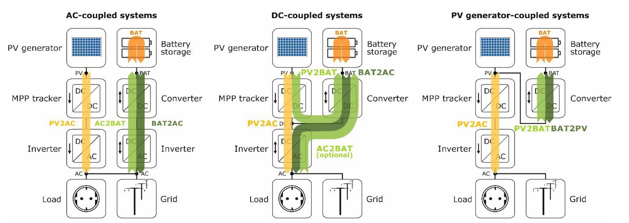
Assessing the Reliability of Battery Systems in Solar Power Plants
Energy conversion pathways of PV battery storage systems …
Source: HTW Berlin
Report IEA-PVPS T13-35:2026, July 2026

Slide 4
 | Name of use case | Function | Typical duty cycle
Energy management | Peak shaving and time shifting | Avoid/reduce clipping losses Avoid/reduce curtailment losses Increase utilization of infrastructure Reduce energy costs of operation | Daily/few deep cycles
 | Self-consumption and self-sufficiency | Maximize share of self-consumed PV power | Daily/few deep cycles
Market operations | Spot market | Energy arbitrage | Frequent cycles of varying depth
 | Capacity market | Profitability based on ability to supply firm power (W) in accordance with contract (PPA) | Daily/few deep cycles with frequent smaller corrections
 | Day ahead and intra-day bidding | Reduction of production forecast uncertainty Reduction/avoidance of imbalance fee | Variable
Resilience | End user energy resilience | Energy resilience for end users Power back-up Black start capabilities | Few deep cycles
Grid services | Capacity firming and smoothing | Capacity firming Smoothing Ramp rate control | Frequent shallow cycles (firming, smoothing), few deeper cycles (ramp rate control)
 | Ancillary services | Provision of frequency reserves Provision of voltage support | Frequent fast and potentially deep cycles
Offgrid | Off-grid PV and appliances | Off-grid PV systems PV appliances | Large variation
Assessing the Reliability of Battery Systems in Solar Power Plants

Slide 5
Assessing the Reliability of Battery Systems in Solar Power Plants
Key Takeaways
The performance, reliability and lifetime of PV + BESS are strongly dependent on technology, use case, operating conditions and system design, with limited long-term field data for several emerging applications.
A technical assessment framework is defined around six key performance indicators: capacity, power tolerance, internal resistance, round-trip efficiency, response time and standby losses. It enables consistent performance assessment of PV + BESS.
Field results from residential inspections (HTW Berlin), resilience systems (SunSmart Schools), building-scale PV + BESS (RISE) and Nordic virtual power plant operation demonstrate wide spreads in real‑world efficiency, inverter and standby losses, highlighting the need for harmonised monitoring, high‑quality open data and validated ageing models.
Report IEA-PVPS T13-35:2026, July 2026

