Slide 1
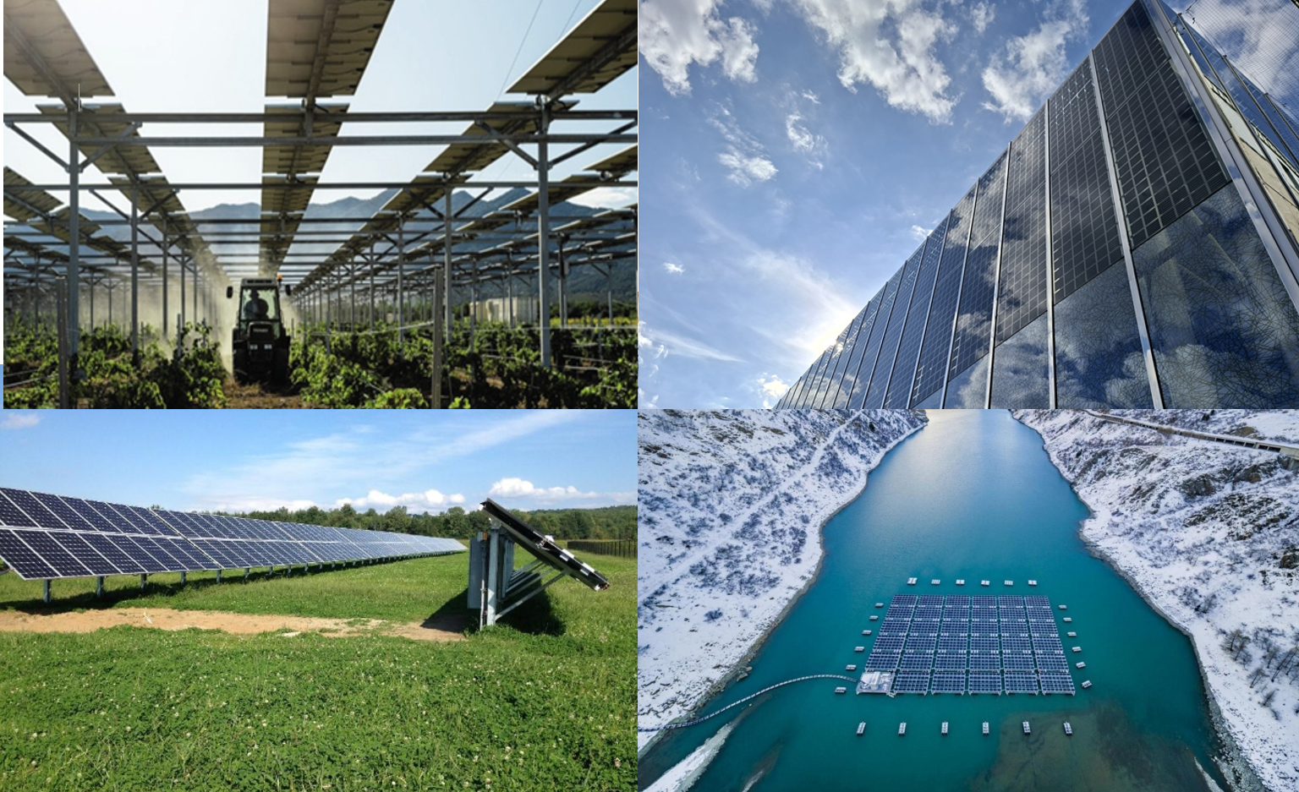
Optimisation of Photovoltaic Systems for Different Applications
G.Friesen, SUPSI PVLab; L. Micheli, Sapienza University of Rome; et al.
Report IEA-PVPS T13-39:2026, August 2026
Task 13 Reliability and Performance of PV Systems

Slide 2
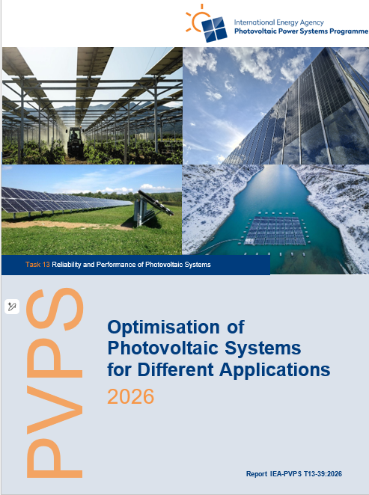
Optimisation of Photovoltaic Systems for Different Applications
Introduction
Photovoltaic (PV) deployment is entering a new phase of diversification. Ground-mounted systems have driven the rapid global expansion of solar power, but future growth will increasingly rely also on integrated PV solutions such as BIPV, FPV and AV.
As PV applications diversify, understanding application-specific stressors becomes essential. Integrated PV systems must move beyond energy yield and cost optimisation, considering also reliability, lifetime, environmental compatibility, and social acceptance.
This report aims to provide comprehensive guidance and a structured overview of current strategies for optimising PV module and system design across three key PV integration examples: BIPV, FPV, and AV.
Report IEA-PVPS T13-39:2025, June 2026
This report addresses application-specific optimisation of PV systems, focusing on the main technical challenges and design strategies for BIPV, FPV, and AV.
Notes:
Add new cover image!

Slide 3
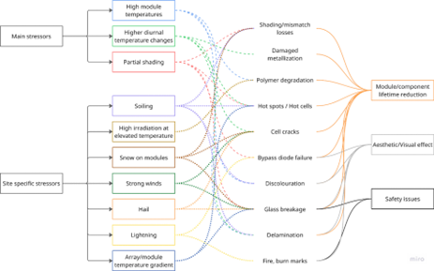
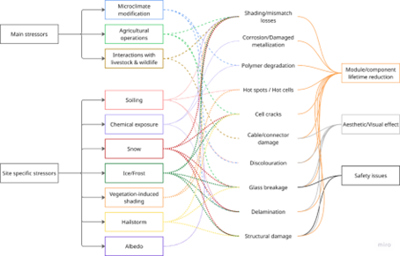
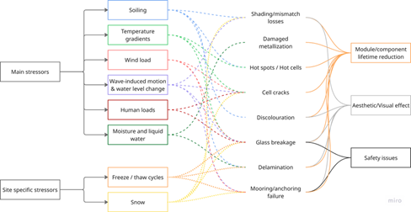
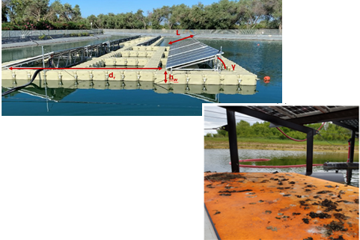
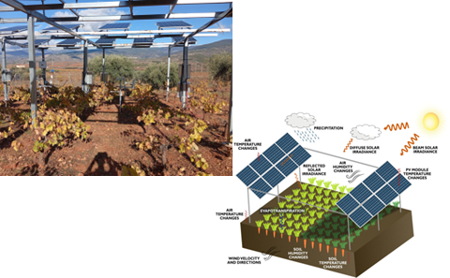
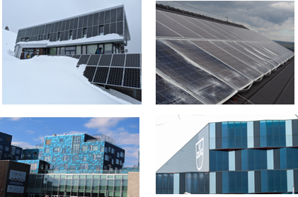
Optimisation of Photovoltaic Systems for Different Applications
Stress factors and stress combinations acting on BIPV systems
Stressors, induced degradation mechanisms and failure modes in FPV modules.
Stress factors acting on AV systems

Slide 4
Optimisation of Photovoltaic Systems for Different Applications
Key Takeaways
New integrated PV applications such as BIPV, FPV, and AV are becoming new driver for future PV growth, enabling energy generation within buildings, water bodies, and agricultural land while addressing land-use and sustainability challenges;
the application context requires a shift from conventional optimisation based only on energy yield and cost toward a multidimensional framework including reliability, durability, environmental impact, and social acceptance;
integrated PV systems experience new operating conditions and stressors — including modified thermal behaviour, partial shading, humidity, corrosion, biofouling, and mechanical loads — making conventional ground-mounted PV design assumptions insufficient;
application-specific design, modelling, materials, standards, and operational strategies are essential to improve long-term performance, reliability, and risk assessment for BIPV, FPV, and AV systems.
Report IEA-PVPS T13-39:2026, June 2026

