Slide 1
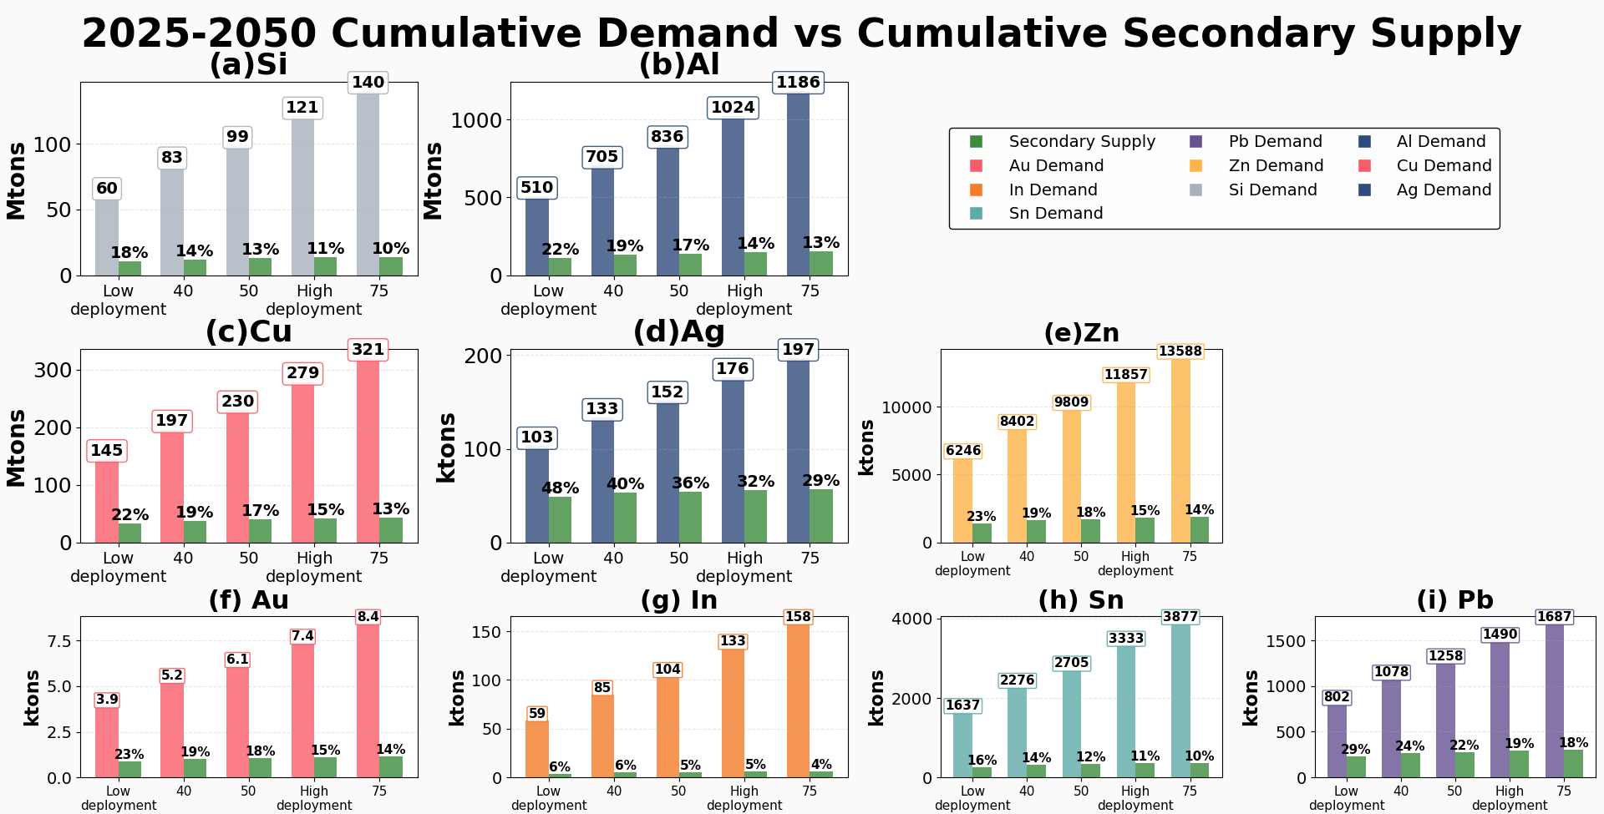
A1.6 – Primary and Secondary Material Flows for the Future Global Deployment of Silicon-based Photovoltaic Systems
Mohammad Abdelbaky, Chengjian Xu, Olindo Isabella, Malte R. Vogt

Slide 2
Goals
Anticipate scenarios for the future raw material demands of global PV installations
Identify strains with regard to
  mine production [short term]
  reserves availability [long term]
  3. Identify scenarios for secondary material flows from end-of-life PV systems and their potential to reduce future raw material demand

Slide 3
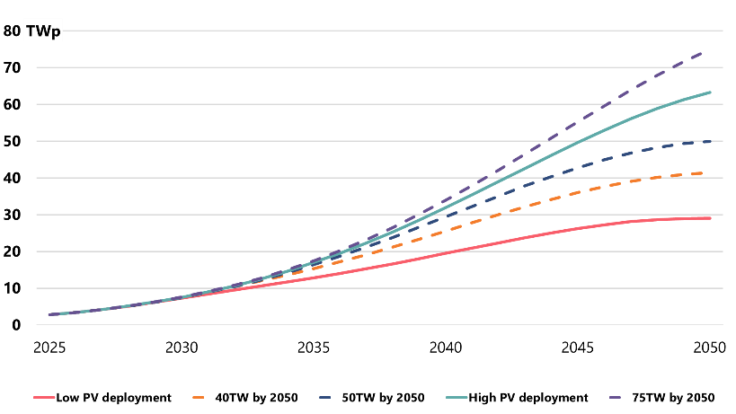
Methodology
Cell
  Cell technology market share
  Cell efficiency
  Cell dimensions
  Silver metallization specific intensity
  Copper metallization market share
  Silicon wafer thickness
  Kerf losses during slicing
Module
  Module efficiency
  Bi-facial modules market share
  Lead-free solder alloy market share
  Front and back glass thickness
  Frame material
Balance of System
  Share of utility and residential installation
  Material intensity learning curve
    Inverters
    Copper cabling
    Ground-mounting structure
Dynamic material flow analysis
accounts
for
Under multiple scenarios for future installed capacity

Slide 4
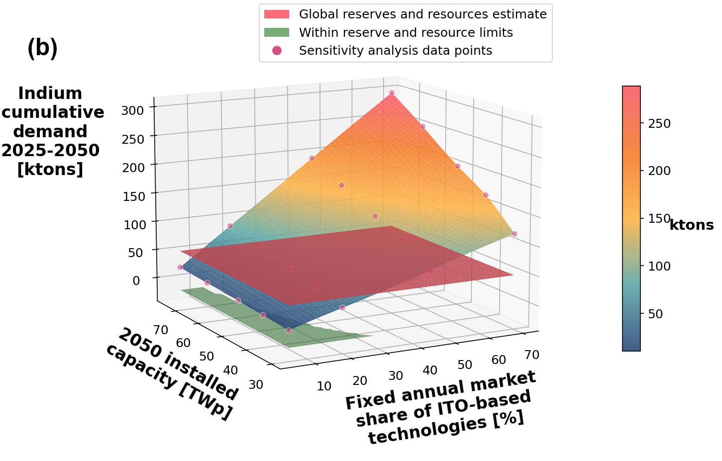
Results
We see an upward trend in material demands until 2040, which then reverses due to assumptions regarding the lifetime of PV systems and the annual growth rate of new installations
A sensitivity analysis confirmed that future material demand is mainly driven by PV capacity growth, but technology choices are critical for silver (copper substitution) and indium (limiting indium-based technologies to well below 20% market share)

Slide 5
Key Takeaways
Reducing future silver demand in the PV sector depends on continued advances in cell metallization. Retired PV modules could also become a significant secondary source of silver (30-45w% by 2050).
Cumulative 2025-2050 PV indium demand is projected to surpass the most recent global reserve and resource estimate. Thus, replacement of indium in transparent conductive oxides (TCOs) is necessary for PV deployment at terawatt per year scale.
Copper PV demand scenarios of 7-15 million tons per year in the mid-2040s are equivalent to 30-65w% of the current annual global mine production.
Tin cumulative PV demand scenarios between 2025 and 2050 could amount to 30-64w% of the estimated global Sn reserves.
These results have implications for research and development priorities and policies.

Slide 6
Malte R. Vogt, Task 12
m.r.vogt@tudelft.nl

