Slide 1
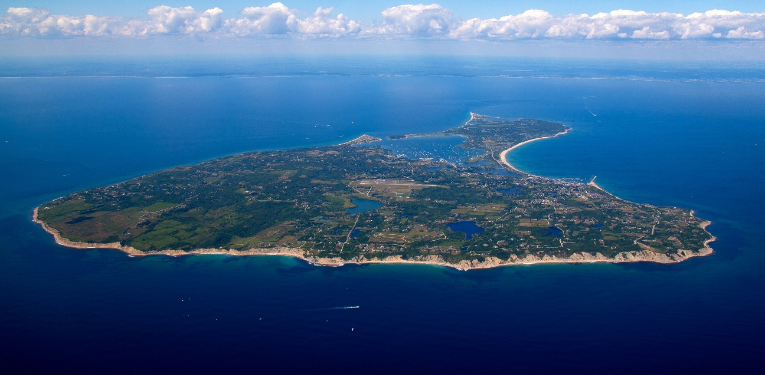
INSERT A PICTURE THIS SIZE
Success Factors for Renewable Island Mini-Grids
Task 18: Off-Grid and Edge-of-Grid Photovoltaic Systems
September 2026
Notes:
Foto: David Ouma //Unsplash

Slide 2
Motivation and objectives of report
  Islands face acute energy vulnerability — isolated, diesel-dependent grids exposed to volatile fuel costs and climate risks (storms, sea-level rise)
  Islands are natural testbeds — small, contained systems make them ideal for demonstrating high-renewable-share solutions
  Shift focus from barriers to success factors — identify what works and why, not just catalogue obstacles
  Provide structured guidance by mapping success factors across the project life cycle: Preparation, Design, Implementation, and Monitoring & Evaluation.
  Evaluate success factors using a 5-category analytical framework (Social, Political, Technical, Economic, Environmental).
  Offer a validated catalogue of 111 success factors across 11 real-world island case studies, with practical insights for replication.

Slide 3
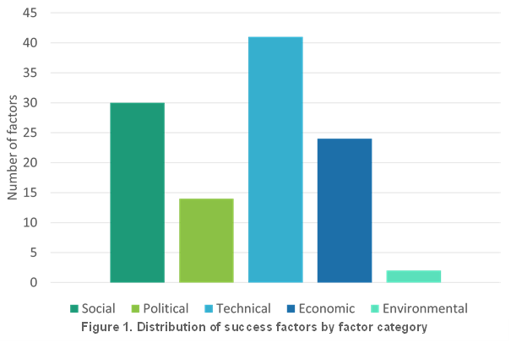
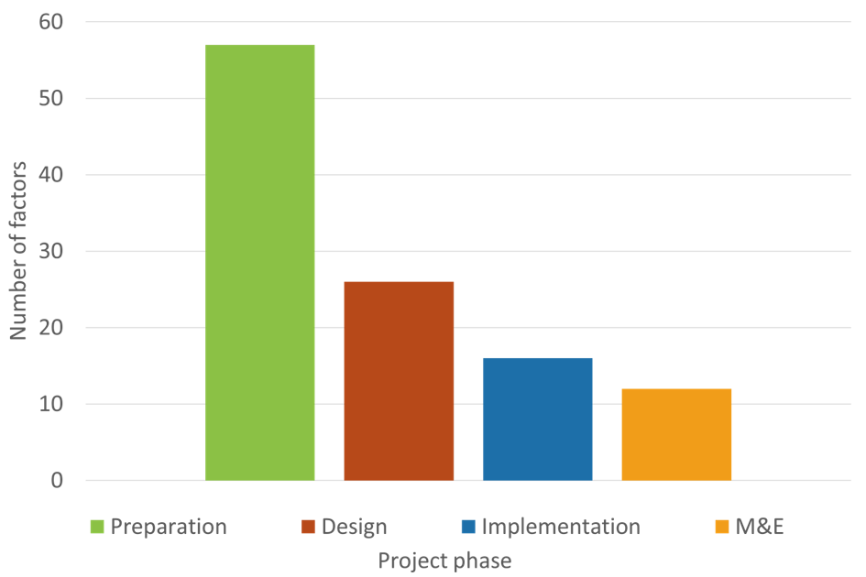
Main results: Distribution of success factors

Slide 4
Summary and recommendations
  Success is engineered, not accidental — the islands that reach 80–100% renewable electricity got there through deliberate attention to social, political, technical, economic, and environmental factors, not just good technology.
  Preparation makes or breaks the project — nearly half of all success factors sit in the earliest phase; islands that invest in community buy-in, resource assessment, and political alignment upfront see smoother rollouts and fewer costly surprises later.
  People are the constant, everywhere — whatever the technology mix or governance model, sustained stakeholder engagement and strong local champions show up as the two most universal ingredients of success.
  The playbook travels — these lessons aren't island-specific; they offer a ready-made roadmap for off-grid and edge-of-grid electrification anywhere in the world.

Slide 5
Philipp Blechinger, Task18
Philipp.Blechinger@rl-institut.de

